Slide 1
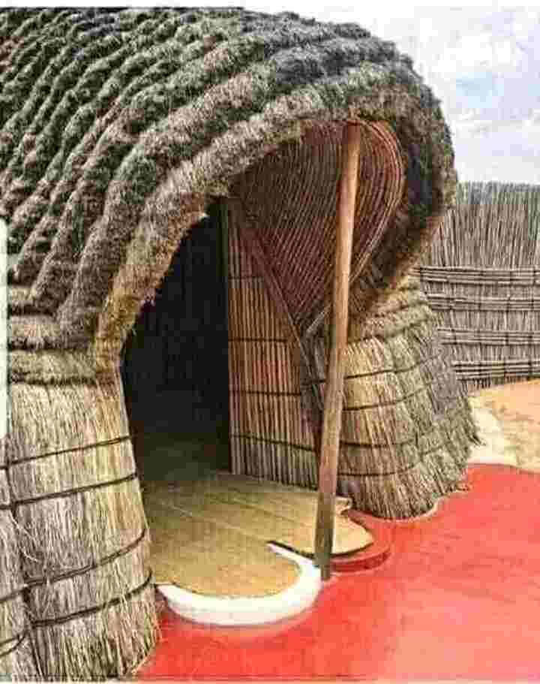
Welcome TO MY
English CLASS

Slide 2
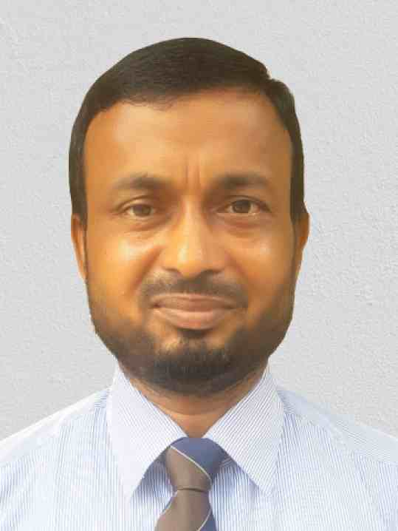
Introduction
Md. Mojibur Rohman( M.A. Eng.)
Assistant Teacher ( English)
Dogachi Borendro High School & College
Nachole, Chapainawabganj.
E-mail: moJiburrohman300@gmail.com
Sub: English For Today
Class : eight

Slide 3
Look at the following Pictures

Slide 6
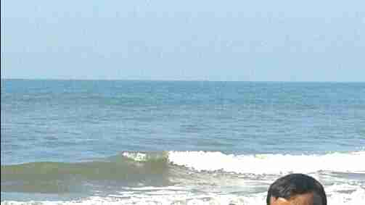
1. What kind of people do we say them?
Ethnic people
2. What is our relation with the Ethnic people ?
They are our friends

Slide 7
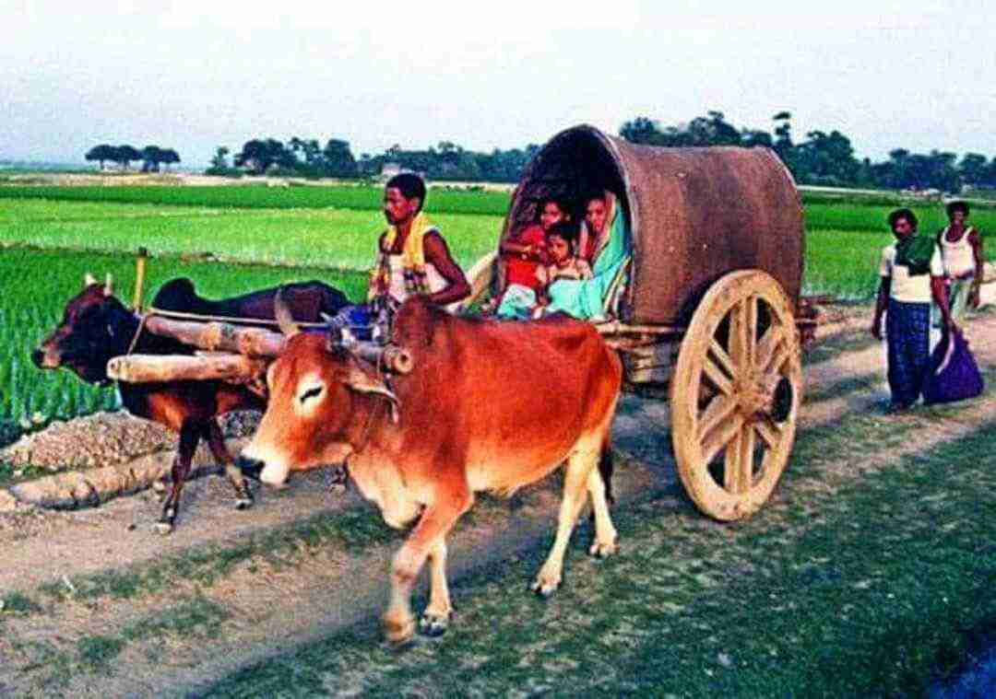
Our today’s topic is...
Our ethnic friends
Unit -1, Lesson -4

Slide 8
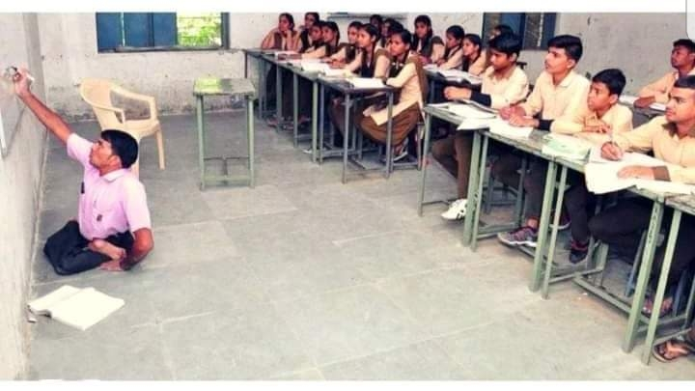
Learning Outcomes
After the lessons student will be able to...
Read out the passage.
Choose the similar meaning words.
Answer to the questions.

Slide 9
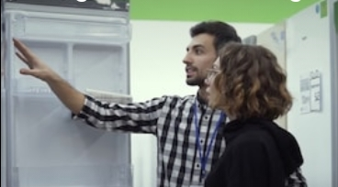
WORD MEANING
Characteristics
>
Usual, Innat,
Now a days, outing is an usual matter for the young couple.

Slide 10
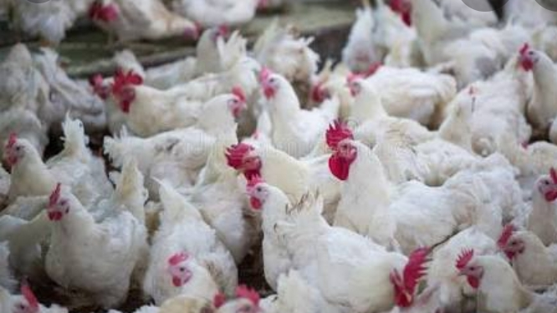
Word meaning
Poultry
domestic fowl

Slide 11
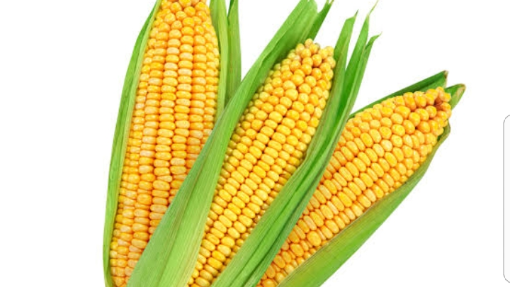
Maize
Indian pop corn
Millet
Children like pop corns very much

Slide 12
Dear students, go through
the text and try to guise
the contextual meaning of
the text.

Slide 13
Most of these people living in Bangladesh have some common characterstics

Slide 14
They have their own lifestyles

Slide 15
They build their house on bamboo or wooden platforms called “machang”.

Slide 16
Rice is their staple food.

Slide 17
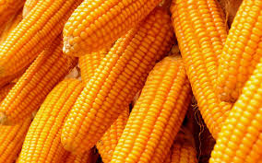
They eat
vegetables
maize
fish
poultry
meat

Slide 18
Their kitchen utensils are
bamboo
wooden
earthen
Pots which they make themselves

Slide 19
Men wear Lungis and

Slide 20
Women wear thamis or sarongs and angis

Slide 21
Women weave their own clothes

Slide 22
Hunting and fishing are their favourite pastime

Slide 23
They are fond of songs

Slide 24
Dance

Slide 25
Theatre and

Slide 26
Fairs.

Slide 27
Traditional musical Instruments used are bugles made from buffalo horns,drums and bamboo flutes

Slide 28
Wrestling is a popular sport for them

Slide 29
INDIVIDUAL WORK
Synonym Practice
Ethnic =
Main
Tribal
Staple =
Lifestyle =
Way of life
Wooden =
Made of wood
Characteristics =
Uniqueness

Slide 30
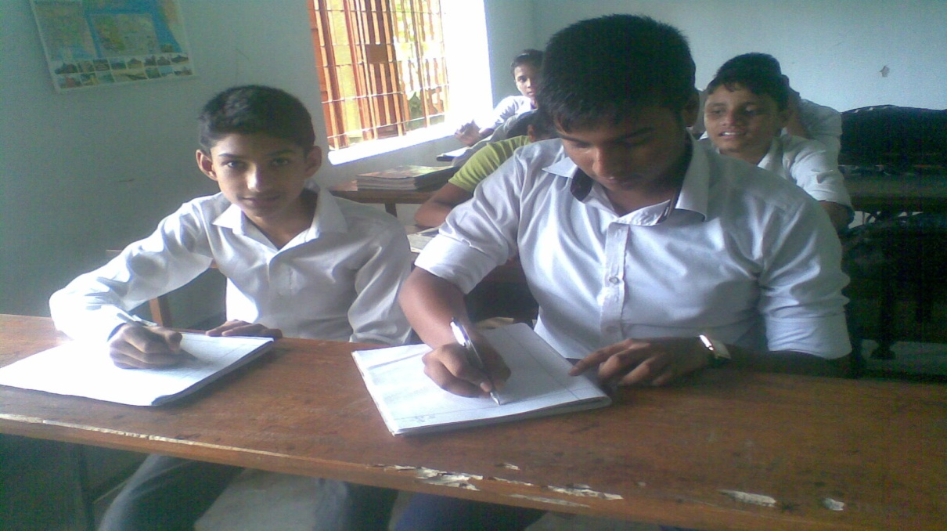
Pair Works
Guess the meaning of the following words and choose the correct meaning closest to the text.
1.Common- a.familiar b.peculiar c.dissimiliar d.trait
2.Popular- a.local b.regional c.famous d.main
3.Build- a.house b.construct c.arrange d.design
4.Staple- a.main b.favourite c.rich d.cheap
5.Wear- a.put on b.put off c.buy d.use

Slide 31
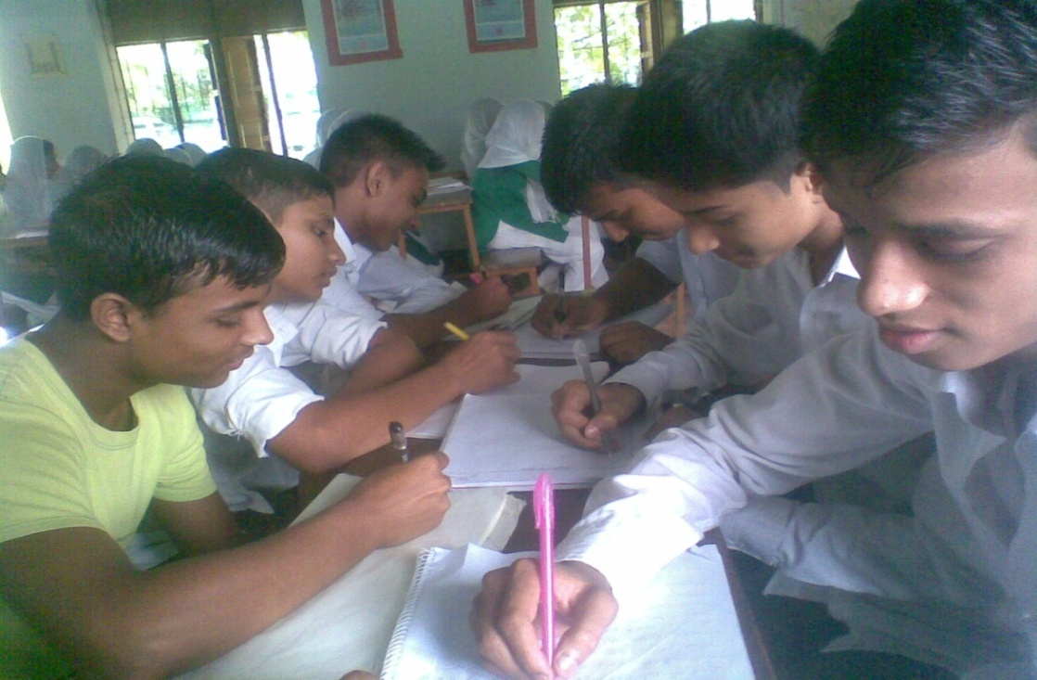
Group Works
Answer the following questions.
1.What are the staple food of the ethnic people?
2.What are their kitchen utensils ?
3.What do their women wear ?
4.What are their favourite pastime ?
5.What are their traditional musical instruments?

Slide 32
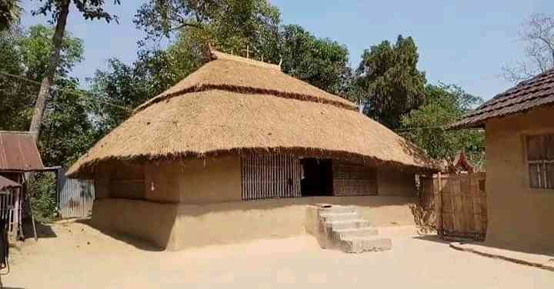
HOME WORK
Write a short paragraph on “The culture and food habit” of the ethnic people.

Slide 33
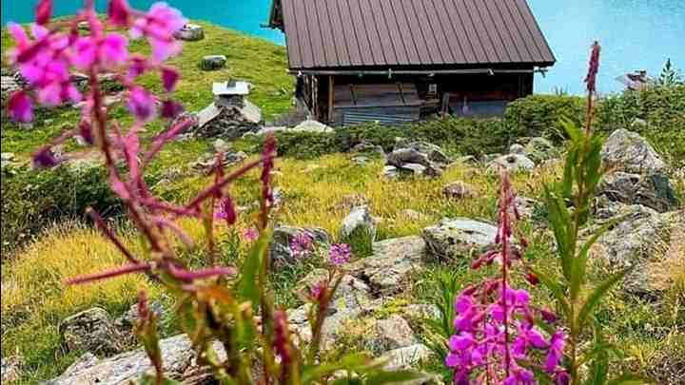
Thanks To All

