Slide 2
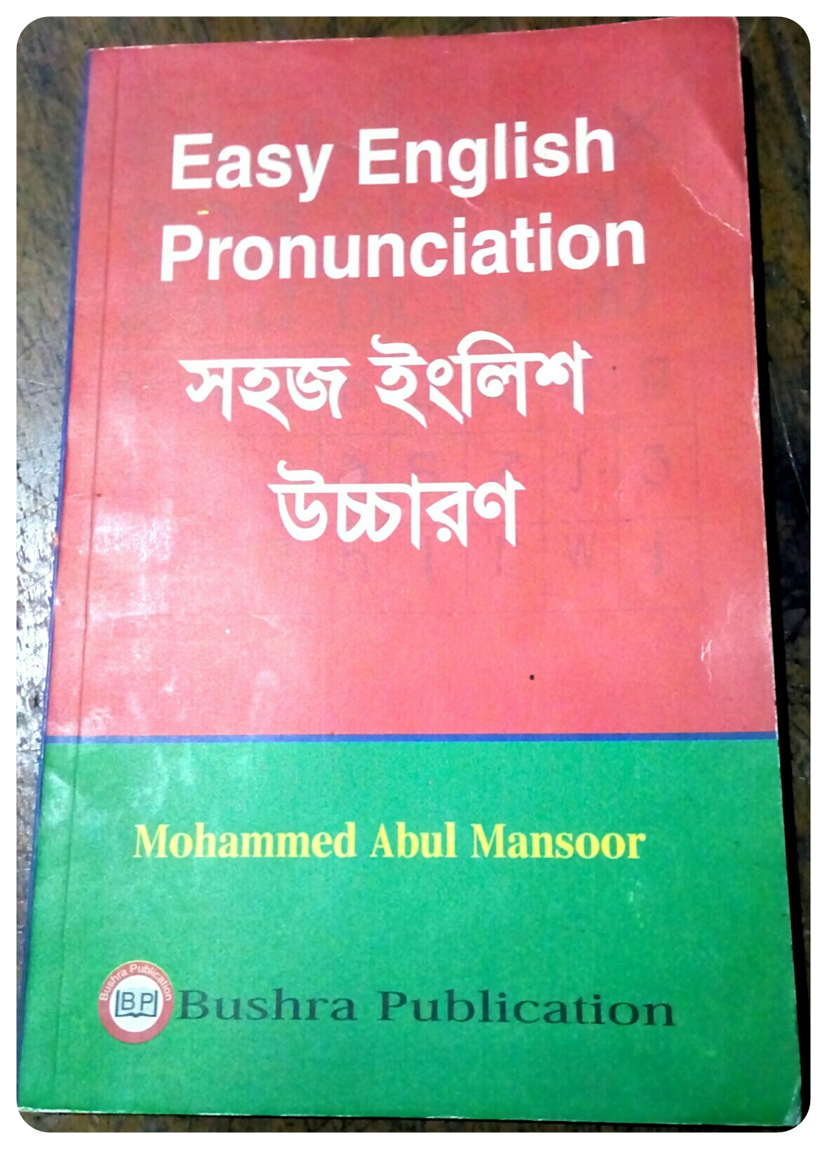
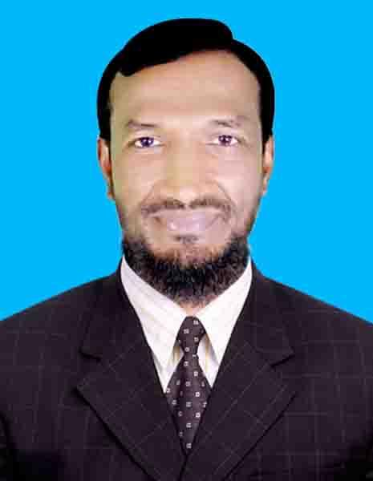
Mohammad Abul Mansoor Head teacher Borumchora Jonotha GPS Anwara, Chattogram

Slide 3
Today’s Lesson Class: Five Subject: English Unit: 4 Lesson: 7 Page: 17

Slide 4
Learning out come 1.1.1 recognize sound differences in the context of words. ( Practicing the sound /θ/ থ্ )
Tongue position of pronouncing / /θ/ থ্ ) sound

Slide 5
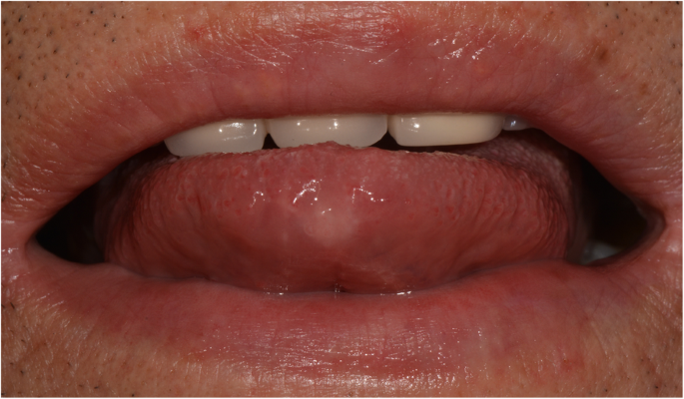
Look, listen and say
/θ/ (থ্ ), /θ/ থ্ ), /θ/ থ্ )
/θ/ (থ্ ), /θ/ থ্ ), /θ/ থ্ )
/θ/ (থ্ ), /θ/ থ্ ), /θ/ থ্ )
/θ/ as in three
/θ/ree
/θ/ree
/θ/ree
3, 3, 3

Slide 6
Number three is above the trees
Number /θ/ree is above the trees

Slide 7
Repeat after me
Think, think, think
/θ/ink, /θ/ink, /θ/ink,
Three and thirty-three
/θ/ree, and /θ/irty-/θ/ree
3 33

Slide 8
Home work
3, 13, 30 and 33
Three, Thirteen, thirty and Thirty-Three
/θ/ree, /θ/irteen, /θ/irty and /θ/irty - /θ/ree
This Photo by Unknown Author is licensed under CC BY-NC-ND

Slide 9
Thank you so much for your active participation

