Slide 1
Welcome

Slide 2
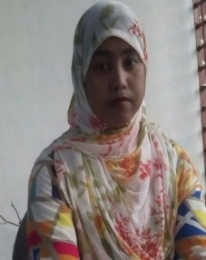
Introduction
Most.Sharmin Sultana
Assistant Teacher
Porahati Govt. Primary school
Harinakundu,Jhenaidah.
Email:sherminmithu@gmail.com

Slide 3
Today’s lesson
Live everyday
Unit: 25
Lessons: 4-6
Page:51

Slide 4
LEARNING OUTCOMES
By end of the lesson students will be able to-------
Listening: 1.1.1 become familiar with English sounds by listening to common
English words.
Speaking: 1.1.1 repeat after the teacher simple words and phrases with proper
sounds and stress.
1.1.2 say simple words and phrases with proper sounds and stress.
Reading: 1.4.1 read words and phrases with the help of visual clues
( about 30 new words)and simple sentences.

Slide 5
Let’s see some picture

Slide 7
Today’s Lessons
Life everyday
প্রতিদিনের জীবন

Slide 8
Let’s learn some word and word meaning
Homework
বাড়িতে পাঠ অনুশীলন করা
Watch
দেখা
Play
খেলা করা

Slide 9
Let’s us learn some word and word meaning
Bed
বিছানা
পড়া
Read

Slide 10
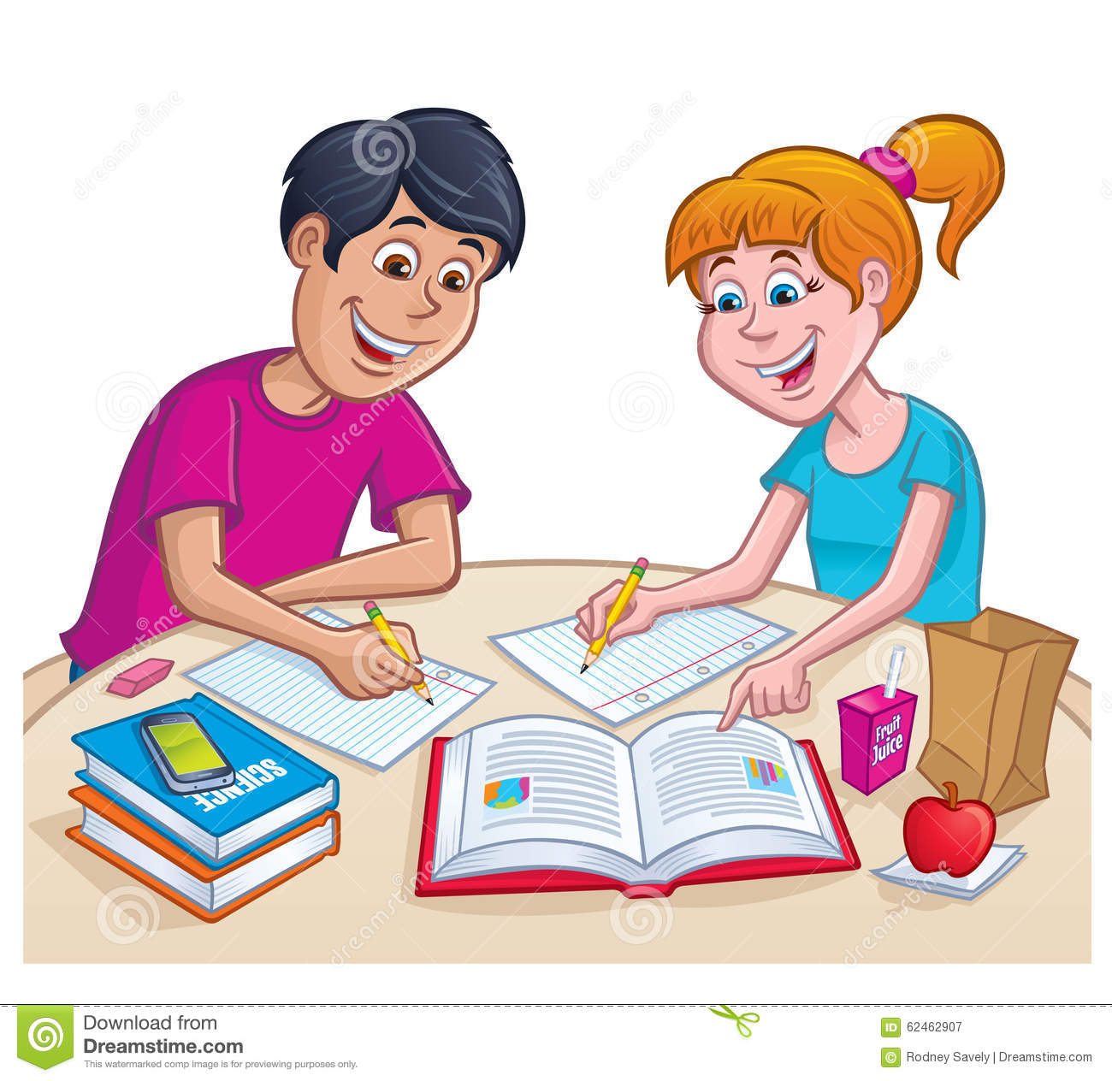
do my homework

Slide 11
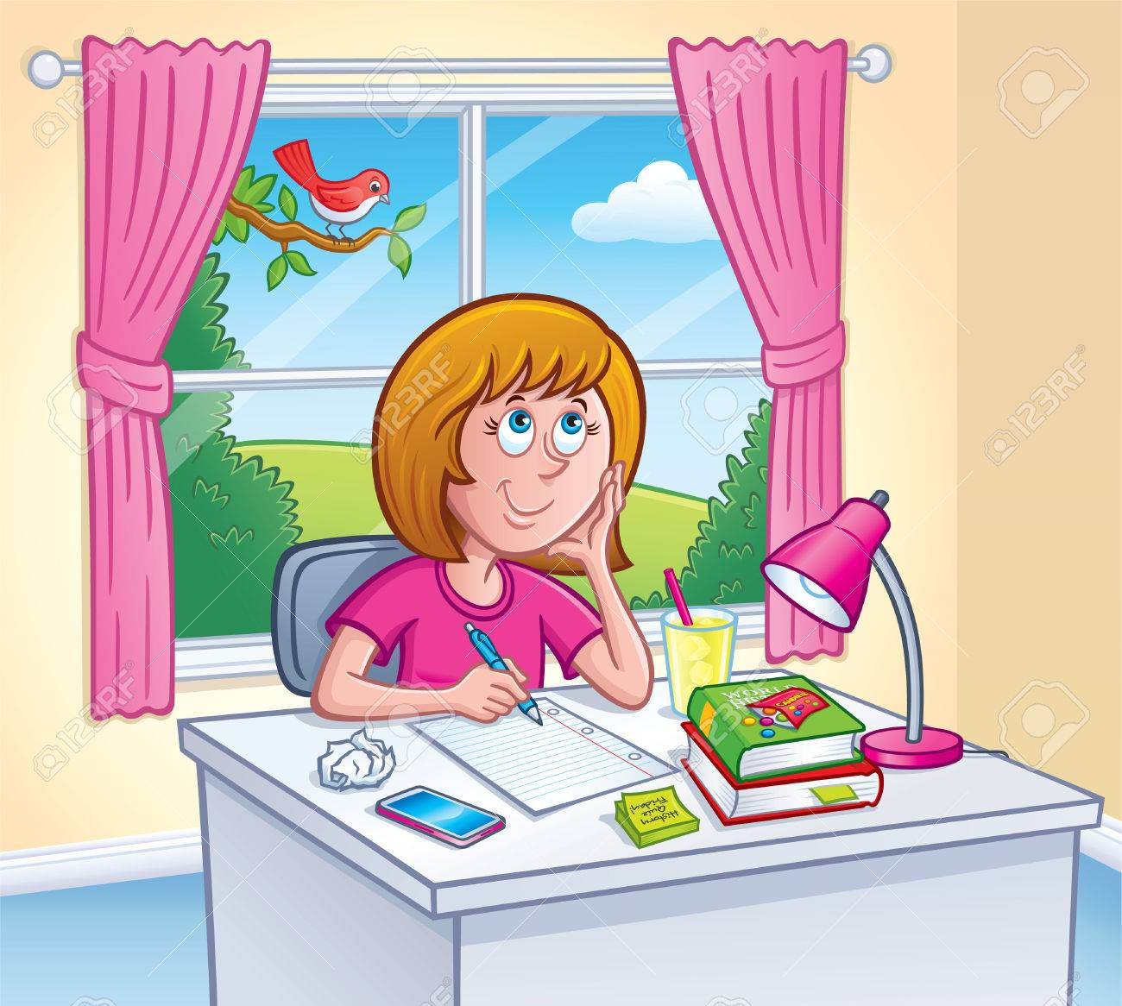
Read

Slide 12
Play

Slide 13
WatchTV

Slide 14
Go to bed

Slide 15
Page -51

Slide 17
B.Read.
In the afternoon,I do myhomework.
I play with my friends.Then, I read and watch TV.After diner,Ibrush my teeth and go to bed.

Slide 18
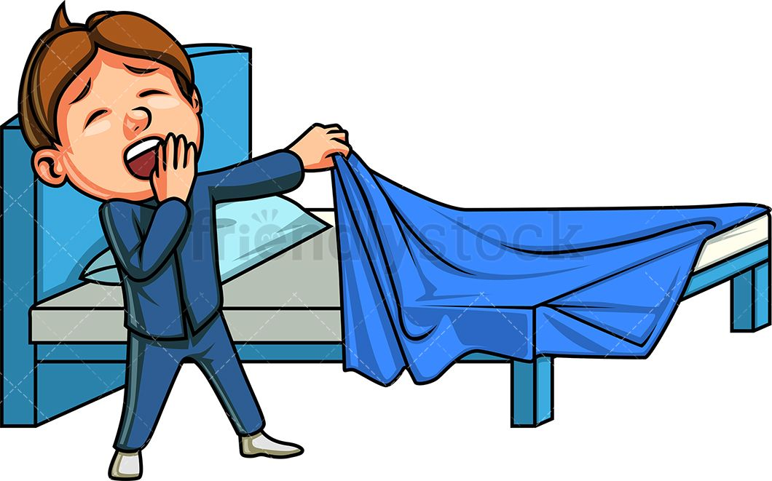
Matching:
Bed
Play
Read
Homework

Slide 19
Let’s us learn a word
Rose
গোলাপ

Slide 20
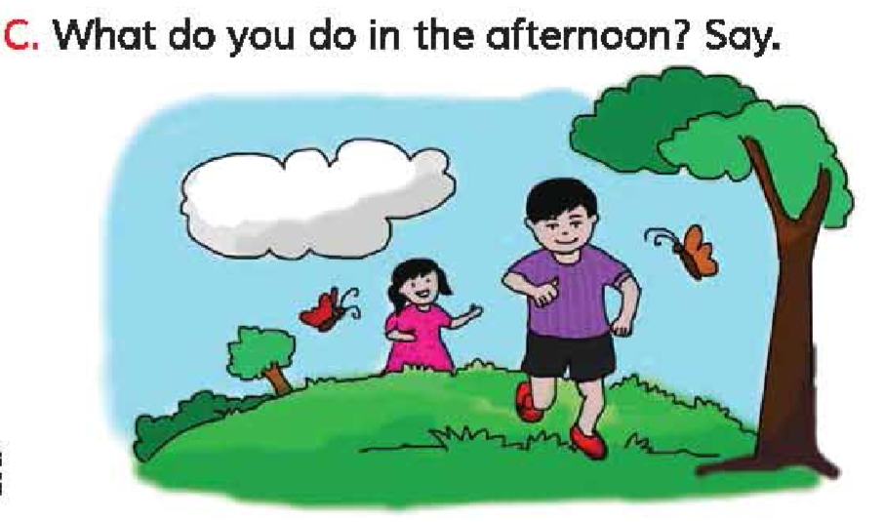
Home work
What do you do in the afternoon.write down your note book and discuss with your parents about life everyday.

Slide 21
Thank you everybody.
See you again.

