Slide 2
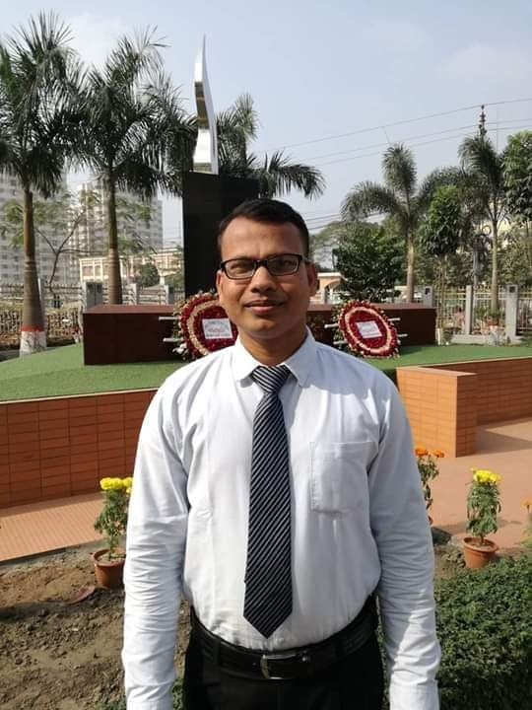
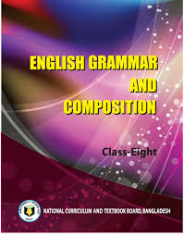
IDENTITY
JEWEL CHAKRABORTY
Assistant Teacher (English)
Govt. S.C Girls’ High School
Sunamgonj.
Cell-01728-829242
English 2nd Paper
CLASS : Eight
Topic: Transformation of Sentence

Slide 3
There are 4 steps
STEP-1
STEP-2
Assertive sentence
(Affirmative & Negative)
2.Interrogative sentence
3.Imperative sentence
4.Optative sentence
5.Exclamatory Sentence
Superlative
Comparative
Positive

Slide 4
There are 4 steps
STEP-3
STEP-4
Active voice
2.Passive voice
Simple
Complex
Compound

Slide 6
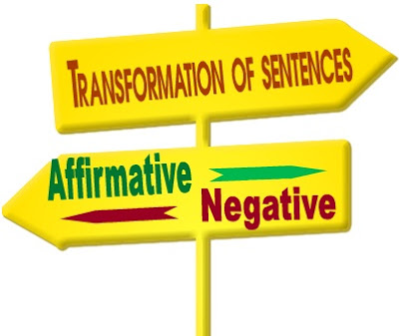
Sakib is dynamic player.
Shipa is very cautious of her health.
We should always follow the path of religion.
Every religion teaches us to be pious.
5. Our present situation is too pathetic to describe.

Slide 7
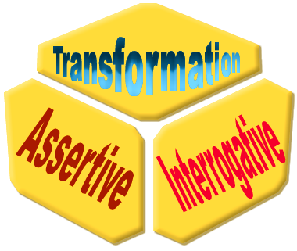
1. Ill news runs apace.
2. He has much money.
3. Wealth is nothing but tension.
4. The wise never hurt others.
5. The greedy farmer cut the belly of the goose.

Slide 8
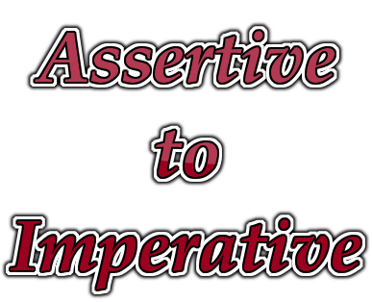
1. We should stay at home.
2. We should not hurt anybody.
3. Sakib does not play foul shots.
4. You must not cram anything.
5. She wants to go out.

Slide 9
1. What a leader Bangabandu was!
2. How time does fly!
3. Fie! He is a collaborator.
4. Would that we may meet soon!
5. O that I could sing like Kumar Sanu!

Slide 10
It is time to do the work.
Mohsin wanted to help the helpless.
One should keep one’s promise.
The teacher made us laugh.
He let me do the work.
Do not do the work.
Do not do it.
They like each other.

Slide 11
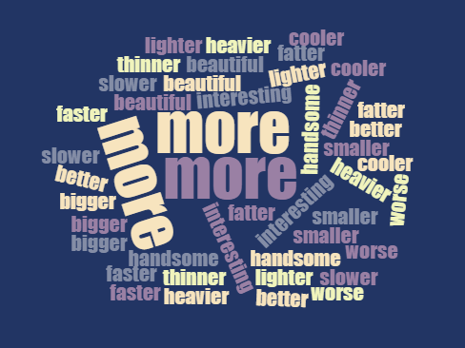
Change as directed:
The roads of Sylhet are not so spacious as those of Dhaka (Comparative)
The rice of Faridpur is better than that of Mymensing (Positive)
A healthy poor man is happier than an unhealthy well off man (positive)
Books are the best of all friends (comparative)
Urban life is not as quiet as rural life (Compa)

Slide 12
1.O woeful day! (Assertive)
2. You ought to obey your parents (Imperative)
3. Wealth is nothing but tension (Question)
4. There is no cloud without a silver lining (Affir)
5. Men cannot remember everything(Affirmative)
6. Were I a great player like Messi! (Statement)
7. Sher-E-Bangla was a great leader (Exclamatory)
8. Something is better than nothing (Positive)

