Slide 1
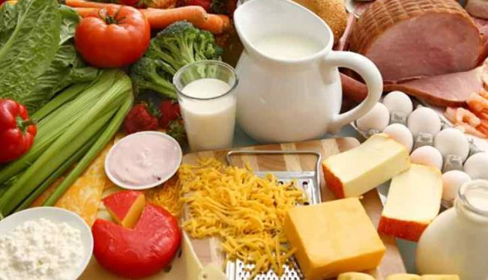
WELCOME

Slide 3
LESSON INTRODUCE
CLASS: FIVE
SUBJECT: ENGLISH
TIME:45 MINUTES

Slide 4
LETS SEE A VIDEO

Slide 5
Larning Outcomes
Listening:
3.3.1 understand questions about objects around them.
Speaking:
1.1.1 say words phrases and sentence with proper sounds and stress.
Reading:
1.5.1 read words phrases and sentences in the text with proper pronunciation stress and intonation.

Slide 6
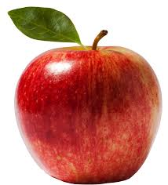
What is this?
Apple

Slide 7
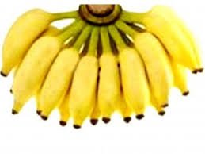
What is this?
Banana

Slide 8
What is this?
Fish

Slide 9
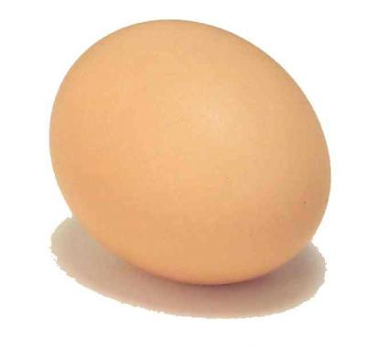
What is this?
Egg

Slide 10
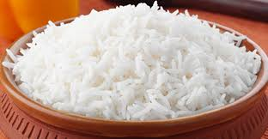
What is this?
rice

Slide 11
LESSON:Eat healthy
Unit: 6
Page:24
F(what food--------our health)

Slide 12
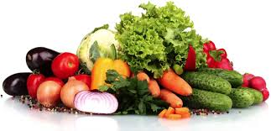
Tell the name of some vegetable items?
Onion,tometo,broccoli, carrot, bringal caulifiower cucumber,

Slide 13
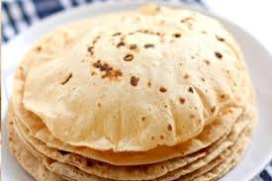
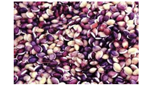
Which foods come under grains?
Corn, rice, ruti, seeds

Slide 14
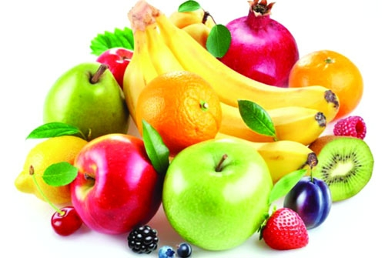
Tell the name of some fruits?
Banana, orange mango, apple, strawberry

Slide 15
What food is good food?
Vegetable,chicken,fish,potatoes,egg,rice,ruti.

Slide 16
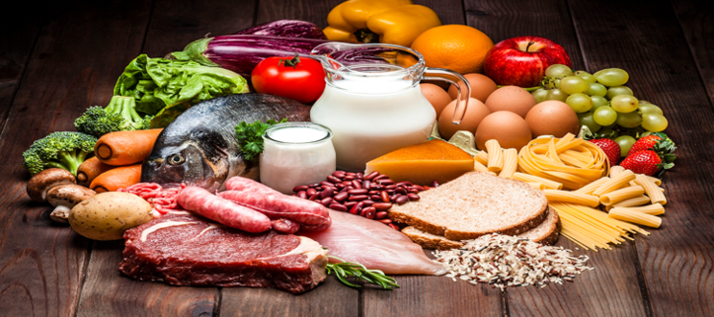
Which foods have vitamins?
Milk ,meet,fish, bread, tomato,egg and fruits.

Slide 17
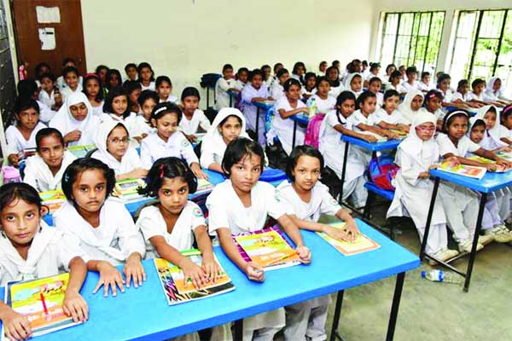
Open your text book page no 24.
Read your book.

Slide 18
Students reading loudly with teacher
Students reading loudly with teacher

Slide 20
Ans the question?
1.What foods are made of grain ?
2.Why are fruit and vegetables important?

Slide 21
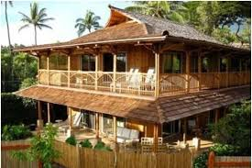
Home work
1. What are in the next level of the pyramid?
2.Write are the five fruits name?

Slide 22
GOODBYE EVERYBODY. SEE YOU TOMORROW.

