Slide 1
Dear
students

Slide 2
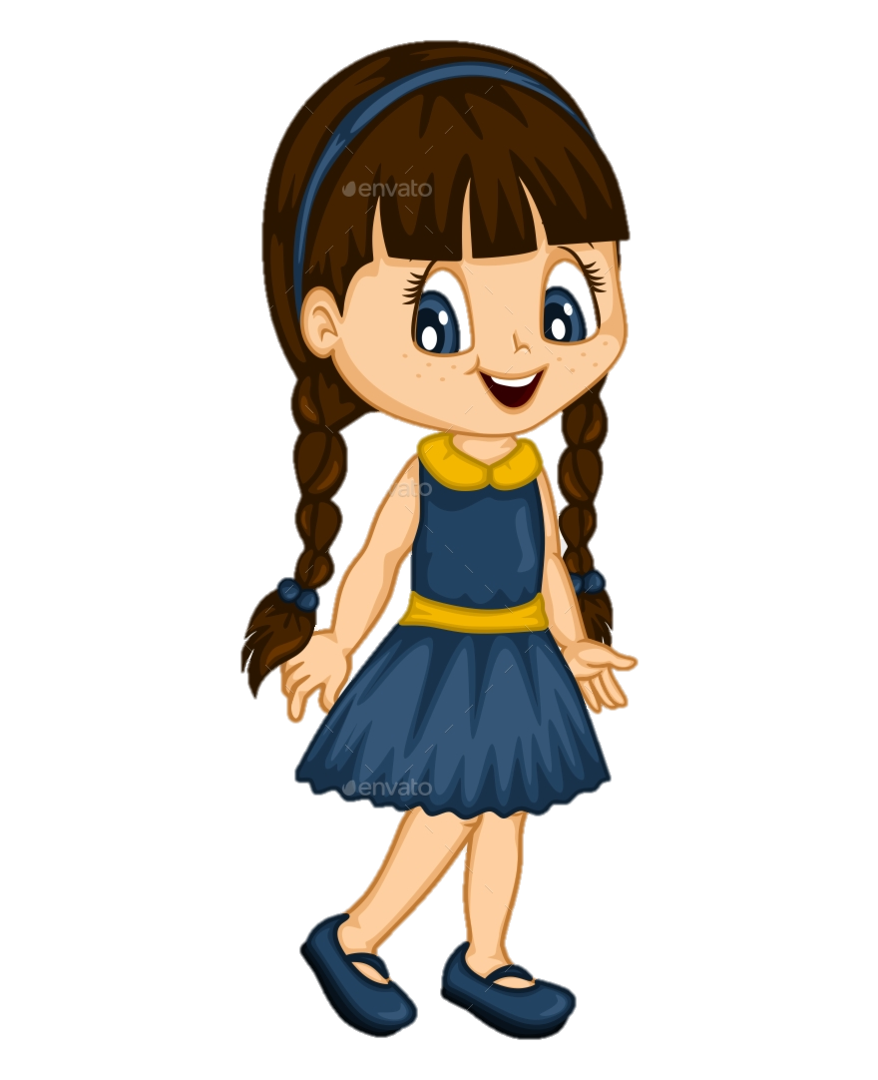
Presented by
Class: Three Subject: English
Unite : 32.
Punctuation and capital letters.
Lesson:1-3,
Page : 64
Hafiza Khanam. Assistant teacher.
99 No. Nilokhi Govt. Primary School.
Gopalganj Sadar,
Gopalganj.

Slide 3
Lets watch the video
We were watching a video.
Now tell me what about the video is?

Slide 4
Today’s lesson
Punctuation and capital letters

Slide 5
Learning outcomes
By end of the lesson students will be able---
Reading:
7.1.1 recognize punctuation marks and read accrdingly.
Writing:
5.1.1 use full stop.
5.1.2 use comma.
6.1.1 use capital letters for sentence beginnings.
6.1.2 use capital letters for proper nouns.

Slide 6
What do you see in the picture?

Slide 7
Maliha is Bangladeshi.She comes from Dhaka.Dhaka is the capital of Bangladesh. Maliha lives near the Buriganga River.The river is very big.In June,July and August,there is a lot of rain in Bangladesh.

Slide 8
The first letter of the sentence has to be written in capital letters.
Maliha is Bangladeshi.She comes from Dhaka.Dhaka is the capital of Bangladesh. Maliha lives near the Buriganga River.The river is very big.In June,July and August,there is a lot of rain in Bangladesh.

Slide 9
People’s names are always written in capital letters.
Maliha is Bangladeshi.She comes from Dhaka.Dhaka is the capital of Bangladesh. Maliha lives near the Buriganga River.The river is very big.In June,July and August,there is a lot of rain in Bangladesh.

Slide 10
The name of the country is always written in capital letters.
Maliha is Bangladeshi.She comes from Dhaka.Dhaka is the capital of Bangladesh. Maliha lives near the Buriganga River.The river is very big.In June,July and August,there is a lot of rain in Bangladesh.

Slide 11
The name of the country is always written in capital letters.
Maliha is Bangladeshi.She comes from Dhaka.Dhaka is the capital of Bangladesh. Maliha lives near the Buriganga River.The river is very big.In June,July and August,there is a lot of rain in Bangladesh.

Slide 12
The name of the river is always written in capital letters.
Maliha is Bangladeshi.She comes from Dhaka.Dhaka is the capital of Bangladesh. Maliha lives near the Buriganga River.The river is very big.In June,July and August,there is a lot of rain in Bangladesh.

Slide 13
The name of the month is always written in capital letters.
Maliha is Bangladeshi.She comes from Dhaka.Dhaka is the capital of Bangladesh. Maliha lives near the Buriganga River.The river is very big.In June,July and August,there is a lot of rain in Bangladesh.

Slide 14
Open at page 64

Slide 15
Read the text in your group properly.
Group work
Maliha is Bangladeshi.She comes from Dhaka.Dhaka is the capital of Bangladesh. Maliha lives near the Buriganga River.The river is very big.In June,July and August,there is a lot of rain in Bangladesh.

Slide 16
Pair work
Underline words with capital letters.
Maliha is Bangladeshi.She comes from Dhaka.Dhaka is the capital of Bangladesh. Maliha lives near the Buriganga River.The river is very big.In June,July and August,there is a lot of rain in Bangladesh.

Slide 17
Individual work
Write the sentences correctly in your exercise book.
1.dev lives in rengpur .
2.rahin is bangladeshi .
1.Dev lives in Rengpur .
2.Rahin is Bangladeshi .

Slide 18
Evaluation
Correct the sentences. Then write them in your exercise book.
1.he comes from chittagong
2.chittagong is a big city in bangladesh
3.it rains a lot in august september and october
4.barisal comilla and gazipur are big cities in bangladesh
5.the jamuna river is very big
1.He comes from Chittagong.
2.Chittagong is a big city in Bangladesh.
3.It rains a lot in August, September and October.
4.Barisal, comilla and gazipur are big cities in Bangladesh.
5.The Jamuna river is very big.

Slide 19
Homework
You have to practice activity C of your English book at page 64.

Slide 20
Good
bye

