Slide 1
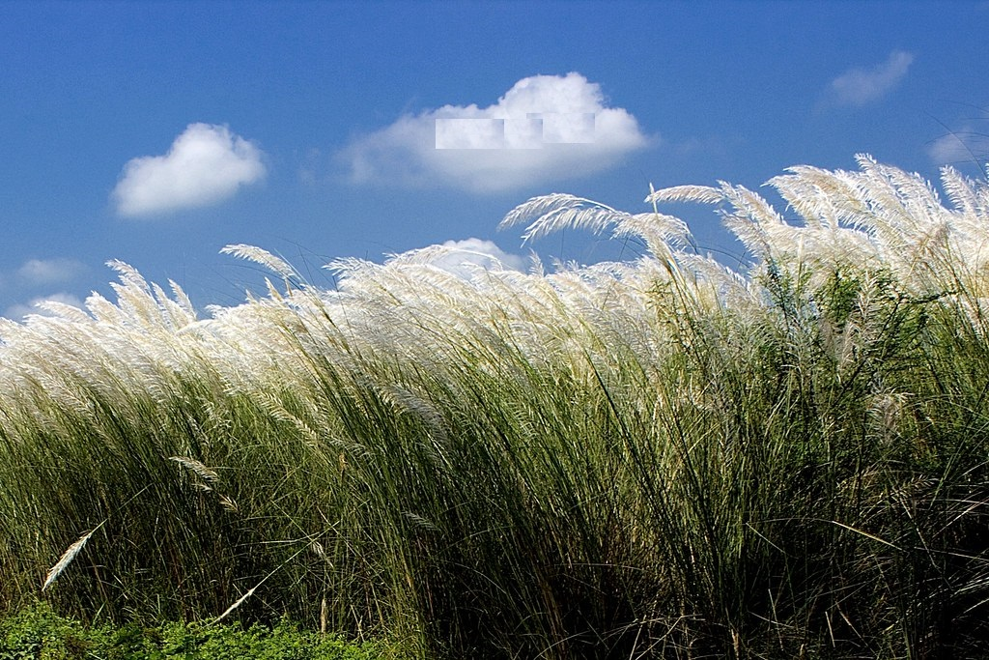
Welcome

Slide 2
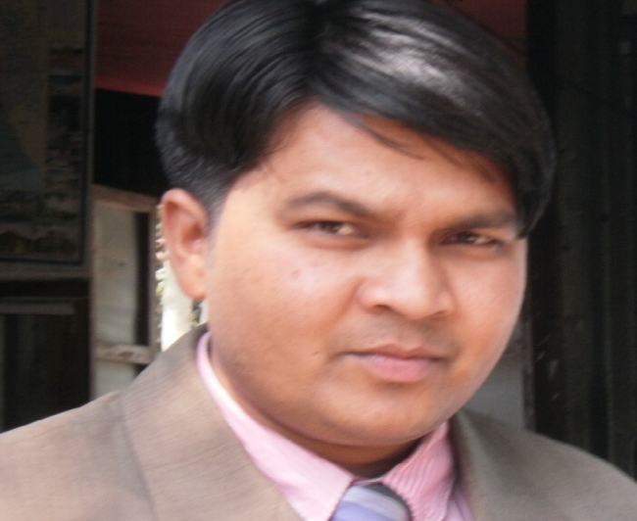
Introduction
Md. Saiful Islam (Sohel)
Assistant English Teacher
Achia High School, Aikdia
Muksudpur, Gopalganj.
Mobile: 01717-377371
E-mail: islammdsaiful981@gmail.com
Subject : English 2nd Paper
Class : Six – Eight
Time : 45 Minutes
Date : 08.10.2020

Slide 3
Read the following passage and try to identify the parts of speech of the words underlined.
Last week I went to Dhaka. My uncle, aunt and my cousin, Sumi were very happy to get me among them. I have a deep friendship with Sumi. Sumi is a very brilliant student. She wants to join the army after the completion of HSC. We visited many places in Dhaka together. One day my cousin bought some necessary items like milk, bread, butter, honey etc.

Slide 4
Today our topic is ……

Slide 5
Learning Outcomes
After this lesson, students will be able to……
1. define the Noun.
2. classify the Noun.
3. give examples of Noun.
4. identify nouns from a passage.

Slide 6
What is Noun
Person
Place
Thing
Noun is the name of a person, place, thing or quality.

Slide 7
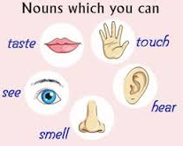
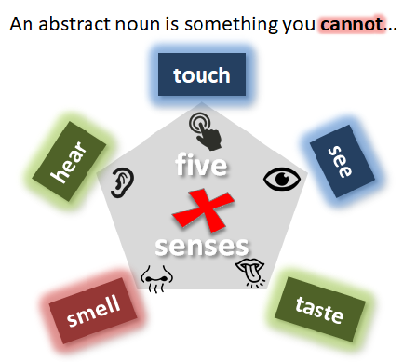
Kinds of noun
Concrete
Abstract
Name of an object which you can see, touch, hear, smell or taste.
Name of a quality, action or state.
Boy, Book, Flower, River, School, Rahim, Mother etc.
Honesty, kindness, truth, love, hatred, health etc.

Slide 8
A Concrete Noun is divided into four kinds.
Concrete
Proper
Common
Collective
Material
Countable
Uncountable

Slide 9
Proper Noun
The noun that refers to the name of a particular person, place etc. is called proper noun.
যে Noun কোন নির্দিষ্ট ব্যাক্তি, বস্তু বা স্থানের নাম বুঝায়, তাকে Proper Noun বলে।
Rahim, Karim, Rani, Kajol etc. (Name of person)
Examples:
Chair, Table, Bench etc. (Name of thing)
Dhaka, Khulna, India etc. ( Name of place)
Remember:
(1) Proper Noun এর প্রথম অক্ষর সর্বদা Capital Letter হবে। যেমনঃ Kamal, Joy, Jibon
etc.
(2) নদী, সাগর, মহাসাগর, উপসাগর, দ্বীপপুঞ্জ, সংবাদপত্র, ধর্মগ্রন্থ, মহাকাব্য, পর্বতমালা এ জাতীয়
Proper Noun এর পূর্বে The বসে। যেমনঃ The Padma,The Meditarian,
TheAtlantic, The Bay of Bengal, The Andaman, The Daily Star, The Quran,
The Mahabharata, The Himalaya etc.

Slide 10
Common Noun
A common noun is the generic name for a person, place, or thing in a class or group.
যে Noun দ্বারা এক জাতীয় ব্যক্তি, বস্তু, প্রাণীর সাধারণ নাম বুঝায়, তাকে Common Noun বলে।
Example: Boy, Girl, Player, River etc.
Differences between Proper Noun and Common Noun are following:
Proper Noun | Common Noun
Dhaka, Khulna, Barisal | City (সকল শহরের সাধারণ নাম)
Padma, Meghna, Jamuna | River (সকল নদীর সাধারণ নাম)
Rana, Nahin, Nabid | Boy (সকল বালকের সাধারণ নাম)
Rina, Mina, Tina | Girl (সকল বালিকার সাধারণ নাম)
Bangladesh, India, Japan | Country (সকল দেশের সাধারণ নাম)

Slide 11
Pair Work
Complete the chart with Common Nouns.
Proper Noun | Common Noun
Sakib, Musfiq, Mashrafi
Joy, Abid, Kamal
Rani, Sumi, Kajol
Dhaka, Khulna, Barisal
Padma, Meghna, Jamuna
Player
Boy
Girl
City
River
Notes:
Teacher will make the students’ pair. The ask them to complete the chart.

Slide 12
Collective Noun
A Collective Noun is the name of a group of similar things or persons, taken as a whole.
যে Noun একই জাতীয় কোন ব্যক্তি বা বস্তুকে পৃথকভাবে না বুঝিয়ে সমষ্টিকে বুঝায়, তাকে Collective Noun বলে। যেমনঃ Class, army, team, group etc.
Differences between Common Nouns and Collective Nouns are following:
Common Noun | Collective Noun
Sheep (সকল ভেড়ার সাধারণ নাম) | Flock (অনেকগুলি ভেড়ার সমষ্টি)
Player (সকল খেলোয়াড়ের সাধারণ নাম) | Team (অনেকগুলি খেলোয়াড়ের সমষ্টি)
Student (সকল ছাত্র-ছাত্রীর সাধারণ নাম) | Class (অনেকগুলি ছাত্র-ছাত্রীর সমষ্টি)
Chairman (সকল চেয়ারম্যানের সাধারণ নাম) | Committee (অনেকগুলি চেয়ারম্যানের সমষ্টি)
Robbers (সকল ডাকাতদের সাধারণ নাম) | Gang (অনেকগুলি ডাকাতের সমষ্টি)

Slide 13
Material Noun
A material noun denotes the matter or substance of which things are made.
যে Noun কে গণনা করা যায় না শুধুমাত্র ওজন দ্বারা পরিমান নির্ধারণ করা যায় বা, যে Noun দ্বারা কোন পদার্থের সমুদয় অংশকে অখন্ডভাবে বুঝায় কিন্তু সে পদার্থ হতে উৎপন্ন কোন বস্তুকে বুঝায় না, তাকে Material Noun বলে। যেমনঃ Gold, Iron, Wood, Milk etc.
Differences between Material Noun and Common Nouns are following:
Material Noun | Common Nouns
Gold | Ring, necklace, bangles etc.
Iron | Sickle, scissors, hammar etc.
Wood | Chair, table, bench, door etc.
Milk | Sweets, butter, chese, curd etc.
Paper | Book, newspaper, packet, magazine etc.

Slide 14
Individual Work
Find out the nouns and then state the different kinds of nouns.
1.The cow is a useful animal. 2. Jute is called the golden fibre of Bangladesh. 3. Gold is valuable. 4. Water has no colour.
5. Dhaka is a big city. 6. The Quran is a holy book. 7. What class do you read in? 8. Truthfulness is a great virtue . 9. The rose is a nice flower. 10. Our team played well yesterday.
1.The cow is a useful animal. 2. Jute is called the golden fibre of Bangladesh. 3. Gold is valuable. 4. Water has no colour.
5. Dhaka is a big city. 6. The Quran is a holy book. 7. What class do you read in? 8. Truthfulness is a great virtue . 9. The rose is a nice flower. 10. Our team played well yesterday.
Let’s match the answers.
1. Cow = Common Noun, Animal = Common Noun 2. Jute = Material Noun, Fibre = Common Noun, Bangladesh = Proper Noun 3. Gold= Material Noun, 4. Water = Material Noun, Colour = Common 5. Dhaka = Proper Noun, City = Common Noun 6. Quran = Proper Noun, Book = Common Noun 7. Class = Collective Noun 8. Truthfulness = Abstract Noun, Virtue = Abstract Noun 9. Rose = Proper Noun, Flower = Common Noun 10. Team = Collective Noun

Slide 15
Evaluation
Give the definition of the following nouns:
1. Proper Noun
2. Common Noun
3. Collective Noun
4. Material Noun
Notes:
Teacher will ask 3/4 students the definition of different Nouns. And correct their answers orally if they are wrong.

Slide 16
Home Work
Do it at home and bring it tomorrow.
Write ten examples of each Noun like: Proper, Common, Collective, Material and Abstract.

Slide 17
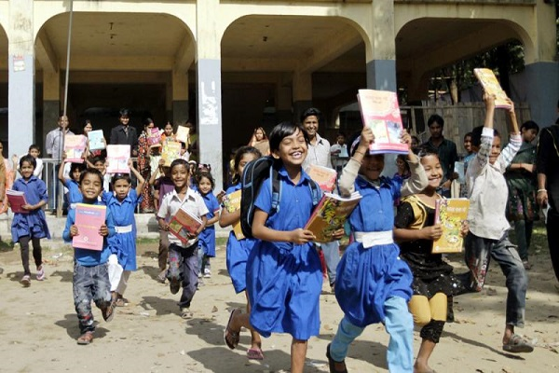
THANK YOU ALL

