Slide 1
Welcome everybody

Slide 2
Teachers Familiarity
Bina Pani Roy
Head teacher
Hazipur Govt. Primary School
Taragonj, Rangpur.

Slide 3
Lesson Identity
Subject: English
Class : Three
Unit:29
Lesson Title : Where is it?
Part of the Lesson : 1-3( in, under , on…)
Time : 40 mins.
Date : 09/03/2020

Slide 4
Learning Outcomes
Students will be able to:
3.3.1*understand simple statements.
6.1.1*say what the speaker is doing.
8.1.3*write sentences.

Slide 5
Where is it?

Slide 6
Where is it?

Slide 7
Teacher’s Activity
What is it ?
in
under
on
Where is it ?
In front of
behind
between

Slide 8
Lets read
Open at page 58.

Slide 9
New words & Meaning
In =ভিতরে
On =উপরে
Under =নীচে
In front of =সামনে
Behind =পিছনে
Between =মাঝখানে

Slide 10
Practice

Slide 11
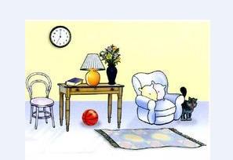
Group A
Fill in the blank of the following sentence:
1.The lamp is…..the table.
2.The ball is……the table.
3.The carpet is…..the table.
4.The clock is…..the table.
5.The table is……the chair and the armchair.

Slide 12
Group B
Matching:
In
In front of
Between
Under
Behind

Slide 13
Silent reading

Slide 14
Task / Evaluation
Make sentence of the following words:
in , under, on ,in front of, between.

Slide 15
In : The fish is in the net.
Under : The ball is under the table.
On : The crow is on the wall.
In front of : The bag is in front of the door.
Between : B is between A and C.

Slide 16
Thank you

