Slide 1
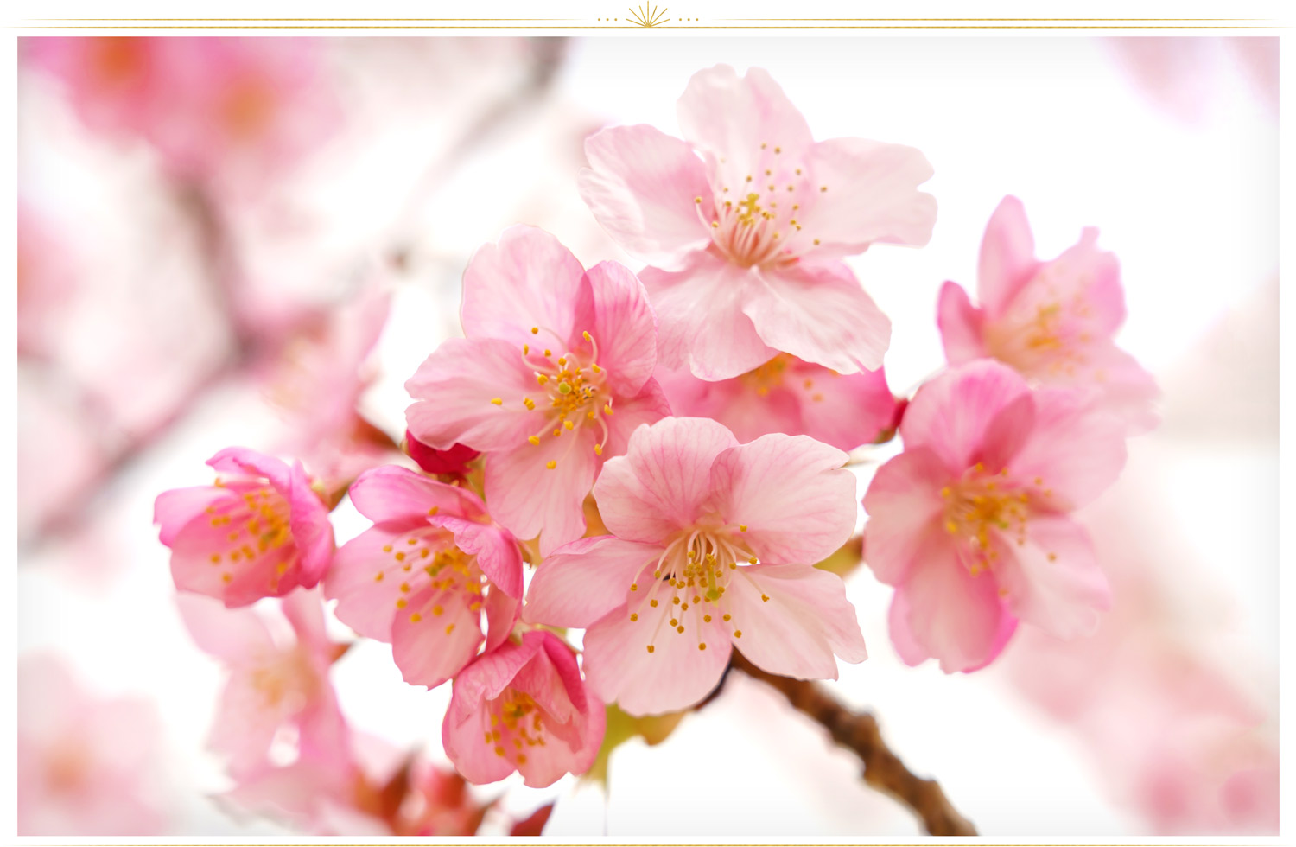
WELCOME

Slide 2
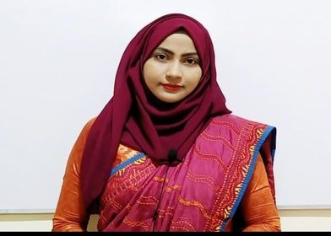
Kalam Ferdousi Shanta
Assistant Teacher
Charandwip Sikdaria Government Primary School, Boalkhali
Chattogram.

Slide 3
Class: Five
Subject: English
Unit:20, Life is beautiful
Lesson:1-2
Part: It’s a beautiful….for school
Page no: 70
Time: 40 minutes
Date:13/10/2020

Slide 4
Let’s see a picture

Slide 6
Introducing new words
Spring---- King of the season--বসন্তকাল
Feel----to experiences something physically or emotionally--অনুভব করা
Warm--- at a fairly--উষ্ণ
Smell---perceive the scent of something--- ঘ্রাণ পাওয়া
Breakfast---a meal eaten in the morning------সকালের নাস্তা

Slide 7
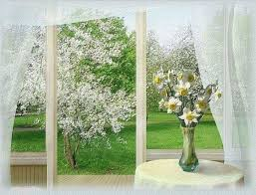
Listen to the lesson attentively
Teachers reading

Slide 8
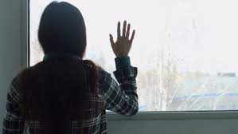

Slide 9
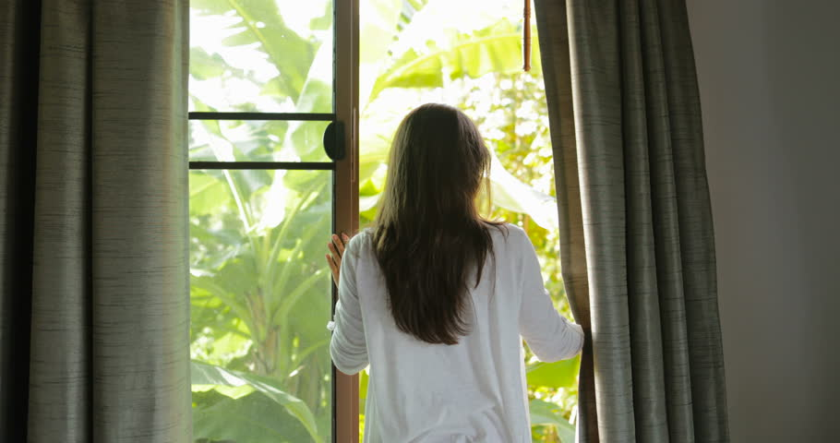
She

Slide 10
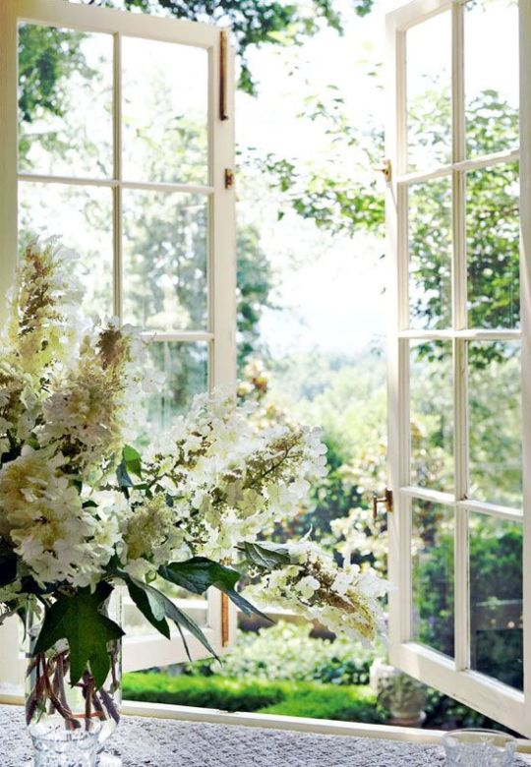

Slide 12
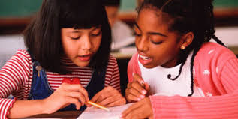
Students reading
IW/PW

Slide 13
Fill up the blanks
WCW
hears
new
fresh
singing
feels
door
In spring , there are …………… leaves on the trees.
Opening the window, Maria …………….. The birds singing.
The birds are …………..outside the room.
Maria…………….happy.
The spring flowers are sweet and ………………..

Slide 14
Answer the following questions
WCW
Who is Maria?
What is the name of the season in the lesson?
Why Maria is happy?
How is the spring flower?

Slide 15
Home Task
Write 5 sentences about Spring day.

Slide 16
THANK YOU

