Slide 1
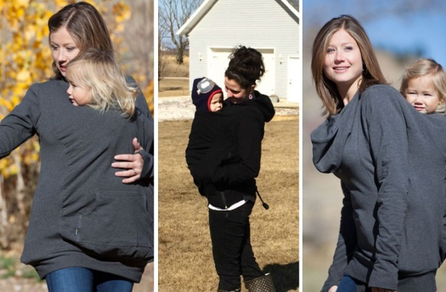
Welcome to my class.

Slide 2
Teacher’s identity
Halema Begum
Assistant teacher
Kamargaon Govt. Primary School
Chhatak,Sunamganj

Slide 3
Lesson’s identity
English
Class:Four
Unt:29 Animals
Lesson: The kangaroo’s pocket.
Part of the lesson:A

Slide 4
Learning Outcomes
Students will be able to…
Listening:1.1.1 recognize English sound differences in the context of words.
1.2.1 recognize which syllable in a word is stressed.
1.3.1 recognize which words in a sentence are stressed.
4.3.1 enjoy and understand simple poems.
Speaking:1.1.1 repeat after the teacher and say words,phrases and sentences with proper sounds,stress and intonation.
4.1.1 repeat poems after the teacher.
4.1.2 recite poems with understanding.
Reading: 1.4.1 read words,phrases and sentences in the text.
1.5.1 read words,phrases and sentences in the text with proper pronounciation,stress and intonation.
4.1.1 read aloud poems with proper sounds,stress and intonation.

Slide 5
Good morning students.
How are you today?
Let’s sing the good morning song .

Slide 6
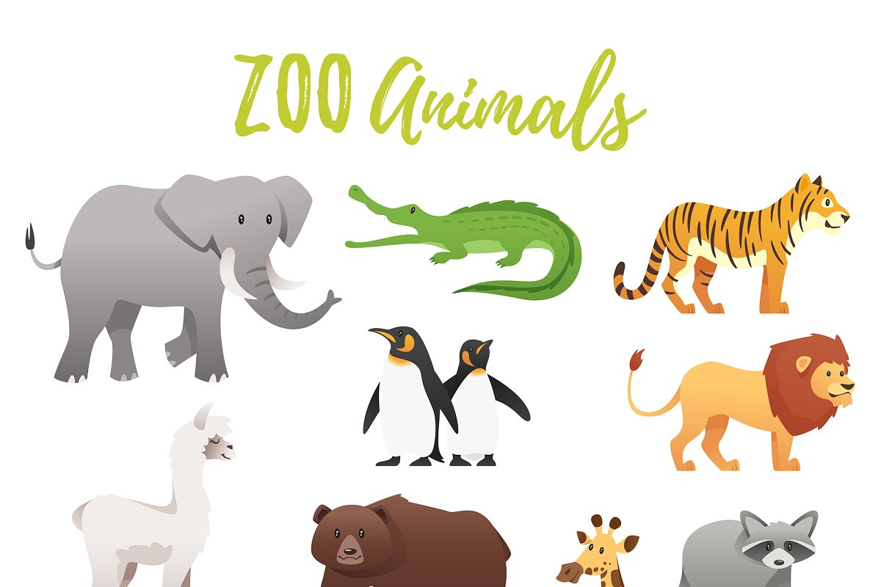
Look at the picture.
Animals

Slide 7
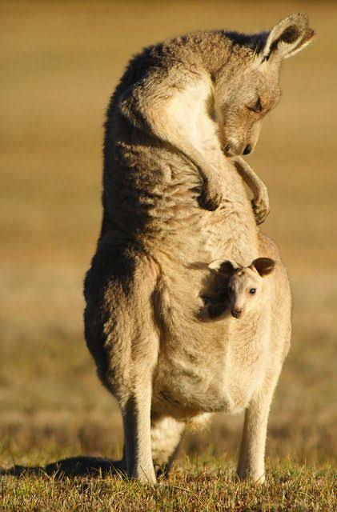
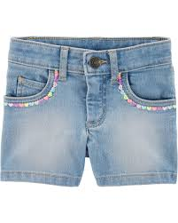
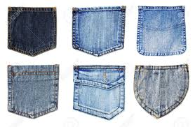
Look at the pictures
Pockets
Pockets
Kangaroo’s pocket

Slide 8
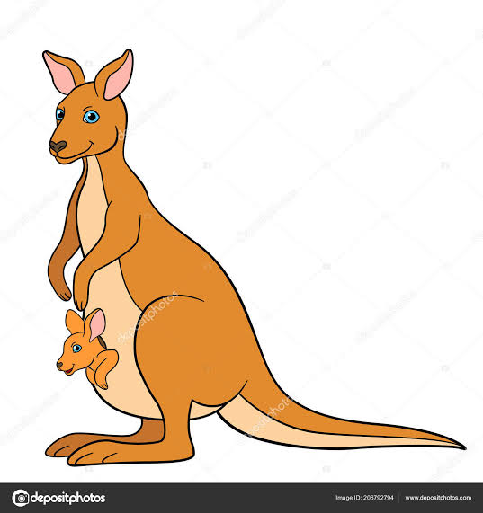
What can you see in the picture?
Mother Kangaroo and her kid in the pocket.

Slide 9
Our today’s lesson is…
The kangaroo’s pocket

Slide 10
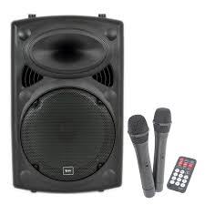
Listen to the text with the audio putting your finger under the line.
I’ll play the audio with my mobile and students will follow.

Slide 11
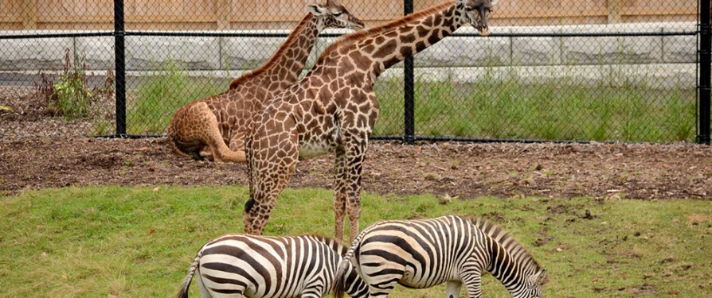
What is the picture about?
This is a zoo

Slide 12
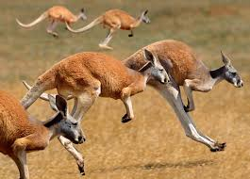
What are
the animals
in the
picture?
K
a
n
g
a
r
o
o
s

Slide 13
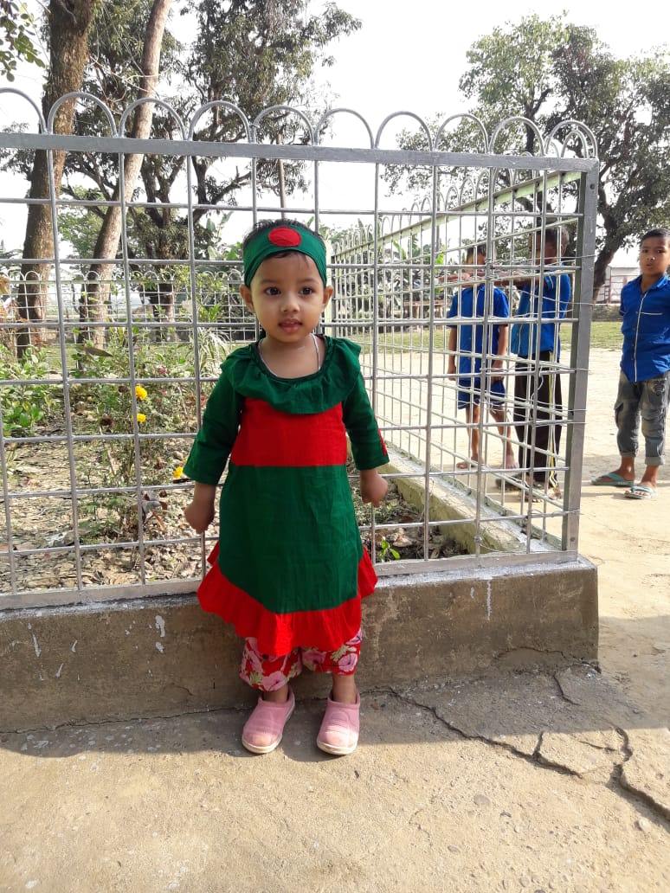
What is this?
A baby/A kid

Slide 14
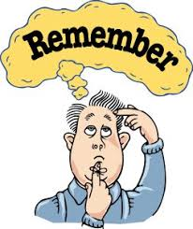
What does he do?
Recalls
something

Slide 15
Listen to the text again and repeat after the audio.

Slide 16
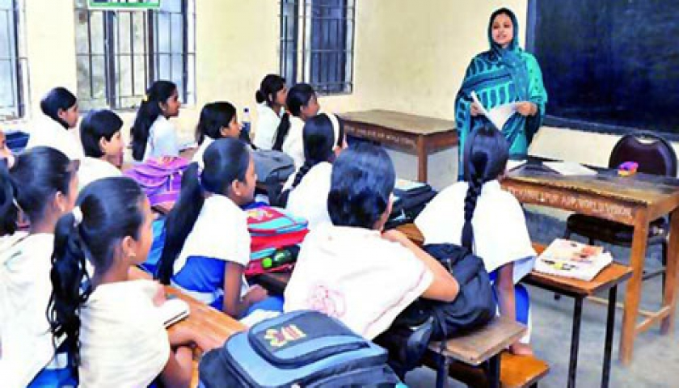
Look,listen and say
Open at page 58 of your textbook and repeat after me.

Slide 17
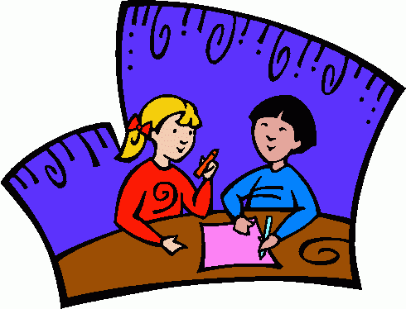
Pair work
Each of you read the poem to other.

Slide 18
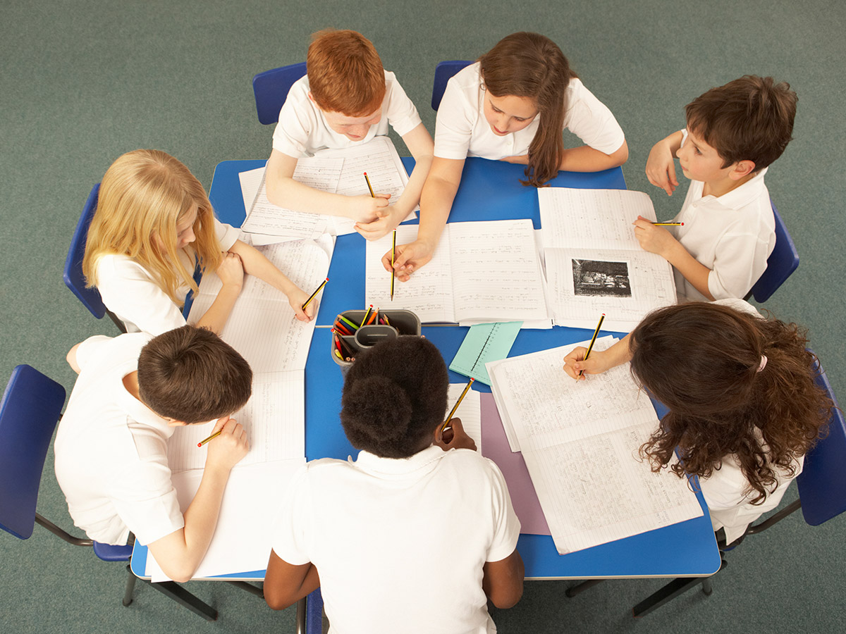
Group work
Now,each of all groups read a line of the poem with proper pronounciation,stress,intonation and physical action.

Slide 19
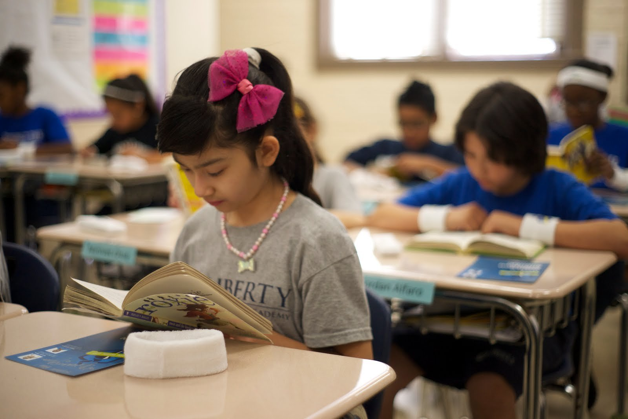
Students’ silent reading.

Slide 20
Match the words
Zoo
Kid
Kangaroo
Recall
Baby
A park of animals
Remember
An animal like goat

Slide 21
Evaluation
Recite the poem one by one.

Slide 22
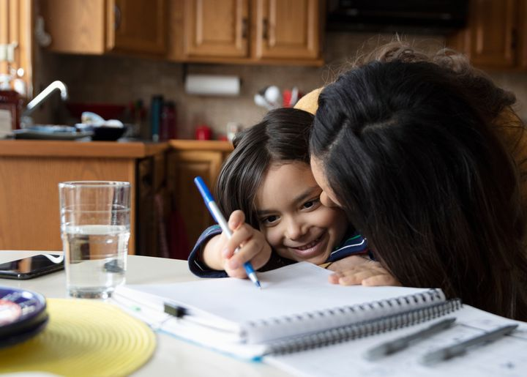
Home Task.
Suppose, you are Ruhi/Ruhan.Recently you have visited the zoo.Now write a letter to your friend about your visite.

Slide 23
Thank you,that’s all for today.

