Slide 1
WELLCOME MY DEAR STUDENTS.
This Photo by Unknown Author is licensed under CC BY-NC-ND

Slide 2
Introduction of me.
Abdulla Al Monzu
Ass.Teacher.
Al-Jameatul Millia Dakhil Madrasah.
Sarishadi,Feni.

Slide 3
Class: Nine
Subject: English Second Paper.
Grammar.

Slide 4
Narration – উক্তি

Slide 5
Learning outcomes
End of the lesson students' will be
able to ---
Can find Narration.
Identify the classification of speech
Identify the part of Narration.

Slide 6
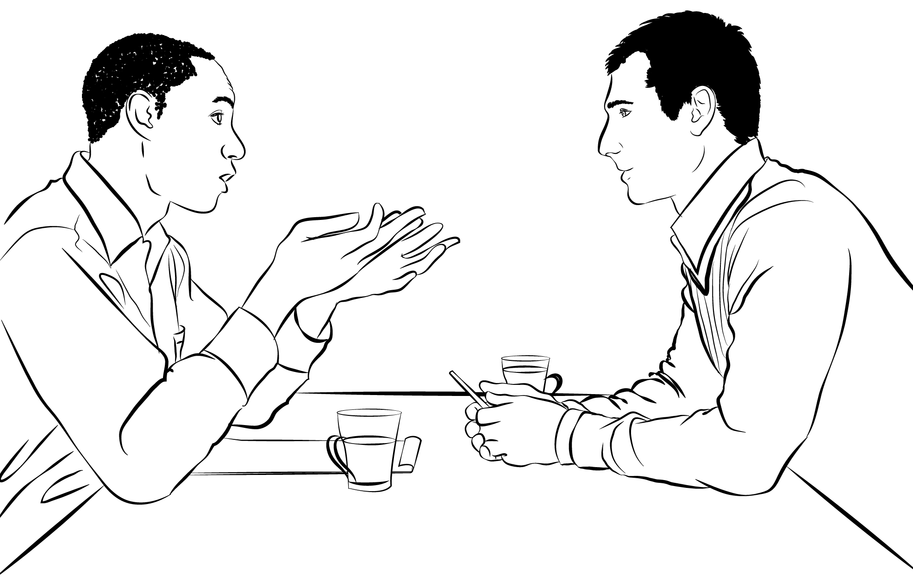
Mr.Raju said to Ovi,”I am feeling sick”.
Mr.Raju said to Ovi that he(R) was feeling sick.
In two sentences,
Raju is describing his statement in two ways.
বক্তার উক্তিকে প্রত্যক্ষ বা পরোক্ষভাবে প্রকাশ করার নাম ই Narration বা উক্তি।

Slide 7
There are two classification of Narration
Direct
Indirect
Fatema said,”I am well.”
Fatema said that she was well.

Slide 8
There are two part of Narration.
Narration এর দুটি অংশ-
Robi said to me, ”You will go home tomorrow.”
Reporting verb
Reported speech

Slide 9
Ways to recognize Narration.
(উক্তি চেনার উপায়)
Sentence এ one Speaker(বক্তা) Ges one Listener (শ্রোতা) থাকেন।
Reporting verb এর পর কমা ( , ) বসে এবং এটি inverted comma (Ó..Ó) এর বাইরে বসে।
Reported speech (Ó.......................Ó) এর ভেতর বসে।
Reported speech এর প্রথম অক্ষর Capital letter এর হয়।

Slide 10
What you need to know to do Narration?
Narration করতে জানতে হবে......
Tense.
Sentence and its classification.
verb.

Slide 11
Home Work.
Make a few Narration Sentences.

