Slide 2
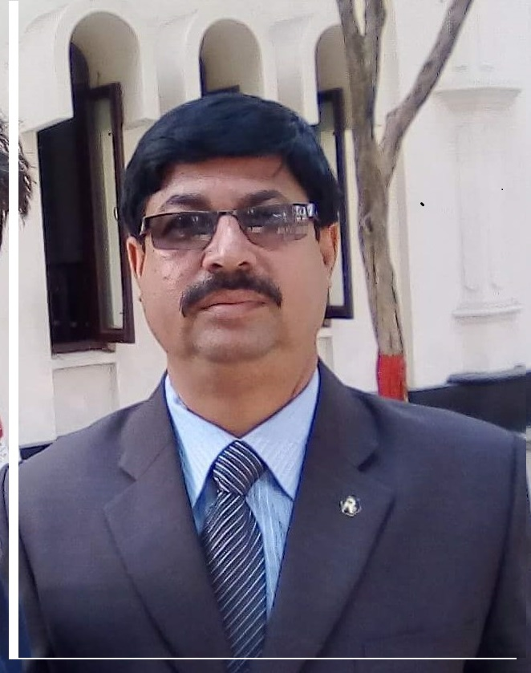
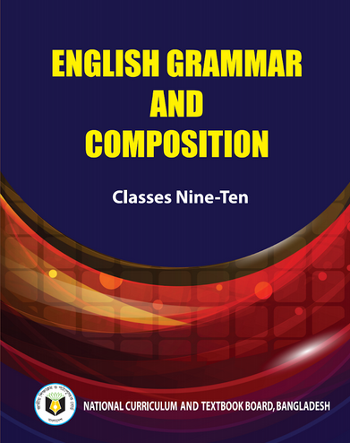
IDENTITY
Md. Afsar Ali
Senior Teacher
Majhira Model High School
Shajahanpur, Bogura
Email: afsar0903@gmail.com
English grammar and composition
Class: IX-X

Slide 3
Look at the following sentence
Health is wealth, isn’t it?
what a beautiful bird it is, isn’t it?
How odd! isn’t it?
Go home, will you?
Let’s go to cinema, shall we?
Can you tell what we call the underlined words?
Yes, we call the underlined words are tag questions.

Slide 4
Today we are going to learn about……
Tag question-3
Unit: 9 (Sentences)
Lesson: 5 (Tag question)
Page: 145

Slide 5
Learning Out comes
By the end of the lesson, the students
will be able to-
● tell the definition of tag question
● know the rules of tag questions
● add tag question

Slide 6
Read the following conversation?
Sam: It’s a nice party, isn’t it?
Zinia: Yes, it is indeed. We’re going to stay the whole night, aren’t we?
Sam: Oh, really? You didn’t go there, did you?
We noticed the above that each of the sentence ends with a question.
These questions are different from the wh-questions or ‘yes/no’ questions. These are called tag questions.

Slide 7
Tag means an inserted thing. So, a tag question means a question inserted in a statement.
There are some rules for making a tag question.
There are as follows:
27. If there is a countable noun after ‘Every/any/some/a few/a great many/many a great/many/a lot of’ in the beginning of a statement, the subject of the tag will be “They”
Example:
(a) Any person can carry the this small bag, can’t they?
(b) Some people do not care for anything, do they?
(c) A few boys were absent, weren’t they?

Slide 8
28. If the subject of the statement is ‘No+noun’ form the subject of the tag will be ‘they’.
Example:
No living being will survive for ever, will they?
No poet can be compared with Tagore, , can they?
No creature is better than a child, are they?

Slide 9
29. If the subject of the statement is ‘No/ no one/nobody/none’ the subject of the tag will be ‘they’.
Example:
None can escape death, can they?
No one is beyond error, are they?
Nobody could overcome the situation, could they?

Slide 10
30. If the subject of the statement is ‘Nothing/ anything/something’ the subject of the tag will be ‘it’.
Example:
Nothing is perpetual in the world, is it?
Anything done for humanity is heavenly, isn’t it?
Something is better than nothing, isn’t it?

Slide 11
31. If the subject of the statement begins with ‘Either’ the tag will be in the negative form. On the contrary, if the subject of the statement begins with ‘Neither’ the tag will be the positive form. The subject of the tag will be ‘they’ in both cases.
Example:
Either of the pens will do, won’t they?
Neither of the neighbours was peace-loving, were they?
Either he or she could do the work, couldn’t they?

Slide 12
32. If there are words such as seldom/hardly/barely/ scarcely/nothing/none/no one/neither/few/little/never/ rarely etc. in a sentence, it is considered as a negative sentence. Therefore the tag question will be affirmative.
Example:
(a) He hardly comes here, does he?
(b) A barking dog seldom bites, does it?
He never came back, did he?

Slide 13
33. ‘Used to’ in the statement is transformed to ‘didn’t’ in the tag.
Example:
(a) I used to swim in the river, didn’t I?
(b) She used to use sun ray protecting lotion, didn’t she?
(c) He used to take exercise regularly, didn’t he?

Slide 14
34. If the statement is ‘To be verb+Used to+main verb’ form, The tag also begin with the same ‘to be verb’.
Example:
(a) I was used to taking black coffee, wasn’t I?
(b) They were used to playing ‘Kabadi’ in their boyhood, weren’t they?
(c) He is not used to watching television, is he?
(d) I am not used to reading science fictions, am I?

Slide 15
35. If the statement begin with ‘There’ .“The subject of the tag will also be ‘there’
Example:
(a) There is a king in China, isn’t there?
(b) There was no way to solve the problem, was there?
(c) There has not been any rainfall in the ‘Atakama’ desert for 400 years, has there?
(d) There is a 500-year old cotton tree in Sierra Leone, isn’t there?

Slide 16
36. If the statement contains auxiliary verbs like ‘had better/had rather/would better/would rather’ the tag begins with ‘shouldn’t,
Example:
(a) We had better wait for the next train, shouldn’t we?
(b) She would rather use cocont shampoo, shouldn’t she?
(c) They had rather do it as early as possible, shouldn’t they?
(d) Boys would better take their decision later on, shouldn’t they?

Slide 17
37. The noun such as ‘The moon, the earth, the spring, the autumn, the nature, liberty, justice, mercy, hope, love, charity, etc. belong to feminine gender. If any of them is the subject of the statement. the subject of the tag will be ‘it/she’.
Example:
(a) The moon gives silvery beams, doesn’t it/she?
(b) The earth is round, isn’t she /it?
(c) Love does not keep a record of wrong, does she/it?
(d) Charity begins at home, doesn’t it/she?

Slide 18
38. The noun such as ‘The sun, the summer, the winter, the fire, the death, the storm, the flood, the cyclone earthquake, etc. belong to masculine gender. If any of them is the subject of the statement. the subject of the tag will be ‘it’.
Example:
(a) Fire burns, doesn’t it?
(b) Death is the ultimate destiny, isn’t it?
(c) Earthquake hits Japan every three minutes, doesn’t it?
(d) The sun is the center of the solar system, isn’t it?

Slide 19
39. If the statement is a complex sentence, the subject and verb of the tag will follow the subject and verb of the principal clause of the complex sentence.
Example:
(a) Though he is rich, he is honest, isn’t he?
(b) If you come, I shall go with you, shan’t I?
(c) If he hurts me, I’ll take revenge, won’t I?
(d) He took the umbrella as it was raining, didn’t he?

Slide 20
40. If the statement does not have any conjunction/
relative pronoun/relative adverb, the tag will follow
the second clause.
Example:
(a) I see, you are a Nazrul, aren’t you?
(b) You are a Nazrul, I see, don’t I?
(c) I agree, she is right, isn’t she?
(d) She is right, I agree, don’t I?

Slide 21
41. As the from of verb (present, past and past participle) ‘put, cut, read, cast, spread, hurt, beat, hit etc. are same. So, be careful while making Tag of those verbs.
Example:
(a) He put the book on the table, didn’t he?
(b) She hurt her self, didn’t she?
(c) He read the book of Kazi Nazrul Islam, didn’t he?
(d) She hit the dog, didn’t she?

Slide 22
42. If structure of the statement isThe + Adjective (Virtuous, Pious, Poor, Rich, Educated, Civilized, Unfed.........) the Pronoun will be `they’.
Example:
The rich are not always happy, are they?
(b) The educated should be respected, shouldn’t they?
(c) The pious are happy, aren’t they?

Slide 23
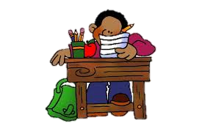
Individual work
Make tag questions
1. My parents and I are happy, ............?
2. Neither of them is guilty, ...................?
3. Study hard to succeed in life, .............?
4. The sooner, the better, ............?
5. Who dares to disobey the law, ..................?
6. You and he went there, ......................?
7. You and I came to terms, ...................?
8. Many a man will come, .......................?
9. The little girl knew a little of the matter, .................?
10. A barking dog seldom bites, .....................?
1. aren’t we? 2. are they? 3. will you? 4. isn’t it? 5. don’t they? 6. didn’t you? 7. didn’t we? 8. won’t they? 9. did she? 10. does it?

Slide 24
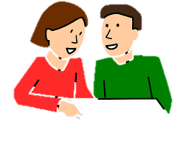
Pair work
Make tag questions from the following sentences.
1. The Headmaster and the secretary said many things,.....................?
2. The oldest of the men little thinks about death,............?
3. Someone is crying,................?
4. What a shame,..............?
5. Slow and steady win the race,............?
6. All that glitters is not gold,..............?
7. Look here he comes,..................?
8. The brother in him rose, ...................?
9. He set up a school in his village,................?
10. You never say what you are thinking, ...................?
1. didn’t they?
2. does he?
3. aren’t they?
4. isn’t it?
5. don’t they?
6. is it?
7. doesn’t he?
8. didn’t it?
9. didn’t he?
10. do you?

Slide 25
Evaluation
Fill in the blanks with tag questions.
1. Who cares, ....................?
2. Who dares to disobey the law, ...............?
3. What a pity, ........................?
4. The will of people prevails......................?
5. One should do one’s duty, .....................?
6. The girl in her will surprise you, ................?
7. That he is honest is known to all....................?
8. The tree has borne fruits...................?
9. The girl in her pleased us all..................?
10. He spent few hours with us, .................?
1. doesn’t he? 2. does he? 3. isn’t it? 4. doesn’t it?
5. shouldn’t they? 6. won’t it? 7. isn’t it? 8. hasn’t it?
9. didn’t she? 10. didn’t he?

Slide 26
Home work
Fill in the blanks with tag questions.
1. I think that he is right, don’t I?
2. The brother in him arose, didn’t it?
3. Everybody desires success, don’t they?
4. The pupil cut a sorry figure in the exam, didn’t they?
5. Many a rose is born to blush unseen, aren’t they?
6. Your honesty charmed us, didn’t it?
7. A lie never lies hidden for long, does it?
8. The strong always oppress the weak, don’t they?
9. This book is rare now, is it?
10. When he came, I was sleeping, wasn’t I?
1. don’t I? 2. didn’t it? 3. don’t they? 4. didn’t they? 5. aren’t they? 6. didn’t it? 7. does it? 8. don’t they? 9. is it? 10. wasn’t I?

