Slide 1
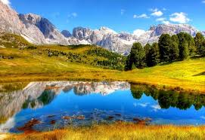
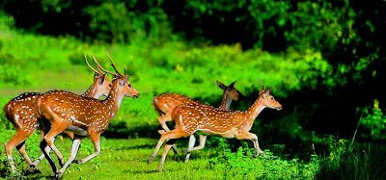

Slide 2
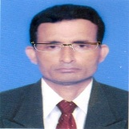
Identity
Manik Chandra Majumder
Senior Teacher
Gazirhat High School
Senbag, Noakhali
Mobile No: 01717155169
Class : Nine-Ten
Subject : English 1st paper

Slide 3
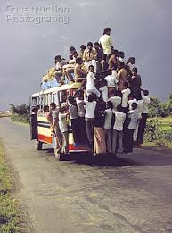
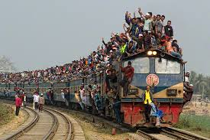
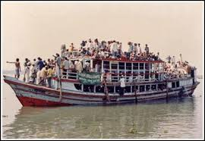
Overcrowded bus
Overcrowded train
overcrowded launch
What can you see in the pictures ?
In this circumstances a question may arise your mind.
Are we too many?
Let’s find out the answer of the question.

Slide 4
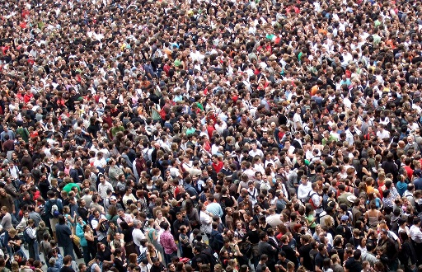
So dear, our today’s lesson is----
Are we too many?
Unit : Four
Lesson : Two
Page No : 45

Slide 5
Learning outcomes
After we have studied this lesson, we will be able to -----
ask and talk about problems,
b) seek and give suggestions,
c) listen for specific information,
d) narrate something in writing.

Slide 6
Observe the text related video
Individual work-1
Write in short about the theme of the video.

Slide 7
Read the text and do the following project work.
The next day when the teacher came to the class and was about to start the lesson, Shanti Barua stood up and said, "Teacher, can I ask you a question, please?" "Go ahead, Shanti," said the teacher. "In our last class, we heard Jamil’s story of how too many people made the ferry boat sink. I have also seen crowds of people at the bus stand, railway station, launch and steamer ghats. It is not uncommon to see people travelling on top of a bus or train and meeting with tragic accidents.

Slide 8
My question is: Are we really too many people in the country?"
“Thank you, Shanti. Please sit down." The teacher then looked round the class and asked, "How many of you have the same question in mind?" Almost all die hands went up. "Okay," the teacher continued. "Finding the right answer to this question is very important for us— for our national development. So we will look at this issue with some facts so that we can find out if we are really too many or not.”

Slide 9
Project work: Discuss in groups and carry out a survey on the topic: "Too many people!' You can do the following things:
Select only one small area such as your village or locality in the town / city where you live.
Find out its area. (You can do it by walking around it. At normal speed you can cover about one kilometer in ten minutes.)
Find out the number of people living in it.
Find out about the people's occupations, unemployment and poverty.

Slide 10
Observe survey report
Locality | Area | Population | Occupations | Unemployment | poverty
Sripur, Noakhali | 5 Sq Km | 8500 (Men- 4000 Women 4500) | Farmers-3500 Traders-1500 Employers-100 | 2000 | 2300 people live under poverty line. 4200 people are poor but live above poverty line
The project findings indicate that poverty and unemployment are the direct impact of over population. If we divide total population by total land area we can easily get the density of population.( 8500 5 sq.km)=1700 people live in per sq km

Slide 11
Listen to the Audio. Listen how the teacher talks about the population of Bangladesh and answer the following questions.

Slide 12
Read the text and answer the questions individually.
Bangladesh is a small country with an area of 1,47,570 sq km. This area also includes our rivers, hills and forest. But the country has a large population about 160 million. It is the eight largest country in the world on the basis of population. The density of population is 1000 per sq km.
Our population growth rate is high. It is 14 per one thousand people which is 1.4%. Birth rate and death rate are respectively 20.1& 6.1 and it is also calculated per thousand basis.

Slide 13
For example,20.1 more children are added to per thousand people and 6.1 people die every year. Hence our growth rate is (20.1-6.1)= 14.
So we can see 2 million people are added to our population every year. And if this rate continues, our population will be about 217 million in 2050. Can you imagine how densely people live this small country?
To solve the problem of overpopulation: Family planning / planned family programme should be strengthen.
Education is an important tool for controlling over population growth particularly female education. Early marriage marriage must be controlled though law.

Slide 14
Two students will make a pair and make dialogue about the number of population, occupations, unemployment and poverty of their locality.
Hello Friend, Let’s make a discussion about our previous class project.
Good idea, let’s start.
Can you say how many people live in your village?
About 8500 people live in our village. It’s a very densely populated village.

Slide 15
What are their main occupations?
Mostly they are engaged in agriculture. But when there is no agricultural work they remain unemployed.
This is the fact.
But what’s about your village?

Slide 16
The same condition.
But what is the reason, friend?
I think, the increasing growth of population, ignorance, early marriage…
There are no mills and factories in rural areas. They have no income raising source.
Exactly.But how can we bring the change?

Slide 17
First of all, We should control over growth of population. Stop early marriage,increase awareness about the bad effect of over population.
All right.
Our government should establish mills and factories in rural areas.
It’s true. I think government should decentralize our important cities.

Slide 18
Yes, We see the crowds in the big cities. Health, education, accommodation, sanitation and security are badly affected.
It’s a very miserable condition.

Slide 19
Read the chart and fill the gaps with information from the table using comparative and superlative degree where necessary.
 | Bangladesh | Sri Lanka | India | China
Land area | 1,47570 sq km | 65,600 sq km | 32,87,590 sq km | 96,00,000 sq km
population | 150m | 20m | 1.15b | 1.33b
Density of population | 1000 | 332 | 382 | 143
Birth rate (per1000) | 20.1 | 17.42 | 22.22 | 12.29
Death rate (per1000) | 6.1 | 5.92 | 7.48 | 7.03
Growth rate | 1.40% | 0.7% | 1.41% | 0.5%

Slide 20
Now fill up the gaps with appropriate words from the box below
second
Sri Lanka
bigger
least
highest
smaller
least
less
China
largest
In land area Bangladesh is 1) larger than Sri Lanka but 2) ………. than India. China is , of course, 3) ………of all three countries. Sri Lanka has the 4) …… population among the four countries. However, China has the 5)……… population shown in the chart. In fact, China has the 6)……… population in the world and India has the 7)………..highest population in the world. On the other hand, China has the 8) ………growth rate among the 4 countries. Bangladesh has 9) ……..growth rate than India, but higher birth rate than 10) ………and 11)…….. .

Slide 21
Choose the correct answer from the following alternatives
a. Bangladesh is a small country because
Cor. Ans:
ii) it is the 8th position among the top populous countries.
Cor. Ans:
i) its land area is small.
i) its land area is small.
iii) it has 150 million people.
iv) it has limited resources.
b. Density of population in any country means
i) all the people in a country.
ii) 1000 people living in one sq km.
Cor. Ans:
Cor. Ans:
iii) number of people living in one sq km.
iv) too many people living in sq km.
iii) number of people living in one sq km.

Slide 22
c. Our population growth rate is
Cor.Ans:
Cor.Ans:
i) 1.9%
ii) 1.40%
iii) 2.1%
ii) 1.40%
iv) 1.1%
d. Our birth rate is--------- per thousand.
Cor.Ans:
i) 1.9
iii) 20.1
Cor.Ans:
ii) 1.40
iii) 20.1
iv) 14
e. What will be the size of our population in 2050?
Cor. Ans:
Cor. Ans:
i) 150 m
iii) 217 m
ii) 197 m
iii) 217 m
iv) 250 m

Slide 23
f. Finding the right answer to this question is very important for us for our national development. Why?
i) We need to use our rivers
Cor.Ans:
Cor.Ans:
ii) We need faster and safer communication
iii) We must utilize our human resource
iv) Increasing population may hamper our development
iv) Increasing population may hamper our development
g. What could be the closest meaning for occupation
Cor.Ans:
i) activity
ii) employment
Cor.Ans:
iii) profession
iii)profession
iv) service

Slide 24
Answer the following questions:
What do you mean by density of population?
b) When does population of a country become curse?
c) How can we calculate the growth rate of population of a
country?
d) Write down the effects of over population that caused by high
growth rate of population.
e) How can we minimize high growth rate of population?
Answer-e) We can minimize high growth rate of population by adopting family planning , keeping family size small, stopping early marriage, spreading education specially female education and creating awareness among the common people about bad effect of over population. Mass media can play important role in this regards.
Answer-b) We know population of a country is an asset. But it becomes a curse when the country cannot provide the basic needs of its population.
Answer-c) We can calculate the growth rate of population by deducting death rate from birth rate. Generally it is calculated per thousand basis.
.
Answer-d) Over population hampers our development. It causes various problems such as food, clothes , accommodation, education, medical, employment, and environmental problems. Sometimes the government cannot meet the basic needs of increasing population.
Answer-a) Density of population means how closely people live together in per square mile or per square kilometre or a particular area.

Slide 25
Evaluation
What do you mean by birth rate and death rate of population?
How do you get the population growth rate of a country?
Why will the population of Bangladesh be so large in 2050?

Slide 26
HOME WORK
Write a paragraph about the “Population problem of Bangladesh”.

Slide 27
