Slide 2
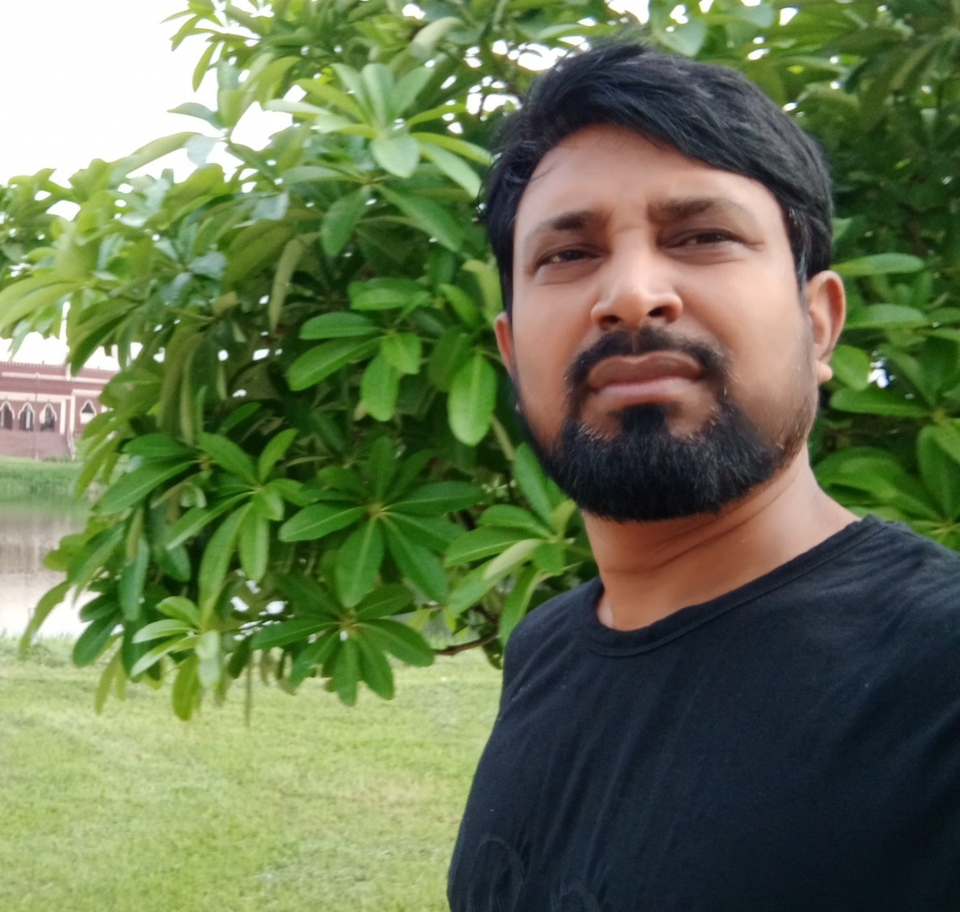
PRESENTED BY
KAWSER AHMED
HEADMASTER
RAYERDIA HIGH SCHOOL

Slide 3
WE MUST FOLLOW
Maintain Health Rules.
Watch The Classes Of Sangsad TV .
Learn 10 vocabulary every day.
Read online newspaper.
Read your text book attentively.
Exercise Math every day.
Don’t go outside unnecessarily .

Slide 5
Phrase and clause
PHRASE
No subject and predicate.
No sentence can be formed.
CLAUSE
Contain subject and predicate.
A meaningful sentence can be formed.

Slide 6
She saw the man
going to market
clause
phrase
Classification of clause
Principal clause .
Sub-ordinate clause.
Co-ordinate clause

Slide 7
Sohel became pleased
when he heard the news
P.C
S.C
Principal cl. + Sub-ordinate clause
= COMPLEX
How can we identify Sub-ordinate clause
When
While
After
before
Till
Untill
Since
as
Because
Though
Although
if
Who
That
So that
So..that

Slide 8
TRANSFORMATION OF SENTENCES
Internet is a computer based networking system.(interrogative)
Ans. Isn’t internet a computer-based networking system.
It is a speedy transmitting system of information.(complex)
Ans. It is a transmitting system of information which is speedy.

Slide 9
Its functions are smooth and rapid.(Negative)
Ans. Its functions are not only smooth but also rapid.
A man has an internet connection and gets link soon according to his expectation.(Simple)
Ans. Having an internet connection a man gets link soon according to his expectation.
Many educational institutions are already benefited through the use of internet.(Complex)
Ans. There are many educational institutions which are already benefited through the U. of INT.

