Slide 2
Identity
Md. Robiul Islam
Assistant Teacher English
Pioneer Girls’ High School, Khulna
ICT4E Ambassador, Khulna Sadar, Khulna
Email. robittck@gmail.com
Cell. 01914223493
English For Today
Class-Nine-Ten
Date- 01/10/2020
Time- 45 minutes

Slide 3
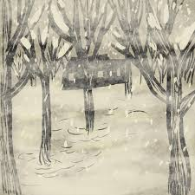
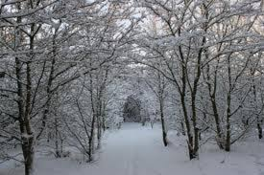

Slide 4
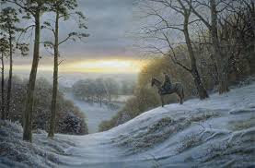
What is the picture about?
The picture is about a horse man is Stopping by Woods on a Snowy Evening.

Slide 5
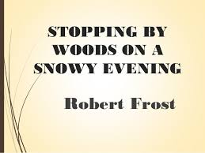
Today we are going to read about -

Slide 6
After we have studied this lesson, we will be able to -
Ask and answer these questions.
Understand and enjoy text.
Interpret, evaluate and summarize literary text.

Slide 7
Robert Lee Frost
March 26, 1874 – January 29,1963
Born in San Francisco, Moved to Massachusetts at age 11
Taught English , sold a few poems, then tried farming
Moved to England and returned to the U.S in 1915
Often depicted rural New England life from the early 1900’s
Well – respected in his life time
Won four Pulitzer prizes for poetry
Awarded the United states Congressional Gold Medal in 1960
At 86, he read his poem “ The Gift Outright” at president
Kennedy’s inauguration
He died 2 years later from complications from surgery
His farm in New Hampshire is now a museum
He was honored on a US postage stamp in 1974
Information about Robert Lee Frost

Slide 8
A. Ask and answer these questions.
1. Do you know natural beauty like flowers, trees, woods, hills etc. ?
Ans. Yes, I know natural beauty like flowers, trees , woods and hills etc. It increases the beauty of nature always.
2. Have you ever been to a place where you enjoyed such beauty?
If yes, briefly describe it.
Ans. Yes, I have ever been to a place where I enjoyed such beauty. The place is one evening near the dark forest in a winter session. It’s very amazing for me.

Slide 9
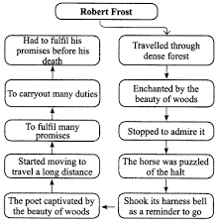

Slide 10
Stopping by Woods on a Snowy Evening
B. Read the poem.
Whose woods these are I think I know,
His house is in the village though;
He will not see me stopping here
To watch his woods fill up with snow.
My little horse must think it queer
To stop without a farm house near
Between the woods and frozen lake
The darkest evening of the year.
He gives his harness bells a shake
To ask if there is some mistake.
The only other sound’s the sweep
Of easy wind and downy flake.
The woods are lovely , dark and deep.
But I have promises to keep,
And miles to go before I sleep,
And miles to go before I sleep.
Robert Frost

Slide 11
Interpretation of 1st stanza:
He comes upon a church even though the church is in the village. The person he’s talking about is God and he’s saying that God won’t see him stopping by because he needs time to think alone.
Interpretation of 2nd stanza:
The horse must think it’s odd of the master to stop him without a farmhouse in sight. The man is besides the woods and a lake that is frozen. We can infer that “ The darkest evening of the year” is the winter solstice, The first day of winter , the time when the sun is out the shortest.

Slide 12
Interpretation of 3rd stanza:
The horse shakes his bells to ask his master why they had stopped because the horse doesn’t see a farmhouse. Besides the horse’s bells, the master only hears the wind blowing softly and the quietly soothing sound of the snowflakes falling.
Interpretation of 4th stanza:
The woods are lovely, dark and deep . This line is consists of symbol , here is lovely, dark and deep. Lovely, dark and deep here is as symbolism of mystery in life. It is describes that the author stop is a place which are many things to temptation him over there in order he almost fall asleep and forgot his duties.

Slide 13
Rhyming Words from Stopping by Woods on a Snowy Evening by Robert Frost
know | queer | keep
lake | flake | year
mistake | though | deep
snow | sweep | here
sleep | near | shake

Slide 14
Diction and Tone
Diction: Tone:
Woods, sweep, easy wind, The tone is peaceful because like all of us,
downy flake, lovely, promises at some point we feel like we need some
Stopping , snow, queer, without, frozen time to be alone, away from others
lake, Darkest evening, mistake, dark, sleep to think about situations that are happening in our life.

Slide 15
Literary Text
Poetic device | Lines from the poem
Alliteration | Watch his woods
Personification | My little horse must think it queer, to ask if there is some mistake.
Repetition | And miles to go before I sleep.
Imagery | The darkest evening of the year, Of easy wind and downy flake.

Slide 16
C. Answer the following questions.
1. Where do you think the poet is going? Why is he going there?
Ans- I think that the poet is going to observe the beauty of nature on a snowy evening.
2. Why did the poet stop by the woods though it was dark and he was alone?
Ans- The poet stopped by the woods though it was dark and he was alone because he observe the beauty of dark , deep and lovely beauty of nature in winter.
3. Guess what promise the poet had to keep before he would sleep.
Ans- The poet has a lot of things to do for the welfare of the world before he sleeps for the last time.

Slide 17
Home work
Write an imaginary dialogue between the poet and his horse.

