Slide 1
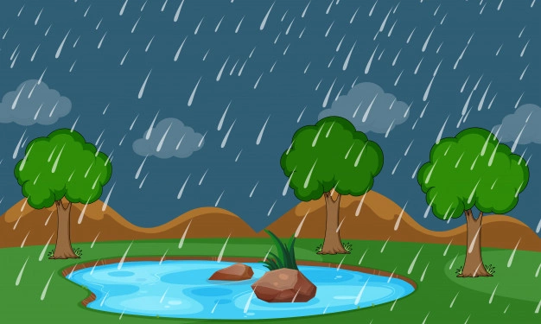
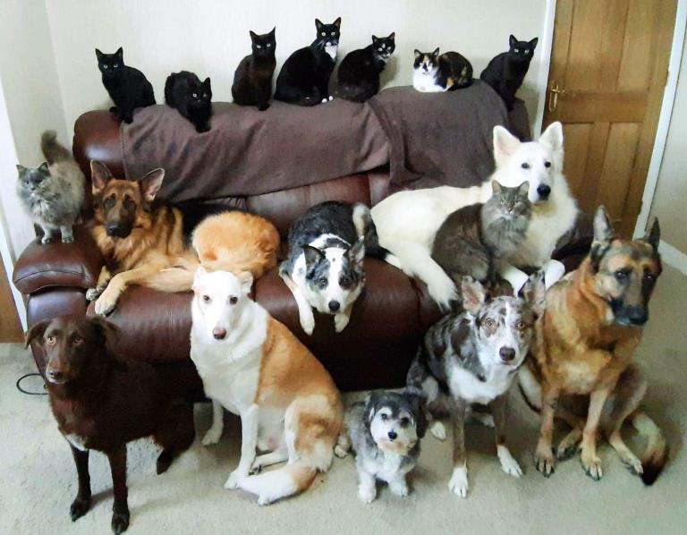
Welcome to my class
It is raining cats and dogs.

Slide 2
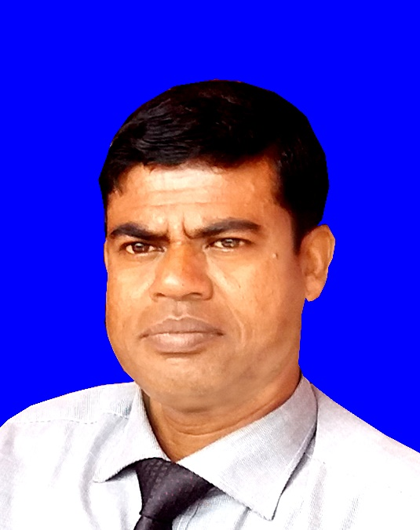
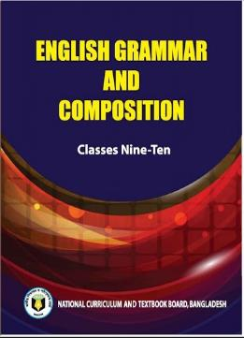
Introduction
MD. ABDUR RAZZAK
Head Teacher
Dhalahara westpara Secondary Girls’ School
E-mail: abdurrazzakmt@gmail.com
Phone number: 01721588402
IDIOMS AND PHRASES
Class: 9 & 10
Time: 50 min

Slide 3
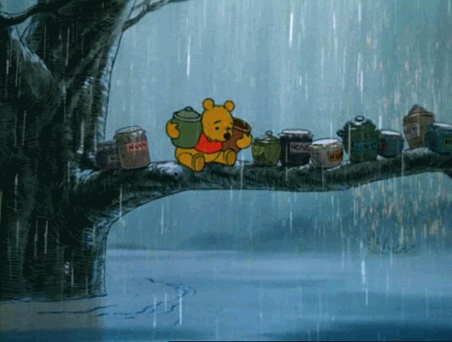
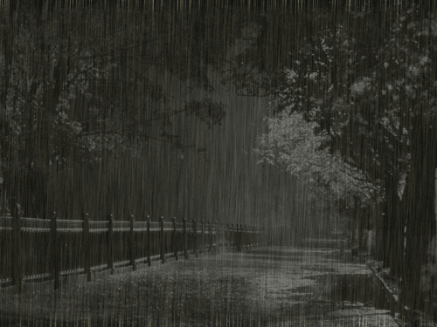
Let’s enjoy a video clip
Observe, think and say
What type of grammar point “cats and dogs ” is?
What is happening here?
What is happening here?
just raining
It is raining cats and dogs.
IDIOMS

Slide 4
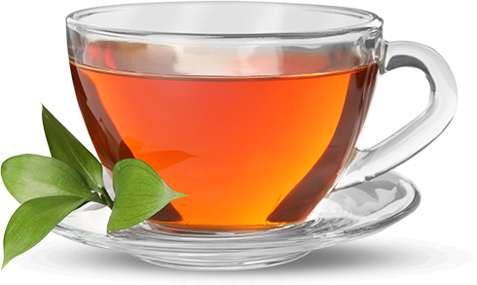
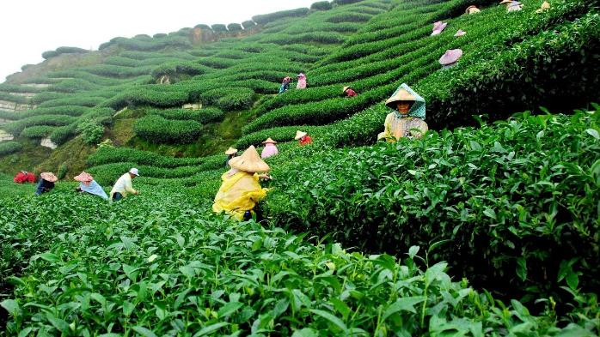
““A lot of ” tea grows in Bangladesh.
What type of grammar point “a lot of ” is?
PHARASE

Slide 5
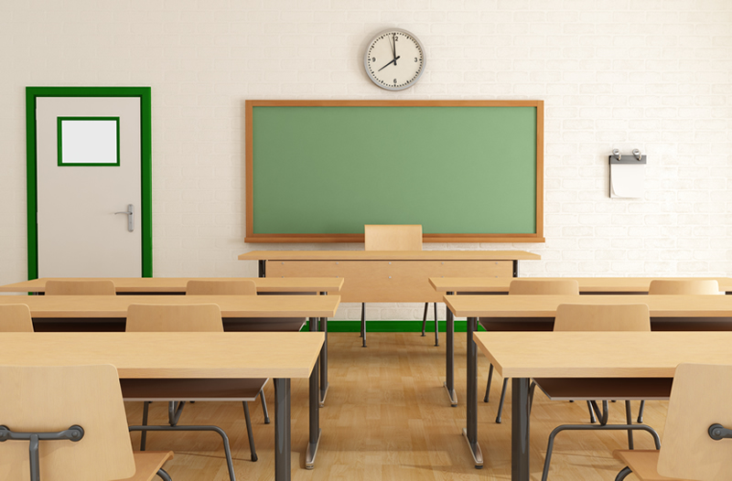
Could you guise what we are going to learn today?
IDIOMS AND PHRASES

Slide 6
Learning outcomes
After the end of the lesson the learners will be able to---
1.
say definition of idioms.
2.
explain what phrase is.
3.
use idioms and phrases in their real life.

Slide 7
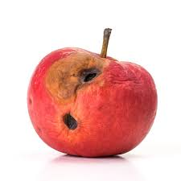
Observe, imagine and say
literal/simple
meaning
rotten/damaged apple
bad
apple
Idiomatic meaning
but
criminal
As: The number of bad apple is growing day by day.
Grammar point: An idiom is a group of words that has a metaphorical (not literal) meaning having no subject, no predicate but works as a single part of speech.

Slide 8
meaning
A lot of
tea
Huge number
Literal/simple
Meaning but no metaphoric
As: A lot of tea grows in Bangladesh.
Grammar point: Phrase-is a group of words that has a literal meaning having no subject, no predicate but works as a single part of speech.

Slide 9
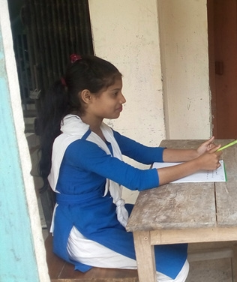
Individual Work 3 min.
click left side writing to check
a group of words having metaphorical meaning.
What is idioms?
a group of words having literal meaning
What is phrase?
bad apple meaning ----?
criminal

Slide 10
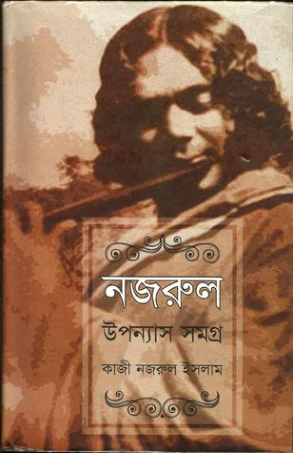
Come
round
literal/simple
meaning
get rid of diseases
Idiomatic meaning
but
moving
Note: A group of words that has a metaphorical meaning having no subject, no predicate but works as a verb is called group verb.
As: The boy has come round from fever.
Come
of
Idiomatic meaning
literal/simple
meaning
but
birth
Just come
As: Kazi nazrul comes of a poor family.

Slide 11
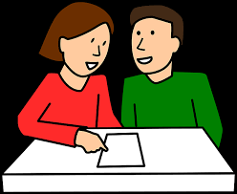
Pair work 4 min
Tick ($√$) the correct of underlined
idioms and phrases.
1. There is a tooth and nail relation between the two brothers.
A. enmity
B. good relation
C. sweet relation
D. coward relation
tooth and nail meaning: engage in fight using all resources.
So , A is correct.
×
×
×
discussion on board

Slide 12
2. The detective left no stone unturned to trace the culprit.
took no pains
did very irrelevant things
C. resorted to illegitimate practices
D. used all available means
no stone unturned meaning: try every possible course of action in order to achieve something. So , D is correct.
×
×
×
discussion on board
2. He goes to school in time regularly.
every time
no time
C. right time
D. all time
×
×
in time meaning: right time to do something. So , C is correct.
×
discussion on board

Slide 13
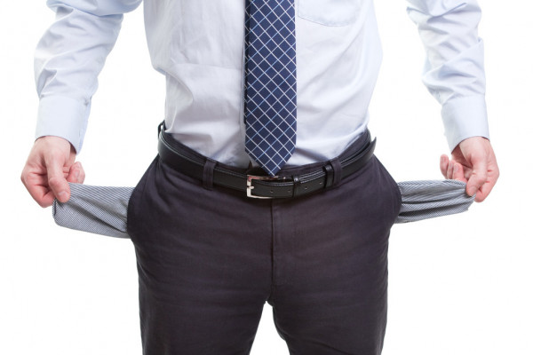
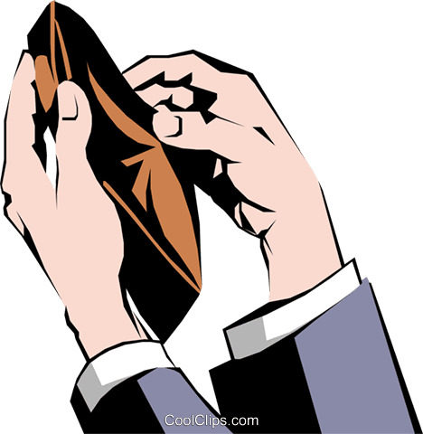
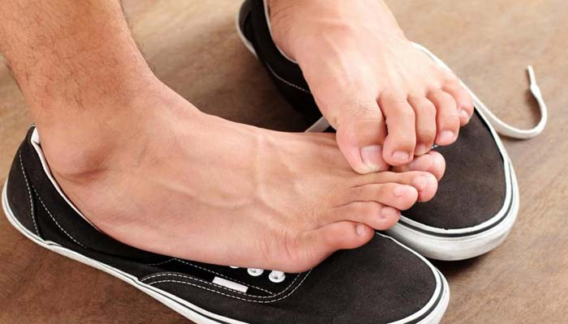
More examples of IDIOMS
Hard up
but Idiomatic meaning
strong
Empty pocket
As: The man is hard up now.
Put off
Idiomatic meaning
literal/simple
meaning
Keep away
but
removing
As: The man has put off his shoes.

Slide 14
Some common IDIOMS
Idioms | Simple meaning | Idiomatic meaning | Examples
Go on | Going | Continuing | Admission is going on.
Put on | keeping | wear | She is putting on her dress.
Give up | Offer | Abandon | She is giving up her hope.
Act on | Acting | affect | Hard working can act on health.
Put out | Keeping out | unlit | Put out the lamp.
Look for | Looking | search | I am looking for a job.
Set out | setting out | Journey | He set out for London.

Slide 15
Idioms | Simple meaning | Idiomatic meaning | Examples
Bad blood | Poisoned blood | Ill feeling | Bad blood is going on between the two friends.
ABC | letters | Primary knowledge | She has no ABC of music.
Bring to book | Opening book | punish | She should bring to book for her misconduct.
Red tape | Red color tape | Official formalities | Red tapism causes delay in official work.
Turn down | Come down | refuse | He turned down the proposal.

Slide 16
Group work 5 min
Complete the following story with appropriate idioms and phrases.
comes of
answer
Habib is my friend. He -------------- a poor family. He is honest --------------. He lives from --------------------. He has a European friend who is fully a ------------- .
no doubt
hand to mouth
answer
answer
bad apple
answer
click on answer to check answer

Slide 17
Evaluation
Tick ($√$) the correct answer from alternatives.
1. Human life is full of --------.
(b) well & woe
(a) at all
$√100$%
$$×$$
(d) no time
(c) $in time$
$$×$$
$$×$$
2. He is not a criminal -----------.
(a) at times
(b) In time
$$×$$
$$×$$
(c) at all
(d) $all the time$
$√$100%
$$×$$

Slide 18
3. There is ------- between the two brothers.
(a) High blood
(b) bad blood
$$×$$
$√100$%
(c) blue blood
(d) $no blood$
$$×$$
$$×$$
4. Admission is -----.
(a) going back
(b) going to
$$×$$
$$×$$
(c) $going on$
(d) going in
$√$100%
$$×$$
5. His dream has -------.
(a) come to
(b) come on
$$×$$
$$×$$
(c) $come true$
(d) come in
$√$100%
$$×$$

Slide 19
Homework
Write a short composition within ten sentences about yourself using idioms and phrase.

Slide 20
See you next class
It is raining cats and dogs.

