Slide 2
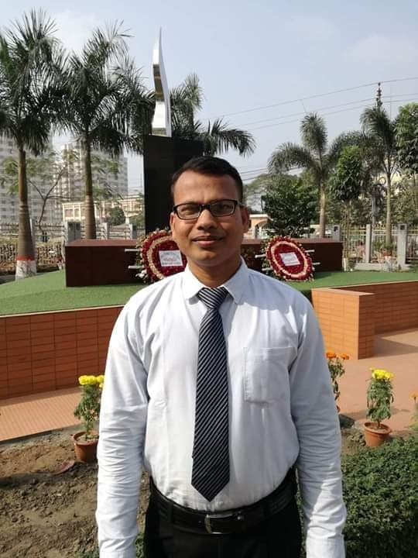
IDENTITY
JEWEL CHAKRABORTY
Assistant Teacher (English)
Govt. S.C Girls’ High School
Sunamgonj.
Cell-01728-829242
Class-Eight
Subject-English-2
Topic-

Slide 3
Go through the sentences.
1. Money cannot buy (happy).
2. Happiness is the name of a (feel).
3. A poor man with mental (satisfy) can be happy.
4. Wealth sometimes becomes the cause of (happy).
5. Rich people often suffer from (security).
Can you guess our today’s topic?

Slide 4
Learning Outcomes
Our Today’s Topics - Suffix & Prefix
1
Identify different parts of speech
2
Make new words using suffix & prefix
3
Use them in right places
4
Answer question number 9
After completing this lesson students will be able to ..

Slide 5
Introduction
We have got 8 parts of speeches- among them 4 are base words and rest 4 are subsidiary words. Root or base words are - Noun, Adjective, Verb, Adverb. Subsidiary words are - Pronoun, Preposition, Conjunction, Interjection. The subsidiary words can never be changed. But we can change the root or base words from one parts of speech to another ones. We can add letters to the beginning or to the end of the root words and make new words. The way of this changing is called “Derivatives” or “Affix”

Slide 6
Suffix & Prefix
Derivatives or Affix are of two kinds.
Suffix.
Prefix.
A prefix is a group of letters (or an affix) that's added to the beginning of a word, and a suffix is an affix that's added to the end of a word. Prefixes modify the meaning of a word. They can make a word negative, show repetition or indicate opinion. Some suffixes add to or change a word's meaning.

Slide 7
Suffixes & Prefixes
NOUN
ADJ.
VERB
ADV.
OPPOSITE
-ment
-ness
-ence
-ance
-er
-or
-ship
-hood
-sion
-tion
-r
-full
-ous
-able
-ive
-al
-ing
y
less
ed/d
-en
-en
-be
-ise
-ize
-ify
-ate
-re
-ly
-words
-wise
-dis
-in
-un
-il
-im
-ir
-mis
in
Extra
anti

Slide 8
USE OF SUFFIXES & PREFIXES
USE OF NOUN
USE OF VERB
After adjectives
After preposition
After articles (a/an/the)
Between sub. & obj.
After modals (V1)
After other auxiliary verbs (Past form / past participle / gerund)
After preposition (V+ing) except (to)

Slide 9
USE OF SUFFIXES & PREFIXES
USE OF ADJECTIVE
USE OF ADVERB
Before a noun
After an adverb
After some specific verbs (let, get, seem, appear, look, become)
Between sub. & verb.
Between auxiliary & main verbs
Before an adjective
Before sub. or obj.

Slide 10
Dhaka Board-2019
As human beings, we must gain some moral qualities. In fact, (a) –moral is one of the (b)- great virtues. (c)-Moral hampers all (d)-develop works of a country. So morality should be (e)-practise since one’s (f)- boy. Educational (g)-institute can play important roles in this regard. This (h)-ward quality helps a man to be noble. (i)- Noble is another virtue. This virtue can (j)- rich a man’s life.

Slide 11
Mymensing Board-2019
Our education remains (a) –complete if we do not learn good manners. In our behavior with others, we must be (b)- respect with others. We should never (c)-behave with anybody because our (d)-conduct may hurt others. We should not create any (e)-necessary quarrel with others. The (f)- important of good manners is (g)-measurable. (h)-Real a man of good manners is a gentle man. We should try to learn good manners from our (i)- child and grow up (j)- proper.

Slide 12
Sound health is the (a)— (come) of physical exercise in a (b)—(regulate) form. (c)— (regulate) form of exercise or (d)—(exercise) is injurious to health. Remember that if you take physical exercise, you must not be (e)— (regular). Physical exercise increases our appetite and improves (f)— (digest) power. If anybody suffers from (g)— (digest) he should take physical exercise. Proper (h)— (digest) of food removes his loss of appetite. Physical exercise removes (i)— (constipate) and helps proper blood (j)— (circulate).

Slide 13
King Solomon had a great (a) (repute) for his (b) (wise). Once the Queen of Sheba wanted to test how wise he was. She brought two kinds of flowers. One was the floral wreath of (c)(nature) flower and the other was of (d) (artifice) flower. Sheba asked the king to (e) (different) between the flower wreaths. Solomon did not answer (f) (instant). He thought for a while. There were bees outside. He told someone to open the window and keep it (g) (close). The bees came in and sat on the natural flowers. The wreaths could be (h) (identify) by Solomon. Thus the (i) (identify) of real flowers by the king made the queen (j) (great) impressed.

Slide 15
a) outcome b) regulated c) Unregulated d) over-exercise e) irregular f) digestive g) indigestion h) digestion i) constipation j) circulation.
a) reputation b) wisdom c) natural d) artificial e) differentiate f) instantly g) unclosed h) identified i) identification j) greatly.

Slide 16
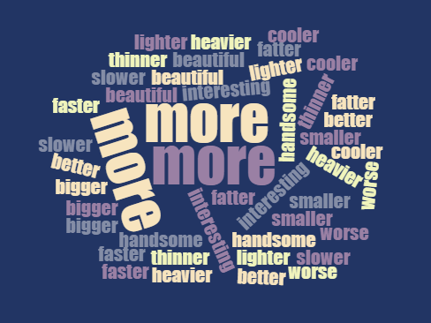
The roads of Sylhet are not so spacious as those of Dhaka (Comparative)
The rice of Faridpur is better than that of Mymensing (Positive)
A healthy poor man is happier than an unhealthy well off man (positive)
Books are the best of all friends (comparative)
Urban life is not as quiet as rural life (Compa)
Change as directed:

