Slide 1
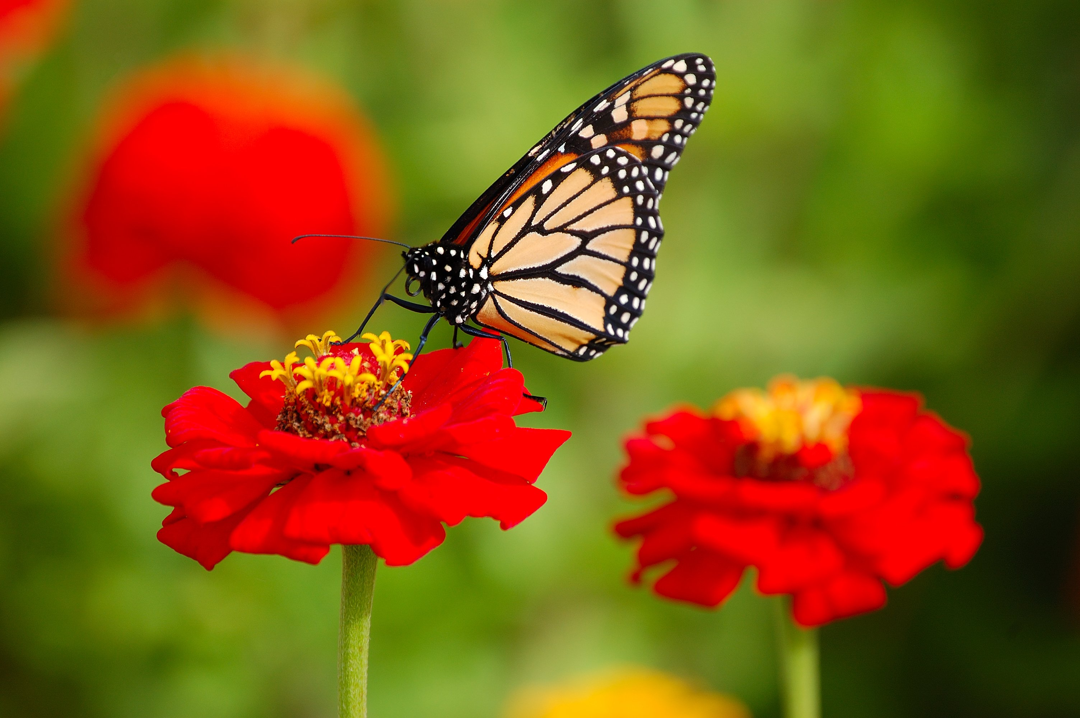
You’re Welcome

Slide 2
Mohammad Abul Mansoor Head teacher Borumchora Jonotha GPS Anwara, Chattogram Mobile: 01818 91 15 90 email: md.abulmansoor@yahoo.com

Slide 3
Today’s topic Class: Four Subject: English Unit: 5 Lesson:3 sound practice 1 Page: 11

Slide 4
Learning out comes 1.1.1 Recognize sound differences in the context of words. (Practicing sound /s/ ( স্ ), /ʃ/ শ্ )

Slide 5
Look, Listen and Say
/s/ , / s/ , /s/ ( স্ )
/s/ , / s/ , /s/
/s / is for Sun

Slide 6
Look, Listen and Say
/ʃ/, /ʃ/, /ʃ/ ( শ্ )
/ʃ/, /ʃ/, /ʃ/
/ʃ/ is for Shoe

Slide 7
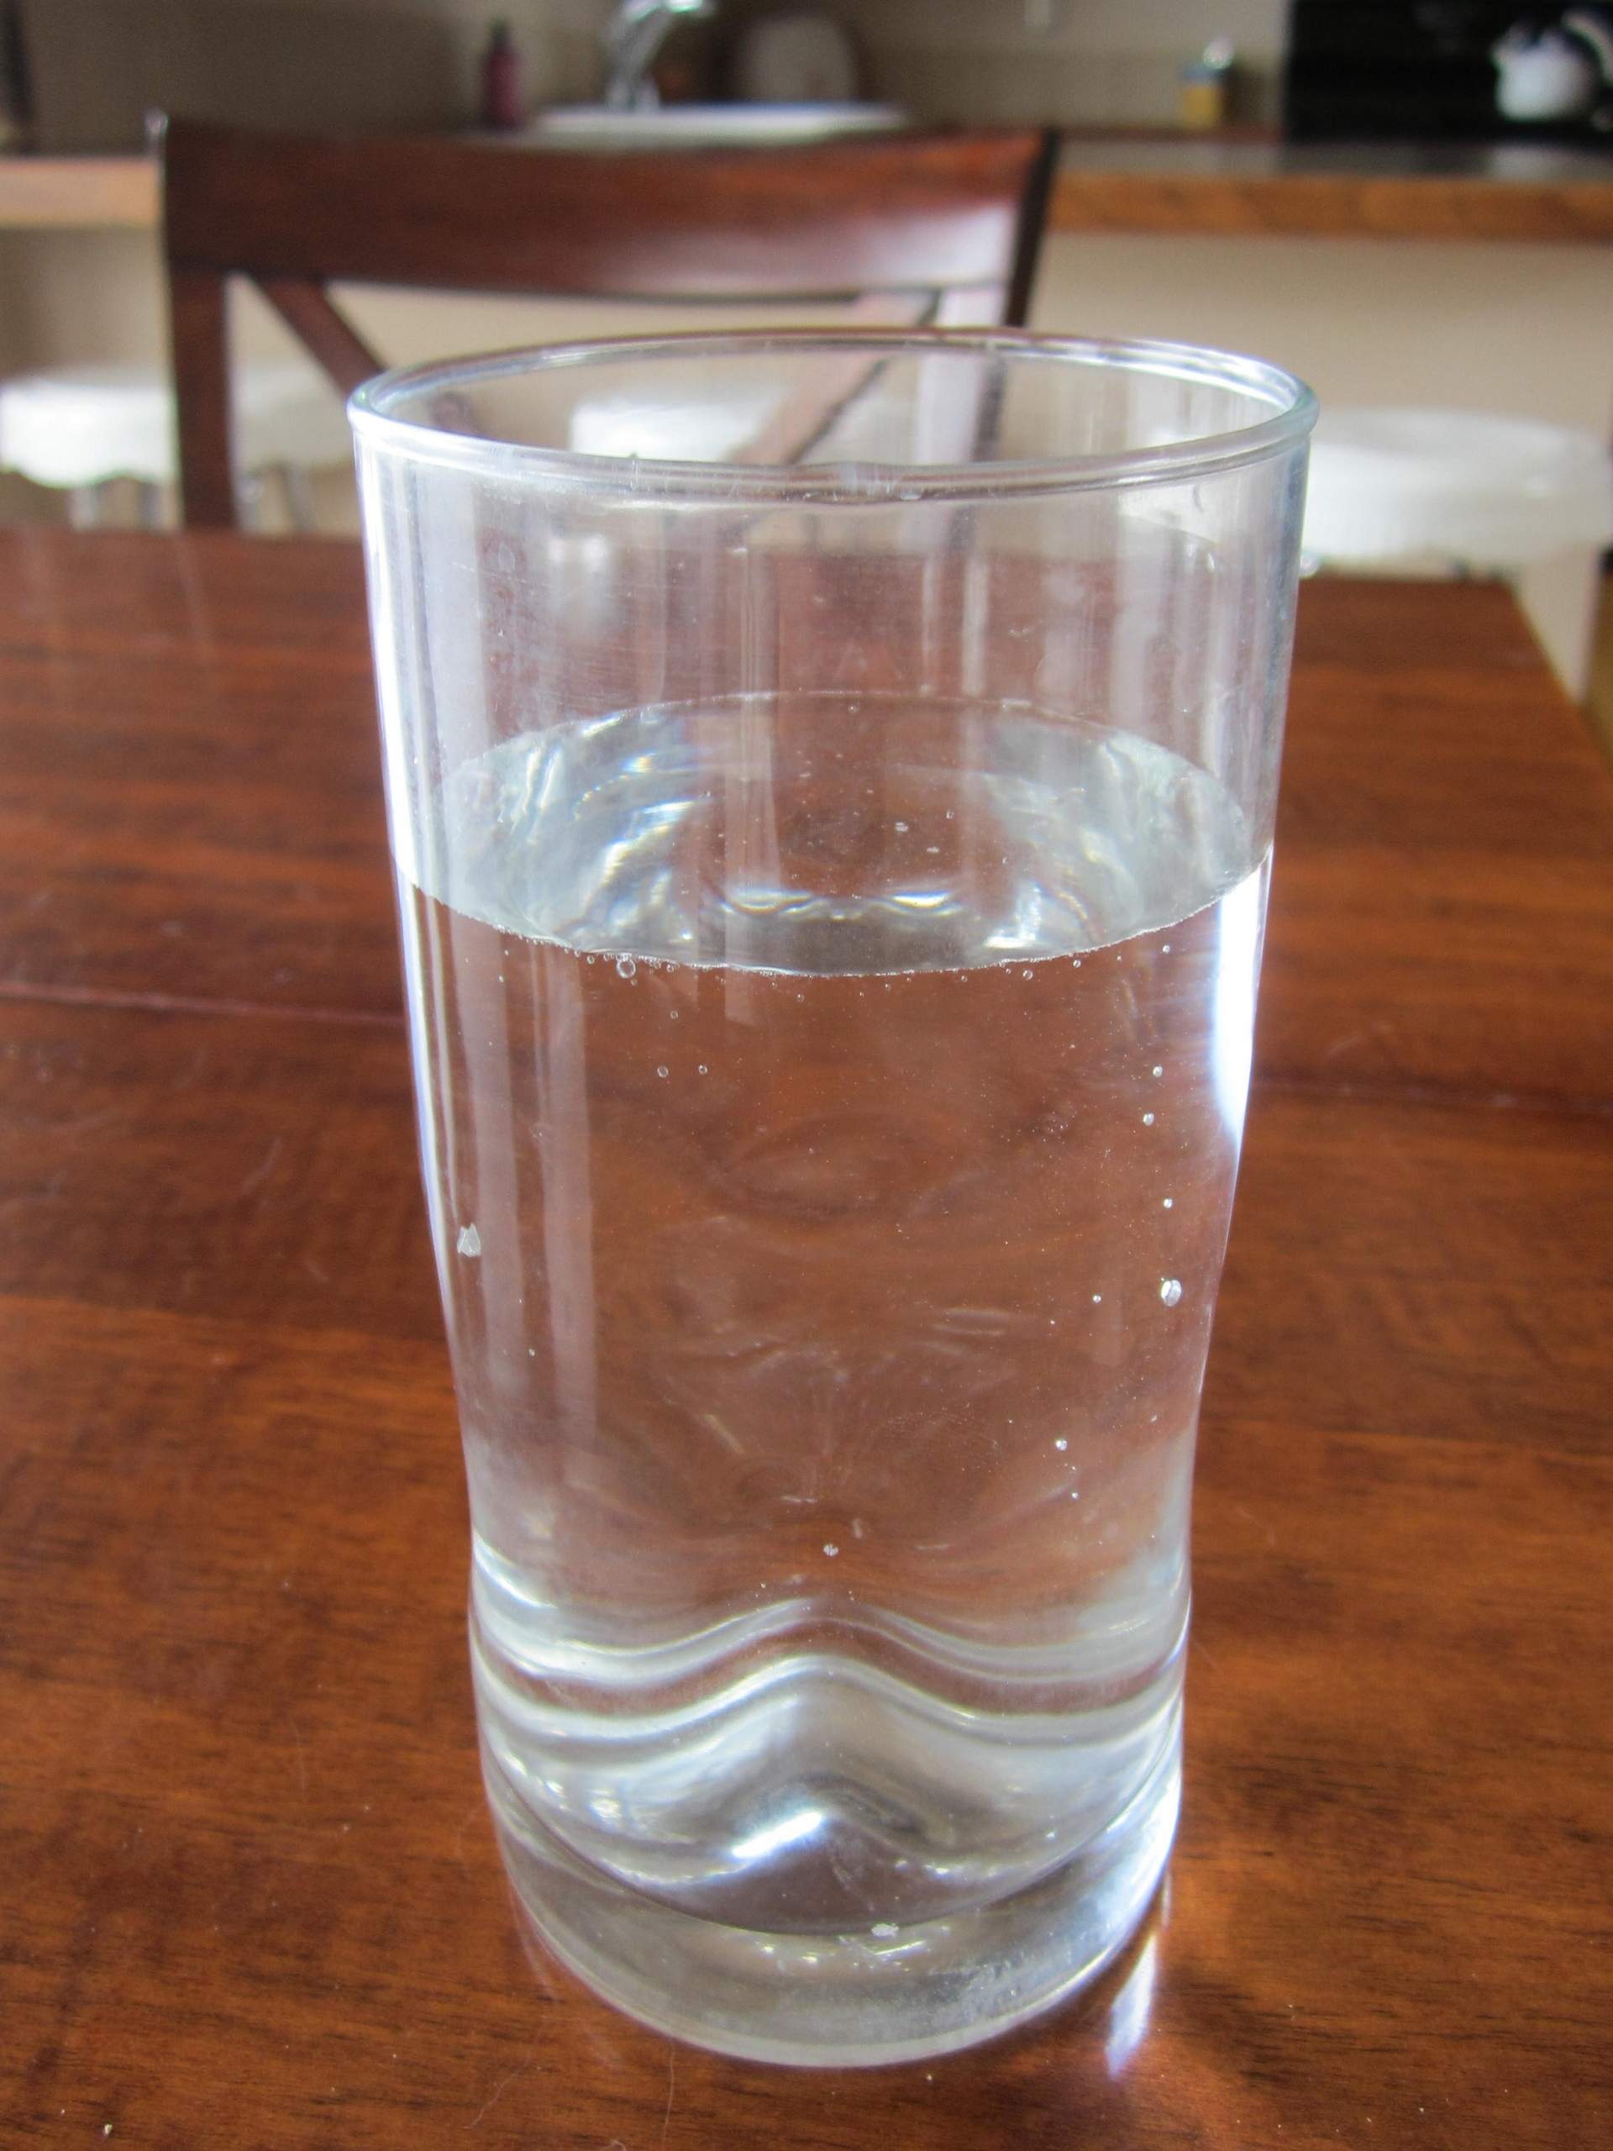
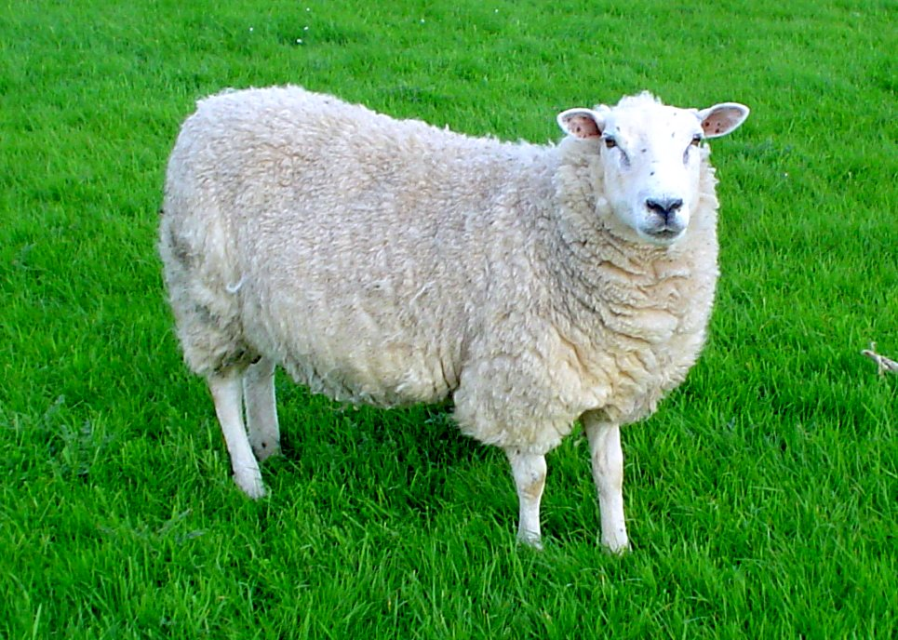
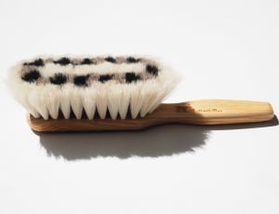
Look listen and say
Ship
Shirt
Sun
Brush
Glass
Sheep

Slide 8
circle the sound /s/ and under line the sound /ʃ/
Ship
Shirt
Sun
Brush
Glass
Sheep

Slide 9
Check your answer
/ s /
/ ʃ /
/ ʃ /
/ ʃ /
/ s /
/ ʃ /

Slide 10
Thank you so much for your active participation

