Slide 1

Welcome

Slide 2
Class-Eight
Sub-Eng 2nd
Time-50m

Slide 3
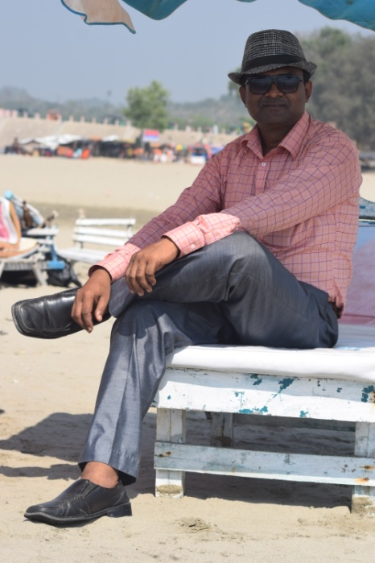
Presented by
Solaiman
English teacher
Kapasia Horimonjury pilot Girls’ High School
Kapasia Gazipur.

Slide 4
Look at the following pictures

Slide 5

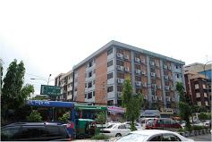




Slide 6
Which parts of speeches are they?

Slide 7
T0day’s lesson
Noun

Slide 8
Learning outcomes
After the lesson they will able to-
1.Define noun
2.Describe noun
3.Identify noun

Slide 9
Presentation

Slide 10
Definition:Noun means person, thing,place,idea,quality and action.
Mojib was a great leader.(person)

Slide 11
2.This is our natinal flag.(thing)

Slide 12
3.Dhaka is a big city.(place)

Slide 14

4.Love is devine/Heaven (Idea)

Slide 15
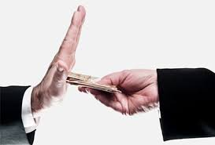
5.Honesty is a noble virtue.(Quality)

Slide 16

6.Swimming is good for health.(Action)

Slide 17
Pair work

Slide 18
Identify the types of the following nouns--
Football is a popular game
Kindness makes a man great
We live in Bangladesh
Messy is my favorite player
Walking is a good exercise
Devotion to parents makes a man great

Slide 19
Answers
Thing
Quality
Place
Person
Action
Idea

Slide 20
Evaluation
What type of nouns are the following---
Tiger
The moon
Purity
Wisdom
Kapasia
Affection

Slide 21
Homework
Write six names that indicate the definition of noun.

Slide 22
Thanks a lot

