Slide 2
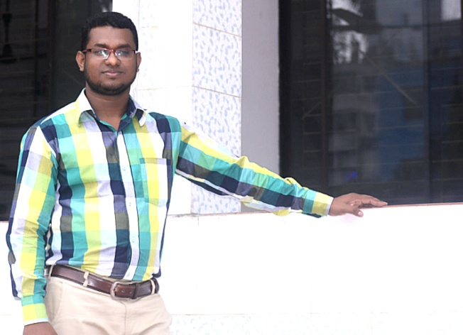
Md. Saiful Islam Lecturer (English) Chatkhil Kamil Madrasah

Slide 3
Class Introduction
Class: Alim/HSC 1st & 2nd Year
Subject: English 2nd Paper
Topic: Preposition
Question No: 02
Marks: 0.5*10=5

Slide 4
Shortcut Rules
For Exercise-1
For Exercise-2
Prerequisite for - c~e© kZ©
Of - i/Gi
Without - Qvov
In the age of - hy‡M
By/run by - Øviv/w`‡q/KZ…K
Result of - ‡Kvb wKQzi djvdj
Fight against - ‡Kvb wKQzi weiæ‡× jovB Kiv
To + Base form of Verb
Need of - `iKvi/cÖ‡qvRb
Essential for - `iKvi/cÖ‡qvRb
Condition of - ‡Kvb wKQzi Ae¯’v
Attribute to - Av‡ivc Kiv
Inaccessibility to - AÿgZv
Result of - djvdj
Knowledge of - Ávb
How to - wKfv‡e

Slide 5
Exercise -1
Fill in the gaps with appropriate prepositions.
for
Education is a prerequisite (a) ….. social progress and development (b) … a nation. No nation can stand upright (c) ………. education. Now, we are living (d) … the age (e) … science. Our everyday life is being run (f) … science. We cannot do even a single day without the blessing of science. All the wonders of science including computer, TV and radio are the result (g) … education. Education is a weapon (h) … fight (i) ……….. all vices. We cannot think of a good nation (j) …….… education.
of
without
in
of
by
of
to
against
without

Slide 6
Exercise -2
Fill in the gaps with appropriate prepositions.
of
Education is one of the basic needs (a) .… a human being and is essential (b) …. any kind of development. The poor socio-economic condition (c) .…Bangladesh can be largely attributed (d) … most people’s inaccessibility (e) ...… education. Many illiterate people don’t have any knowledge (f) .…health, sanitation and population control. If they were educated, they could live a healthy and planned life. Education teaches us how (g) … earn well and how (h) … spend well. It enables us to make the right choices (i) … life and (j) …. perform our duties properly.
for
of
to
to
of
to
to
of
to

