Slide 1
WELCOME TO EVERYBODY

Slide 2
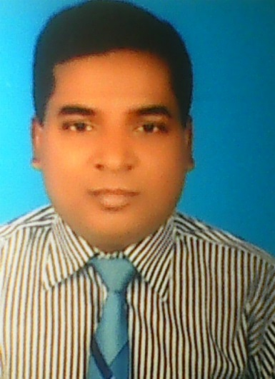
Introduction
AMERANDRA NATH BISWAS
Assistant Teacher
Kumar khali govt. secendary girls school
Kumar khali, kushtia
Mobile: 01716189410
E-mail: omorendrags72@gmail.com
Lesson - 23
Page no- 71
Time- 50 minutes
Date- 18/10/2020

Slide 3
Learning outcomes
After completing the lesson students will be able to
Read and understand texts
Write short paragraphs

Slide 4
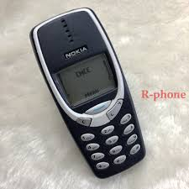
See the picture and say

Slide 5
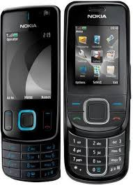
See the picture and say

Slide 6
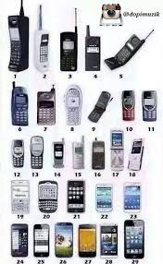
See the picture and say

Slide 7
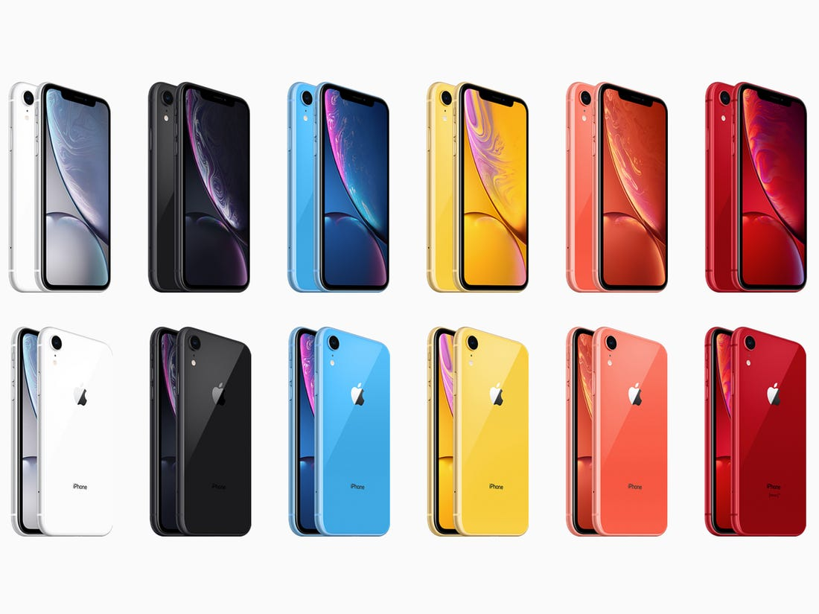
See the picture and say

Slide 8
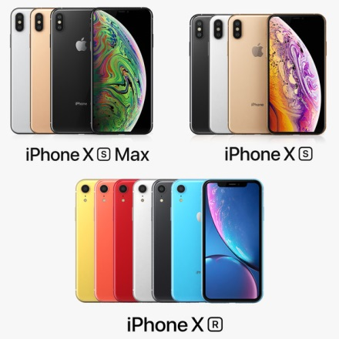
See the picture and say

Slide 9
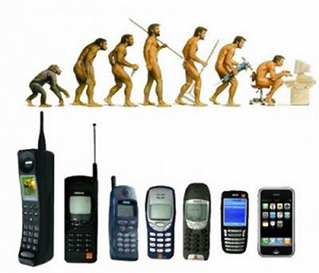
See the picture and say

Slide 10
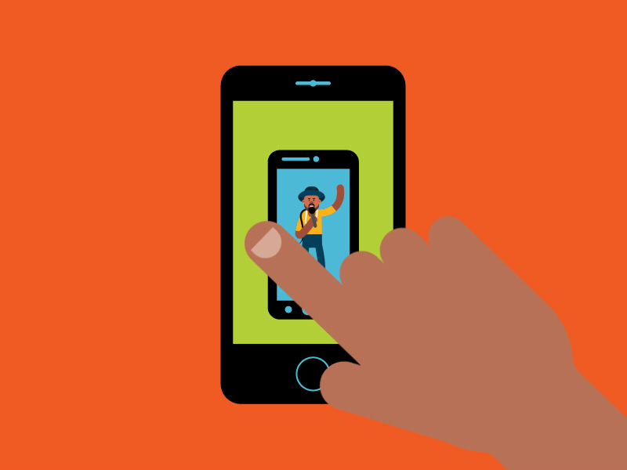
SMART PHONE

Slide 11
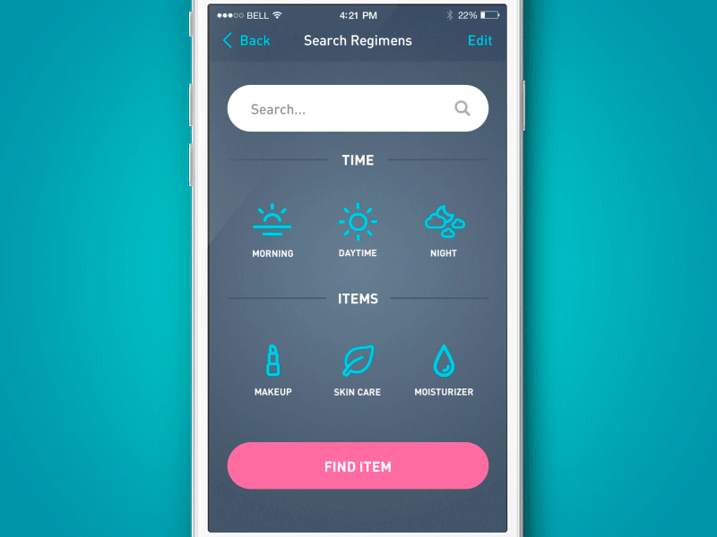
SMART PHONE

Slide 12
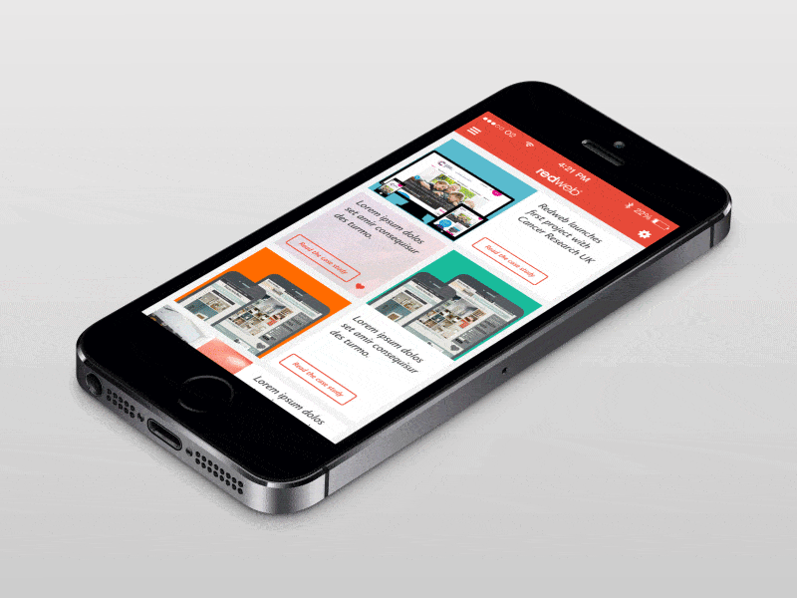
SMART PHONE

Slide 13
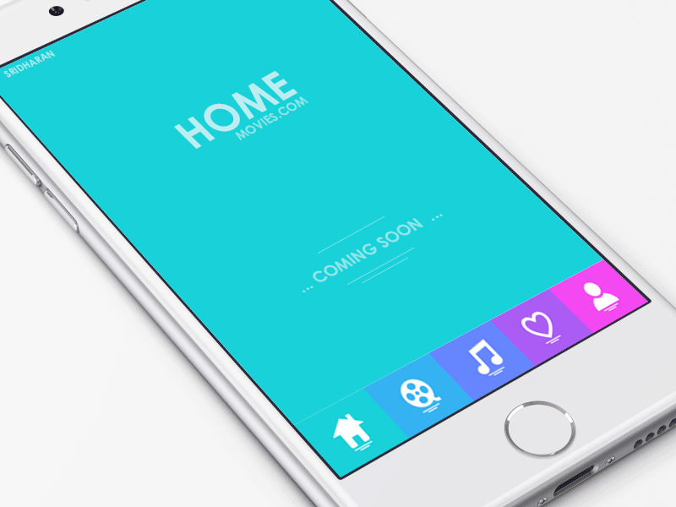
Today’s Lesson
MOBILE PHONE

Slide 14
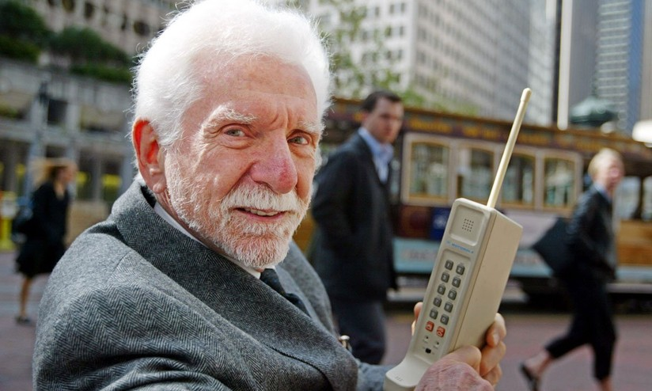
Dr. Martin Cooper

Slide 15
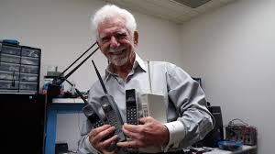
Dr. Martin Cooper

Slide 16
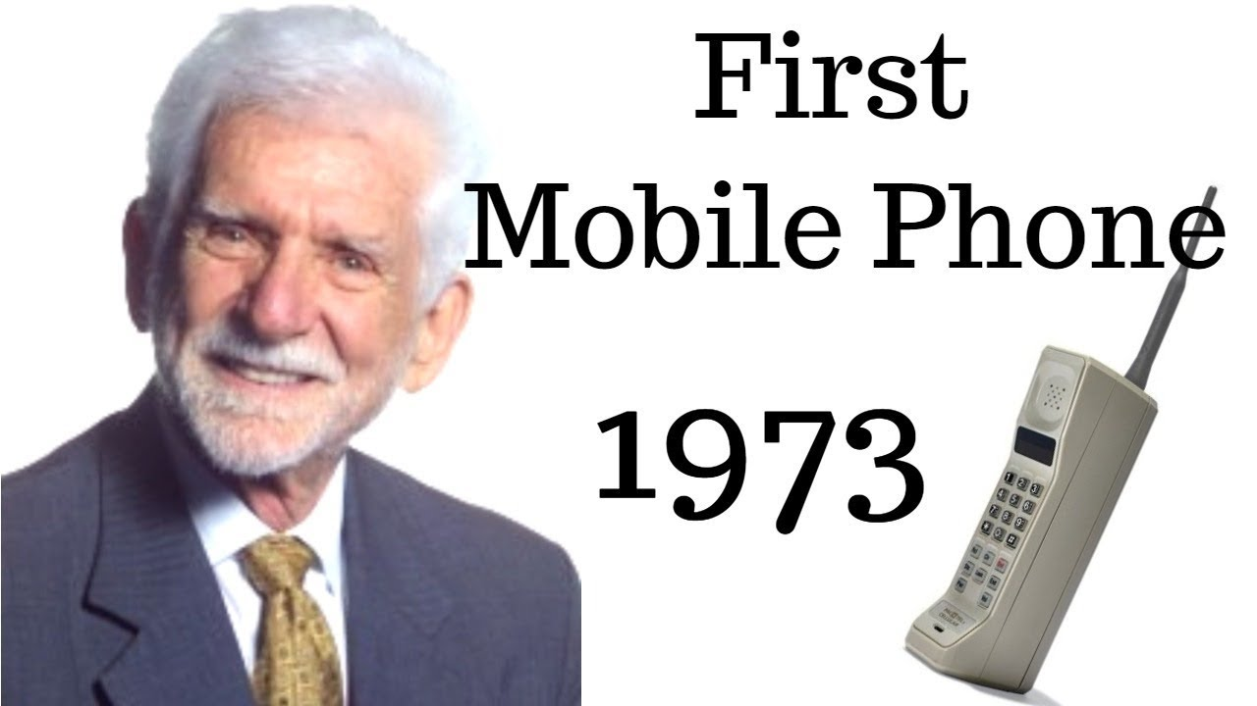
Dr. Martin Cooper

Slide 17
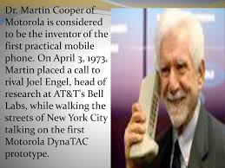
He is the father of Mobile Phone

Slide 18
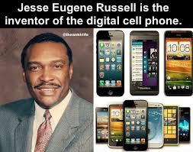
JESSE EUHENE RUSSEL

Slide 19
Reading Texts: Mobile phone is another useful invention of the world. Like computers mobile phones help us greatly in our daily life. Through mobiles we can connect the whole world. Only a few years ago we had difficulty to contact our near and dear ones. That was very costly too.Mobile phones are very handy and we can use them for communication with people at a very low cost. Mobile phones have different functions such as making calls, listening to music, taking photographs, storing information, etc. Even it can be used for distance learning.

Slide 20
Vocabulary:
Greatly-ব্যাপকভাবে
Connect- সংযোগ
A few- সামান্য
Contact-যোগাযোগ করা
Costly- ব্য্যবহুল
Handy-সুবিধাজনক
Function- নিদির্ষ্ট কাজ
Distance learning - দুরশিক্ষণ
Invention- আবিস্কার
World- পৃথিবী
Whole- সমগ্র
Difficulty- কঠিনভাবে
Communication- যোগাযোগ
Even- এমনকি

Slide 21
Pronunciation:
Greatly- adv, syn-very much, ant.- hardly
Connect- v, syn- join, engage, ant.- disconnect
A few-phr, syn- a little, ant.- many
Contact-v, syn- communicate
Costly- adv, syn.- expensive, ant.-cheaper
Handy- adj. syn- convenient, ant- unhandy
Fdunction-n, syn- operation, ant.- malfunction
Distance learning- n

Slide 22
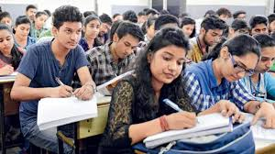
Pairs of work:
Time: 10 minutes
What is the father of Mobile phone ? Discuss its function.

Slide 23
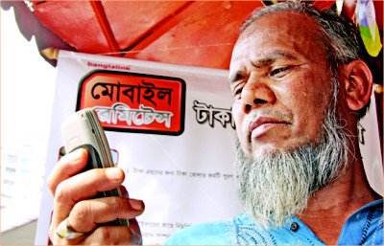
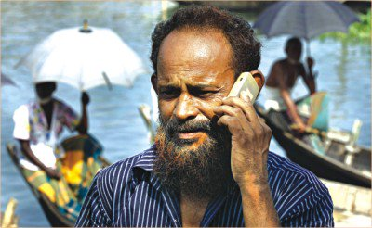
User in Mobile Phone

Slide 24
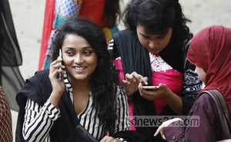
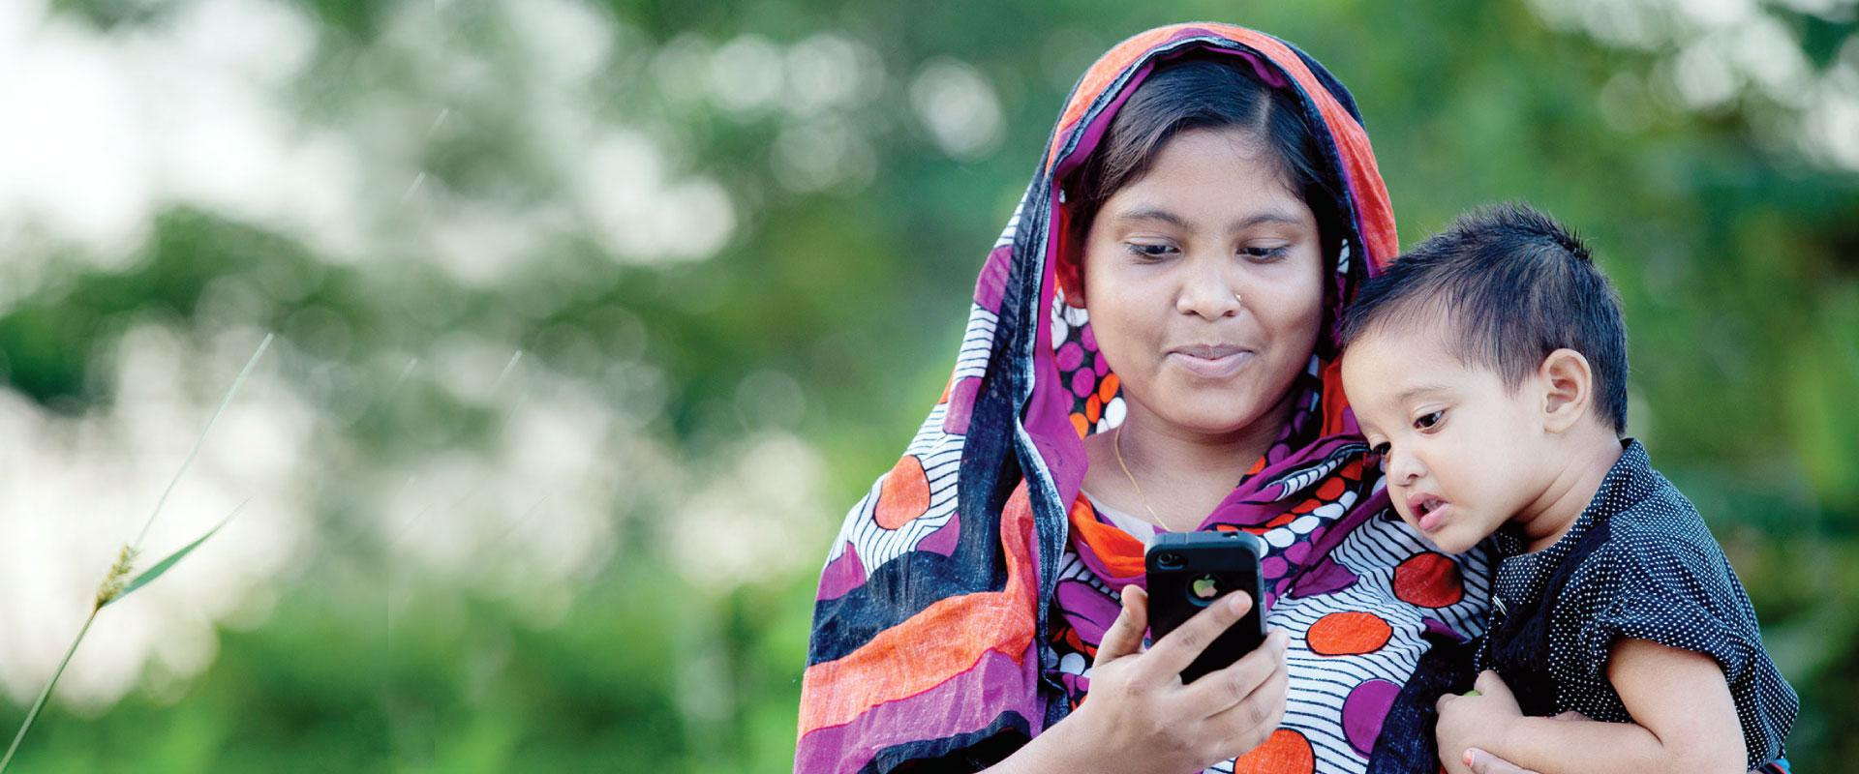
User in Mobile Phone

Slide 25
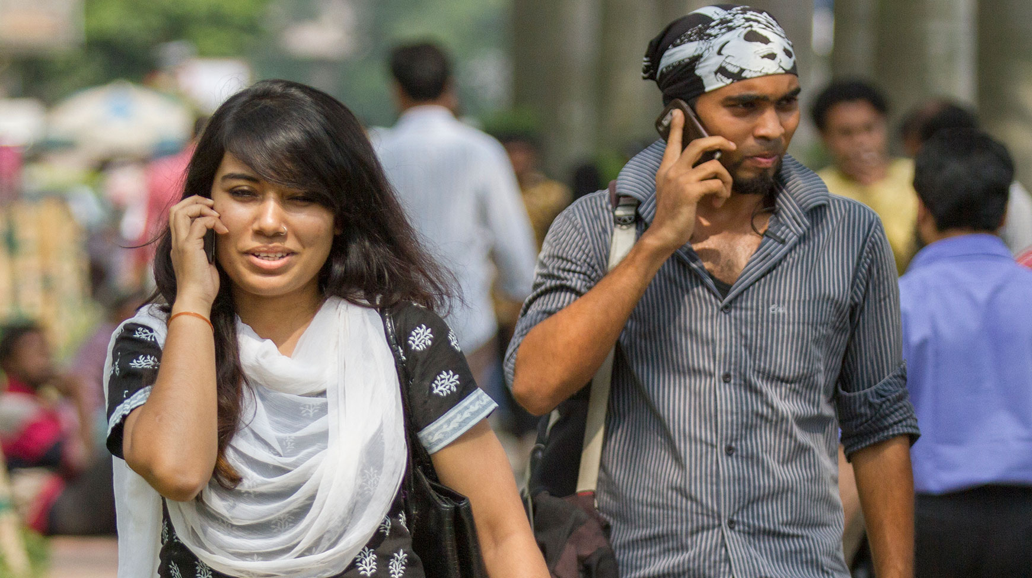
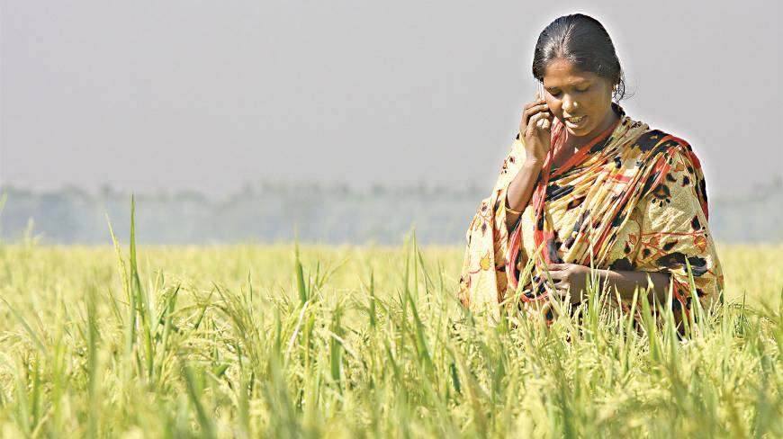
User in Mobile Phone

Slide 26
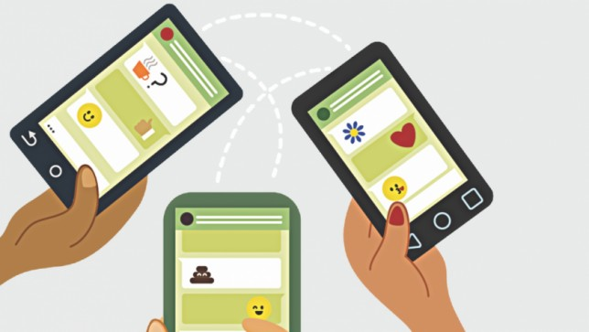
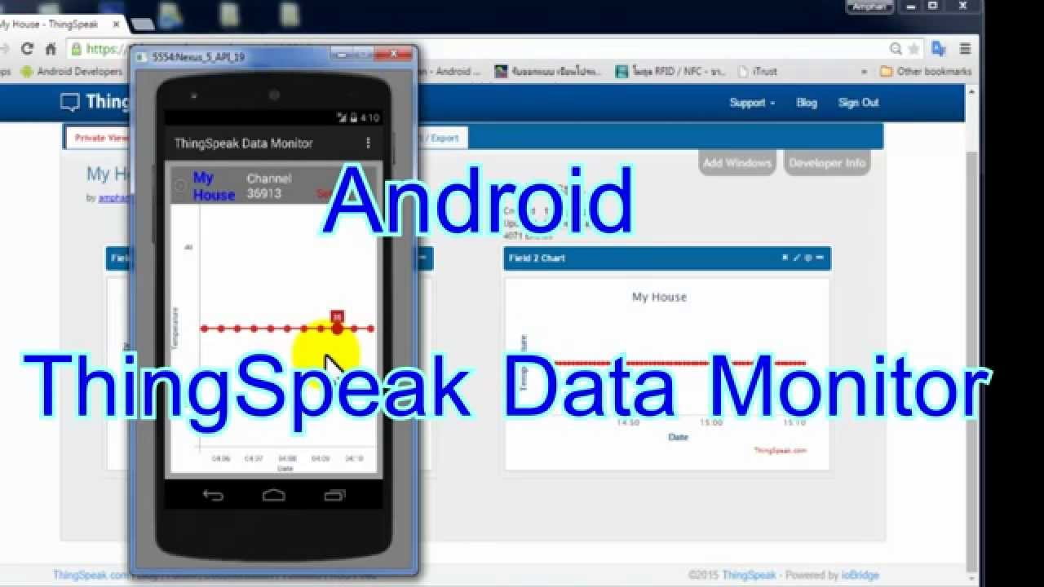
Data uses in Mobile Phone

Slide 27
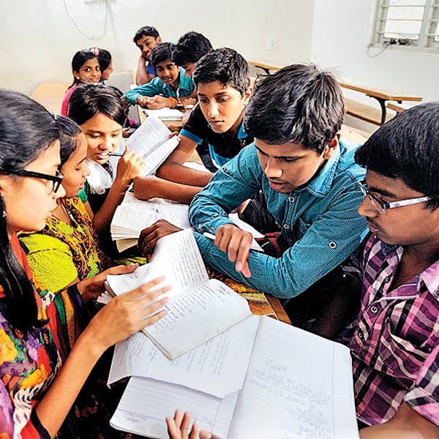
Time: 10 Minutes
Group Work
How many uses can be Mobile Phone ? Discuss.

Slide 28
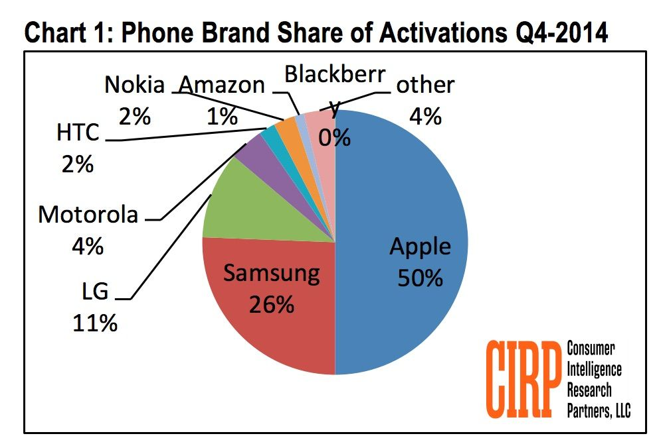
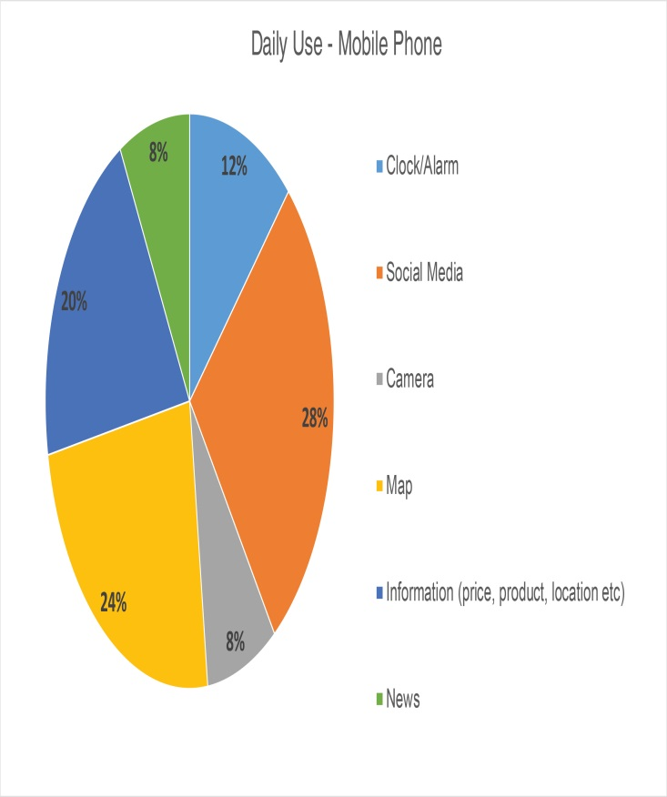
Pie chart of brand Mobile Phone

Slide 29
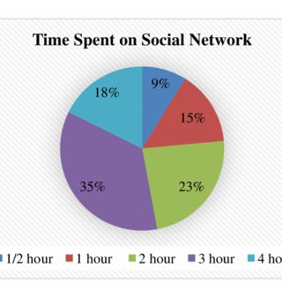
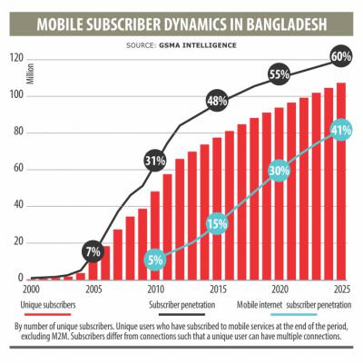
Time spent of social network
Bangladeshi subscriber

Slide 30
EVALUTION
Time: 05 Minutes
What is Mobile phone ?
What is smart phone?
Who is the father of Mobile Phone ?
Name the 3 items of uses in Mobile Phone ?
What is the functions of Mobile Phone ?

Slide 31
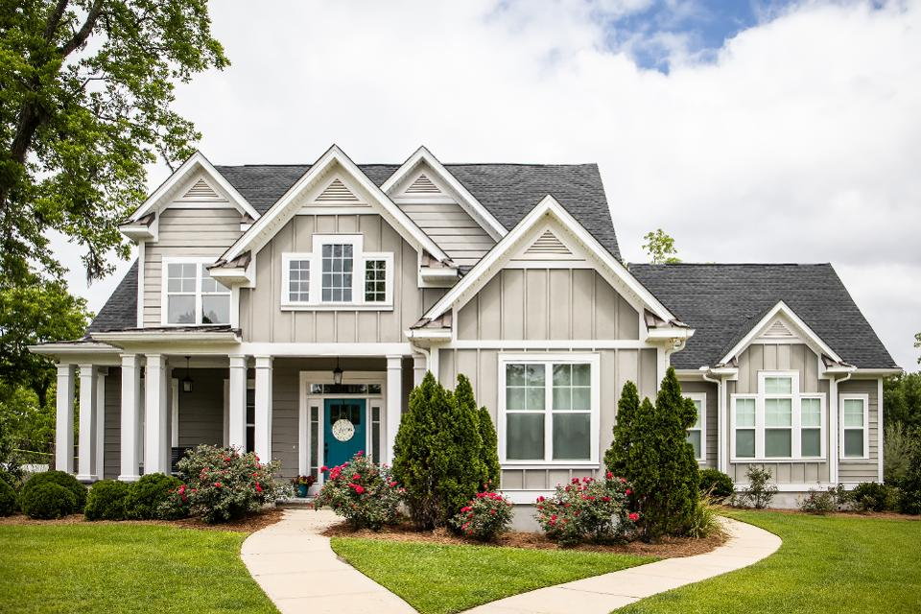
HOME WORK
Name the one item of electronic machine which is use of Mobile Phone- discuss.

Slide 32
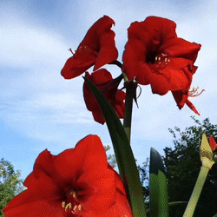
THANKS ALL

