Slide 1
WELCOME

Slide 2
TEACHER’S IDENTITY
MD. REZAUL KARIM
LECTURER
DEPT. OF ENGLISH
MULFATGANJ A.J FAZIL MADRASAH
NARIA,SHARIATPUR

Slide 3
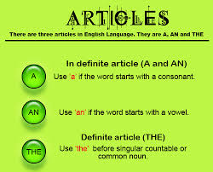
LESSON’S IDENTITY
USE OF ARTICLE

Slide 4
LEARNING OUTCOME
YOU CAN DISCUSS ABOUT ARTICLE.
YOU CAN DESCRIBE ABOUT THE SIGNIFICANCE OF ARTICLE.
YOU CAN LEARN ABOUT THE USE OF ARTICLE.

Slide 5
LESSON’S FOCUS POINT
DEFINITION
CLASSIFICATION
USE OF INDEFINITE ARTICLES
USE OF DEFINITE ARTICLE

Slide 6
VALUATION
FILLING IN THE GAPS
CORRECTION

Slide 7
HOMEWORK
FILLING IN THE GAPS
CORRECT THE SENTENCE BY USING ARTICLE.
IMPPPORTANCE OF ARTICLE IN THE SENTENCE.

Slide 8
THANKS ALL

