Slide 1
WELCOME

Slide 2
Identity
Class: 9-10
Sub: English 1st Paper
Time: 1 hour
Date: 21-10-2020
S.M.MOZAMMEL KABIR (TOTOL)
Asst. Head Master
Bhawal Baria Union High School,Gazipur Sadar
Mobile: 01770633593 Email:- tmcsltd777@gmail.com

Slide 3
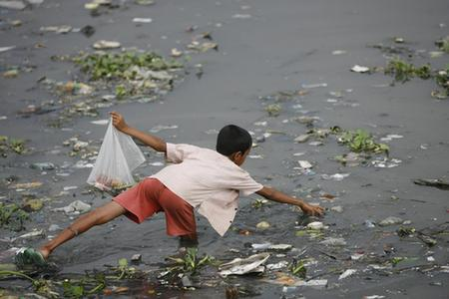
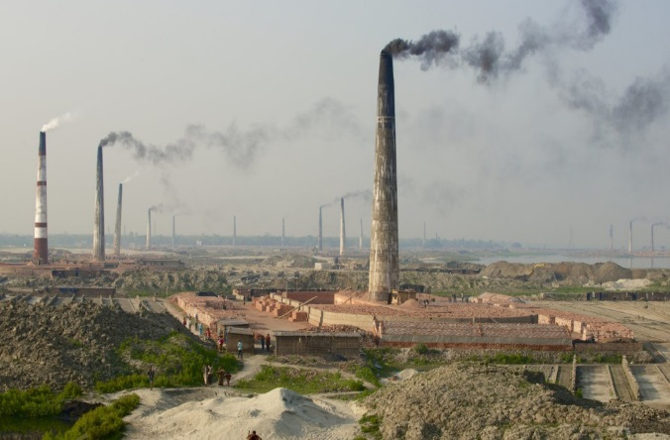
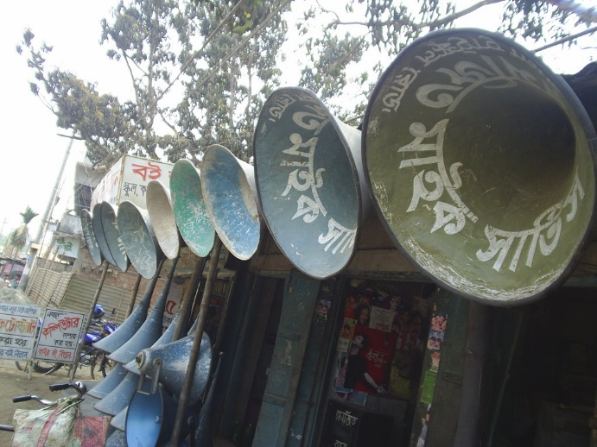
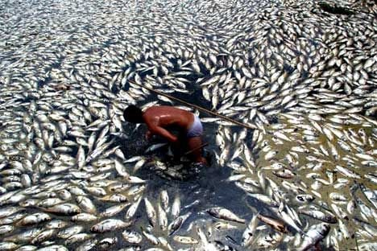
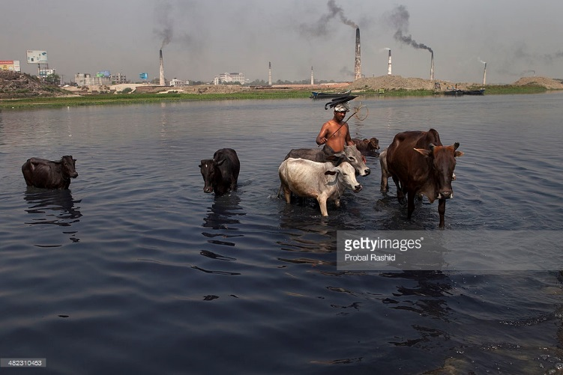
are environment pollution
These

Slide 4
Learning outcomes
They will be able to identify-
the cause of environment pollution
the kinds of environment pollution
the effect of environment pollution
how to servive from this situation

Slide 5
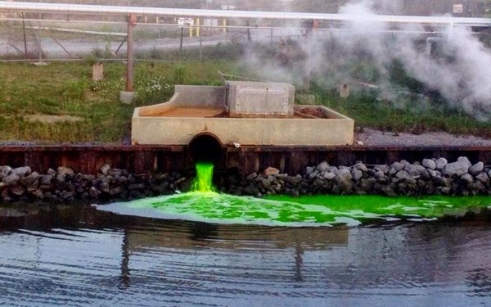
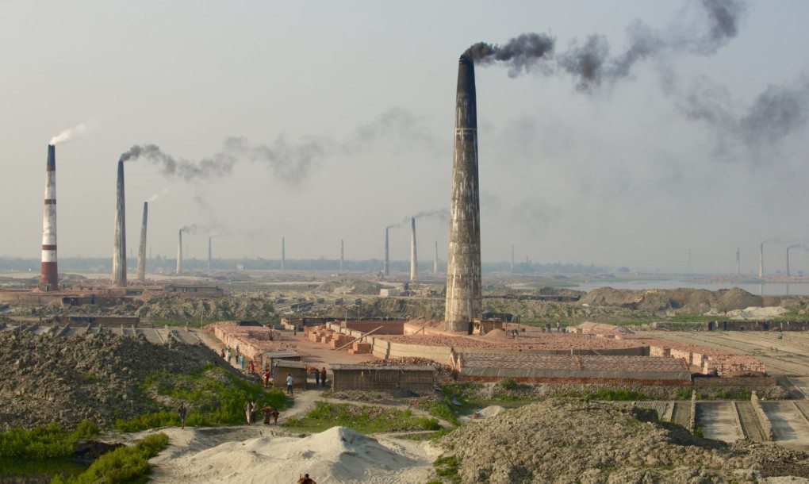
The indiscriminate industrialization process is making air pollution.

Slide 6
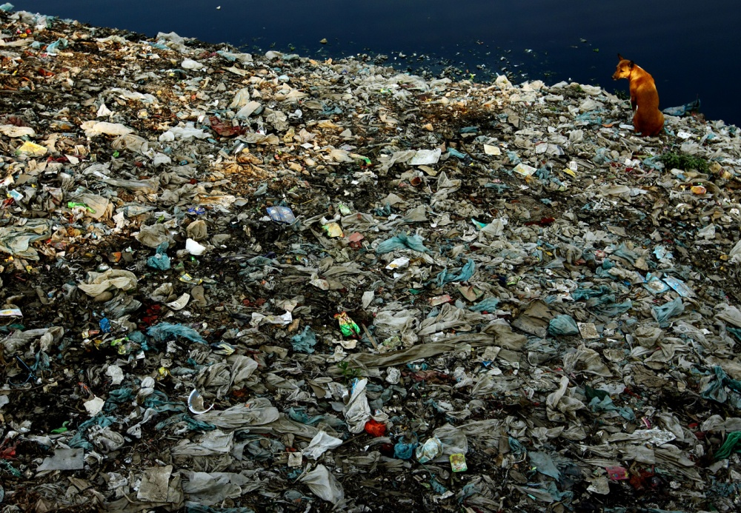
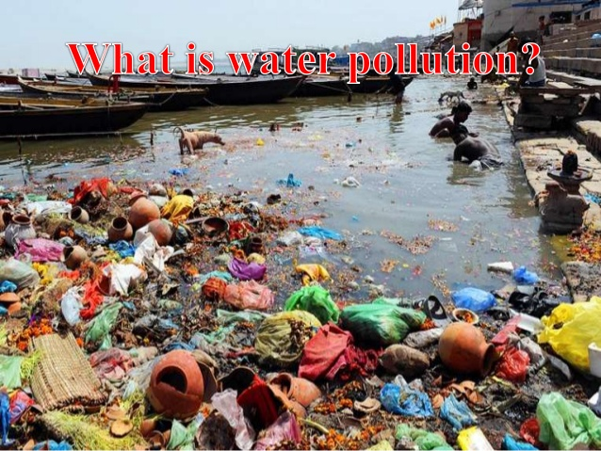
Soil pollution and water pollution are increasing day by day

Slide 7
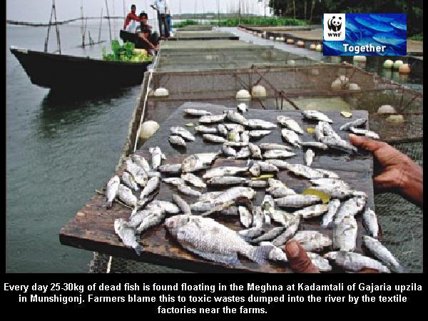
FFihhjugff
Fish pollution

Slide 8
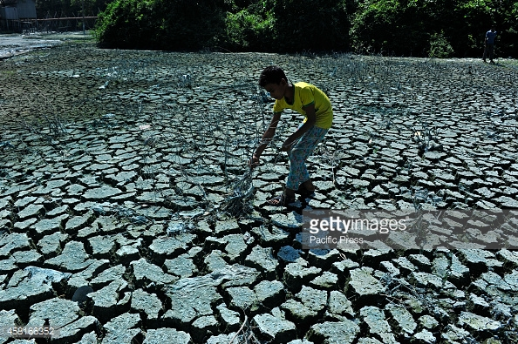
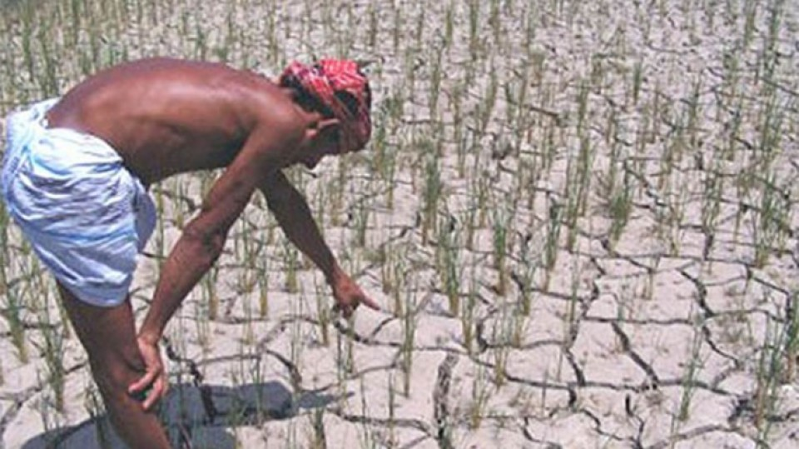
Soil Pollution

Slide 9
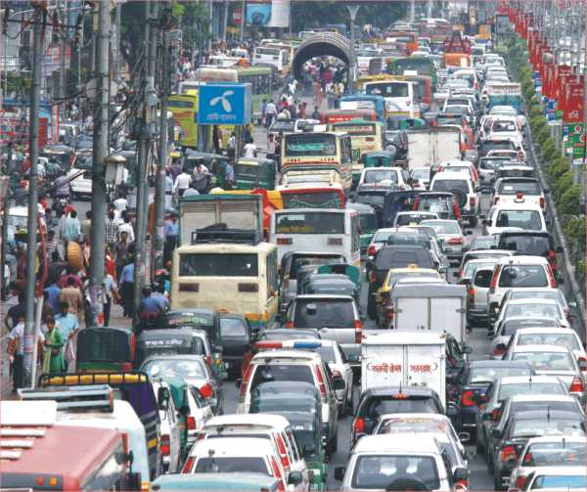
Sound pollution

Slide 10
Group work
Identify the main sources of environment pollution.

Slide 11
Evaluation
How many kinds of environment pollution?
How is it possible to minimise environment pollution?
Which of those sources are most treating?

Slide 12
Answers
Five kinds. Water,air,fish,soil,sound.
By planting trees and reforestation.
By throughing industrial andHousehold waste in right places.
By avoiding the use of vehicles older than 20 years.
Household waste in right places.
Using compost and natural fertilizers.
Brick kilns, can, polythine shopping bag,greenhouse effect, deforestation, chemical fertilizers

Slide 13
Home work
Make a slogan for poster to stop environment pollution

Slide 14
Make yourself as a concious citizen
Particularly as a man.
Thanks a lot

