Slide 1
WELCOME

Slide 2
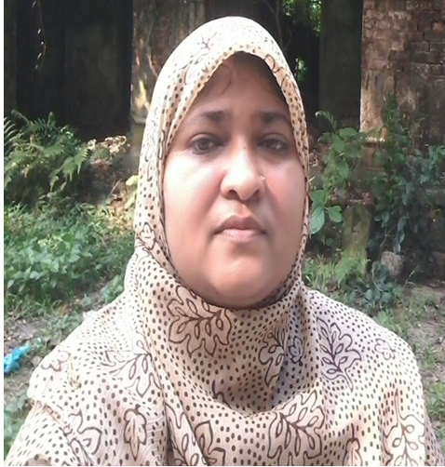
Teacher’s Introduction
Zannaton Nahar
Head Teacher
Teknogopara Govt. Primary School
Gazipur citycorporation, Gazipur.
Mobile-01768031223
Mail-zannatonnahar@gmail.com

Slide 3
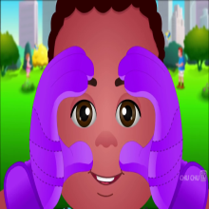
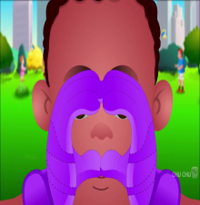
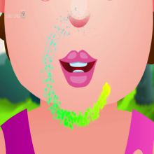
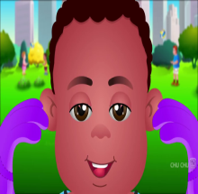
Sub:English Class:Two
Unit :2
Lesson:4-6
Title:Parts of the body .

Slide 4
Learning outcomes:
Student will be able to –
1.1.1become familiar with English sound by listening to common English word.
1.1.2Say simple words phase with proper sound and tress
1.3.1 Recognize and read the name object having the final sound .
3.1.2 Write words and phrase using non-cursive small letters.

Slide 5
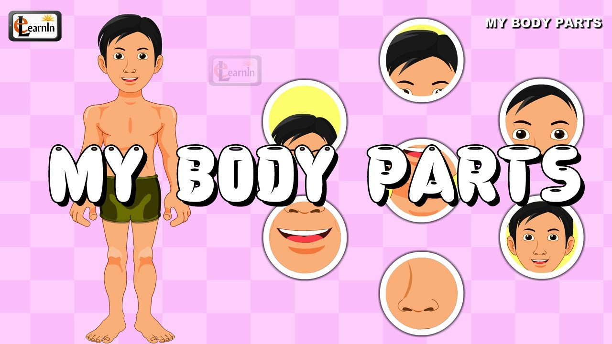
Lesson declaration

Slide 6
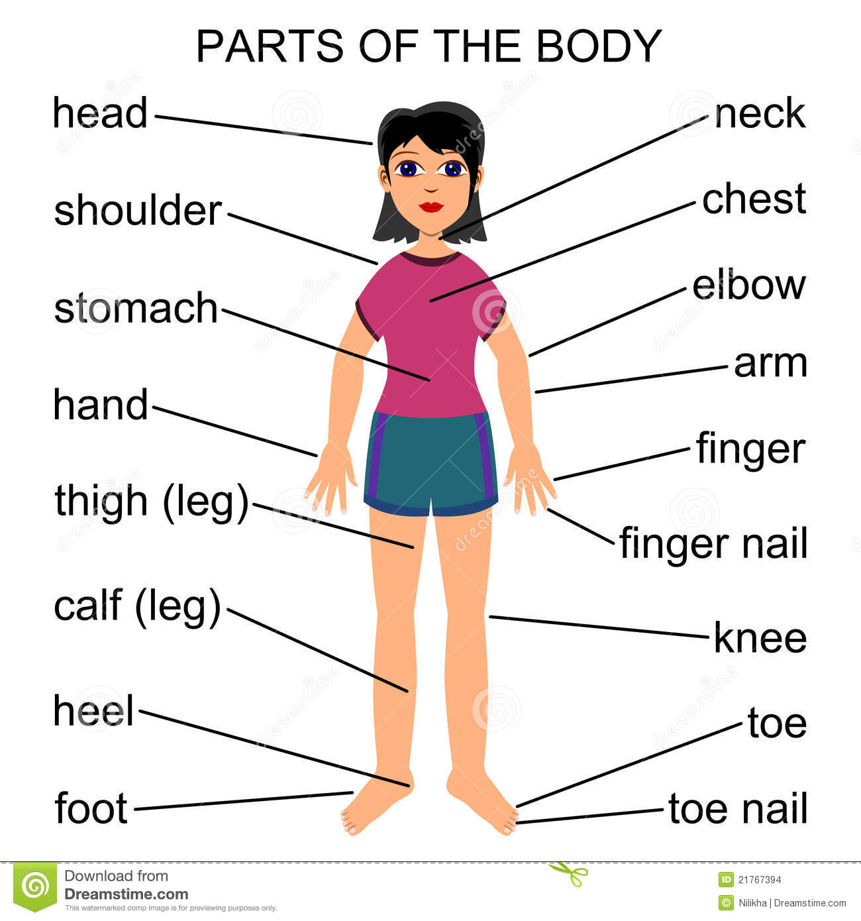

Slide 7
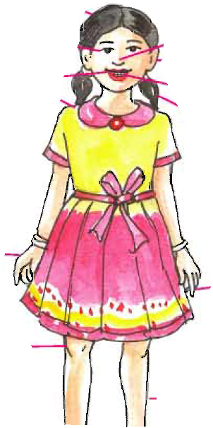
Parts of the body
Head
Ear
Hair
Eye
Nose
Mouth
Teeth
F
Hand
Finger
Leg

Slide 8
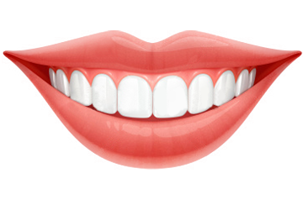
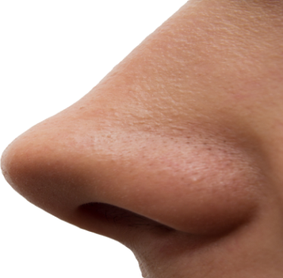
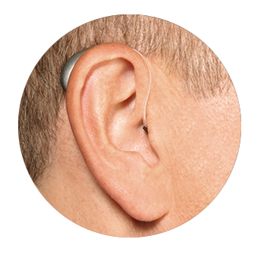
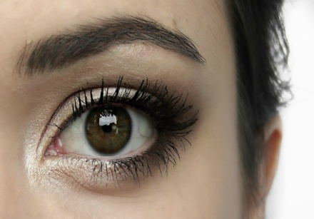
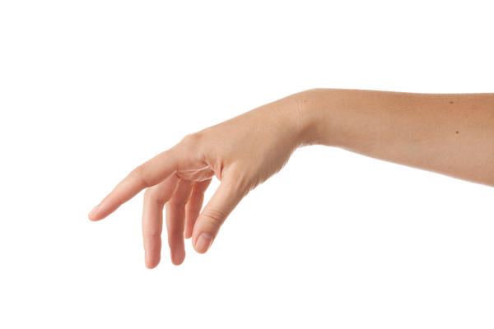
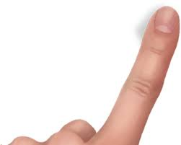
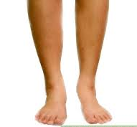
Parts of the body
Head
Hair
Mouth
Teeth
Nose
Ear
Eye
Hand
Finger
Leg

Slide 9
Head
Hair
Mouth
Teeth

Slide 10
Ear
Nose
Eye

Slide 11
Hand
Finger
Leg

Slide 12
Teacher’s reading
Open page no.-
Follow the teacher

Slide 13
Group work
Set of distribution card

Slide 14
Pair work :
Students will ask question each other to show different parts of the body.

Slide 15
Evaluation:
Showing different parts of the body –
1.What is this?

Slide 16
Home work
Write the name of the parts of the body .

Slide 17
Thanks to all

