Slide 1
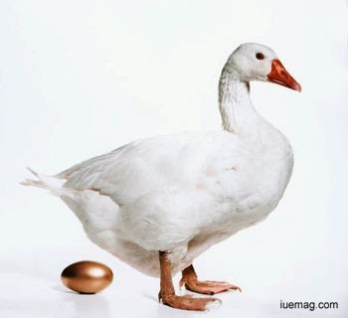
WELCOME

Slide 2
Introduction of the teacher
Md Abdul Kader
Assistant Teacher
Rustompur Govt. Primary School
Faridgonj, Chandpur
Email: abdulkdr81@gmail.com
Mobile No- 01732225593

Slide 3
Introduction of the lesson
Class: Two
Unit: 29
Page: 59
Lesson: 4-8
Lesson Title: The golden goose.
Today’s Lesson: Listen and say ( 1st para)
Total Time: 35 minutes

Slide 4
Learning outcomes
Student will be able to-
Listening:
1.1.1 – become familiar with English sounds by listiening to common English words.
4.2.1- enjoy simple stories.
Speaking:
1.1.1- repeat after the teacher simple words and phrases with proper sounds and stories.
1.1.2- say simple words and phrases with proper sounds and stress.

Slide 5
Creating safety environment

Slide 6
Lesson Declaration
The golden goose

Slide 7
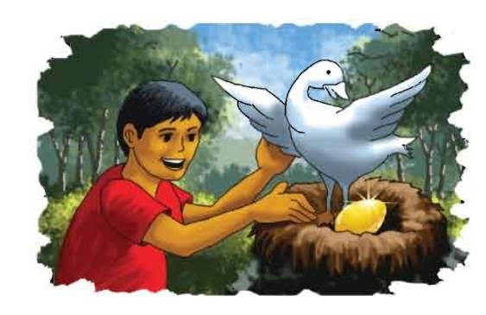
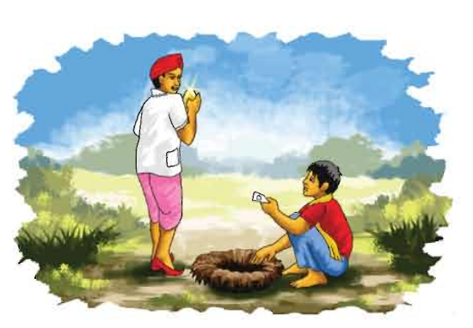
What do you see in these picture?
হাঁসটি একটি স্বর্নের ডিম পাড়লো এবং লোকটি ডিমটি নিল।
লোকটি স্বর্নের ডিমটি বিক্রয় করলো এবং টাকা হাতে নিল।

Slide 8
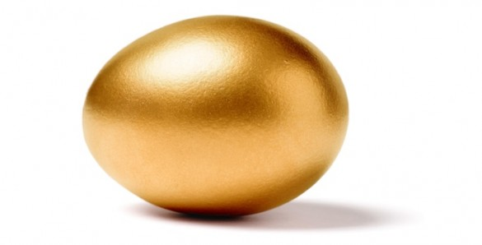
What do you see in these picture?
Golden egg
A Goose and an egg

Slide 9
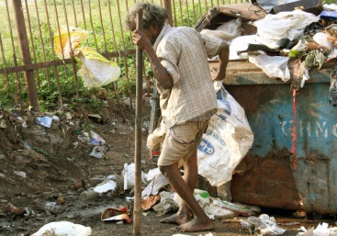
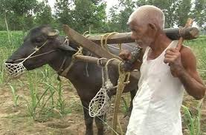
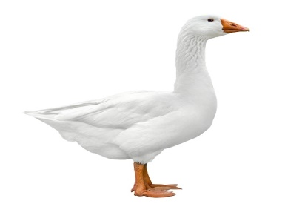
poor
গরীব
farmer
কৃষক
রাজহাঁস
goose
Golden egg
স্বর্নের ডিম

Slide 10
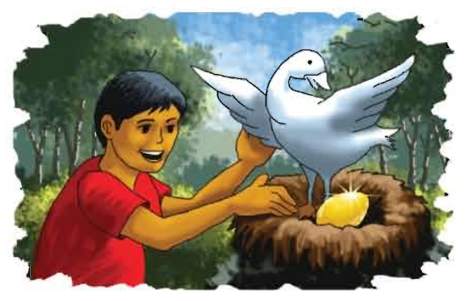
The golden goose
Teacher’s loud reading
A poor farmer has a goose. Everyday, goose lays an egg. It’s a golden egg.
Everyday, the farmer sells the egg.

Slide 11
Say after me
A poor farmer has a goose. Everyday, goose lays an egg. It’s a golden egg. Everyday, the farmer sells the egg.
P
R
A
C
T
I
C
E

Slide 12
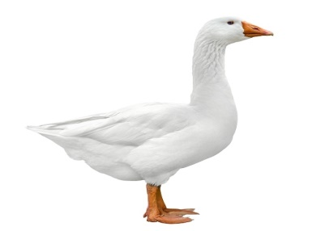
Match words with picture
poor
farmer
goose
golden egg
P
R
A
C
T
I
C
E

Slide 13
This is a goose.
What is this ?
T
A
S
k
What is this?
This is a golden egg.
What do you see in this picture?
This is a poor man.
This is a farmer.
What do you see in this picture

Slide 14
Thanks

