Slide 1
WELCOME

Slide 2
Identification
Teacher Identification.
Md. Rabiul Hasan
Asst. Teacher in English
Shaharpar Gausul Azam Dakhil
Madrasah.
Debidwar, Cumilla

Slide 3
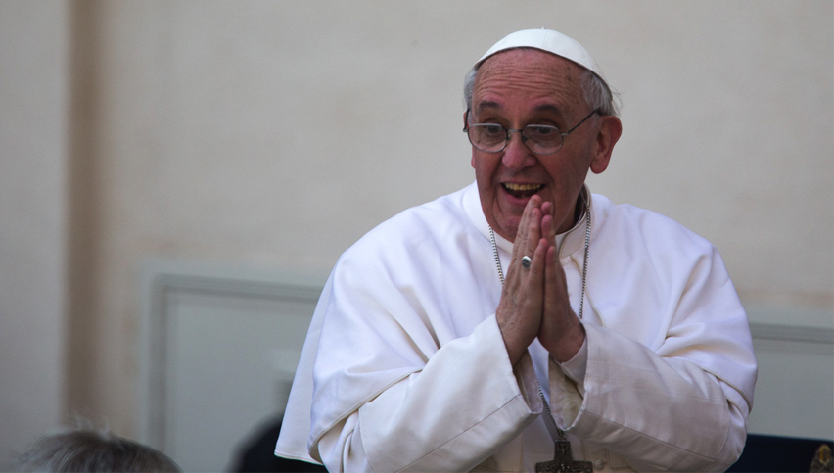
Look at the picture

Slide 4
Look at the sentences below.
1.Sakib is going to School.
2.Are they going to School?
3.What a slim Mim is!
4.May you be happy .
5.Go to School at once.
Notes:
How many sentences are there? What is the name of these sentence?What is sentence and its classification?

Slide 5
Today’s Lesson is-
Transformation of Sentences

Slide 6
How to convert a sentence from affirmative to negative.
None but( for person)
Nothing but( for things)Not more than/Not less than( for Number/Age)
Only/alone
Replaced by
Affirmative: Only Allah can help us.
Negative: None but Allah can help us.

Slide 7
Can not but/Can not help(V+ing)
Must
Replaced by
Affirmative: We must obey our teacher.
Negative: We cannot help obeying our teacher.

Slide 8
Not only……but also
Both…………and
Replaced by
Affirmative: Both Hira and Saimun were present.
Negative: Not only Hira but also Saimun were present.

Slide 9
No sooner had+ sub+v3….than
As soon as
Replaced by
Affirmative: As soon as the man saw the police he ran away.
Negative: No sooner had the man seen the police than he ran away.

Slide 10
No other+ object verb+so+positive form+as+sub.
sub+verb+the+ superlative form+ object
Replaced by
Affirmative: Dhaka is the biggest city in Bangladesh.
Negative: No other city in Bangladesh is as good as Dhaka.

Slide 11
Always
Never + opposite word
Replaced by
Affirmative: Rony always attends the class.
Negative: Rony never misses the class.

Slide 12
Every যুক্ত
There is no+ every এর পরের word+but+rest part
Replaced by
Affirmative: Every mother loves her child.
Negative: There is no mother but loves her child.

Slide 13
If we don’t find any clues
বিপরীত শব্দ বসিয়ে এবং ঐ বাক্যটি negative করে
Replaced by
Affirmative: I shall remember you.
Negative: I shall not forget you.

Slide 14
As……..as
Not less……than
Replaced by
Affirmative: Shimi is as wise as Rimi.
Negative:Shimi is notless wise than Rimi.

Slide 15
Too……….to
So……..that+ sub+can /could not+verb
Replaced by
Affirmative: He is too weak to walk.
Negative:He is so weak that he can not walk.

Slide 16
Universal truths are
making them negative and interrogative
Replaced by
Affirmative: The sun sets in the west.
Negative:Does not the sun set in the west?

Slide 17
Sometimes
Not always
Replaced by
Affirmative: Rahim sometimes visits me.
Negative:Rahim doesnot always visit me.

Slide 18
Many
Not a few
Replaced by
Affirmative: I have many friends.
Negative:I have not a few friends.

Slide 19
A few
Not many
Replaced by
Affirmative: Bangladesh has a few scholars.
Negative:Bangladesh has not many scholars.

Slide 20
Much
A little
Replaced by
Affirmative: He belongs much mony.
Negative:He does not belong a little money.

Slide 21
A little
Not much
Replaced by
Affirmative: Dolon has a little riches.
Negative:Dolon does not have much riches.

Slide 22
Group Work
Write five rules of changing from affirmative to negative.

Slide 23
Thank you

