Slide 1
Welcome To
Online Class

Slide 2
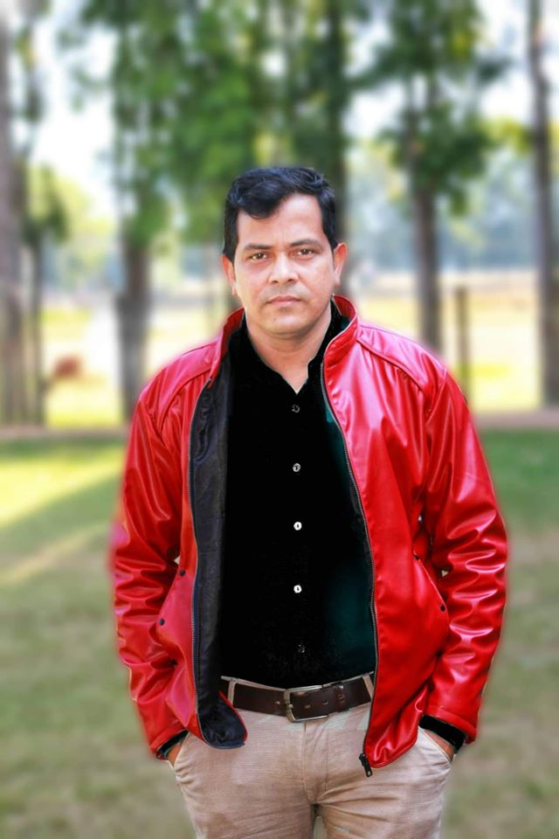
Mohammad Shahidullah
Head of the English Department
Colonel (Rtd.) Oli Ahmed
Bir Bikrom University College
Satkania, Chittagong. Contact Cell: 01819 646039
email: shahid.epa@gmail.com

Slide 3
HSC English 2nd Paper
Topic: Modifiers
Board Question – 2019
Part: 02

Slide 4
Jashore Board - 2019

Slide 5
9. Read the following text and use modifiers as directed in the blank spaces: — 0.5×10=5
Air and water are the most (a) — (pre-modify the noun with an adjective) elements of the environment. But we are polluting them (b) — (post modify the verb with an adverb). Mills and factories use fuel (c) — (post modify the verb with an infinitive) their products. The burning of this fuel creates smoke (d) — (post modify the verb with an adverbial). Motor vehicles also pollute the air, (e) — (use an appositive).
(e) a vital element of the environment
(a) important
(b) indiscriminately
(c) manufacture
to a great extent

Slide 6
Water is polluted by (f) — (pre-modify the noun with a quantifier) kinds of waste and filth. We also contaminate water (g) — (post-modify the verb with a present participle phrase) into it. Farmers use (h) — (pre-modify the noun with an adjective) fertilizers and insecticides and pollute water. (i) — (pre-modify the noun with a past participle) water is (j) — (pre-modify the adjective with an intensifier) harmful for health.
(f) many
(g) throwing toxic chemicals/dumping oils
(h) chemical
(i) Polluted /Contaminated
(j)very

Slide 7
Chattogram Board - 2019

Slide 8
9). Read the following text and use modifiers as directed in the blank spaces: — 0.5×10=5
We can't think of our existence without language. It plays a (a) — (use an intensifier) important role in our life. We use language from the time We wake up (b) — (post-modify the verb) till we go to bed at night. We use language not only in our (c) — (pre-modify the noun) hours but also in our dreams. We use language (d) — (use an infinitive) what we feel and to say what we like or dislike. We also use language (e) — (post-modify the verb with an infinitive) information.
(a) very
(b) in the morning
(c) waking/ active
(d) to express
(e) to impart/ to record

Slide 9
Language is (f) — (pre-modify the adjective) present in our life. It is an (g) — (pre-modify the noun) part of our life. As an (h) — (pre-modify the noun) nation, we also have a language. But we had to struggle (i) — (post-modify the verb) to establish the right of our language. Many (j) — (pre-modify the noun) sons sacrificed their lives for the language.
(f) constantly/ always
(g) essential/ indispensable
(h) emerging
(i) hard/earnestly
(j) brave/ valiant/ heroic.

Slide 10
Sylhet Board - 2019

Slide 11
9). Read the following text and use modifiers as directed in the blank spaces: — 0.5×10=5
A library is a (a) — (pre-modify the noun) of knowledge. The students (b) — (use a participle) to all classes visit it in their library periods. Our college library is housed in two rooms, (c) — (pre-modify the noun) almirahs are placed in one room. The other room is the (d) — (use a participle to modify the noun) room where magazines, journals and newspapers are placed. There are about five thousand books in our library which are arranged (e) — (post modify the verb).
(a) store-house
(b) belonging
(c) Some
(d) reading
(e) Systematically
/orderly

Slide 12
Any type of book can be traced in no time. The books cater to the needs and interests (f) — (use a prepositional phrase). There are two separate sections in the library. One of them contains reference books like (g) — (use nouns) etc. The other section contains books (h) — (use prepositional phrase). Every student has a library (i) — (use a noun). The reading room is always crowded) (j) — (post modify the verb) in the afternoon.
g) dictionaries, thesauruses, encyclopedias
(f) of all ages
(h) on various subjects
(i)card
(j) with the students

Slide 13
Barishal Board - 2019

Slide 14
9). Read the following text and use modifiers as directed in the blank spaces: — 0.5×10=5
The roads (a) — (use an adjective phrase to post modify the noun) are beset with problems. (b) — (pre-modify the noun) driving is one of them. Most of the drivers are not (c) — (pre-modify the participle) trained. They are not well educated. They can (d) — (use an adverb to pre-modify the verb) put their signature and read Bengali. They are indifferent to (e) — (use a noun adjective) life.
a) situated in Bangladesh
b) Reckless
/Careless
c well/properly
d) hardly
e) public/human

Slide 15
They do not realize that life is (f) — (use a determiner) valuable than time. They drive (g) — (post modify the verb). They do (h) — (use an adverb to pre-modify the verb) drive consciously. Even they themselves are not conscious of (i) — (use a possessive) own lives. They drive (j) — (use an adverb phrase to post modify the verb) and try to overtake others.
j) violating the traffic rules
/in a competitive way
f) more
g) Carelessly
/recklessly
h) not
i) their

Slide 16
Thank You
The End

