Slide 1
Welcome

Slide 2
Welcome
Notes:
Greeting slide

Slide 3
Introduction
Introduction
Teacher
Lesson
Md. Golam Kabir(B s s, B Ed)
Assistant teacher
Boalia Boirtola Dakhil Madrasah
Post office: Boalia
Upozila: Gomastapur
District:Chapai Nowabgong
Email- golamka637@gmail.com
Class: Six- Eight
Subject: English 2nd paper
Topic: Voice-(বাচ্য)
Time : 45 ms
Date : 26/09/2020
Notes:
Introduction slide

Slide 4
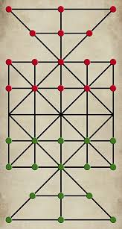
Dear students , Notice here silently
Have you play this game ?
Let’s go play this game !
Five guthi
sub
verb
obj
I was subject, now object.
be
pre
I was object, now subject.
I am preposition by the rules of changing voice.
I am auxiliary verb according to the following subject of number, person,& tense.
I was verb 1form now verb form 3.
16 Guthi

Slide 5
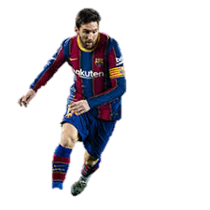
Notice here again
Played
is
by
Football
Mesi
Football
Mesi
Plays
Subject
Verb
Object
What is it related to ?
1.Active voice এর object কে passive এ subject হিসাবে(subjective form) বসাতে হবে ।
2. Active voice এর subject কে passive এ object হিসাবে(objective form) বসাতে হবে ।
3.Sentence এ subject এর number , person এবং tense অনুযায়ী Auxiliary/to be verb বসবে ।
4.মুল Verb এর past participle = play-played- Played
5.Passive voice এর Object পুর্বে Verb এর অর্থ অনুযায়ী by/to/ with এর যে কোন একটি বসে ।

Slide 6
Voice change
Our today’s Topics is …..
So, Let us discuss about voice change in today's class.

Slide 7
Learning outcome
After studied the lesson the students will be able to….
identify the definition of the Voice
identify the classification of voice
identify the structures of active and passive voice
change voice from active to passive

Slide 8
Voice(বাচ্য)
Voice is the very important for learning English skill
What is voice ? ( ভয়েস কাকে বলে ?)
voice is a formation of verb by which subject does something itself or something is done by subject .
Voice is classified into two kinds
Voice
Active
2. Passive
When the subject does something itself .
When something is done by the subject.

Slide 9
Active voice
Structure :
Subject
+
Verb transitive
+
Object
Example:
CV
She writes a letter.
CV
CV
Subject
Verb transitive
Object
When the subject dose something itself then it active voice.

Slide 10
Passive voice
Structure
Object of subject
Auxiliary verb
Verb>p.p
By/with/to
Subject of object
Object of Subject
+
+
+
+
subject of Object
Follow the structure and write your text according with this rules.
Active voice : He drives a car.
A car
is
driven
by
him

Slide 11
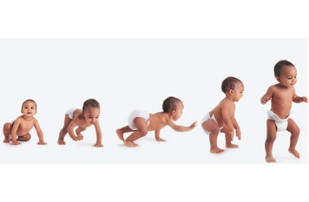
Basic rules of voice
1.Active voice এর object কে passive এ subject হিসাবে(nominative form) বসাতে হবে ।
2.Sentence এ subject এর number , person এবং tense অনুযায়ী Auxiliary/to be verb বসবে ।
3.মুল Verb এর past participle বসবে
4.Passive voice এর Object পুর্বে Verb এর অর্থ অনুযায়ী by/to/ with এর যে কোন একটি বসে ।
5. Active voice এর subject কে passive এ object হিসাবে(objective form) বসাতে হবে ।
প্রিয় শিক্ষার্থী , প্রাথমিকভাবে এই নিয়ম পাঁচটি মনে রাখা খুবই জরুরি ।এর ফলে পরবর্তিতে voice পরিবর্তন সহজ হয়ে যাবে ।

Slide 12
Individual work
Now, change the voice.
Match your answers.
He learns English.
We make a team.
She sang a song .
Rahim brought a book.
You will do the work.
Asma is reading a book.
English is learnt by him.
A team is made by us .
A song was sung by her .
A book was brought by Rahim.
The work will be done by you.
A book is being read by Asma.

Slide 13
সকল Tense এর structure অনুযায়ী voice পরিবর্তন
Tense | Active এ নিম্নরূপ থাকলে | Passive এ পরিবর্তন হবে নিম্নরূপ
Present indefinite | Subject +v1+object/ex. | Object+am/is/are+pp+preposition+subject
Past indefinite | subject+v2+object/ex. | Object+ was/were+pp+by+subject
Future indefinite | Subject+shall/will+v1+object/ex | Object+ shall/will be+pp+by+subject
Present continuous | Subject+am/is /are+(v+ing)+object/ex. | Object+ am/is/are being+pp+by+subject
past continuous | Subject+was/were+(v+ing)+object/ex | Object+ was/were being+pp+by+subject
Future continuous | Subject +shall/will be (v+ing)+object/ex | Object+ shall/will be being+pp+by+subject .
Present perfect | Subject+have/has+v3+object/ex | Object+ have/has been+pp+by+subject
Past perfect | Subject +had+v3+object/ex | Object+ had been+pp+by+subject
Future perfect | Subject + shall/will have+v3+object/ex | Object+ shall have/will have +been+pp+by+subject
Look at this
বাকী তিনটি tense এর voice ব্যবহার কম তাই পরে শিখব ।

Slide 14
Active voice থেকে passive voice করার সময় tense অনুযায়ী যে auxiliary verb গুলো বসে ।
Tense | Type of tense | Passive voice যে সাহায্যকারী verb হয় ।
Indefinite | Present indefinite | Am/is/are
 | Past indefinite | Was/were
 | Future indefinite | Shall be/will be
Continuous | Present Continuous | Am/is/are+being
 | Past Continuous | Was/were+being
 | Future Continuous | Shall be/will be+being
perfect | Present perfect | Have been/had been
 | Past perfect | Had been
 | Future perfect | Shall have/will have+been
Perfect continuous | Present Perfect continuous | Have been/has been+being
 | Past Perfect continuous | Had been+being
 | Future Perfect continuous | Shall have/will have+been+being
নির্দেশিত tense অনুযায়ী be verb পরিবর্তন হবে

Slide 15
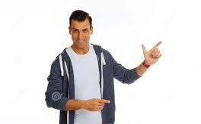
Active voice এর Nominative case যেভাবে passive voice এর objective case হয় ।
Subject | Object
I | Me
We | Us
You | You
He | Him
She | Her
They | Them
It | It
Jamal | Jamal
Change style
Change style
Change style
Change style
Change style
Change style
Change style
Change style

Slide 16
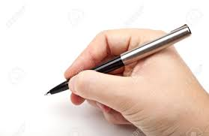
Tense এর structure অনুযায়ী voice পরিবর্তণ এর উদাহরণ
Tense | Active | Passive
Present indefinite | He learns Bangla. | Bangla is learnt by him .
Past indefinite | I sang a song . | A song was sung by me.
Future indefinite | You will do the work . | The work will be done by you.
Present continuous | Asma is reading a book . | A book is being read by Asma.
past continuous | Mamun was writing a letter. | A letter was being written by Mamun
Future continuous | Mijan will be dinking water . | Water will be being drunk by Mijan.
Present perfect | I have publish a book. | A book has been published by me.
Past perfect | Mina has prepared lesson before teacher come. | Lesson had been prepared by Mina before teacher came .
Future perfect | We had saved the man before the bus came.. | The man had been saved by us before the bus came .

Slide 17
Modal Auxiliary এর ব্যবহার
Voice এর ক্ষেত্রে Modal Auxiliary Verb গুলো কি কি ও তার ব্যবহার কি হবে তা দেখা যাক ।
Modal Auxiliary – Can , could , shall, should , will, would , may , might , must, ought to , going to ,ctc এই verb গুলো Active voice এ subject এর পর থাকলে passive করার সময় Modal Auxiliary verb টি অপরিবর্তিত থাকে এবং Modal verb টির পর be বসে। অন্যান্য নিয়ম ঠিক থাকবে ।
(উদাহরণ) Active: I can drive a car.
(উদাহরণ) passive: A car can be drived by me

Slide 18
Active to passive
Assertive sentence
He learns English. (make it passive)
English is learnt by him.
We should respect our teacher (make it passive)
Our teacher would be respected by us .

Slide 19
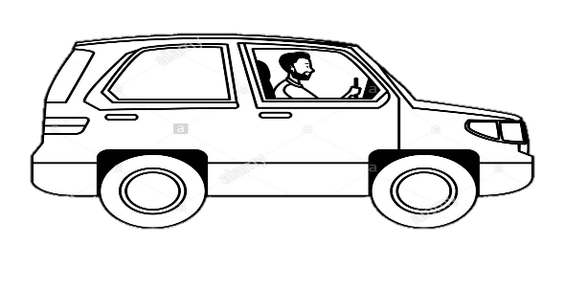
Active to passive
The driver is driving a car (make it passive )
A car is being drived by the driver.

Slide 20
Let us know the voice change of double object
He teaches us English.
sub
Verb transitive
Obj
Obj
Double object
us = indirect object
English = direct object
Note: You can use any object as the subject of the passive voice.

Slide 21
Let’s practice
He teaches us English
We are taught English by him
English is taught us by him
Now , Try to change it into passive voice.
He gave me a book.
I taught him lesson.
They feed me fruits.
We made him captain.
She informed me this .

Slide 22
Passive voice of silent infinitive
I told him do this .
Sometime infinitive remains silent in the active voice.
He was told to do this by me .
Infinitive must be shown in the passive voice .

Slide 23
Pair of work
Change the active voice into passive voice.
He advised me tell the truth.
They elected him go there.
She found it hard to break.
The bird made the wind blow.
The teacher told him do the some.

Slide 24
Passive voice of reflexive verbs
Active voice এর object যদি reflexive pronoun হয় তাহলে subject অপরিবর্তিত অবস্থায় থেকে নিম্নরূপ structure অনুযায়ী passive হয় । .
subject+ + auxiliary verb + by + reflexive pronoun
She killed herself
She was killed by herself
You punished yourself .
You were punished by yourself .

Slide 25
Passive voice of Quasi-passive Verb.
If the active voice is with Quasi- passive verb-
Subject + auxiliary verb + v3 + adjective
Example: active: Honey test sweet.
Passive: Honey is sweet when it is tested.
Active : The book reads well.
The book is well when it is read .

Slide 26
Group works
Honey tests sweet .
The pill testes bitter
The food looks delicious.
The man seems strong .
You look nice.

Slide 27
Home work
Change the active voice into passive voice at your home.
He advised me tell the truth.
They elected him go there.
She found it hard to break.
The bird made the wind blow.
The teacher told him do the some.

Slide 28
Thank you, see again

