Slide 1
Welcome
Notes:
Welcome slide.

Slide 2
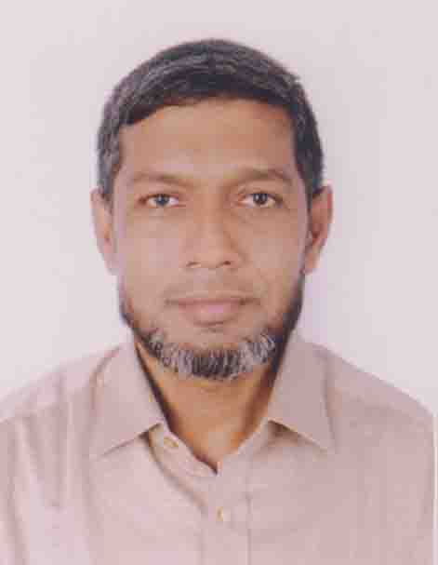
Identity
Md. Abdul Motalab
ENGLISH
Police Lines School and College, Rangpur

Slide 3
WHAT ARE THE STUDENTS DOING HERE?

Slide 4
Our Topic is
Exercise on Sentence Connectors

Slide 5
Learning outcomes
After completing this lesson, we will be able to –
prepare for the annual examination
Notes:
Aim of this lesson.

Slide 6
1. Complete the passage using suitable connectors.1 x 5 = 5
Women are nowadays as important as men in society. They constitute nearly half of our total population. (a) -----, there can be no denying the fact (b) ----- they too possess equal rights and duties (c) ----- men do. They have noble missions to fulfill as men. (d) ---- they get opportunity, their genius, powers (e) ----- capacities will bloom fully.

Slide 7
Answer-1
So
(b) that
(c)as/what
(d) If
(e) and

Slide 8
2. Complete the passage using suitable connectors.1 x 5 = 5
“Where there is a will there is a way. This proverb is quite true. People hate their fate (a) ----- they cannot get the result as their wishes. But (b) ----- a man works deliberately for building his future, success will touch him definitely. There is no magic power (c) ----- it is the magic of hard work. (d) ----- when one gets success, fortune will side him too. The unlucky people rebuked the fate. (e) ----- there is no alternative of work.

Slide 9
Answer-2
when
(b) if
(c) but
(d) So
(e) Actually/In fact

Slide 10
3. Complete the passage using suitable connectors.1 x 5 = 5
Rural life and urban life have many common sides. (a) ------- differences between them are greater. Rural people do not have adequate educational and medical facilities. (b) -------, they face problems with their communication network. (c) ------- the urban people enjoy a lot of educational and medical facilities. (d) ----- the people of cities and towns enjoy a smooth and easy communication system. (e) -------- rural life is deprived of modern facilities whereas urban life is as modem as enjoyable.

Slide 11
Answer-3
But
(b) Moreover
(c) But/On the other hand
(d) So/As a result
(e) But

Slide 12
4. Complete the passage using suitable connectors.1 x 5 = 5
Fortune has often been blamed for blindness. (a) ----- blindness and fortune are not (b) -------- blind as those (c) ------- blame their fate (d) ------- do not try to overcome adversities. Neither good luck (e) ------- bad luck has anything to do with the ultimate destiny of a man.

Slide 13
Answer-4
But
(b) so/as
(c) who
(d) but
(e) nor

Slide 14
5. Complete the passage using suitable connectors.1 x 5 = 5
(a) ----- flood is considered to be a natural calamity, it is no doubt a blessing for the people. It is considered to be a blessing in the sense (b) ------- it makes the soil alluvial. (c) -------- silt is scattered over land and land (d) ------- flood and makes the soil fertile. So it can be said that flood has (e) ------ constructive and destructive sides.

Slide 15
Answer-5
(a) Though
(b) that
(c) when
(d) after
(e) both

Slide 16
6. Complete the passage using suitable connectors.1 x 5 = 5
People usually want to have their own way. They want to think and act (a) -------- they like. (b) -----, one cannot have ones own way all the time. A person cannot live in an environment without considering the interest of others (c) ------ his own interest. People in society may take their own decision. (d) ------ these decisions ought not to be unjust (e) ------- harmful to others.

Slide 17
Answer-6
(a) as/what
(b) In fact/That’s why/For this
(c) instead of/along with
(d) but
(e) and

Slide 18
7. Complete the passage using suitable connectors.1 x 5 = 5
Seed is the mother of a plant (a) ------- the plant lies in its heart. (b) ------- the seed is buried deep into the soil, the plant comes out. (c) ----- the plant creeps to the light. (d) -----the plant comes out, it hears and sees many things. (e) ----- the world seems to it to be the” wonderful.

Slide 19
Answer-7
(a) as/since/because
(b) When
(c) And
(d) When/As
(e) So/As a result/And

Slide 20
8. Complete the passage using suitable connectors.1 x 5 = 5
There are a group of rich farmers in our country (a) ------ their number is very few. They often get enough from their land to meet up their daily necessaries. They may buy clothes, cosmetics and ornaments for their wives, sons and daughters. (b) ------- they may have some money left for further investment. (c)----- they get up late in the morning. Then, they take breakfast. After that, they go to the bungalow and discuss with others the current affairs of the village. (d)----- they settle disputes of the villagers. (e) ----- midday meal, they often take a nap.

Slide 21
Answer-8
(a) but
(b) Even
(c) Generally
(d) Sometimes
(e) After

Slide 22
9. Complete the passage using suitable connectors.1 x 5 = 5
Everybody wants success in life (a) ----- everybody can’t achieve it. In our society, there are people (b) ----- get frustrated. (c) ----- success does not come very easily at first attempt. (d) ------- , if you want to achieve true success in life, you must have some qualities such as sincerity and honesty. (e) -----, you need to have perseverance and patience.

Slide 23
Answer-9
(a) but
(b) who
(c) but
(d) So
(e) Moreover

Slide 24
10. Complete the passage using suitable connectors.1 x 5 = 5
21st February is red letter day in our national history. It is our pride (a) ----- no nation of the world has ever fought for its language the way we fought. So it has been now declared as International Mother Language Day. The proposal has been passed unanimously in the general assembly of UNESCO (b) ---- some countries pointed out (c) ---- the incident 21st February is related to the Bangladesh only. (d) ---- the recognition of the day (e) ---- International Mother Language Day by UNESCO has uphold the prestige of Bengalese all over the world.

Slide 25
Answer-10
(a) because/as/since
(b) where/though
(c) that
(d) So
(e) as

Slide 26
See you again.
Notes:
Ending slide.

