Slide 1
Welcome
Notes:
Welcome slide.

Slide 2
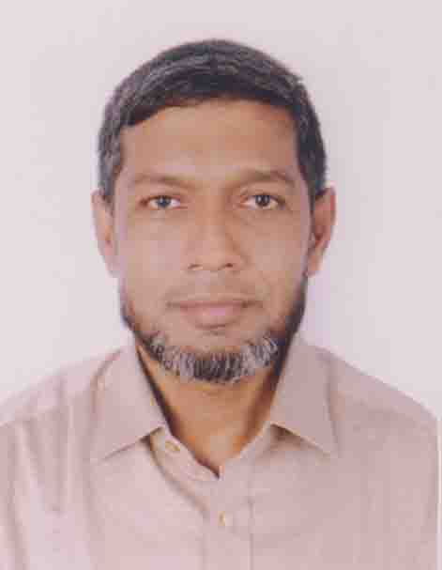
Identity
Md. Abdul Motalab
ENGLISH
Police Lines School and College, Rangpur

Slide 3
WHAT ARE THE STUDENTS DOING HERE?

Slide 4
Our Topic is
Exercise on Capital Letters and Punctuation marks

Slide 5
Learning outcomes
After completing this lesson, we will be able to –
prepare for the annual examination
Notes:
Aim of this lesson.

Slide 6
1. Use capitals and punctuation marks where necessary in the following text. 5
fahim said to me have you finished reading the book i gave you yesterday yes i have finished reading the book i replied what an interesting book it is i said will you return the book to me today he asked.

Slide 7
Answer-1
Fahim said to me, “Have you finished reading the book I gave you yesterday?” “Yes, I have finished reading the book,” I replied. “What an interesting book it is!” I said. “Will you return the book to me today?” he asked.

Slide 8
2. Use capitals and punctuation marks where necessary in the following text. 5
give me a few grains of corns i am dying of hunger said the grasshopper but what did you do in the summer didn’t you store any grain the ant remarked i was too busy in singing.

Slide 9
Answer-2
“Give me a few grains of corns. I am dying of hunger,” said the Grasshopper. “But what did you do in the summer? Didn’t you store any grain?” the Ant remarked. “I was too busy in singing.”

Slide 10
3. Use capitals and punctuation marks where necessary in the following text. 5
mother said are you going to college mouree yes replied mouree i have got very important classes today you have to come back home earlier because we shall go for eid shopping this afternoon said mother dont forget this thing what an idea you are really great said mouree

Slide 11
Answer-3
Mother said, “Are you going to college, Mouree?” “Yes,” replied Mouree. “I have got very important classes today.” “You have to come back home earlier because we shall go for Eid shopping this afternoon,” said mother. “Don’t forget this thing.” “What an idea! You are really great,” said Mouree.

Slide 12
4. Use capitals and punctuation marks where necessary in the following text. 5
the man said to mohsin my family have been starving for a couple of days i have gone from door to door in quest of work but i have found no work mohsin said take this bunch of keys and open the almirah have as much money a you require

Slide 13
Answer-4
The man said to Mohsin, “My family have been starving for a couple of days. I have gone from door to door in quest of work but I have found no work.” Mohsin said, “Take this bunch of keys and open the almirah. Have as much money as you require.”

Slide 14
5. Use capitals and punctuation marks where necessary in the following text. 5
william shakespeare the monarch of world literature was born on 23 april 1564 in Stratford on avon his mother was mary arden and his father was john shakespeare he was not much educated he had little knowledge of grammar

Slide 15
Answer-5
William Shakespeare, the monarch of world literature, was born on 23 April 1564 in Stratford on Avon. His mother was Mary Arden and his father was John Shakespeare. He was not much educated. He had little knowledge of grammar.

Slide 16
6. Use capitals and punctuation marks where necessary in the following text. 5
what kind of stories did aesop tell said anwar fables replied mrs amin do you know what fables are no replied anwar well continued mrs amin fables are stories with a message or a moral

Slide 17
Answer-6
“What kind of stories did Aesop tell?” said Anwar. “Fables,” replied Mrs. Amin. “Do you know what fables are?” “No,” replied Anwar. “Well,” continued Mrs. Amin. “Fables are stories with a message or a moral.”

Slide 18
7. Use capitals and punctuation marks where necessary in the following text. 5
summer the first season of bangla year consists of baishakh and jaishta fruits of different items are seen available in the summer season when strong wind blows the children and girls come out under the trees to pick up mangoes it is risky to go out because it might cause an accident

Slide 19
Answer-7
Summer, the first season of Bangla year, consists of Baishakh and Jaishta. Fruits of different items are seen available in the summer season. When strong wind blows, the children and girls come out under the trees to pick up mangoes. It is risky to go out because it might cause an accident.

Slide 20
8. Use capitals and punctuation marks where necessary in the following text. 5
the aim of education is to make a man fully equipped to be useful to himself and to the society it is to develop the whole man his body mind and soul education aims at providing a child with opportunities to bring out all the latent talent that it possesses

Slide 21
Answer-8
The aim of education is to make a man fully equipped to be useful to himself and to the society. It is to develop the whole man, his body, mind and soul. Education aims at providing a child with opportunities to bring out all the latent talent that it possesses.

Slide 22
9. Use capitals and punctuation marks where necessary in the following text. 5
death is inevitable everybody knows it yet everybody forgets it for the necessity of life again someone becomes immortal by welcoming the death with smiling face someone dies many times before death

Slide 23
Answer-9
Death is inevitable. Everybody knows it. Yet everybody forgets it for the necessity of life. Again, someone becomes immortal by welcoming the death with smiling face. Someone dies many times before death.

Slide 24
10. Use capitals and punctuation marks where necessary in the following text. 5
dont speak ill of others to speak ill of others is a great sin rather rectify yourself through self-criticism if you rectify yourself in this way others will follow you if you speak ill of others only problems increase this does not do any good to society

Slide 25
Answer-10
Don’t speak ill of others. To speak ill of others is a great sin rather rectify yourself through self-criticism. If you rectify yourself in this way, others will follow you. If you speak ill of others, only problems will increase. This does not do any good to society.

Slide 26
See you again.
Notes:
Ending slide.

