Slide 1
Welcome to Dear, All Students.

Slide 2
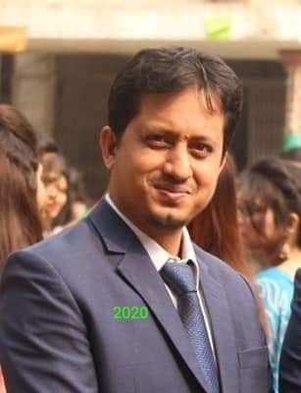
Md. Mannan Mollah, Assistant English Teacher, Jinjira Pir Moh. Girls' High School, Keraniganj, Dhaka – 1310.

Slide 3
Today's Topic is.....
Completing Sentence, Part - 1
Conditional Sentence

Slide 4
The sentence that begins with if known as conditional sentence.
Remember, had, were, in case, unless, provided, provided that, providing that, when can be used instead of If.

Slide 5
Try to Understand If Clause & Main Clause.
If it rains
,
I will not go to school.
If Clause
Comma
Main Clause

Slide 6
Structure
,
If Clause
Main Clause
Main Clause
If Clause​

Slide 7
Classification
Conditional Sentence
First
Second
Third

Slide 8
Conditional | Usage | If Clause | Main Clause
1. Zero | General Truth | Simple Present | Simple Present
2. 1st | Possible and very likely | Simple present | Simple Future
 |  |  | Imperative Sentence
 |  |  | Sub + Can/may + V1
3. 2nd | Possible but very Unlikely | Simple past | Sub+would/could/might+verb1
4. 3rd | Impossible to fulfill | Past perfect | Sub+would/could/might+have+verb3

Slide 9
There are four types of Conditional Sentences
Conditional | Usage |  | If clause | Main clause
1. Zero | General truths |  | Simple present | Simple present
2. First | possible and very likely |  | Simple present | Simple future Imperative sentence subject+can/may+verb1
3.Second | possible but very unlikely |  | Simple past | subject+would/could/might+verb1
4.Third | impossible to fulfill |  | Past perfect | subject+would/could/might+have+verb3

Slide 10
Zero Conditional | If + Simple present + Simple present
First conditional | It is possible and very likely that the condition will be fulfilled. If + Simple present , sub + shall/will/can/may + verb1 + ext. If + Simple present, Imperative sentence
Second conditional | It is possible but very unlikely, that the condition will be fulfilled. If + Simple past , sub + would/could/might+ verb1 + ext. Or, Were I a bird, I would fly at large. Or, Had I enough money, I would start a business.
Third conditional | It is impossible that the condition will be fulfilled. If +past perfect, sub + would/could/might+have+verb3+ext. Or, Had I seen her before, I would have disclosed the truth.

Slide 11
Evaluation
(a) If water reaches 100 degrees, it boils. (b)You get water if you mix hydrogen and oxygen.
(c)If you touch a fire, you get burned.
(d) People die if they don’t eat.
(e) If I eat peanuts, I am sick.

Slide 12
Answers..
(a) If water reaches
100 degrees,….
(b)You get water ….....
(c)If you touch a fire, …....
(d) People die ….......... ​
(e) If I eat peanuts, …......​

Slide 13
Home Work
(a) If I invite you, you (come).
(b) If it rains, I (not go) to school.
(c) If he requested me, I (go) there.
(d) If they tried, they (succeed).
(e) If he had studied very seriously, he (make) a bright result.
(f) If she had not missed the interview, she (get) the job.

Slide 14
Thank You, All.

