Slide 1
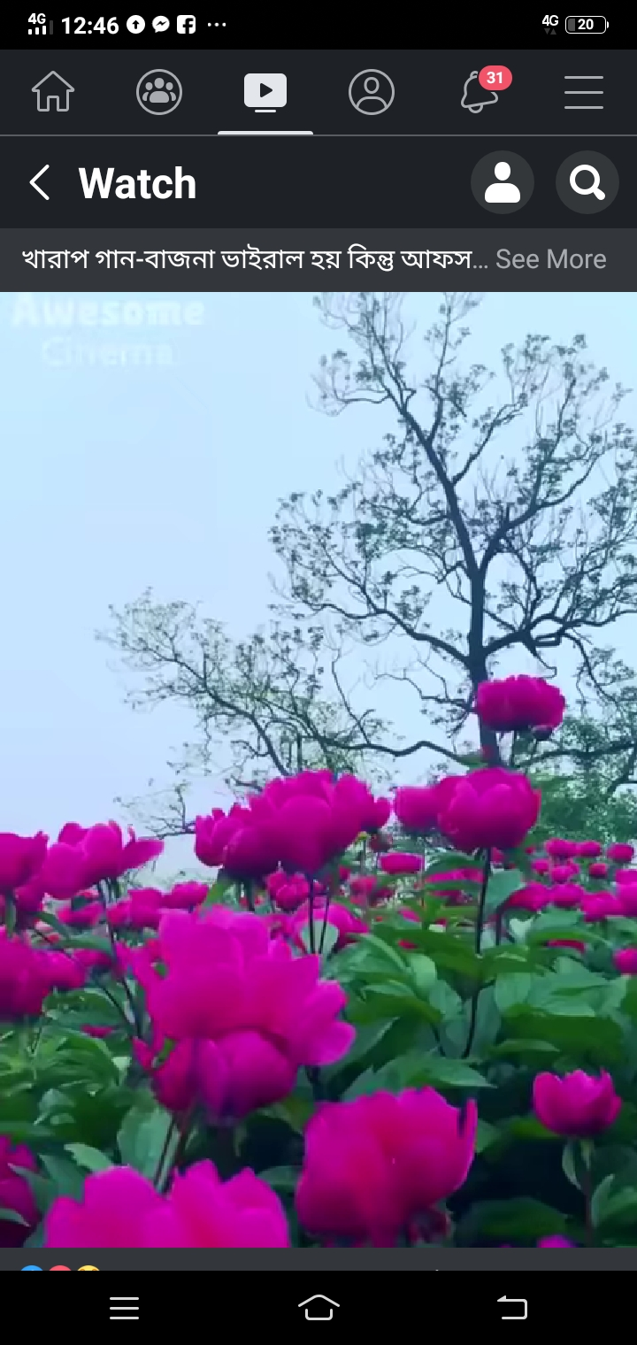
WELCOME TO ENGLISH CALSS
Notes:
WELCOME TO ENGLISH CALSS

Slide 2
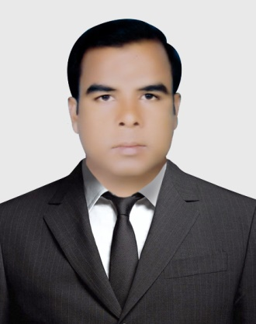
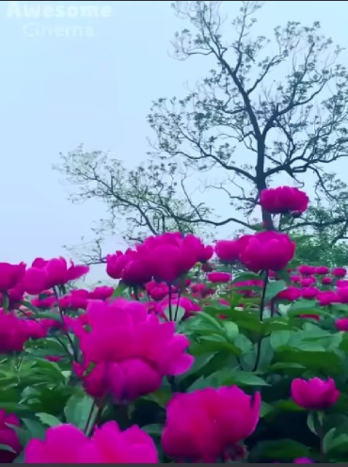
INTRODUCTION
MD. MOBARAK ALI
ASSISTANT TEACHER
PASCHIM RAMKHANA HIGH SCHOOL.
Nageswari, Kurigram
SUB: ENGLISH 2nd PAPER
CLASS: SIX – TEN
ABOUT VERB
Notes:
PASCHIM RAMKHANA HIGH SCHOOL. NAGESWARI, KURIGRAM

Slide 3
Dear Learners , do you know about Verb?
Let us follow below
Notes:
WELCOME TO ENGLISH CALSS

Slide 4
TODAYS TOPIC IS
VERB
Notes:
WELCOME TO ENGLISH CALSS

Slide 5
Learning outcome
What is the define of verb?
How many kinds of verb?
 Why is it important of English Language?

Slide 6
What is the define of verb?
A verb is a word for saying something about a person or thing
A verb is a word that tells or asserts something about a person or thing
A verb is nothing but the work of a person
A verb is such a word which indicates doing something

Slide 7
Classification of verb
Finite Verb
Non-Finite Verb

Slide 8
Finite Verb
Principal Verb
Auxiliary Verb
Transitive Verb
Intransitive Verb

Slide 9
Transitive Verb
Transitive Verb of complete predication
Transitive Verb of incomplete predication or Factitive verb

Slide 10
Transitive Verb of complete predication
Cognate verb
Reflexive verb
Quasi-passive verb
Reciprocal verb

Slide 11
Intransitive Verb
Intransitive Verb of complete predication
Intransitive Verb of incomplete predication

Slide 12
Intransitive Verb of incomplete predication
Compulative Verb or Causative
Linking verb

Slide 13
Non-finite verb
Participle
Gerund
Infinitive

Slide 14
Participle
Present Participle
Past Participle
Perfect Participle

Slide 15
Auxiliary Verb
Primary Auxiliary
Modals Auxiliary
Periphrastic Auxiliary

Slide 16
Primary Auxiliary
To be verb
To do verb
To have verb

Slide 17
Evolution
1. We learn English everyday.
2. We want to learn English everyday.
3. I work in the field.
4. They are playing cricket.
5, The girl sings.

Slide 18
Group Work
How many kinds of verb?
Discuses in group and write down on your work sheet.

Slide 19
Home Work
What is the importance of verb in English Language? Write within 70 words.

Slide 20
THANKS YOU SO MUCH

