Slide 1
SURONJIT DEY
Assistant Teacher(English)
Jamal Khan Kusum Kumari C.C. Girls’ High School,Ctg.

Slide 2
English 1st Paper
Class:Nine
Time:40minutes

Slide 3
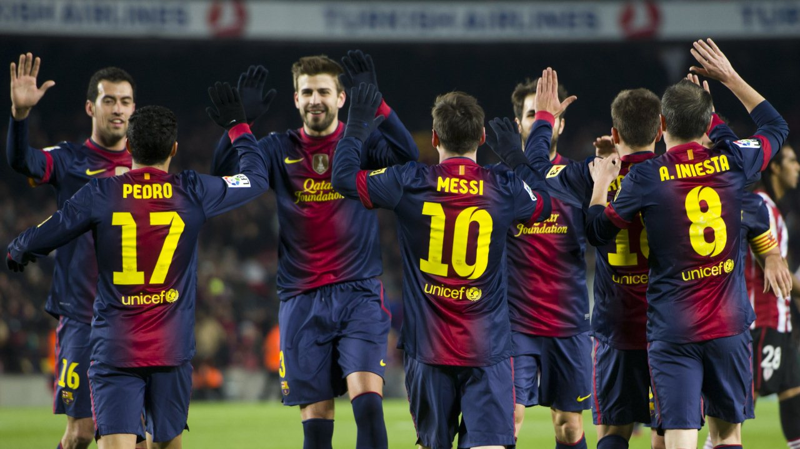
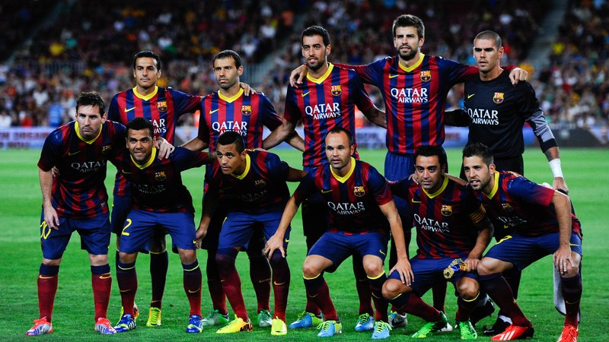
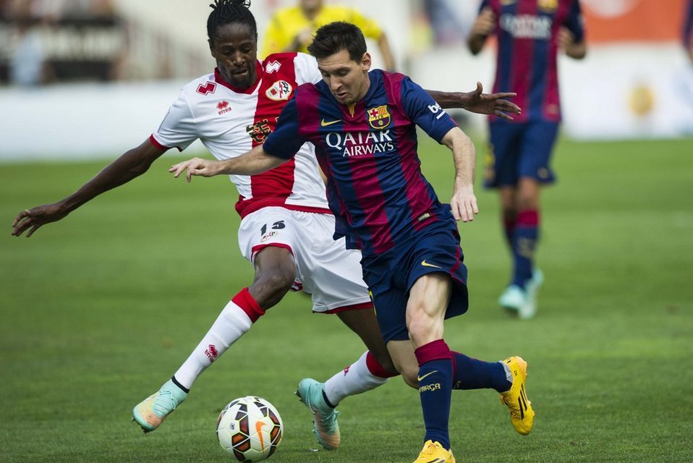
Look at the pictures and answer the following questions:
Celebration
Ready
Run
1)What do you see in the pictures?
2)Are the pictures in correct order?
Ready
Run
Celebration
Correct order :

Slide 4
Re-arranging Sentences
The Pied piper of Hamelin

Slide 5
OBJECTIVES
By the end of the lesson,SS will be able to-
1.learn related vocabularies.
2.rearrange the sentences.
3.complete the story in their own way.

Slide 6
Vocabulary
Presentation
Word | Meaning
Councilor(noun) | Adviser
Town hall(noun) | Local Govt. offices of a town
Knock(verb) | Push
Stranger(noun) | Unknown person
Face(verb) | Encounter

Slide 7
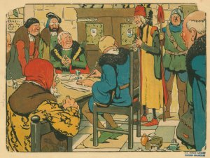
a)The Mayor and the councilors talked about the problem.

Slide 8
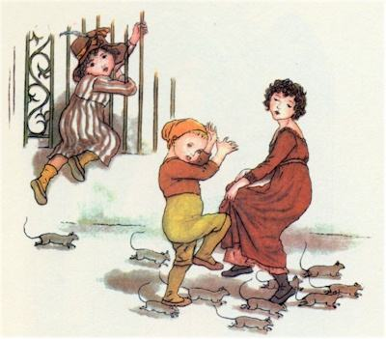
b) At that moment there was a knock at the door.
c)It became full of rats.

Slide 9
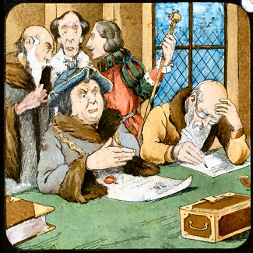
d)But they could not find a way out.

Slide 10
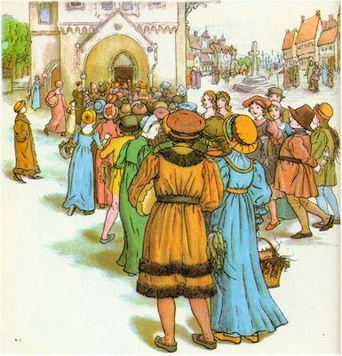
e)The people of the town came to the Town Hall.
f)They said to the Mayor to do something about rats.

Slide 11
g)The Mayor called a meeting of the councilors.
h) A long time ago the town of Hamelin in Germany was faced with a great problem.

Slide 12
EVALUATION
Arrange the sequence in correct order
Now, match them: (h)+(c)+(e)+(f)+(g)+(a)+(d)+(b)

Slide 13
Grammar point
Past Indefinite Tense
Past Indefinite Tense
Example: The Mayor called a meeting of the councilors.
Structure: Sub + Past form of main verb + Ob. + Ex.

Slide 14
Home Task
Complete the story about ‘The Pied Piper of Hamelin’.

Slide 15
Thanks
For
The Day

