Slide 1
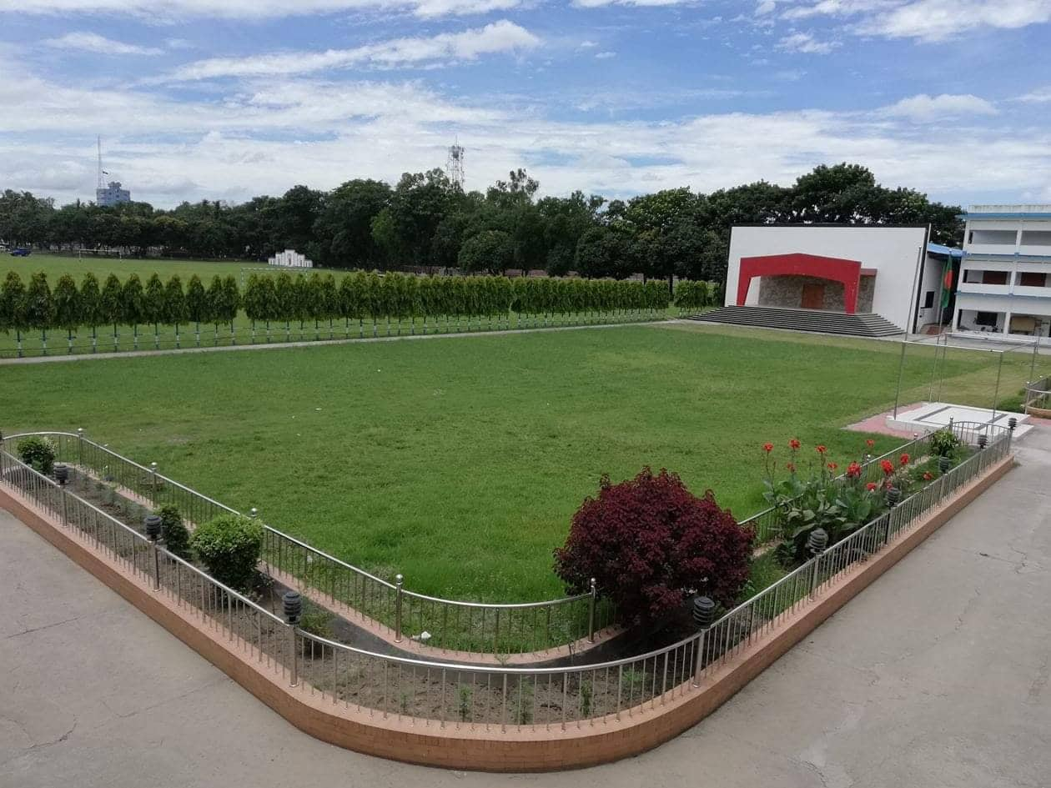
Welcome to all my dear students
Notes:
Welcome slide.

Slide 2
Introduction
Md. Abdul Motalab
Senior teacher (English)
Police Lines School and
College,Rangpur.
English For Today
Class-IX-X
Notes:
Introduction of teacher & class.

Slide 3
Unit-1, lesson-5
Bangladeshi cuisine

Slide 4
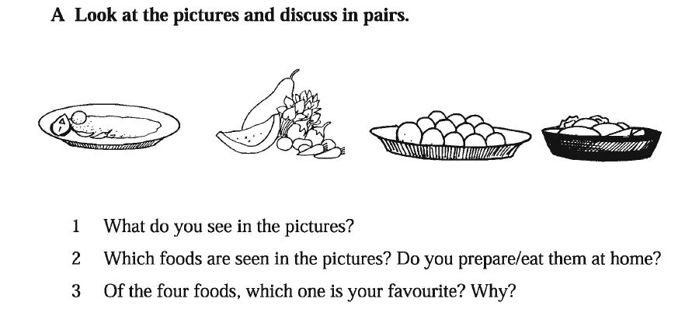

Slide 5
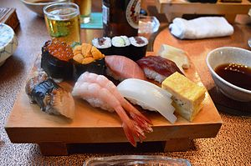
Our today’s Topic: Our Bangladeshi cuisine.

Slide 6
Learning out comes: After completing the lesson, the students will be able to-- 1. ask and answer questions 2. read and understand texts 3. matching words

Slide 7
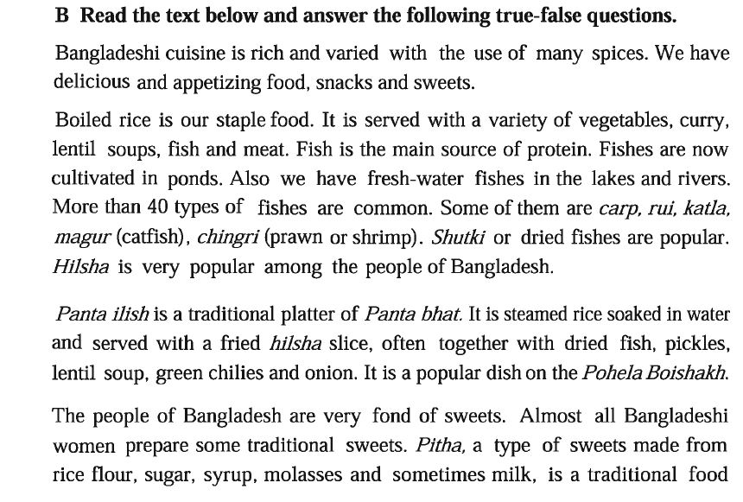

Slide 8
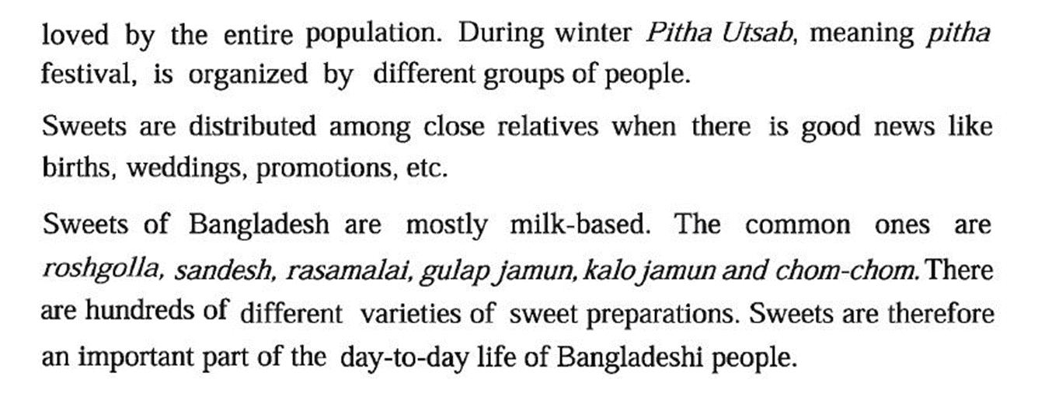

Slide 9
Key words
Words
Meaning
x
1. Cuisine
2.Platter
3. Molasses
s
1. Cooking.
2. dis/ plate/tray
3. Syrup/ treacle.

Slide 10
1.Our foods are rich because they have a lot of oil in them.
c. True or false? If false give the correct information.
Our foods are rich because they have a lot of spices.

Slide 11
2. We get protein mostly from fish

Slide 12
3. On Pahela Boishakh the traditional food is steamed rice and fried Hilsha.

Slide 13
4. Pitha Uthsab takes place almost all the year round in Bangladesh. .
Pitha Uthsab takes place during winter.

Slide 14
5. Sweets are not much appreciated by the people of Bangladesh.
Sweets are much appreciated by the people of Bangladesh.

Slide 15
1. What has made Bangladeshi food so special?
Varieties and use of spices has made Bangladeshi food so special.

Slide 16
2. Where do we get the fishes from?
We get fishes from river, canals and ponds.

Slide 17
3. Apart from fish what other foods do we eat with rice?
Apart from fish we eat vegetables, curry, lentil soup and meat with rice.

Slide 18
4. Why are sweets an important part of our life?
Sweets are an important part of our life because we distributes sweets among the close relatives when we get any good news like weeding, birth, promotion, exam result etc.

Slide 19
Home Work:
1. Apart from fish what other foods do we eat with rice?
2. Where do we get the fishes from?

Slide 20
May Allah bless you all

