Slide 2
Identity
Raushan Ara Akhter
Senior Teacher
Nagendra Narayan Pilot
Girls’ High School,
Muktagacha,Mymensingh.
Class :Nine/Ten
Subject : English 1st Paper
Unit: 8
Lesson:3
Raushan Ara Akhter

Slide 3
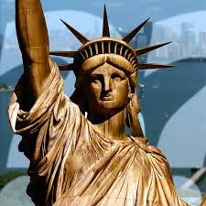
Look at the picture and think about it

Slide 4
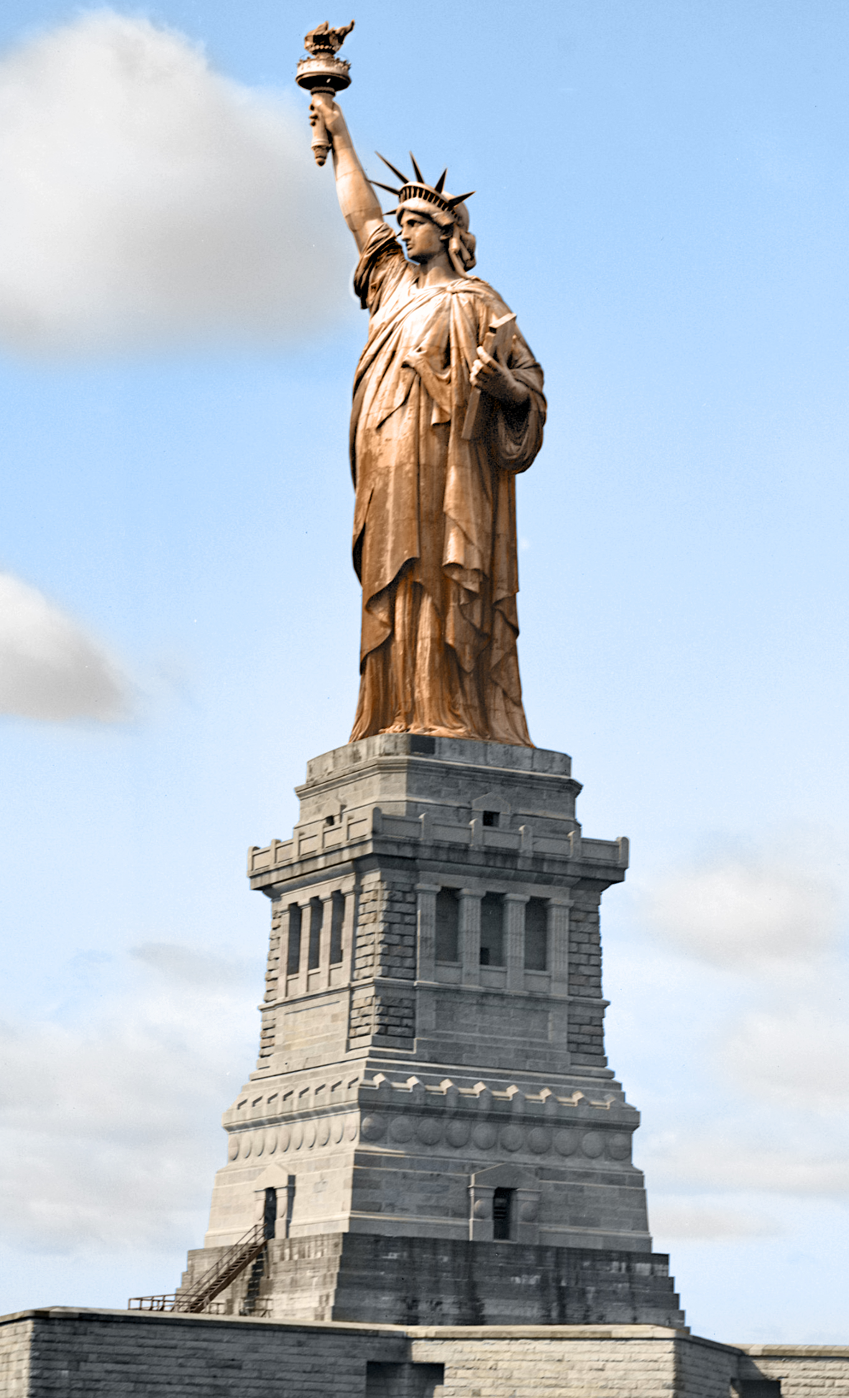

Slide 5
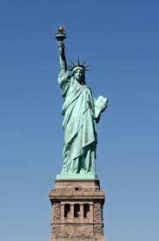
Our today’s topic
is
The Statue of Liberty

Slide 6
LEARNING OUTCOMES
By the end of the lesson the learners will be able to…
ask and answer questions about the picture.
listen to the CD and answer the questions.
complete the chart with the information from the text.
infer meaning of some important words.
read and understand the texts through silent reading
describe a place.

Slide 7
Look at the picture and talk about it in pairs.
1.D0 you know what it is ?
2.Discuss what stands out in the picture.
3.Do you think it is a man or a woman ?

Slide 8
Section-B
Read the question firs. Now listen to the CD about the Statue of Liberty and answer the following questions.

Slide 9
Group work
Now answer the question about it
Where is the statue of Liberty situated ?
Which country gave the statue as a gift ?
The gift was meant for which country ?
On what occasion was it given ?
When was the statue given ?
What does the statue represent ?

Slide 10
Listen to the text again and complete the chart.
Statue of Liberty | Information
Situated
artist
gift from
reason for the gift
presented on
occasion
the statue symbolizes
framework
amount of copper used
weight
year of UNESCO World Heritage Site
on liberty island New York Harbour.
Frederic Auguste Bartholdi
the people of France.
as a sign of friendship .
October 28,1886.
the centennial of freedom of USA.
Liberty has grown to include freedom and democracy.
pure copper sheets.
60,000 pounds.
450,000 pounds or 204.1 metric tonnes.
In 1984.

Slide 11
Vocabulary

Slide 12
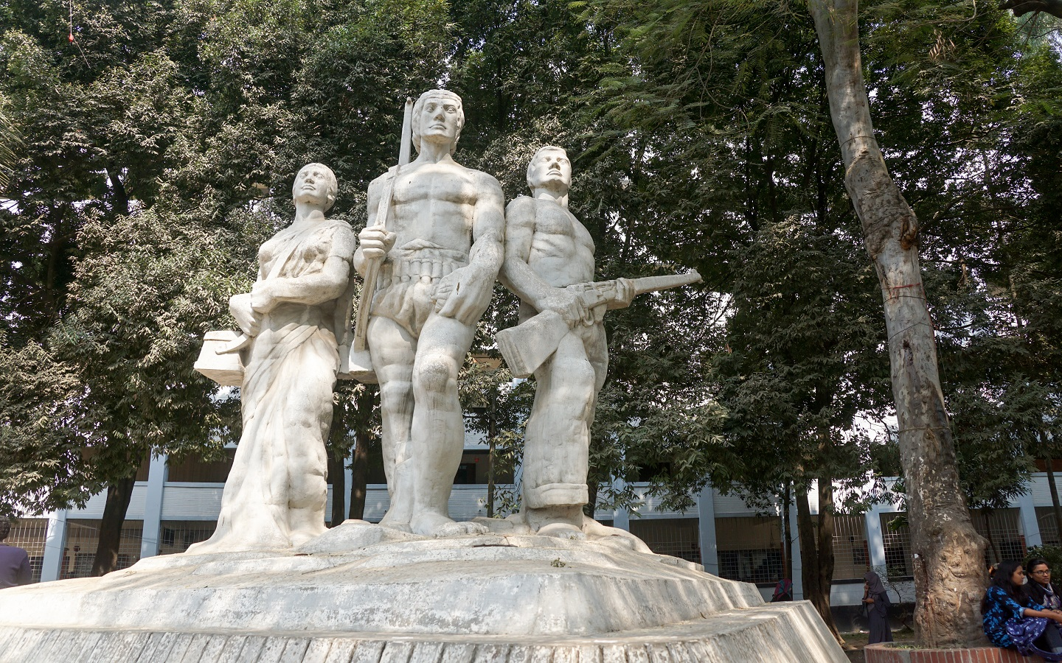
Sculpture
A figure or object made by shapping wood,stone,metal etc.
It is one of the famous sculpture in Dhaka.

Slide 13
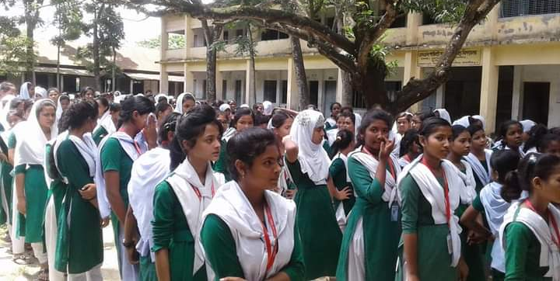
To bring together
These are the scenes of daily assembly in our school

Slide 14
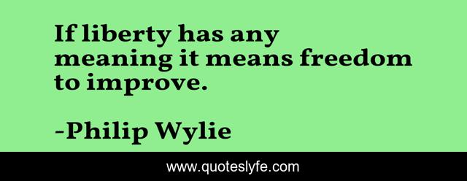
The Statue of Liberty symbolizes liberty enlightening the world.

Slide 15
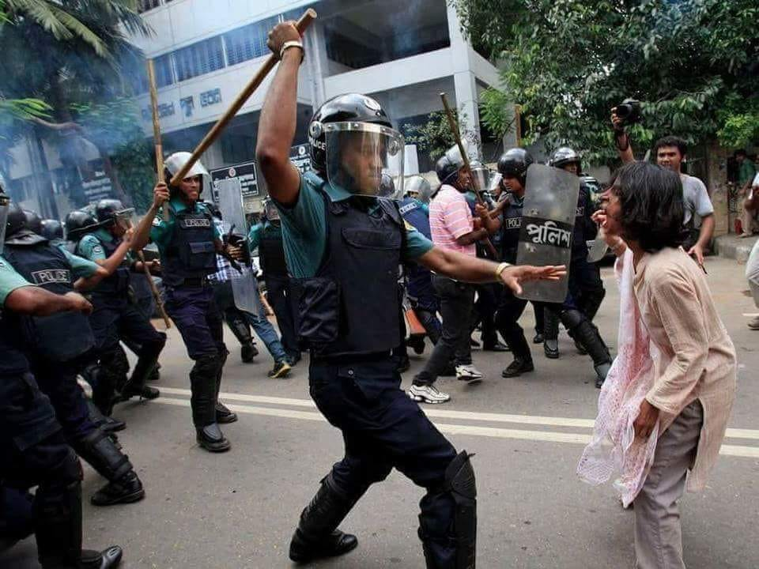
Oppression
When people are treated in an unfair way that spoils their freedom.
A woman is the victim of oppression here.

Slide 16
Joint Venture
The statue was a joint venture between the USA and France.

Slide 17
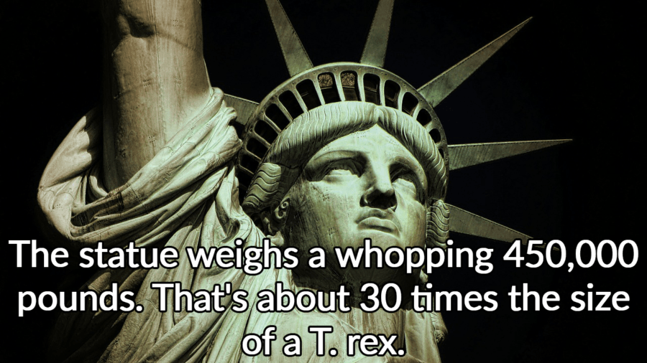
Some important parts of the Statue of Liberty.

Slide 18
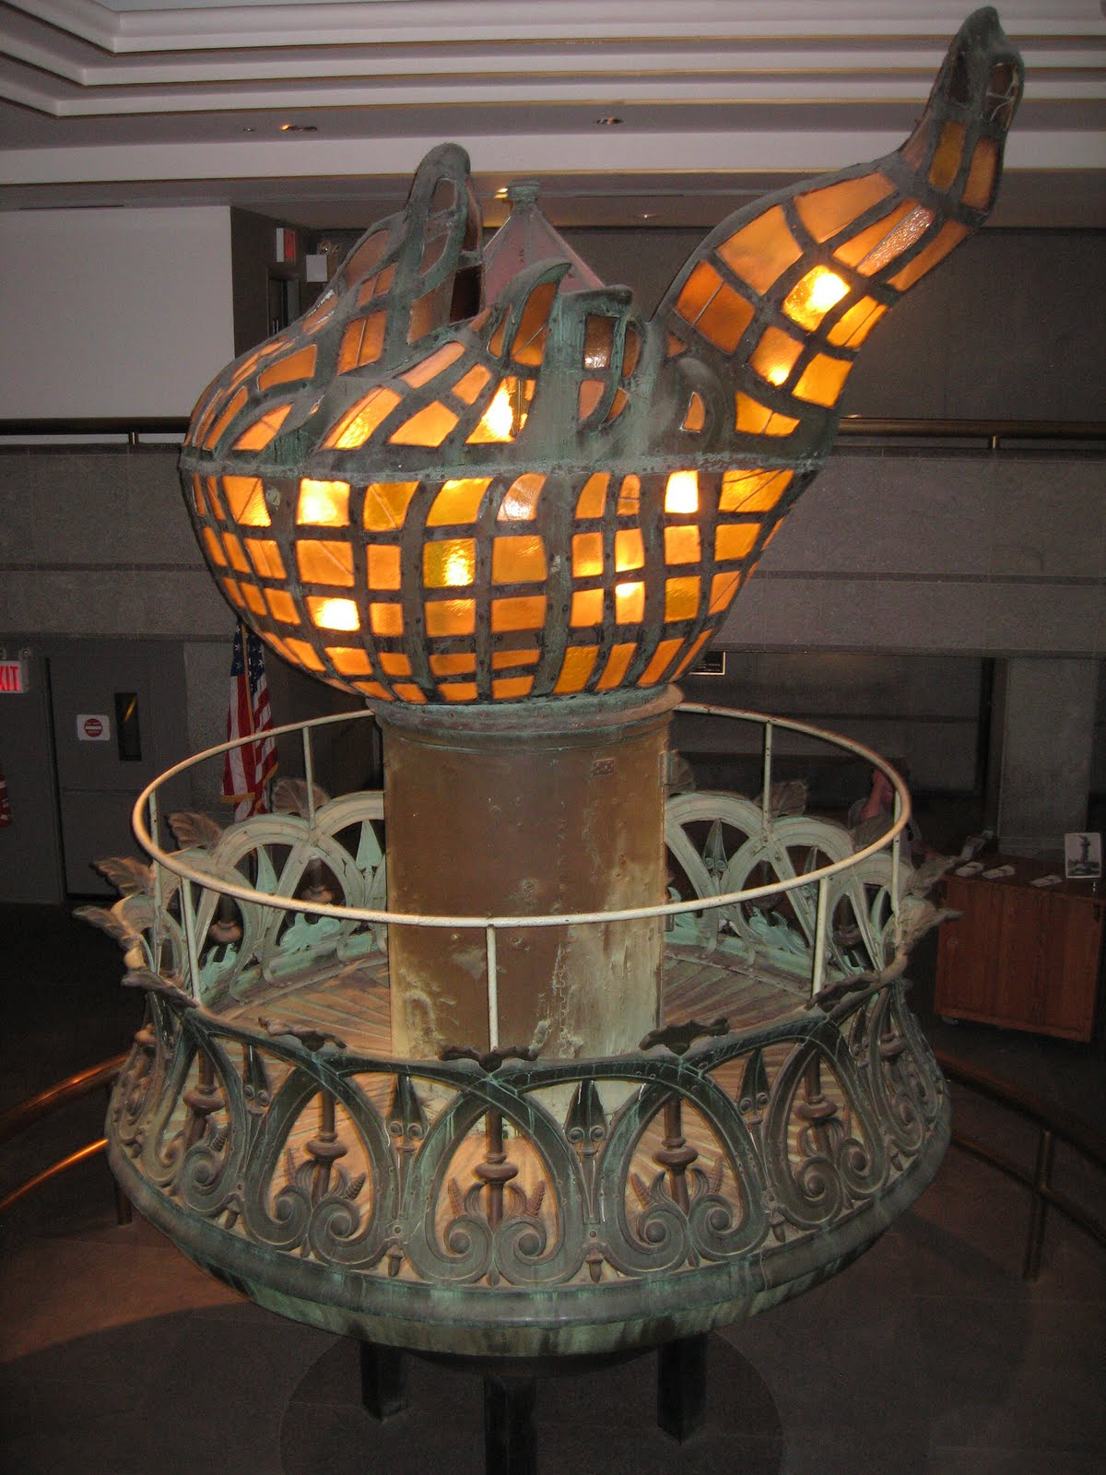
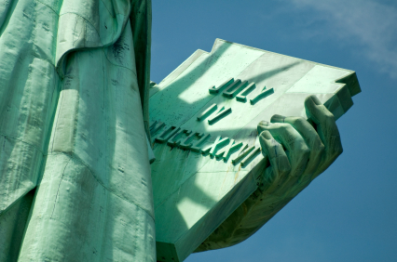
Flaming torch
Robe and tablet

Slide 19
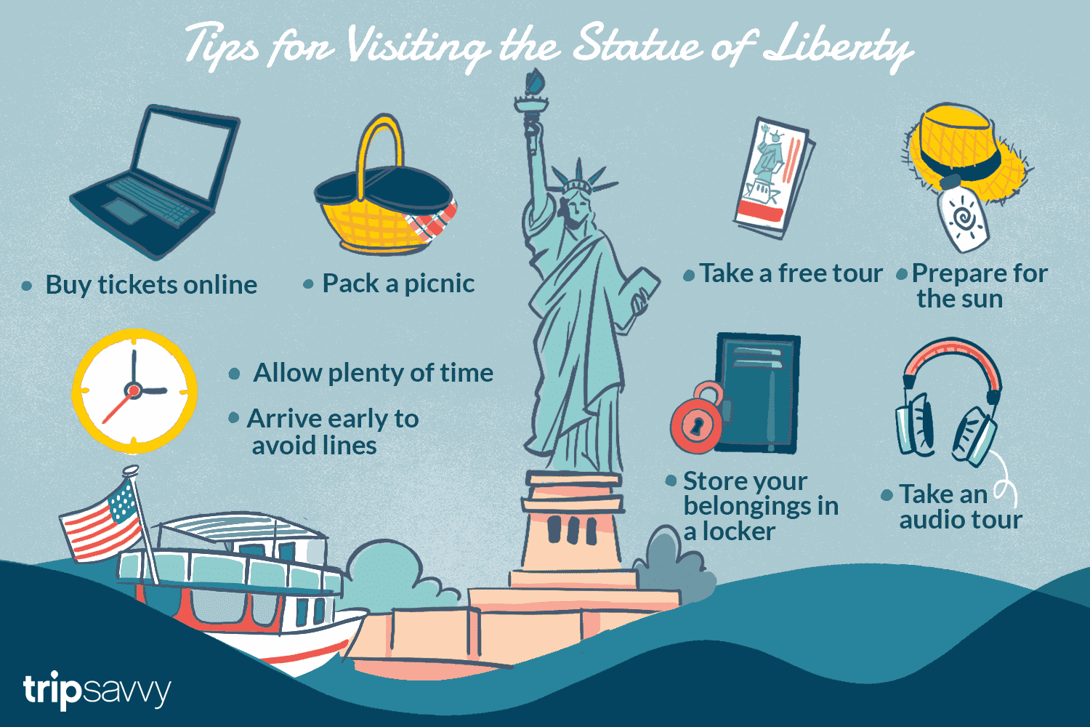

Slide 20
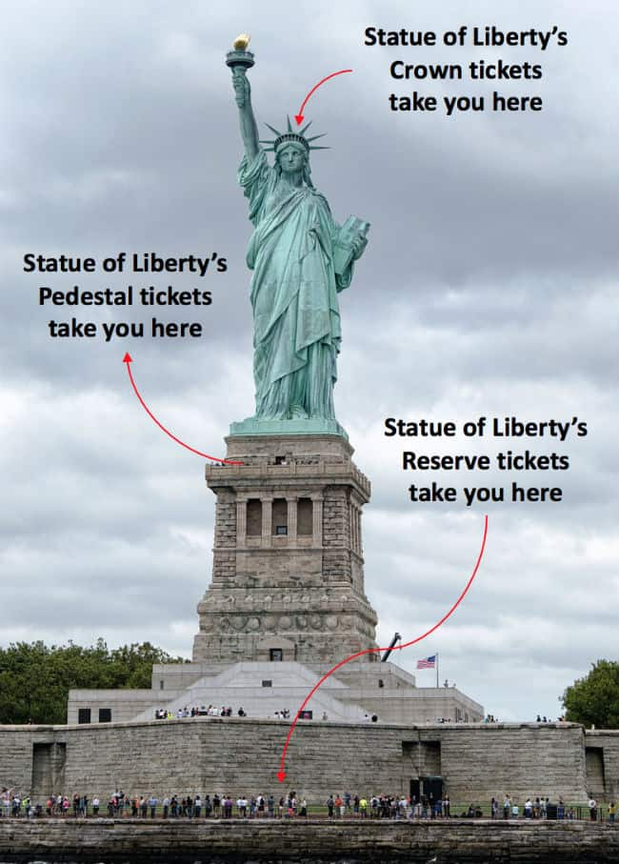

Slide 21
Read the text in section- ‘D’ very attentively as you have to do an activity of answering question just after your reading.

Slide 22
Some important description of the text
The French people would build the statue and assemble it in the States , and the people of USA were to build the pedestal for the statue.
Thousands of people saw the unveiling ceremony of the Statue of Liberty on October 28th 1886.
The freedom that the Statue stands for is not stationary. The broken chain wrapped around her feet ,sticking out from the bottom of her robe ,symbolizes her free forward movement, enlightening the world with her torch, free from oppression and slavery.

Slide 23
Answer to the following questions.
On what occasion did the French Government give the Statue of Liberty to the USA ?
When did she reach her destination ?
How was she transported ?
How has new technology made it possible for people to see the statue from anywhere they are ?
What do you understand by the expression ‘enlightening the world’ ?

Slide 24
Compare the answer
On the occasion of celebrating the hundred years of the American Declaration of independence French government gave the Statue of Liberty to the USA.
She reached her destination in 1885.
She was transported by the French war ship ‘Isere’ after splitting up into 350 individual pieces and packed in 214 crates.

Slide 25
Compare the answer
4. New technology has placed a series of new web cams around her torch so that several amazing views will be just a click of a mouse away. Now ,people can see the statue from anywhere they are.
5. The expression enlightening the world I have understood the freedom from oppression and slavery around the world.

