Slide 1
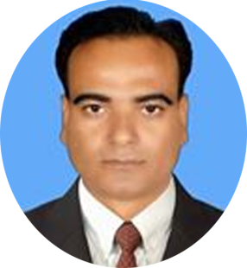
Welcome
* Md. Samsul Alam Moonsoor,Bogura

Slide 2
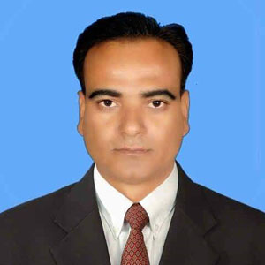
Md. Samsul Alam
Assistant teacher
Atmool B. L High School.
Shibganj, Bogura

Slide 3
Lesson Information
Class: Nine
Subject: English 2nd Paper
Part: Grammar
Time: 50 Minutes

Slide 4
Learning Outcomes
After this lesson Students will be able to….
Identify speech
Identify the classification of speech
change speech from direct to indirect

Slide 5
Notice the text bellow
Raju said to mina,” I am happy.”
Raju said to mina that he was happy.
Can you find any difference between this two sentences?

Slide 6
Yes, exactly you are right.
One is direct speech and
Another one is indirect
speech

Slide 7
Our Today’s lesson is-
Direct and indirect speech/
Narration

Slide 8
Follow the chart
Rafi said to me, “ I have done my duty.”
Rafi told me that he had done his duty.
Speeches are classified into two kinds.
Direct speech
Indirect speech

Slide 9
Individual work
How many kinds of speech?

Slide 10
Anser
There are two kinds of speech?

Slide 11
Verb form of Direct to Indirect speech
Direct | Indirect
Am/is/are | Was/were
Was/were | Had been
Shall/will | Should/would
Has/have/did | Had + past participle
Can/may | Could/might
Must | Had to
Present indefinite | Past indefinite
Past indefinate | Past perfect

Slide 12
She said to me, “ I was ill.
Direct speech
Indirect speech
She told me that she had been ill.

Slide 13
Pair Work
Change the following sentence into indirect.
She said to me, “ I am ill.”
The teacher said to the student, “ Today is Monday.”

Slide 14
Solution
She said to me that he was ill.
Teacher said to the student that that-day was Monday.

Slide 15
Look at the chart about Changing case
Subject | Object | Possitive case
I | Me | My
We | Us | Our
You | You | Your
He | Him | His
She | Her | Her
They | Them | Their
It | It | Its

Slide 16
R.S এর ভিতর 1st Person থাকিলে R.V এর Subject অনুসারে Person Change হবে
Direct: Direct: He said to me , “ I am writing a letter.’’
Indirect: He told me that he was writing a letter.
2. R.S এর ভিতর 2nd Person থাকিলে R.V এর object অনুসারে Person Change হবে
Direct: I said to her, “ you did the work.”
Indirect: I told her that she had done the work.
3. 3rd Person Change হবে না
Direct: He said , “They are reading a book.”
Indirect: He said that they were reading a book.

Slide 17
Home work
Change the following speech from direct to indirect—
The teacher said to me, “The earth moves round the sun.”
Father said to his son, ”I am busy now”
He said to me,” I was there in 2000.”
Uncle said ,“winter is cold”
“Newspaper is a store house of knowledge,” said the head master.

Slide 18
THANK YOU

