Slide 1
Welcome
* Md. Samsul Alam Moonsoor,Bogura

Slide 2
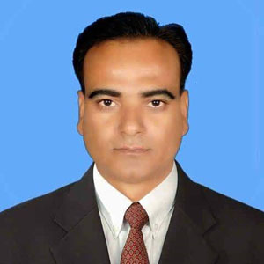
Md. Samsul Alam
Assistant teacher
Atmool B. L High School.
Shibganj, Bogura

Slide 3
Lesson Information
Class: Six
English Grammar
Present Perfect Tense
Time: 45 Min.

Slide 4
Learning Outcomes
Students will be able to….
Know the sentence structure of present perfect tense.
make simple sentences in present perfect tense.
write negative and interrogative sentences.

Slide 5
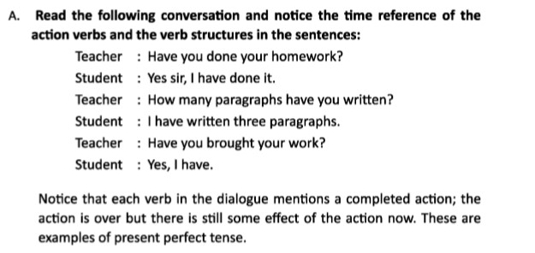
Read the passage and notice the verbs

Slide 6
Sentence Structure
Subject +have/has+ Verb (past participle) + Object. (Affirmative structure)
Have/has+ subject + Verb (past participle) + Object.(Interrogative structure)
Subject +have/has+ not + Verb (past participle) + Object.(Negative structure)

Slide 7
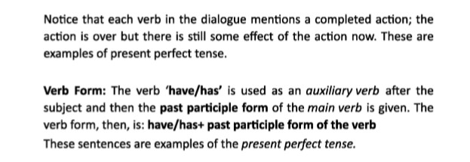
Read

Slide 8
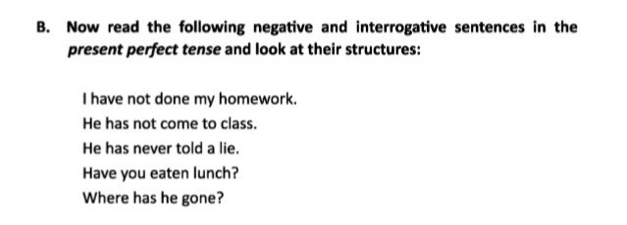

Slide 9
Individual Work

Slide 10
Answer
We have started our journey.
Reba has washed her clothes.
They have bought a new car.
She has learnt the lesson.
He has not come back from school.
You have taken a bath.

Slide 11
Home Work

Slide 12
Thank you

