Slide 1
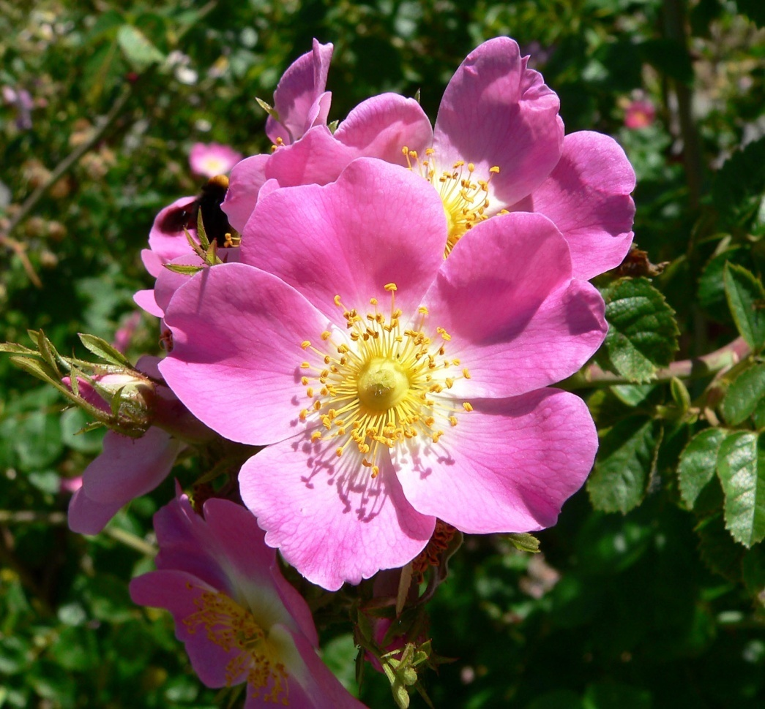
Welcome

Slide 2
Introduction
MD.AL-AMIN
ASSISTANT TEACHER
SANMANIA HIGH SCHOOL
KAPASIA,GAZIPUR
Sub:English
1st Paper Class: Ten

Slide 3
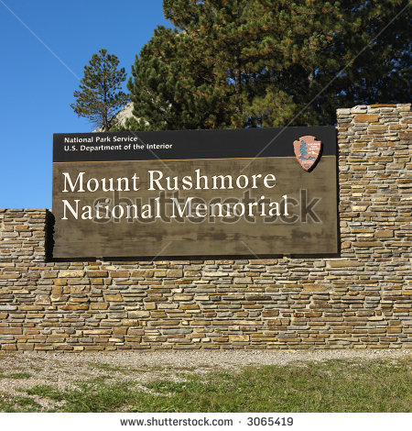
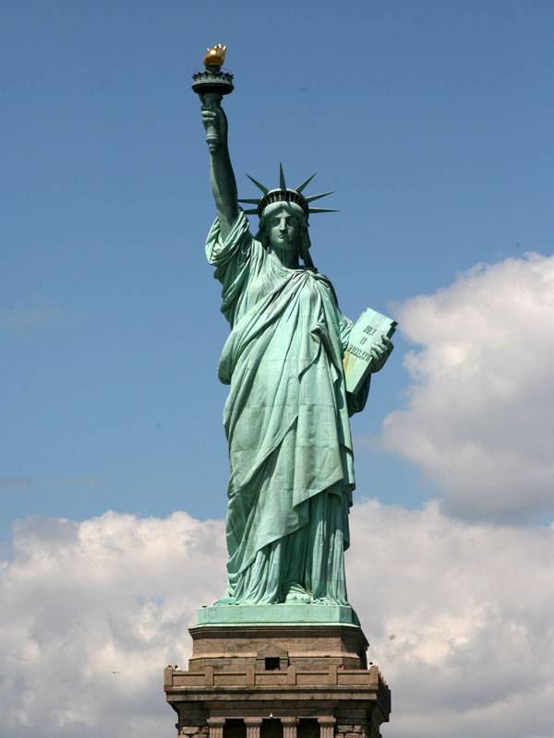
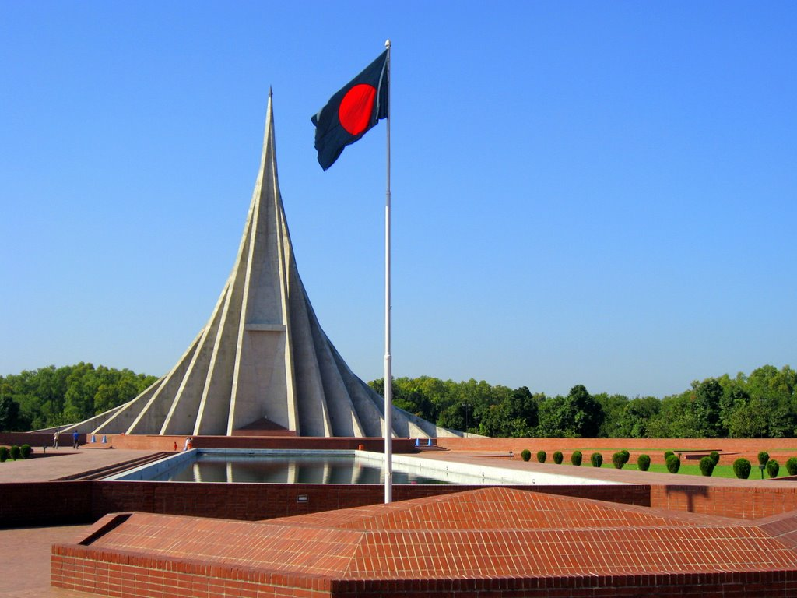

Slide 4
The National Memorial

Slide 5
Learning Outcomes
Where is the National Memorial situated?
Why do we bow down our heads before the graves of the martyrs?
What is the symbolical meaning of The National Memorial?

Slide 6
Teaching Learning Activities

Slide 7
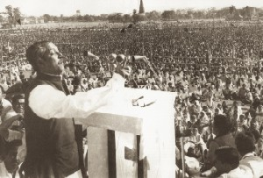
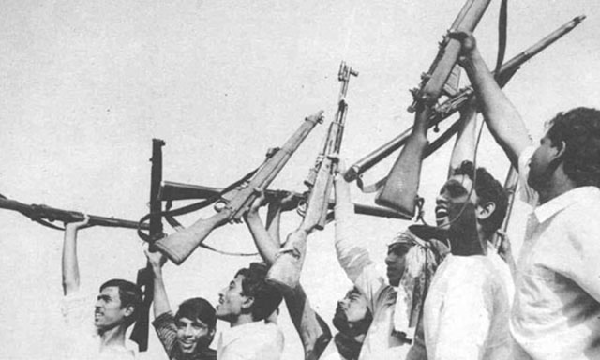
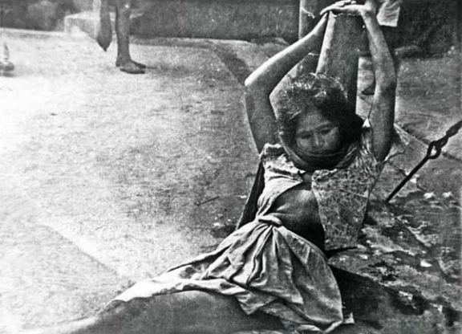
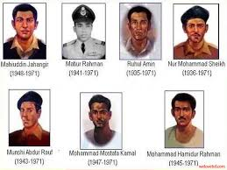
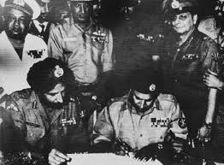

Slide 8
Group Work
Describe five important features of The National Memorial.

Slide 9
Evaluation
1.Who are the freedom fighters?
2.Why we go to the national Memorial?
3.What are the name of the greatestheroes?

Slide 10
Home Work
Why is The National Memorial called”It is built with conceate but made of blood” ?

Slide 11
Thanks

