Slide 1
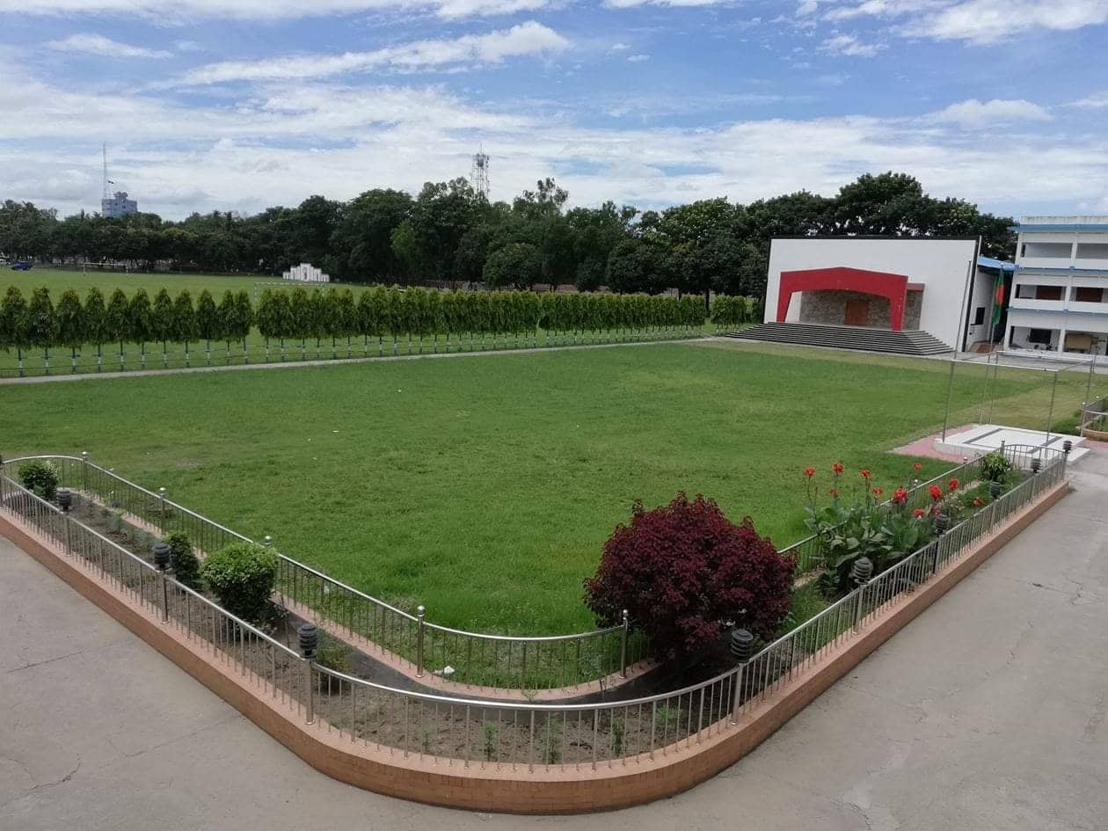
Welcome to all my dear students
Notes:
Welcome slide.

Slide 2
Introduction
Md. Abdul Motalab
Senior teacher (English)
Police Lines School and
College,Rangpur.
English For Today
Class-VIII
Notes:
Introduction of teacher & class.

Slide 3
Unit-6, lesson-3
Going through immigration

Slide 4
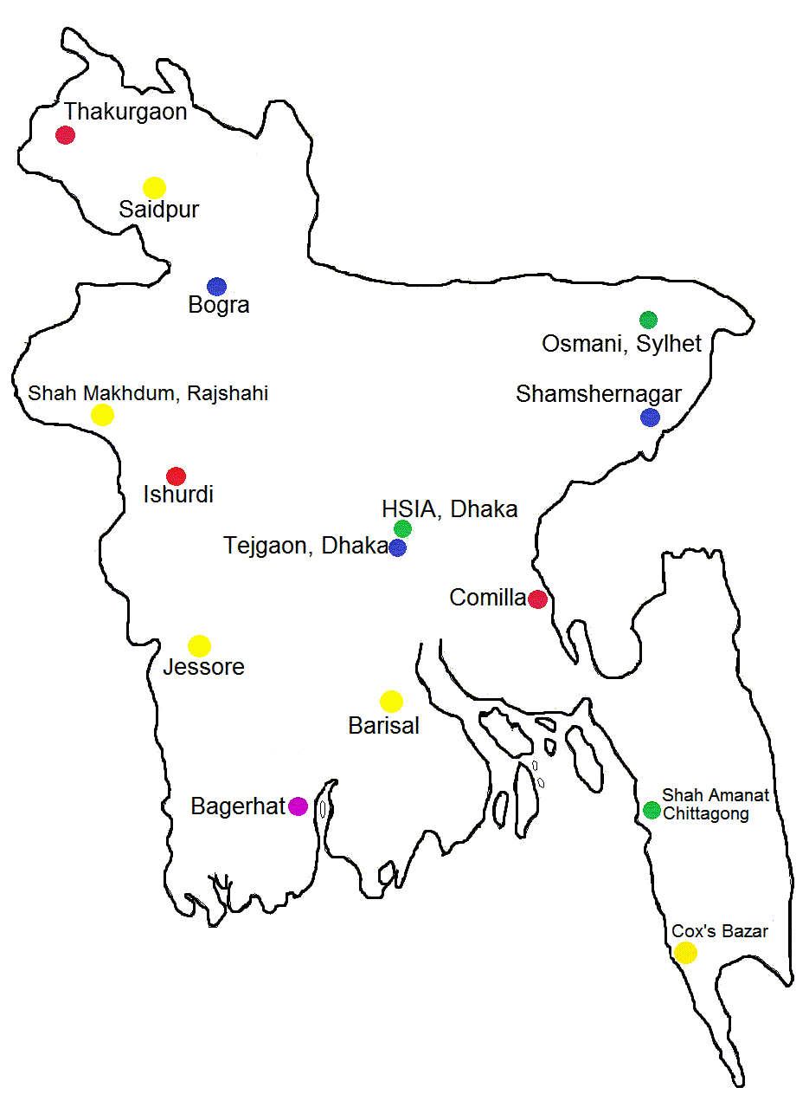
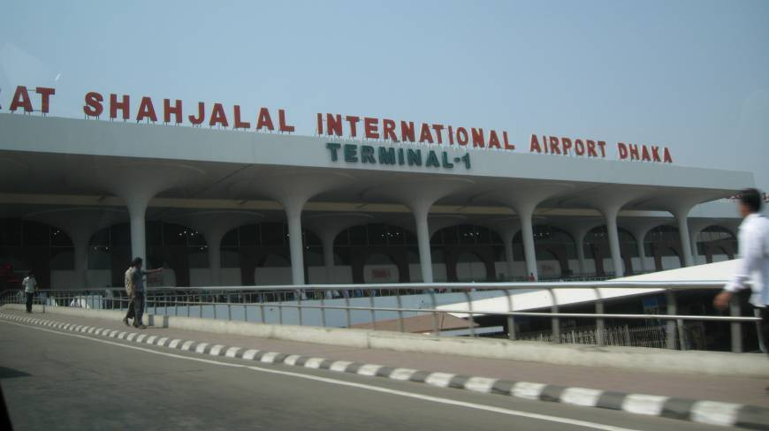
Legend under Bangladesh Map: 1. Green - International Airports 2. Yellow - Domestic Operational Airports 3. Blue - Airports where prior approval is needed

Slide 5
Topic’s name:
Going through immigration
Unit Six
Lesson- 3

Slide 6
LEARNING OUTCOMES
By the end of the lesson the learners will be able to
* talk about pictures
read a dialogue understanding it
ask and answer questions
make a list
act out a role play

Slide 7
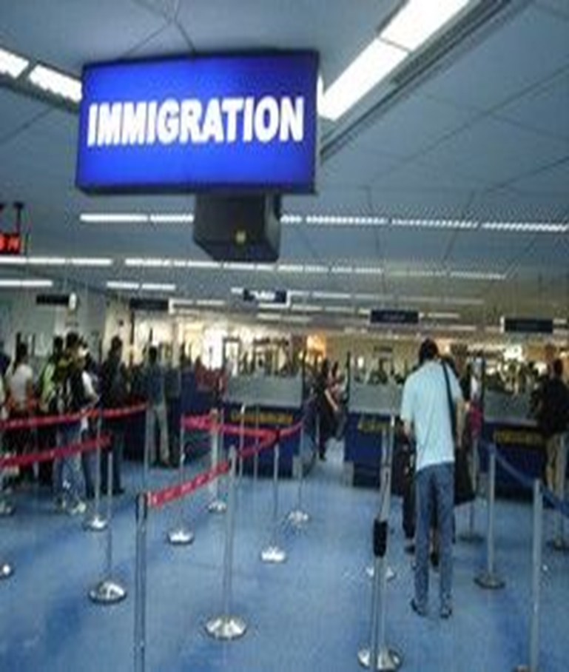
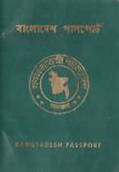
Pair Work : Before reading the text, look at the pictures and discuss in pairs /talk about the pictures.I will ask you some questions ,you will answer them.

Slide 8
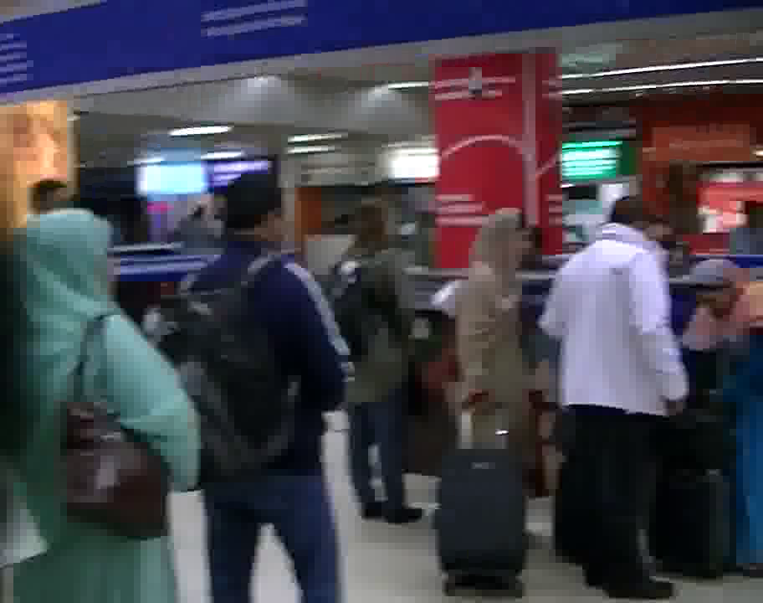
B .Text Reading: Read the text and answer following the questions .
1.Why does a person need a passport?
2.What are those booths for?
3.Why are people standing in a line in front of them?
4.What are the persons doing inside the booth?

Slide 9
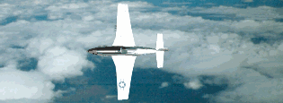
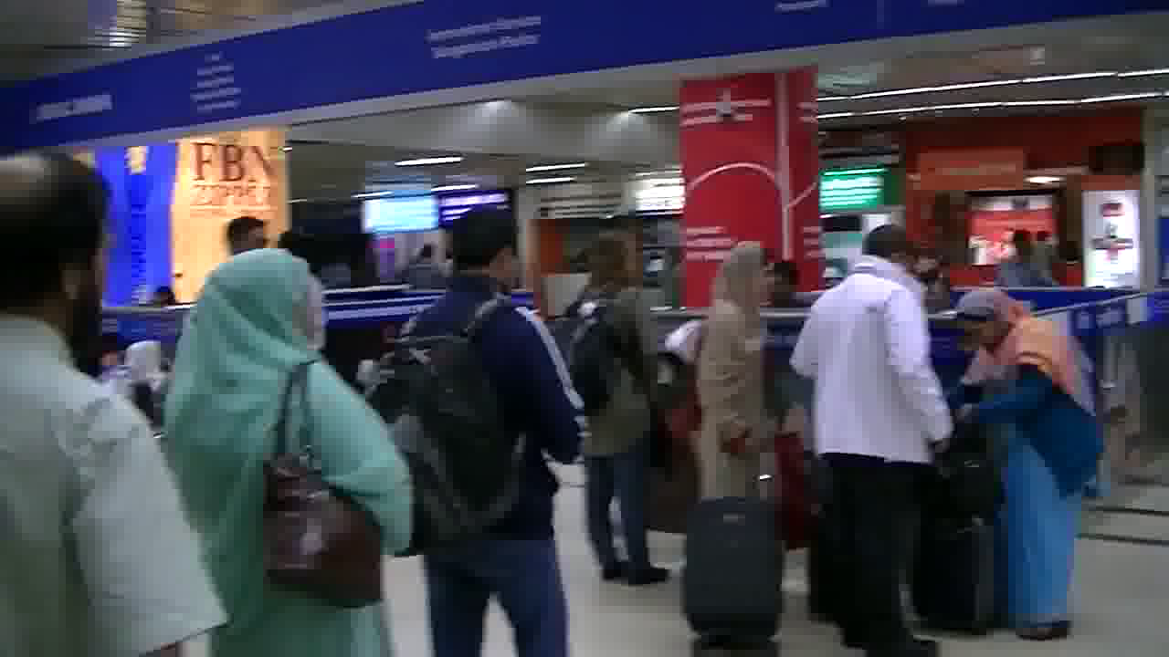
Immigration
(noun)
the part of a port, airport, etc where government employees examine the passports, visas, etc of foreign nationals entering the country
ˌ

Slide 10
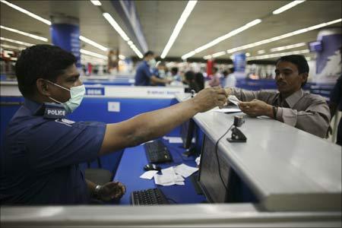
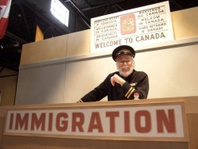
Immigration officer
a government employee who examines the passports, visas, etc of foreign nationals entering the country at a port, airport, etc

Slide 11
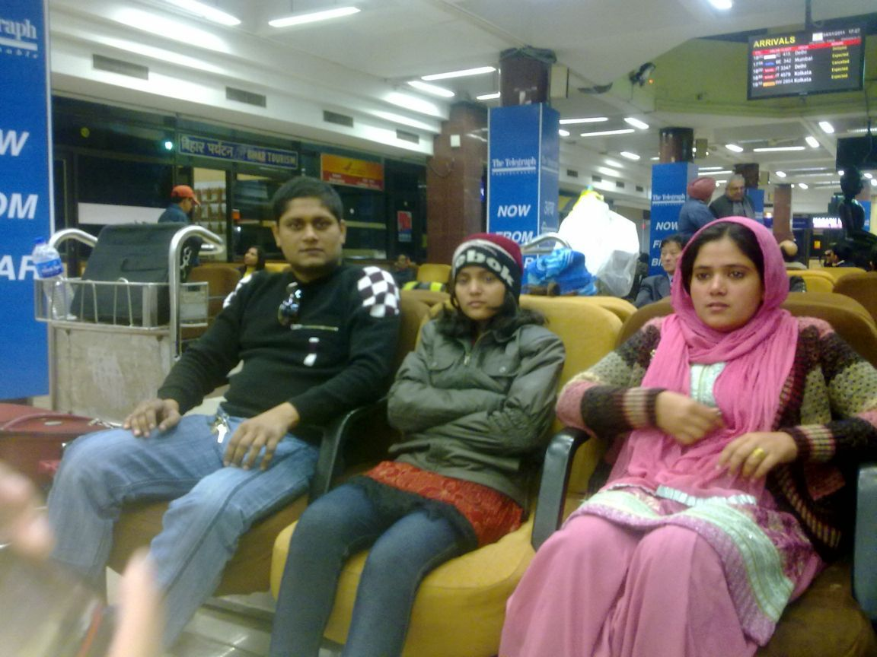
Departure Lounge (noun)
U.S
U.K
waiting area,
lounge
an area / a lounge with seating where passengers can await departure

Slide 12
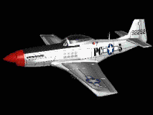
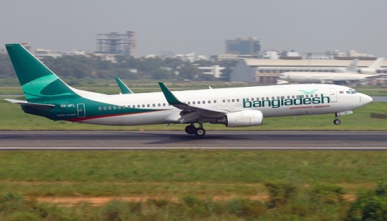
Departure (noun)
(d-pärchr)
The act of leaving
The plane is getting ready for departure .

Slide 13
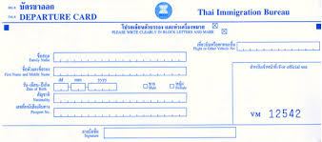
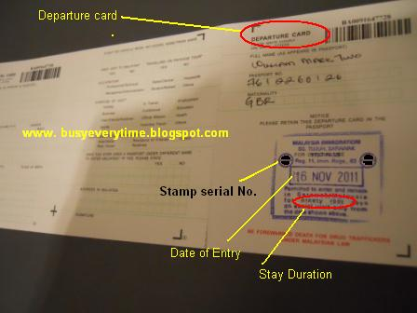
Departure
card
outgoing passenger card
or embarkation card
A departure card, also known as an outgoing passenger card or embarkation card, is a legal document used by immigration authorities to provide passenger identification and an effective record of a person’s departure from certain countries.
10 days

Slide 14
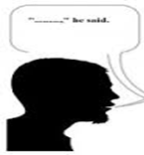
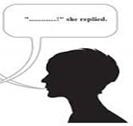
D. Act out the role of Mita and the Immigration officer.
C. Make a list first showing what the immigration officer asks and tells Mita and what Mita said in response.
Immigration officer
Mita
No , I’m Travelling with my aunt,
uncle and cousin.
Are you travelling alone?
Are they over thee right now ?
Yes , they ‘re waiting in front of
another counter.
Are you going to visit Thailand
for the first time ?
Yes, I’m going to visit Thailand
for the fist time.
Hou long are you going to
stay there ?
I’m going to stay there for
7-10 days.
I’m going to stay there
in a hotel.
Where are you going to stay ?

Slide 15
HOME WORK
E. Write the three things needed
at immigration.

Slide 16
May Allah bless you all

Slide 17
THANK YOU VERY MUCH

