Slide 1
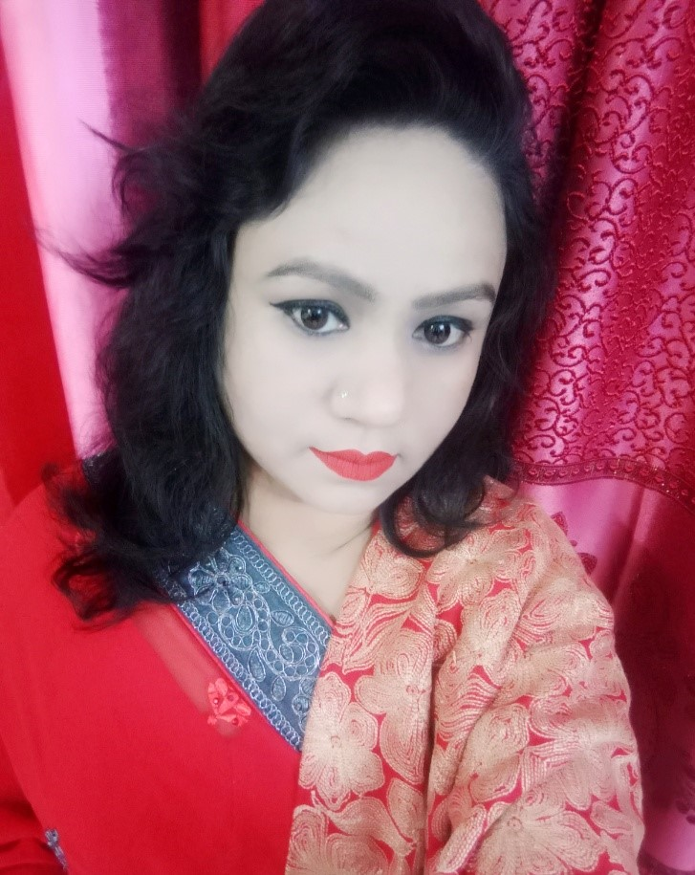
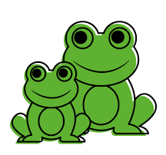
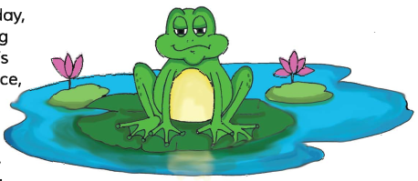
Welcome to
my
Multimedia class
Nahid Akhtar parvin
Jagodishpur government
primary school.
Ekarchali,taragong,
rangpur

Slide 2
Learning outcomes
At the end of the lesson-
Students will be able to ____
read the text with correct pronunciation.
choose appropriate answers from the alternatives.
make answers of the textual questions.

Slide 3
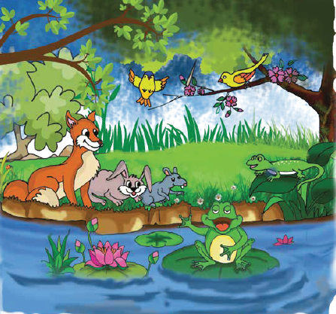
What can you see in this picture?
What are they doing?

Slide 4
Did you notice the sound on the video?
Yes
What was the sound?
Croak, croak
Which animal makes this sound?
Frog

Slide 5
TODAYS LESSON IS
WHY DOES THE FROG QROAK?

Slide 6
New words
Sound – শব্দ / ধ্বনি
Voice – কণ্ঠস্বর
Enjoy – উপভোগ করা
Answer – উত্তর

Slide 7
Why does the frog croak?
Class- Five
Unit-25 lesson: 1
OPEN YOUR BOOK-
Page- 98
What sound……he said

Slide 8
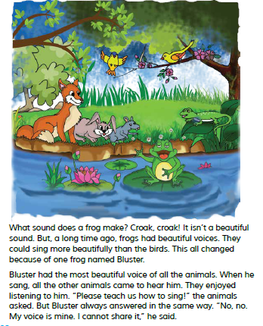

Slide 9
Pronunciation
BLUSTER
BLUS
TER
BLUSTER
BEAUTIFUL
BEAU
TI
FUL
BEAUTIFUL

Slide 10
Fill in the blanks.
1.What sound does a frog ------?.
2.Frog had ---------- voice.
3.They enjoyed ------to him.
Make
beautiful
listening

Slide 11
Make sentences given by the word
─
Sing
I can sing song.
─
Share
I cant share the apple with you.
─
Birds
Birds like to fly.

Slide 12
Evaluation
1.What sound does a frog make?
Ans: croak croak.
2.When did the frogs have more beautiful voice then birds ?
Ans: A long time ago, frogs have more beautiful voice then birds .
3.Which frog had the most beautiful voice ?
Ans:Bluster had the most beautiful voice .

Slide 13
One day one word
Always
- সবসময় -
Lina always try to speak truth,

Slide 14
Home work.
Why did bluster refuse to share his voice ?
Write only two sentences.

Slide 15
THANKS ALL
THINK
POSITIVE
BE POSITIVE.

