Slide 1
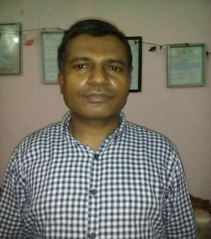
WELCOME

Slide 2
Introduction
TEACHER
Mohammad Nasir Uddin
Senior teacher
Burischar Zia-ul-ulum Fazil(Degree)Madrasha
Hathazari,Chattagram.
Lesson
Class: Seven
Subject: English2nd paper
Topic: Preposition
Time: 40 minutes

Slide 3
Learning outcomes
By the end of the lesson, the students will be able to
tell what prepositions are
identify the prepositions
Use the prepositions

Slide 4
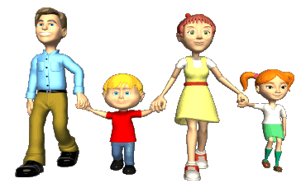
Look at the pictures and sentences;-
Abdur Rahaman is with his family. They are going to visit National Memorial.

Slide 6
A preposition is a word that sits before a noun or pronoun

Slide 7
1.Where are the boats?
2. Where is the man?
3. Where is the bird?
Ans: in the river
Ans: on the buffalo
Ans: on a branch

Slide 8
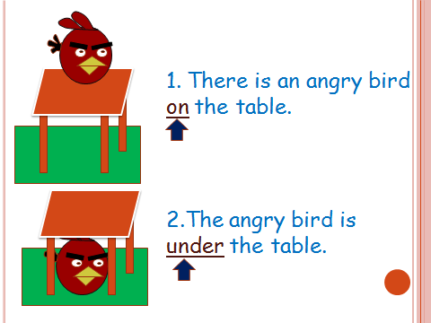

Slide 9
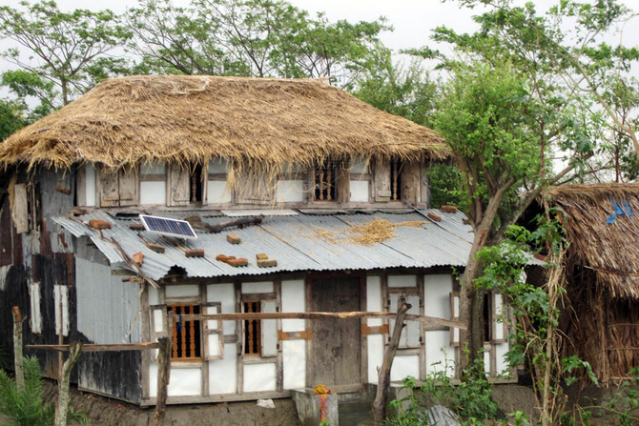
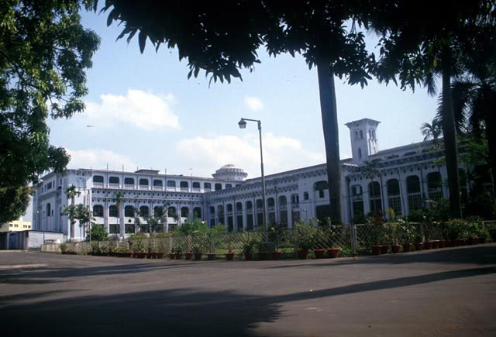
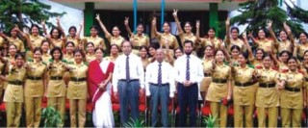
From
To
Asif is a student of acollege.He comes to college from a village.

Slide 10
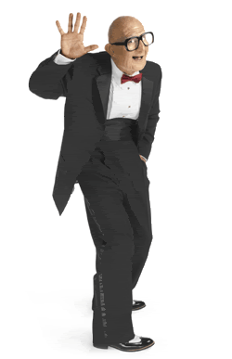
Look at the pictures and tell……
the men in the pictures –alone or with some body.
Abdul is with his family.
Rahim is without his family.

Slide 11
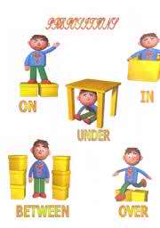
Look the picture below and identify the position of the dolls

Slide 13
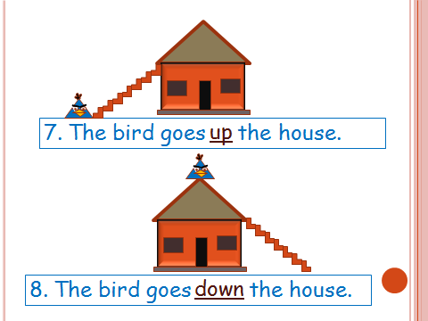

Slide 15
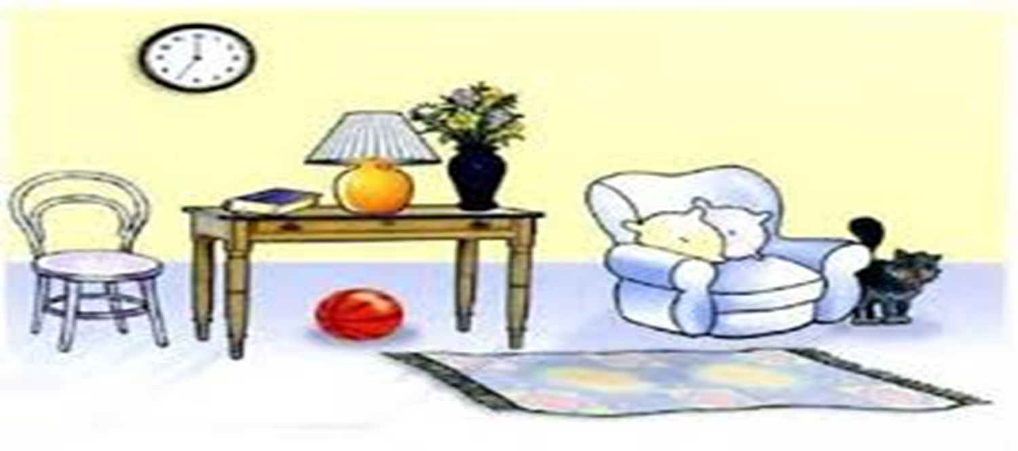
Fill in the gape with preposition watching the pictures below
on
1.The book is-------------the table.
2.The ball is ------------the table.
3.The cat is ---------------the armchair.
4.The table is----------------the armchair.
5.The carpet is-------------------the floor.
6.The lamp is------------------------the table.
7.The flowers are----------------------the vase.
8.The table is------------------------------the chair and the armchair
under
beside
beside
on
on
in
between

Slide 16
Individual work
Read the sentences carefully and identify the prepositions
We sleep ------- night.
She sits-------me.
I will wait ------- you.
We live ----------- Bangladesh.
He is coming -------- Monday.
The students go ------- school.
The cat is ----------- the table.
I will go ---------- you.
The sky is ------------ the earth.
Birds fly --------------- our heads.
We live --------- Burischer-----------Chattagram.
Distribute the mangoes ---------------- the boys.
at
by
for
in
on
to
under
with
above
over
at
in
among

Slide 17
HOME WORK
Fill in the gaps of the passage with preposition from the box.
Modern age is the age--- computer. We can not do even a day ----- computer. Computer is a must --- any institution. We can communicate with others ---- a second ------it. So, we all should learn how ------operate it now a day.
For, without, of, from, in,within,with,to

Slide 18
THANK YOU ALL

