Slide 1
Welcome

Slide 2
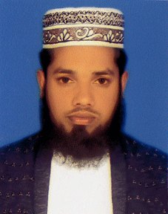
INTRODUCTION
Md. Shahalom
Assistant Teacher (ICT)
Juranpur Karimunnesa High School, Daudkandi, Comilla.
Cell: 01712105450
CLASS: SIX
SUBJECT: ENGLISH SECOND PAPER
UNIT: Six
TOPIC: Tense

Slide 3
Black Zone
Blue zone
Red Zone
Future
Past
Bus stop
Present
Bus

Slide 8
There are three kinds of tenses
1. PRESENT TENSE
2. PAST TENSE
3. FUTURE TENSE
Every tense is divided into four kinds
Present indefinite tense
Past indefinite tense
Future indefinite tense
Present continuous tense
Past continuous tense
Future continuous tense
Present perfect tense
Past perfect tense
Future perfect tens
Present perfect continuous tens
past perfect continuous
Future perfect continuous

Slide 10
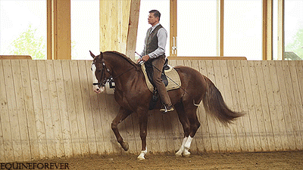
Present Continuous Tense
The horse is running with a man on its back.
The bird is flying is the sky.

Slide 15
Evaluation
Write the structures of the following sentences:
Shahin reads a story book.
Rahman wrote a book.
It has been raining since morning.
Rafik will be playing a football.

