Slide 1
Communication Technology: Fixed Phones, Cell Phones, SMS, Fax, E-mail

Slide 2
Communication Technology
Communications Technology – “the activity of designing, using and maintaining communication systems”

Slide 3
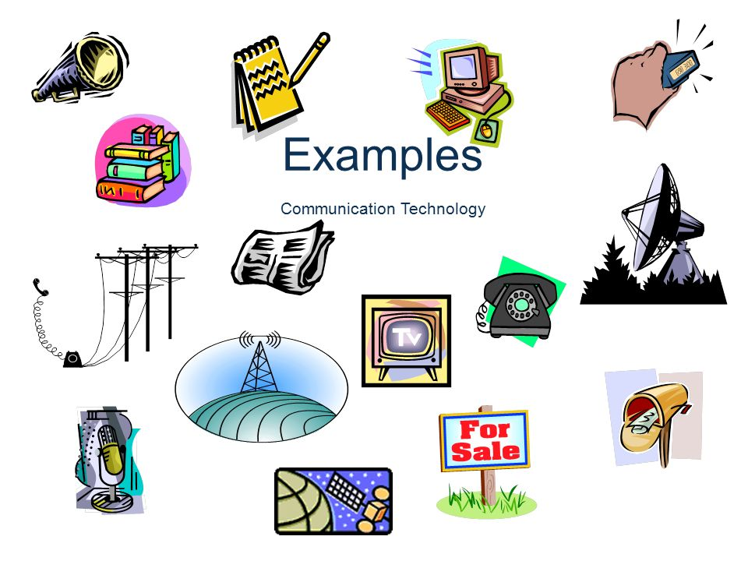
Communication Technology: Example

Slide 4
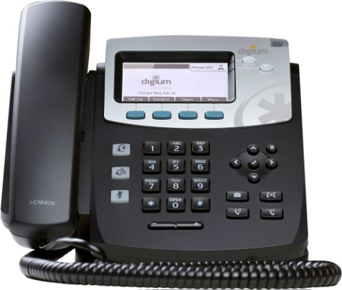
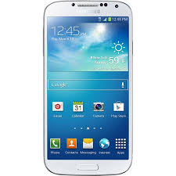
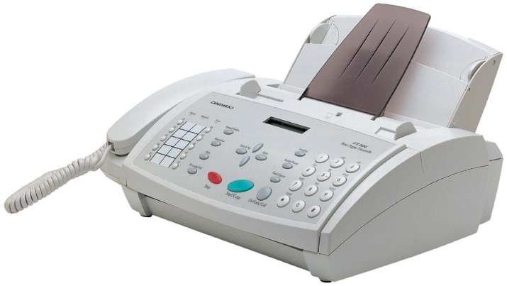

Types of Communication Technology
Phone
Facsimile (Fax)
E-mail

Slide 5
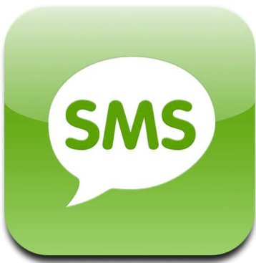
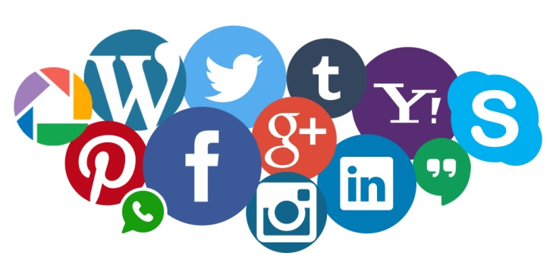
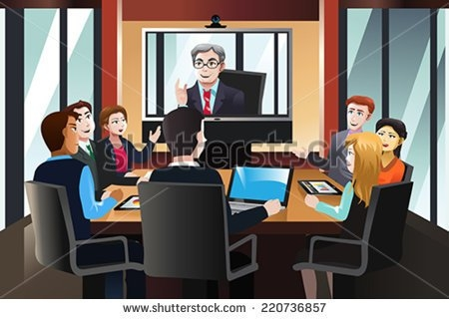
Types of Communication Technology
Texting, Instant messaging, SMS
Social networking, Tweeting, Blogging
Video conferencing.

Slide 6
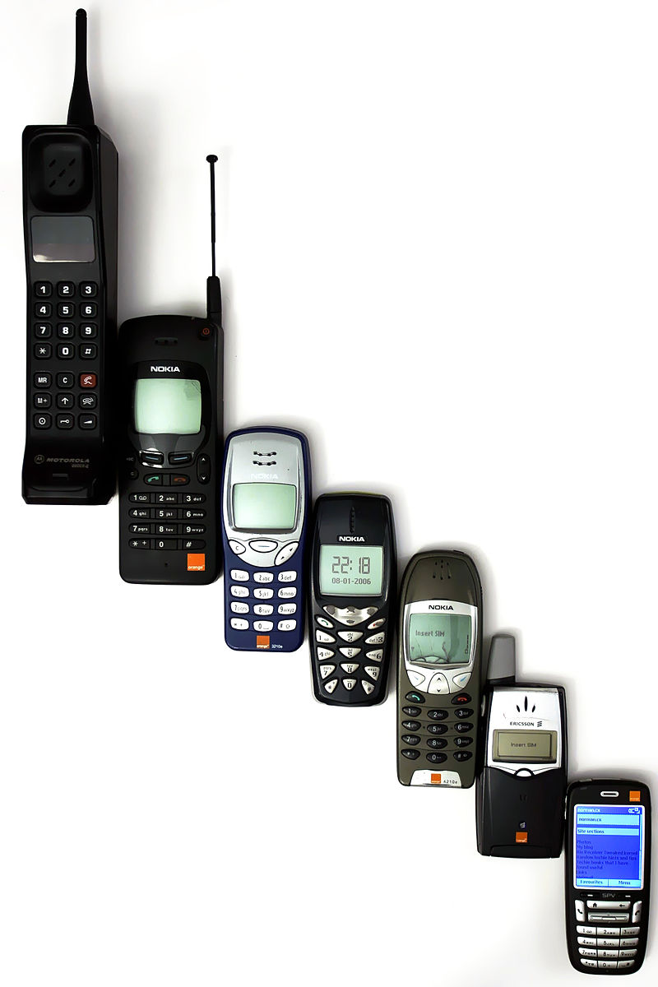
Evolution of Mobile Phones→Smartphone

Slide 7
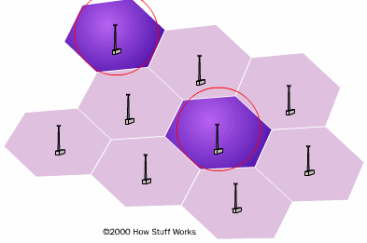
Cell Phone Technology

Slide 8
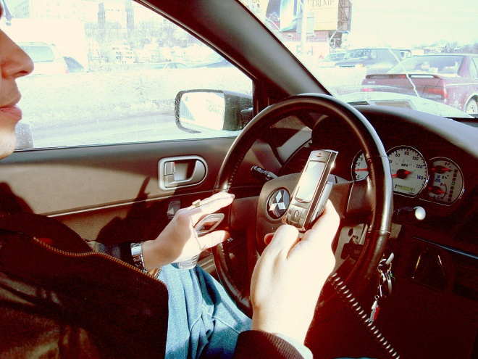
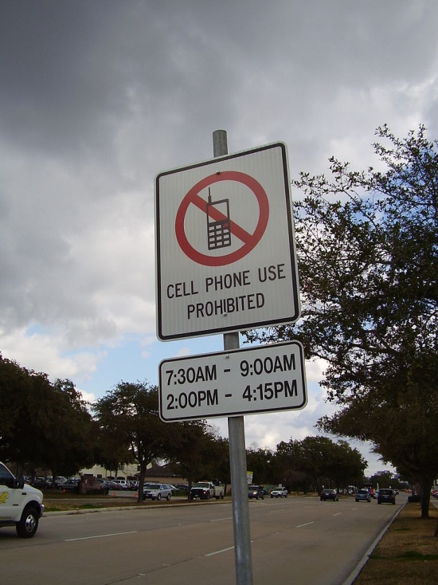
Cell Phone Uses: While Driving
Mobile phone use while driving is common, but controversial.
It is widely considered dangerous due to distracted driving.

Slide 9
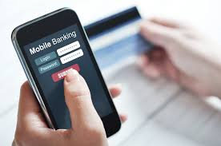
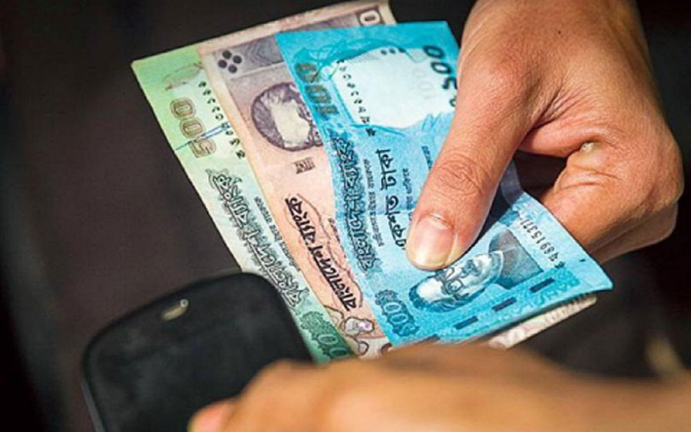
Cell Phone Uses : Mobile Banking and Payment
In many countries, mobile phones are used to provide mobile banking services, which may include
  the ability to transfer cash payments by secure SMS text message.
  Mobile payments were first trialled in Finland in 1998 with SMS payments.
Some mobile phones can make mobile payments

Slide 10
Cell Phone Uses: Mobile Banking and Payments in BD
SL# | Bank Name | Product Name
1. | Duch-Bangla Bank Limited. | Mobile-Banking
2. | BRAC Bank Limited. | bKash
3. | Prime Bank Limited. | EasyCash
4. | Islami Bank Bangladesh Limited. | mCash
5. | Trust Bank | Mobile Money
6. | National Credit and Commerce Bank Limited | SureCash
8. | Dhaka Bank | SMS Banking
9. | Mercantile Bank | Mobile Banking

Slide 11
Cell Phone: Educational and Social Impact
A study by the London School of Economics found that banning mobile phones in schools could increase pupils' academic performance, providing benefits equal to one extra week of schooling per year.

Slide 12
Cell Phone: Health Effects
The effect of mobile phone radiation on human health is the subject of recent interest and study.
Mobile phones use electromagnetic radiation in the microwave range, which someone believe may be harmful to human health.
A large research exists, both epidemiological and experimental, in non-human animals and in humans.
The majority of this research shows no definite causative relationship between exposure to mobile phones and harmful biological effects in humans.
On 31 May 2011, the World Health Organization stated that mobile phone use may possibly represent a long-term health risk.

Slide 13
Cell Phone: Health Effects
Some recent studies have found an association between mobile phone use and certain kinds of brain and salivary gland tumors.
Lennart Hardell concluded that cell phone usage for at least ten years approximately doubles the risk of being diagnosed with a brain tumor
One study of past mobile phone use cited in the report showed a "40% increased risk for gliomas (brain cancer) in the highest category of heavy users (reported average: 30 minutes per day over a 10‐year).
Certain countries, including France, have warned against the use of mobile phones by minors in particular, due to health risk uncertainties.
In May 2016 preliminary findings of a long-term study by the U.S. government suggested that radio-frequency (RF) radiation, the type emitted by cellphones, can cause cancer.

Slide 14
SMS: Message Size
Mobile Application Part (MAP) => SMSC (using SS7 protocol).
Messages length 140 bytes (140 bytes * 8 bits / byte = 1120 bits).
Short messages can be encoded using a variety of alphabets
Depending on which alphabet the subscriber has configured in the handset, this leads to the maximum individual short message sizes of
  160 7-bit characters,
  140 8-bit characters, or
  70 16-bit characters.
Larger content can be sent using multiple messages,

Slide 15
SMS: Unreliability
SMS message delivery is not guaranteed, and many implementations provide no mechanism through which a sender can determine whether an SMS message has been delivered in a timely manner.
SMS messages are generally treated as lower-priority traffic than voice, and various studies have shown that around 1% to 5% of messages are lost entirely,
The use of SMS as an emergency notification service in particular has been questioned

Slide 16
SMS: Flash SMS
A Flash SMS is a type of SMS that appears directly on the main screen without user interaction and is not automatically stored in the inbox.
It can be useful in emergencies, such as a fire alarm or cases of confidentiality, as in delivering one-time passwords
GP showing balance after call

Slide 17
What is email?
Short for electronic mail
Send & receive messages over the internet

Slide 18
What is email?
“E-mail is text-based mail sent via the computer from one person to another.”
“E-mail is an ideal method for sending documents already on your computer using attachments.”
“E-mail is a way to communicate with people as close as your office or as far away as the other side of the world.”

Slide 19
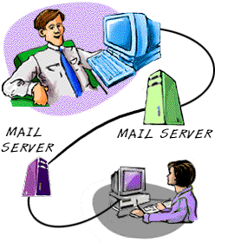
How E-mail Works?
E-mail serves exchange messages using the SMTP protocol.

Slide 20
How to Make an Effective E-mail ?
Selecting Your Audience Correctly
  Who should be the main addressee
  If you are replying to a message does reply go the to right address
  Should my reply go just to the sender, or all or just some of the original recipients?

Slide 21
How to Make an Effective E-mail ?
Using Distribution Lists
Composing Your Messages
  Make the heading meaningful
  Keep each message short and clear.
  Start each message by stating its purpose/context

Slide 22
Summary
Communication Technology
  Phone, Cell Phone, Fax, SMS, E-mail
Most of the people using modern advancement of communication technology
We need to use communication technology properly

Slide 23
Thank you!!!

