Slide 1
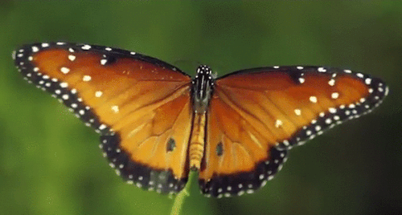
WELCOME
Din Mohammad Email: dmshopon1982@gmail.com Mob: 01720833739

Slide 2
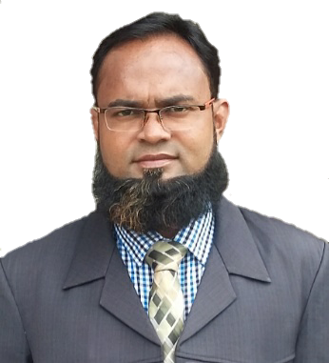
Introduction
Grade -3
Sub: English
unit: 19
Lesson: 3-4
Occupation
Din Mohammad
Assistant Teacher
Satpoa Talutia Govt. Primary School
Gazipur Sadar, Gazipur.
Din Mohammad Email: dmshopon1982@gmail.com Mob: 01720833739

Slide 3
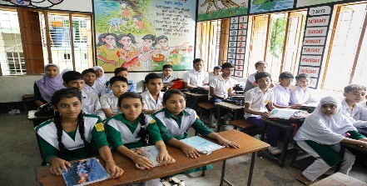
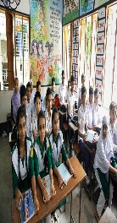
Good morning, students.
Good morning, teacher.
How are you today?
Fine. and you?
Fine, thank you.
Din Mohammad Email: dmshopon1982@gmail.com Mob: 01720833739

Slide 4
Din Mohammad Email: dmshopon1982@gmail.com Mob: 01720833739

Slide 5
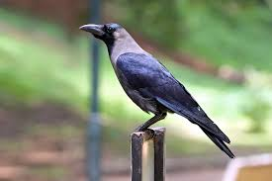
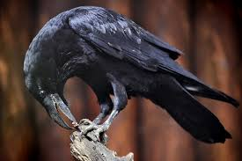
What do you see in the picture?
Din Mohammad Email: dmshopon1982@gmail.com Mob: 01720833739

Slide 6
What do you see in the picture?
What do they do?
Din Mohammad Email: dmshopon1982@gmail.com Mob: 01720833739

Slide 7
Learning outcomes:
Students will be able to
Listening: 1.1.1- recognize English sound difference in the context of words.
Speaking: 1.1.1- repeat words, phrases and sentences after the
teacher with proper sounds and stress.
1.1.2- say words, phrases and sentences with proper
sounds and stress.
Reading: 1.5.1- read simple sentences with proper
pronunciation and stress.
5.1.3- read text
Din Mohammad Email: dmshopon1982@gmail.com Mob: 01720833739

Slide 8
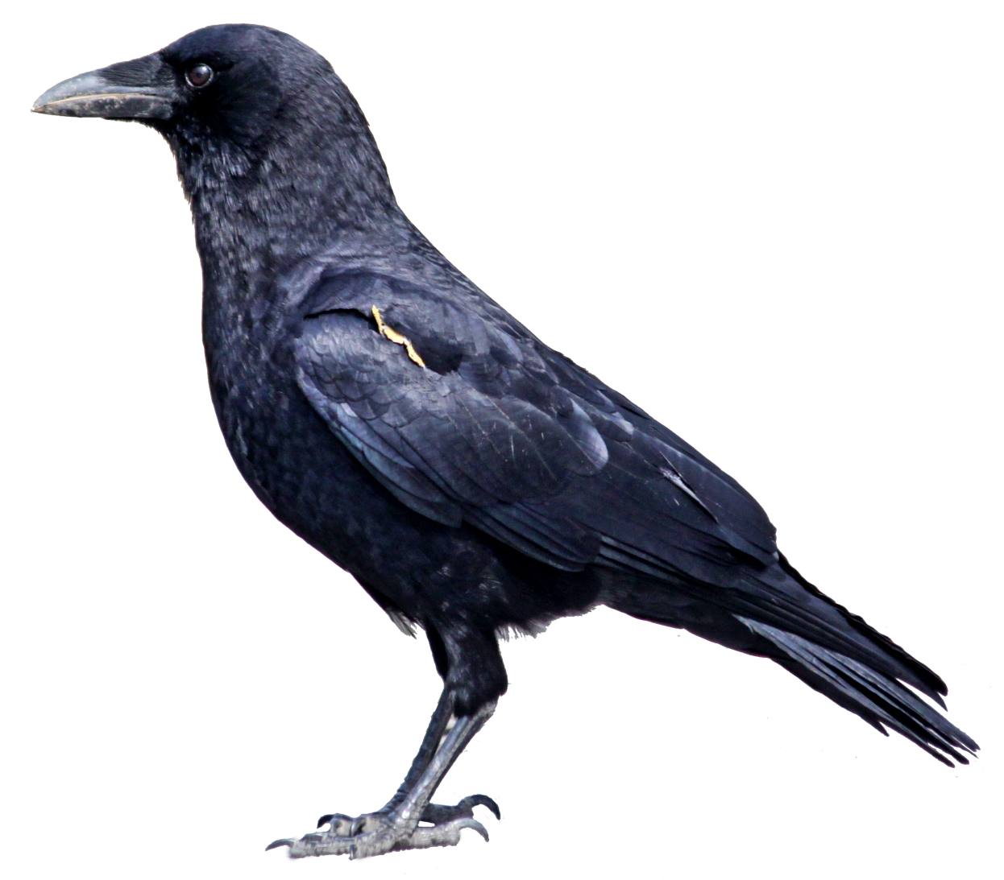
Look at the picture and say.
I’m a crow.
Din Mohammad Email: dmshopon1982@gmail.com Mob: 01720833739

Slide 9
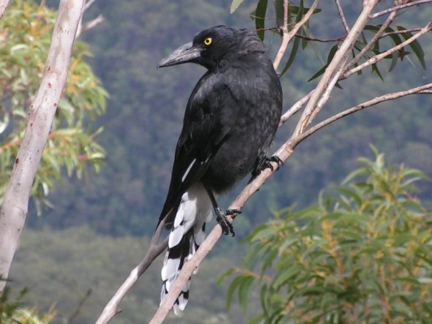
Look at the picture and say.
I live in a tree.
I get up early in the morning.
Din Mohammad Email: dmshopon1982@gmail.com Mob: 01720833739

Slide 10
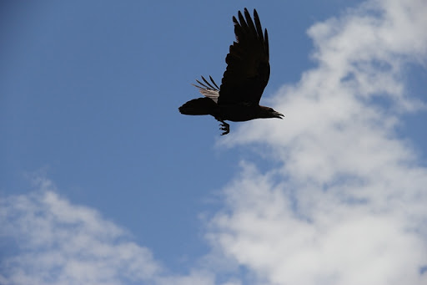
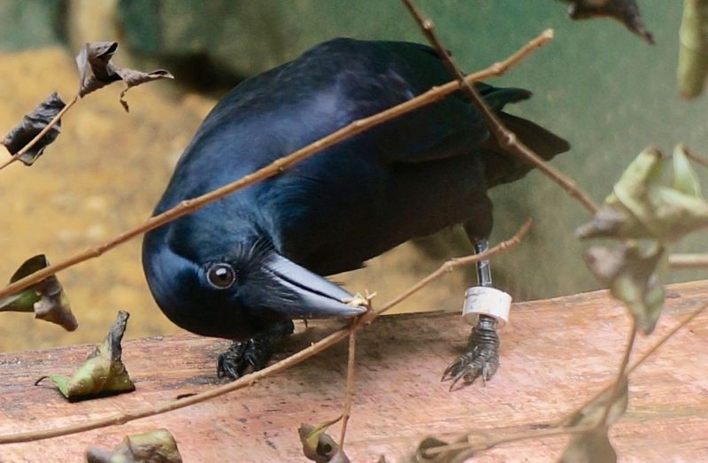
Look at the picture and say.
I fly in the sky.
I’ m active all day.
Din Mohammad Email: dmshopon1982@gmail.com Mob: 01720833739

Slide 11
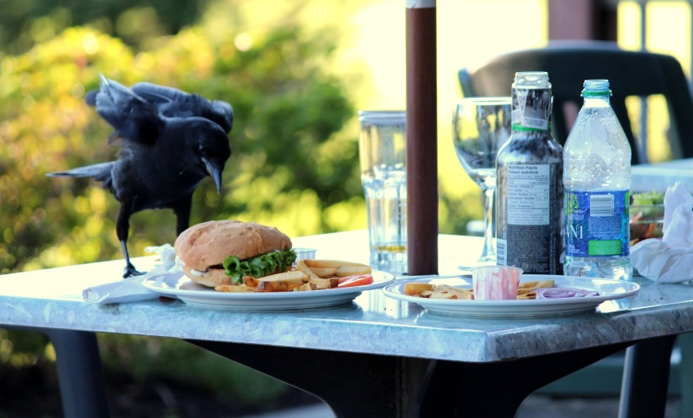
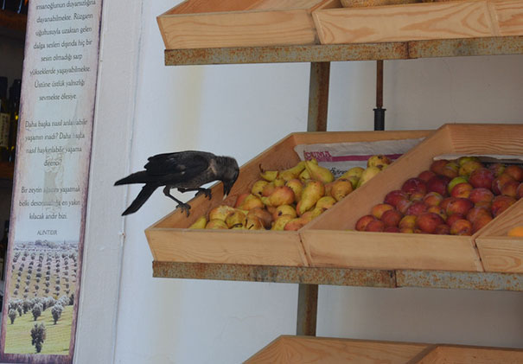
Look at the picture and say.
Sometimes I take food from people.
Din Mohammad Email: dmshopon1982@gmail.com Mob: 01720833739

Slide 12
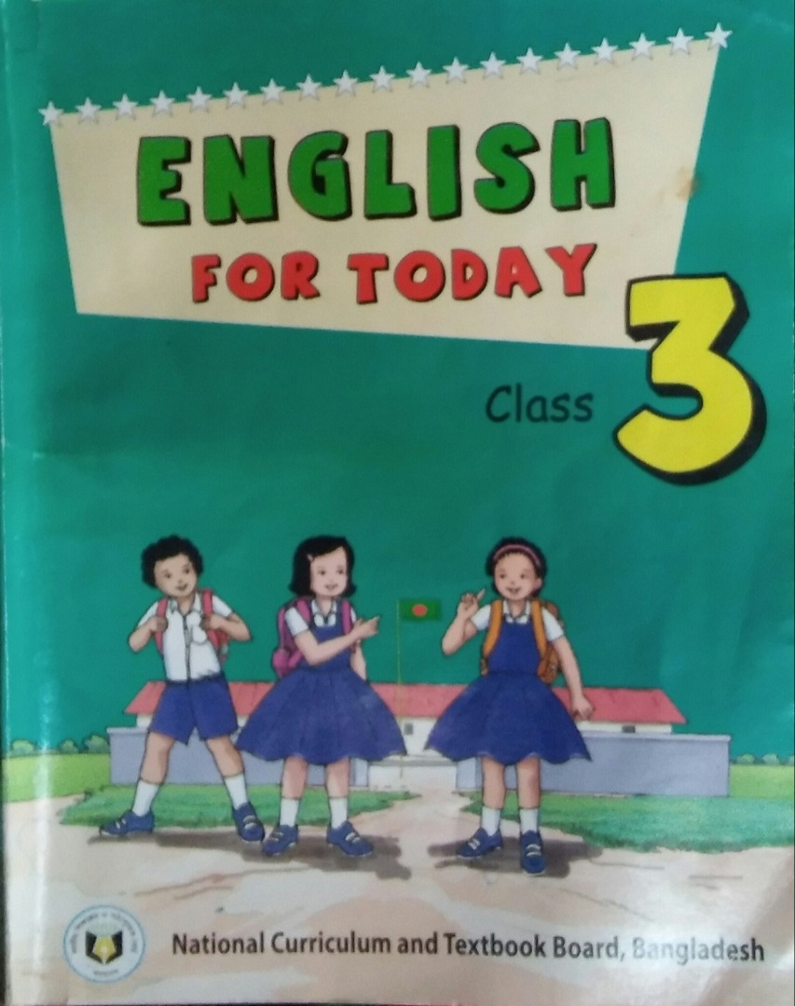
Open your book at page 47.
Din Mohammad Email: dmshopon1982@gmail.com Mob: 01720833739

Slide 13
Teacher’s reading Loudly
I’m a crow. I live in a tree. I get up early in the morning. I’m active all day. I fly in the sky and look for food. Sometimes I take food from people. I’m very quick. Sometimes I eat dirty things.
Din Mohammad Email: dmshopon1982@gmail.com Mob: 01720833739

Slide 14
Student’s reading silently
Din Mohammad Email: dmshopon1982@gmail.com Mob: 01720833739

Slide 15
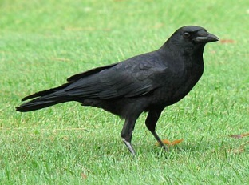
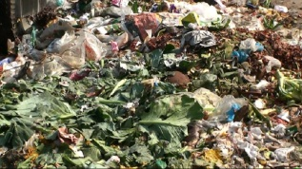
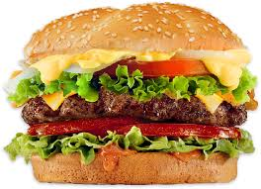
New word
Crow
Fly
Dirty
Food
Din Mohammad Email: dmshopon1982@gmail.com Mob: 01720833739

Slide 16
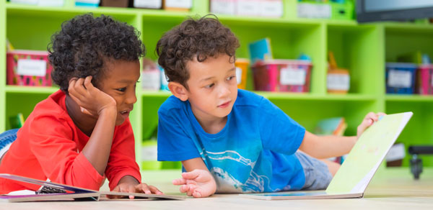
Let’s work in pair
Read the text again and again
Din Mohammad Email: dmshopon1982@gmail.com Mob: 01720833739

Slide 17
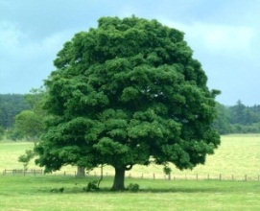
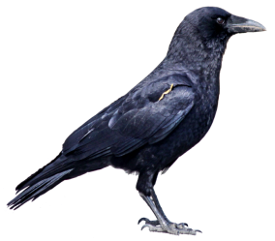
Individual work
Tree
Crow
See the pictures and say about these
Food
Din Mohammad Email: dmshopon1982@gmail.com Mob: 01720833739

Slide 18
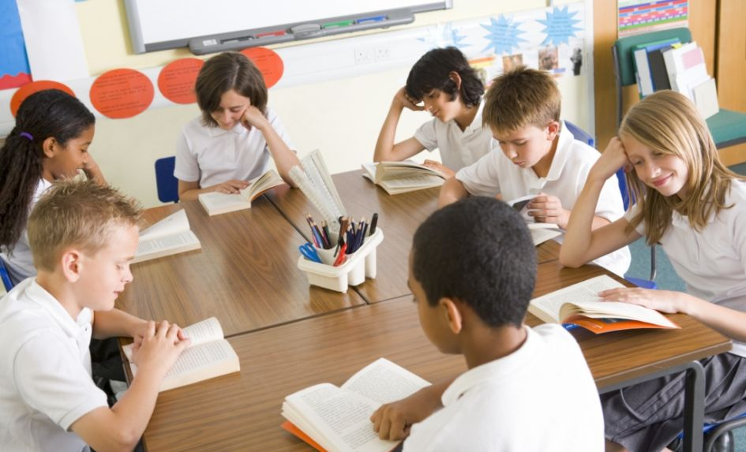
Let’s work in group
Say true or False.
1. The crow lives in a tree.
True
2. The crow is lazy.
False
3. The crow is slow.
False
4. The crow doesn’t eat dirty things.
False
5. The crow takes food from people.
True
Din Mohammad Email: dmshopon1982@gmail.com Mob: 01720833739

Slide 19
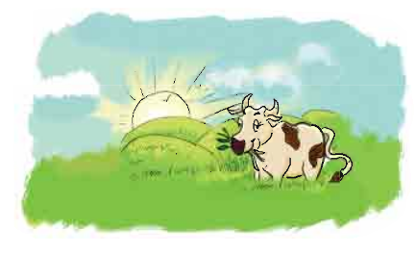
Checking learning
I’m a cow/goat. I live in a stream/shed. I get up early/late. I am slow/quick animal.
Din Mohammad Email: dmshopon1982@gmail.com Mob: 01720833739

Slide 20
Din Mohammad Email: dmshopon1982@gmail.com Mob: 01720833739

