Slide 1
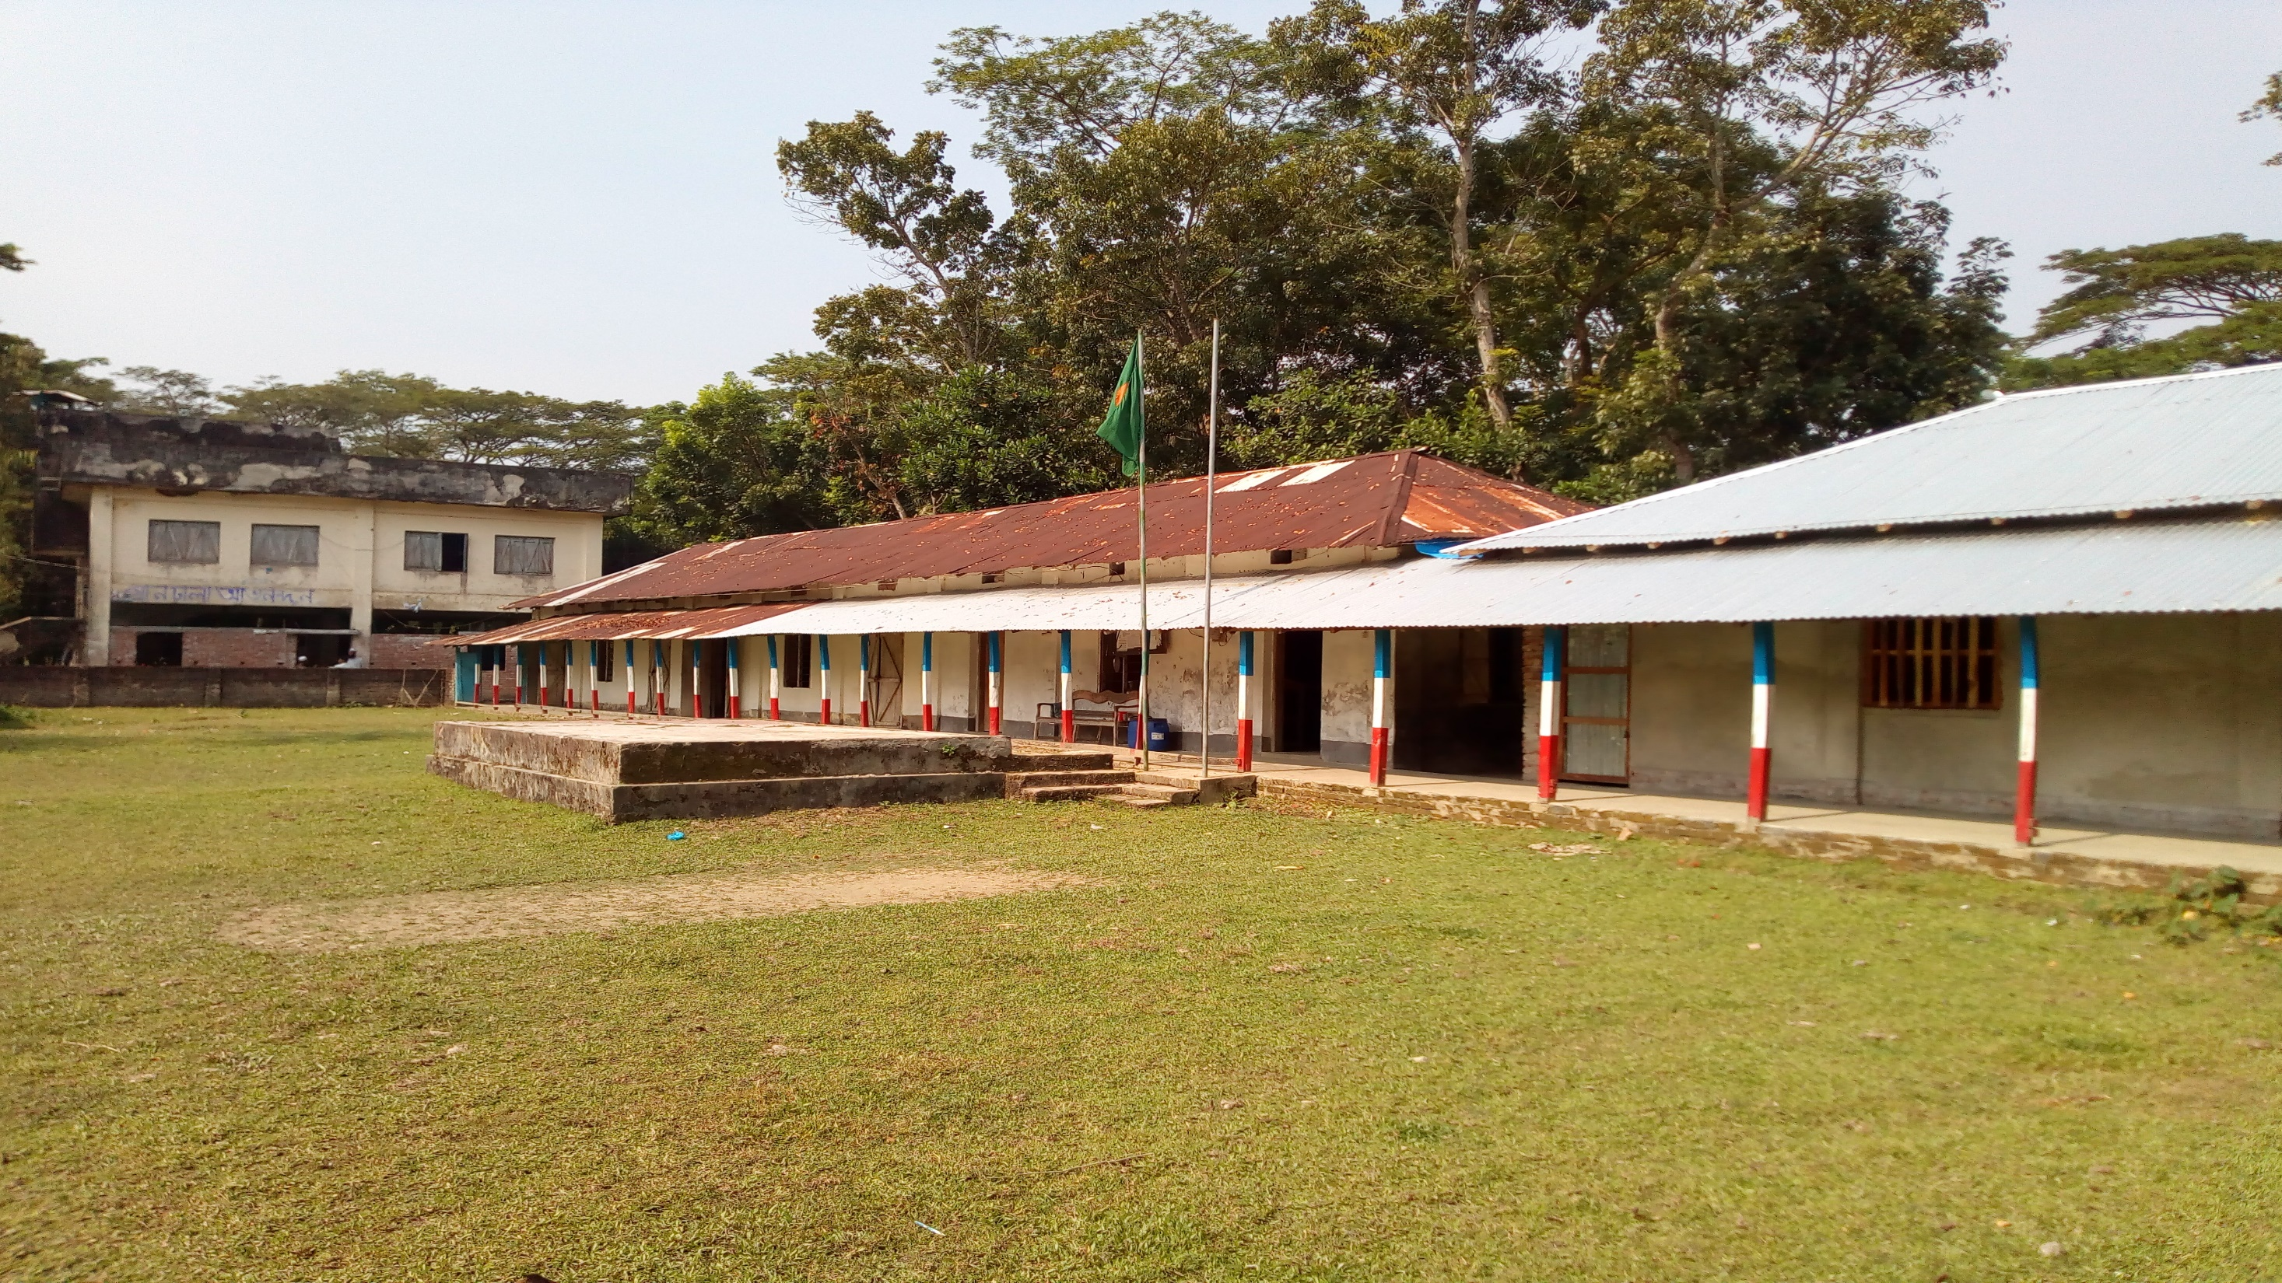
Well come
To
My
Online class
The Best teacher in the world

Slide 2
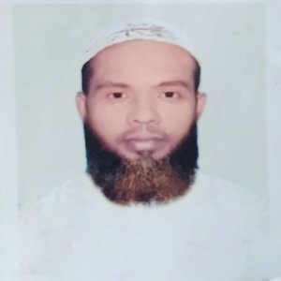
TEACHER
Muhammad Ahsan Habib
Assistant Teacher
Mohsenuddin Nuria Fazil (Degree) Madrasah
Bauphal, Patuakhali
Mobile-01754755169
E-mail- ahsanhabib251281@gmail.com

Slide 3
SUBJECT MATTER
Class- Nine
Subject- English 2nd paper
(Q. 12- Write a CV with a cover letter )

Slide 4
Subject: English 2nd paper Subject code-137 Time: 3 hours Full Marks: 100
Part-A: Grammer
Marks: 60
Part-B: Writing
Marks: 40

Slide 5
Marks: 40
Q. 12- Write a CV with a cover letter 10
Q. 13- Write an application or an E-mail 10
Q. 14- Write a paragraph 10
Q. 15- Write a composition out of three 10
Part-B: Writing

Slide 6
C V
10/10/2020
To
The .............
...................
Sub: Application for the post of ...................................................
Sir,
I beg most respectfully to state that I am a candidate for the post of ..................................................... Here is my C V.
Name : .....................
Father’s name: Abdur Rohim.
Mother’s name: Mst. Rohima.
Address: Baufal, Patuakhali.
Date of birth : 12/12/1995.
Religion: Islam.
Nationality :Bangladeshi.
Education:
I their for pray and hope that you would be kind enough to grant me for the post of ....................................................................
I remain
sir
...............
Exam | year | G P A | BOard
S S C | 2010 | A | Dhaka
H S C | 2012 | A | Dhaka
B A | 2015 | A | Dhaka
MA | 2017 | A | Dhaka

Slide 7
Example-1
Q. 12- Suppose, you are Fahim and you have seen a vacancy ad for the post of a computer operator.
Now write a C V with cover letter for the post . Your C V should not exceed one page.
10/10/2020
To
The Chairman,
X company .
Sub: Application for the post of a computer operator
Sir,
I beg most respectfully to state that I am a candidate for the post of a computer operator. Here is my C V.
Name : Fahim
Father’s name: Abdur Rohim.
Mother’s name: Mst. Rohima.
Address: Baufal, Patuakhali.
Date of birth : 12/12/1995.
Religion: Islam.
Nationality :Bangladeshi.
Education:
I their for pray and hope that you would be kind enough to grant me for the post of a computer operator.
I remain
Sir
Fahim
Exam | year | G P A | BOard
S S C | 2010 | A | Dhaka
H S C | 2012 | A | Dhaka
B A | 2015 | A | Dhaka
MA | 2017 | A | Dhaka

Slide 8
Example-2
Q. 12- Suppose, you are Fahima and you have seen a vacancy ad for the post of an assistant teacher.
Now write a C V with cover letter for the post . Your C V should not exceed one page.
10/10/2020
To
The Principal,
X madrasah.
Sub: Application for the post of an assistant teacher.
Sir,
I beg most respectfully to state that I am a candidate for the post of an assistant teacher. Here is my C V.
Name : Fahima
Father’s name: Abdur Rohim.
Mother’s name: Mst. Rohima.
Address: Baufal, Patuakhali.
Date of birth : 12/12/1995.
Religion: Islam.
Nationality :Bangladeshi.
Education:
I their for pray and hope that you would be kind enough to grant me for the post of an assistant teacher.
I remain
Sir
Fahima
Exam | year | G P A | BOard
S S C | 2010 | A | Dhaka
H S C | 2012 | A | Dhaka
B A | 2015 | A | Dhaka
MA | 2017 | A | Dhaka

Slide 9
Example-3
Q. 12- Suppose, you are Habib and you have seen a vacancy ad for the post of an officer.
Now write a C V with cover letter for the post . Your C V should not exceed one page.
10/10/2020
To
The manager,
X bank .
Sub: Application for the post of an officer.
Sir,
I beg most respectfully to state that I am a candidate for the post of an officer . Here is my C V.
Name : Habib
Father’s name: Abdur Rohim.
Mother’s name: Mst. Rohima.
Address: Baufal, Patuakhali.
Date of birth : 12/12/1995.
Religion: Islam.
Nationality :Bangladeshi.
Education:
I their for pray and hope that you would be kind enough to grant me for the post of an officer .
I remain
Sir
Habib
Exam | year | G P A | BOard
S S C | 2010 | A | Dhaka
H S C | 2012 | A | Dhaka
B A | 2015 | A | Dhaka
MA | 2017 | A | Dhaka

Slide 10
Example-4
Q. 12- Suppose, you are Mamun and you have seen a vacancy ad for the post of a sells man.
Now write a C V with cover letter for the post . Your C V should not exceed one page.
10/10/2020
To
The Director,
X company .
Sub: Application for the post of a sells man.
Sir,
I beg most respectfully to state that I am a candidate for the post of a sells man. Here is my C V.
Name : Mamun
Father’s name: Abdur Rohim.
Mother’s name: Mst. Rohima.
Address: Baufal, Patuakhali.
Date of birth : 12/12/1995.
Religion: Islam.
Nationality :Bangladeshi.
Education:
I their for pray and hope that you would be kind enough to grant me for the post of a sells man.
I remain
Sir
Mamun
Exam | year | G P A | BOard
S S C | 2010 | A | Dhaka
H S C | 2012 | A | Dhaka
B A | 2015 | A | Dhaka
MA | 2017 | A | Dhaka

Slide 11
Good bye
(May allah bless you)

