Slide 1
welcome

Slide 2
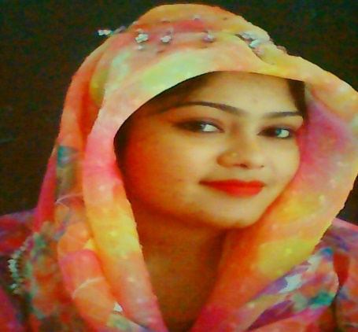
INTRODUCTION
TEACHER
Hafiza Khanam
Assistant Teacher,
99 No Nilokhi GPS,
Gopalganj sadar,
Gopalganj.
khanamhafiza1987@gmail.com
LESSON
Class- Two
Subject: English
Anita’s life.
Unit:- 27
Lesson: 1-3. (A &B)
Page:- 54

Slide 3
Learning outcomes
By the end of lesson Student will be able to
Speaking : 1.1.2 - say simple words and phrases with proper sound and stress.
Reading : 1.4.1 - read words and phrases with help of visual clues ( about 30 new words) and simple sentences.

Slide 4
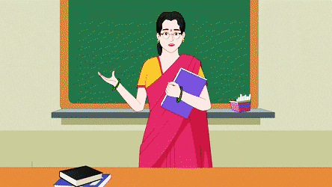
Let’s see a picture.
What have you seen in the picture ?
Yes, you guess right. It’s a picture of a teacher.

Slide 5
Anita’s life.
Today our lesson is..
This is Anita Sarkar.

Slide 6
Word meaning
School
An institution for education
বিদ্যালয়
A person who teaches.
শিক্ষক
Teacher
Breakfast
First meal of the day
সকালের নাশতা
Early
Quickly/Soon
তাড়াতাড়ি

Slide 7
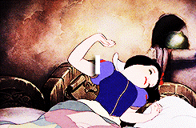
What have you seen in this picture ?
Yes, you guess right. This is a woman who is getting up from her bed.

Slide 8
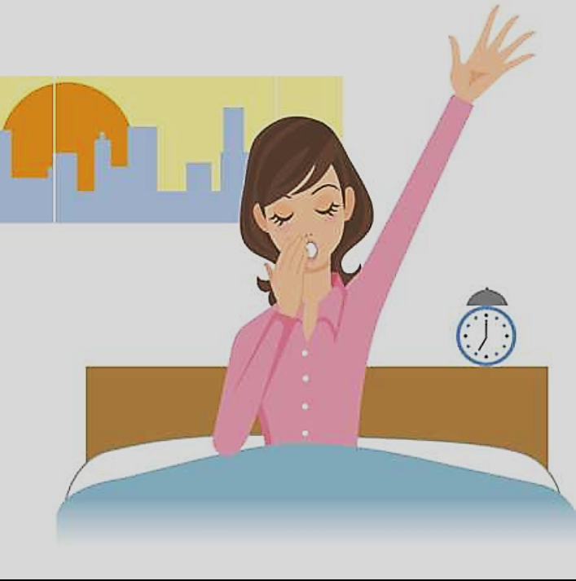
She gets up early in the morning.

Slide 9
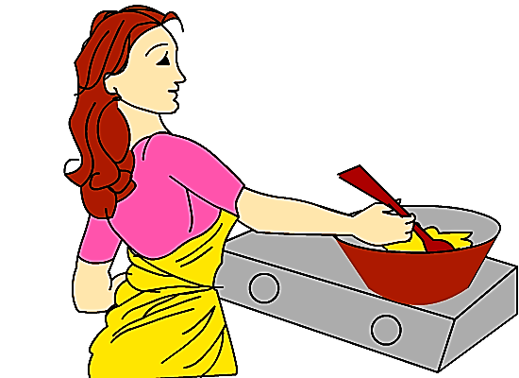
She cooks breakfast for her family.

Slide 10
After breakfast , Anita goes to school.

Slide 11
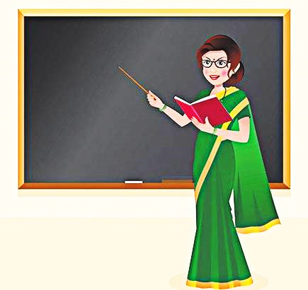
She is a teacher.

Slide 12
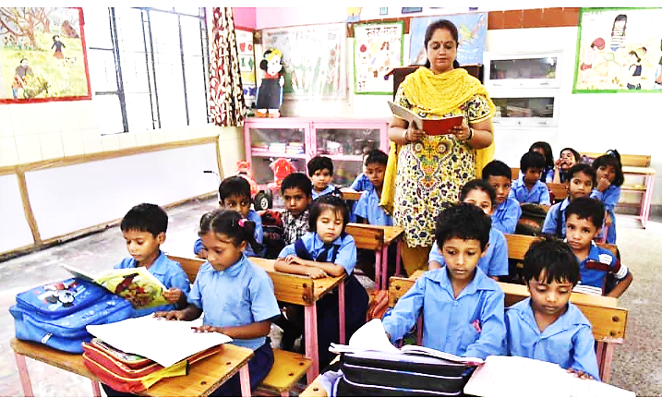
She teaches class 1 and class 2 .

Slide 13
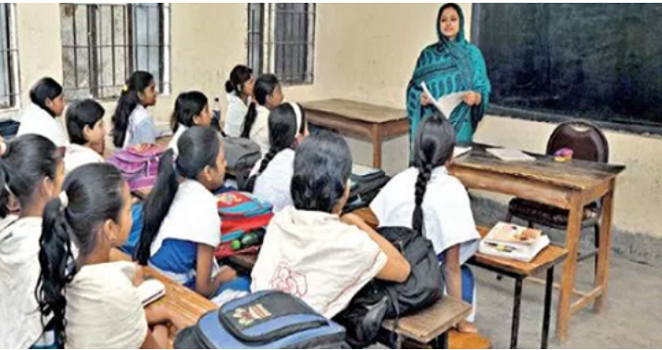
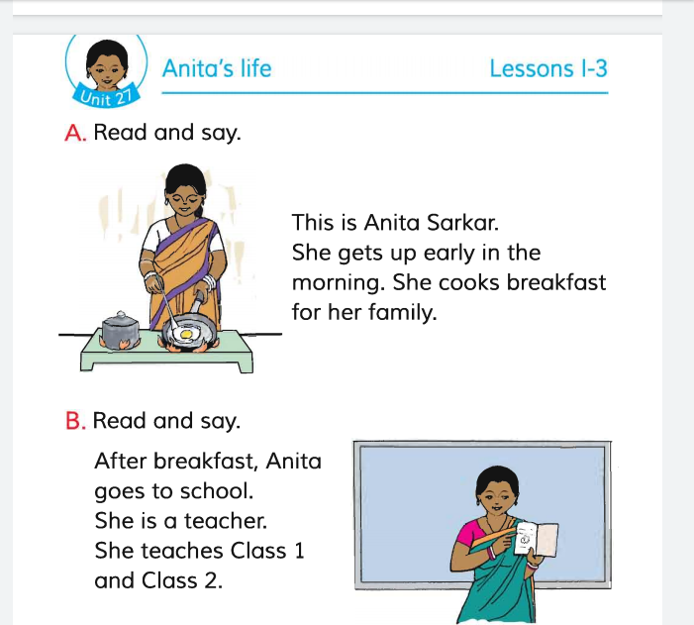
Teacher’s loud reading. open your book at page no 54

Slide 14
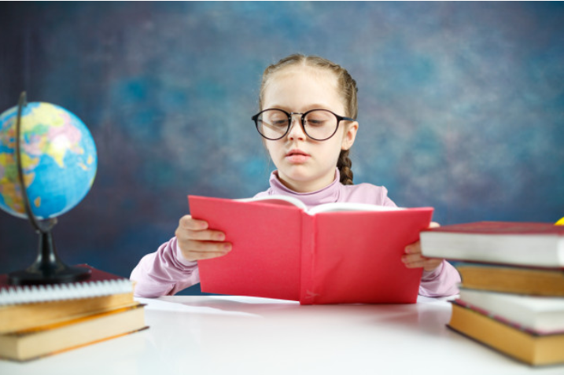
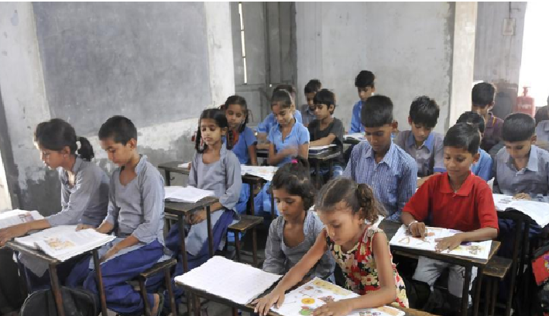
Now, all students read your text book.
Silent reading

Slide 15
Pair work
Ask and answer the question.
Who is the woman?
✓ The woman is Anita Sarkar.
b) When does she get up?
✓ She gets up early in the morning.
c) Where does She Work?
✓ She works in a primary school.

Slide 16
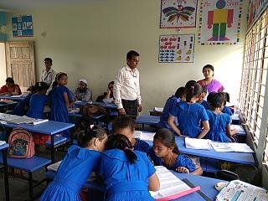
Group work
Now, all students- make group reading your text book. Help each other.
Fill in the blanks with appropriate words.
Early, cooks, goes, teacher
For example. This…..Anita Sarkar.
Ans. This is Anita Sarkar.
Anita Sarkar is a ------------.
She gets up ----------- in the morning.
She ------------ breakfast.
She ---------- to school.
teacher
early
cooks
goes

Slide 17
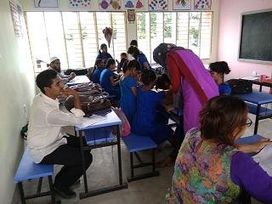
Evaluation
Answer the following question.
a) Who is the woman?
b) What does she do for her family?
c) Where does she go after breakfast?
d) Where does she do?

Slide 18
Now check your answer.
Who is the woman?
✓ The Woman is Anita Sarkar.
b) What does she do for her family?
✓ She cooks breakfast for her family.
c) Where does she do after breakfast?
✓ After breakfast she goes to school.
d) Where does she do?
✓ She is a teacher?

Slide 19
One day one word.
Teacher = শিক্ষক

Slide 20
Home Work
Answer the following questions.
a) Who is your teacher?
b) When does she get up?
c) What does she do for her her family?
d) Where does she go after breakfast?

Slide 21
Thank you.

