Slide 1
Welcome my students

Slide 2
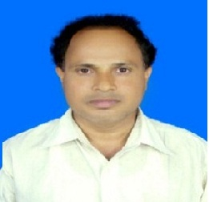
INTRODUCTION
BIKASH CHANDRA KUNDU
ASSISTANT TEACHER ( ICT)
GOVT.C.S PILOT MODEL HIGH SCHOOL HIGH SCHOOL
KACHUA, BAGERHAT.
CLASS: NINE(Vocational)
SUBJECT: ENGLISH-1
UNIT: FIVE
LESSON: ONE
TOPIC: SENTENCE

Slide 3
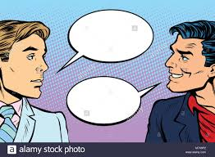
Very fine,What are you doing now?
Very well,How can you illustrate infinitive ?
Illustrated well,
Thank you very much.
How are you?
He wants to do the work.
The underlined phrase is infinitive
Well,what about you?
Welcome
I am reading now about infinitive.

Slide 4
Our today’s lesson is-
Infinitive

Slide 5
Learning outcomes
At the end of the lesson, we will be able to –
Identify the definition of infinitive.
Identify the classification of infinitives.
Be able to apply the rules of infinitives.
make sentences with infinitives.

Slide 6
What is an Infinitive?
Infinitive is the base of a verb,often followed by to.
সাধারণত Infinitive বলতে –to এর মাধ্যমে অনুসৃত verb –এর base form–কে বোঝায়।

Slide 7
Use of Infinitive
(i) Infinitive এককভাবে আবার অনেক অনেক সময় Noun Phrase –এর অংশ হিসেবে Sentence –এর প্রথমে বসে এবং Verb –এর Subject হিসেবে কাজ করে। যেমনঃ
1. To tell (Subject) a lie is a great sin.
2. To err (subject) is human.
3. To find (subject) fault is easy.

Slide 8
(ii) Infinitive Transitive verb –এর object হিসেবে কাজ করে। যেমনঃ
1. He likes to play cricket.
2. I want to read a book.
3.He does not mean to read.

Slide 9
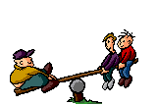
(iii) Infinitive Intransitive verb – এর পৃথক রুপে (complement) হিসেবে কাজ করে। যেমনঃ
1. His custom is to ride dail.
2. I am to see him..
3. She seems to be happy.

Slide 10
(iv) Infinitive Transitive verb –এর object-এর complement হিসেবে কাজ করে । যেমনঃ
1. He asked me to come.
2. He told me to do the work.
(v) It,be verb –এর subject হিসেবে ব্যবহৃত হলে সেক্ষেত্রে infinitive subject -এর complement হিসেবে ব্যবহৃত হয় । যেমনঃ
1. It was my ambition to do well in the examination.
2. It is easy to say but difficult to do.

Slide 11
(vi) ইহা preposition,about,but,expect,than ইত্যাদি object হিসেবে কাজ করে যেমনঃ
1. The man is about do die.
2. He does nothing but (to) sleep.
(vi) এটি Interrogative pronoun –এর complement হিসেবে কাজ করে যেমনঃ
1. I know what to do .
2. He does not know how to sing.

Slide 12
Kinds of Infinitive
Infinitive প্রধানত দুই প্রকার
যথাঃ
1. Simple or Noun Infinitive.
2. Gerundial or Qualifying Infinitive.

Slide 13
1. Simple or Noun Infinitive.
When the infinitive works as a Noun,it is called Simple Infinitive.
অর্থাৎ যখন কোন Infinitive,noun (বিশেষ্য) –এর কাজ করে তখন তাকে Simple বা Noun Infinitive বলে। যেমনঃ
1. To walk is a good exercise.
2. To tell a lie is a great sin.

Slide 14
2. Gerundial or Qualifying Infinitive.
যখন Infinitive কোন noun,verb,adjective বা কোন sentence – কে qualify করে ,তখন তাকে Gerundial or Qualifying Infinitive বলে। মোট কথা infinitive যখন কাজের উদ্দেশ্যে ,কারণ শর্ত বা ফলাফল ব্যক্ত করে তখন তাকে Gerundial or qualifying infinitive বলে। এরুপ ক্ষেত্রে infinitive,adjective হিসেবে noun –এর পরে এবং adverb হিসেবে verb অথবা adjective –এর পরে বসে। যেমনঃ
উদ্দেশ্যঃ He came to see me. I went to market to buy a book.
কারণঃ I am glad to find you. I am sorry to disturb you.
শর্তঃ You can take my book to read only for a week.
ফলাফলঃ He worked hard to succeed in life.

Slide 15
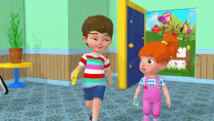
Uses of Gerundial Infinitives
(1) ইহা adjective রুপে কোন noun –কে qualify করতে বসে।
যেমনঃ
This is a chair to sit on.
This is a house to live in.

Slide 16
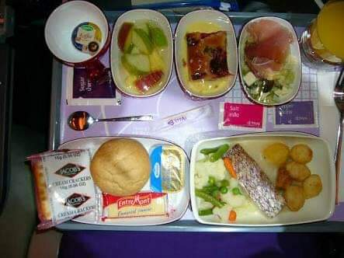
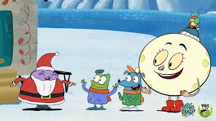
(2) ইহা adverb রুপে কোন verb –কে modify করতে বসে।তবে এক্ষেত্রে ইহা দ্বারা কোন উদ্দেশ্য purpose ব্যক্ত করা হয়।
যেমনঃ
We eat to live.
He came to bury his father.

Slide 17
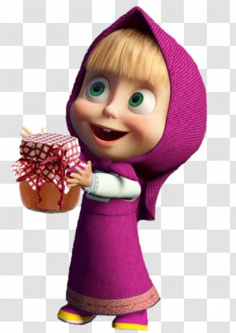
(3) ইহা adverb রুপে too/enough বা অনুরুপ কোন adjective –কে modify করতে ব্যবহৃত হয়।
যেমনঃ
He is too weak to walk.
He is strong enough to lift the bundle.

Slide 18
(4) ইহা কোন বক্তব্যের উপর জোড় দেবার জন্য মূল sentence এর সাথে parenthetically বা সম্পর্কবিহীনভাবে ব্যবহৃত হয়।
যেমনঃ
To speak the truth,I quite forgot my promise.
To say in brief,man is the architect of his own fortune.
Note: Live,sleep,write,play,sit ইত্যাদি verb গুলোর পূর্বে infinitive এর to ব্যবহৃত হলে তাদের পরে preposition বসে। যেমনঃ
This is the house to live in.
This is the room to sleep in.
This is the pen to write with.
This is the ball to play with.

Slide 19
Group work
A
1.Tell me when -------the bill.
2. He is too weak…….. Out.
3. ……..is a good form of exercise.
4. I can’t understand where------ my car.
5. We could not but…….
B
1.He goes to mosque………his prayers.
2. She went to hospital…….medicine.
3. Fishermen use net…… fish.
4. The boy wished…….a story.
5. Give me a chair …… on.
pay
to say
to go
to take
To walk
to catch
park
to tell
lough
to sit

Slide 20
Home Work
He is too weak ……...
This is a house……….
He seems ……better today.
The Headmaster advised me …..regularly.
Munir is eager …….. Engineering.

Slide 21
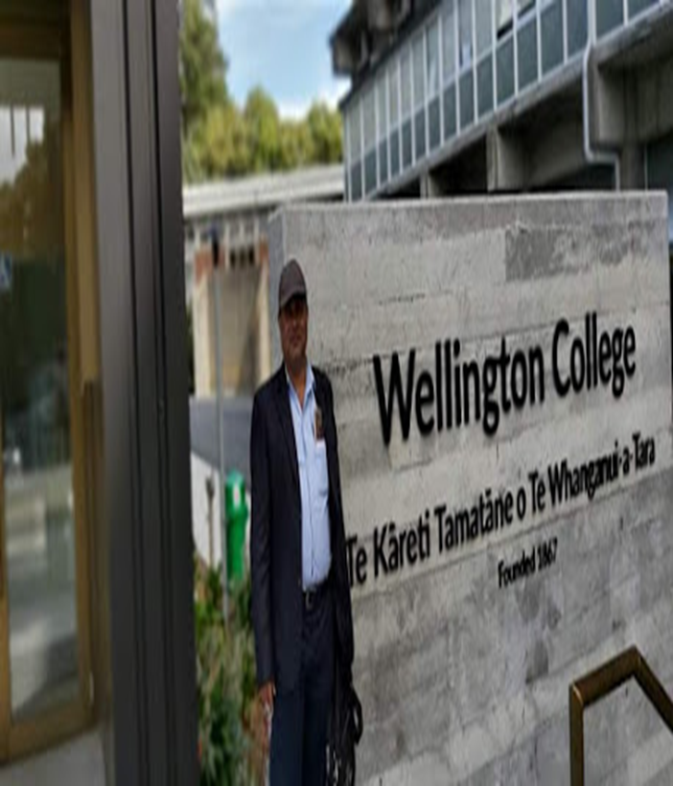
Thank you

