Slide 1
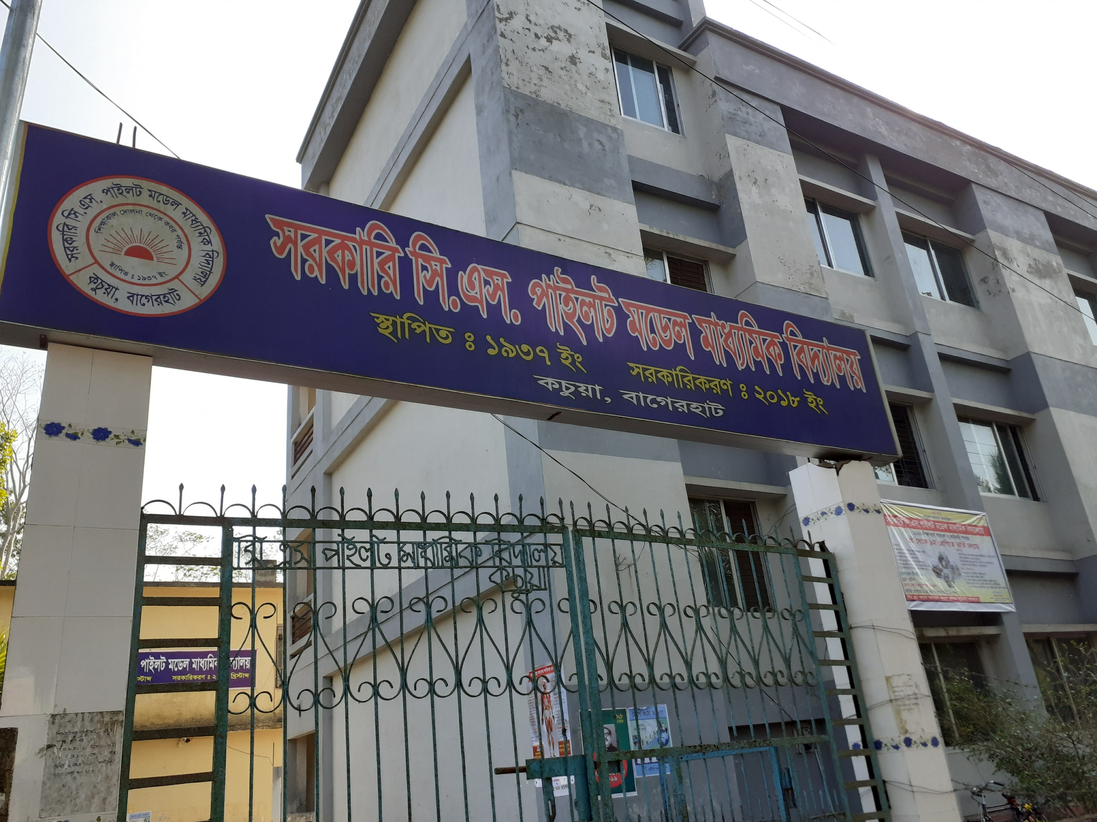
KACHUA ON LINE CLASS
GOVT.C.S PILOT MODEL HIGH SCHOOL,KACHUA, BAGERHAT.
FOLLOW THE ON LINE CLASSES &FOLLOW THE RULES OF HEALTH ,BE AWARE OF YOURSELF WITH CARE

Slide 2
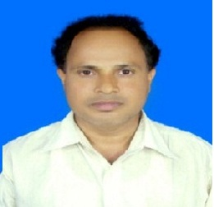
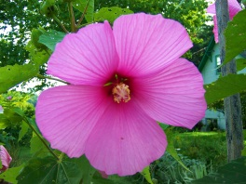
W
E
L
C
O
M
E
INTRODUCTION
CLASS: NINE(Vocational)
SUBJECT: ENGLISH-1
UNIT: ONE
LESSON: ONE
TOPIC: PARTS OF SPEECH (NOUN)
BIKASH CHANDRA KUNDU
ASSISTANT TEACHER ( ICT)
GOVT.C.S PILOT MODEL HIGH SCHOOL HIGH SCHOOL
KACHUA, BAGERHAT.

Slide 3
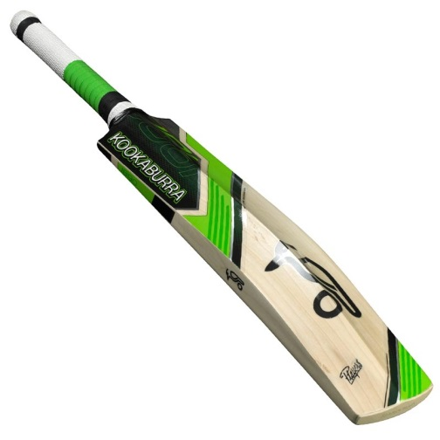
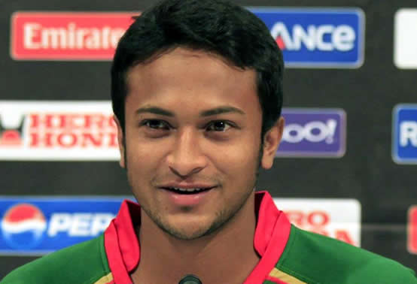
Bat
What is his name?
Sakib Al Hasan
What is the name of this thing?
Can you make sentence with this naming word?
Can you make sentence with this naming word?

Slide 4
1. Sakib Al Hasan is a cricket player.
2. He plays with the bat.
Nouns.
The naming words in a sentence are called

Slide 5
LEARNING OUTCOMES OF THE LESSON
By the end of the lesson the students will be able to
say what noun is.
identify noun.
mention some nouns from real life situation.
make sentence with noun as a subject.
make sentence with noun as an object.

Slide 6
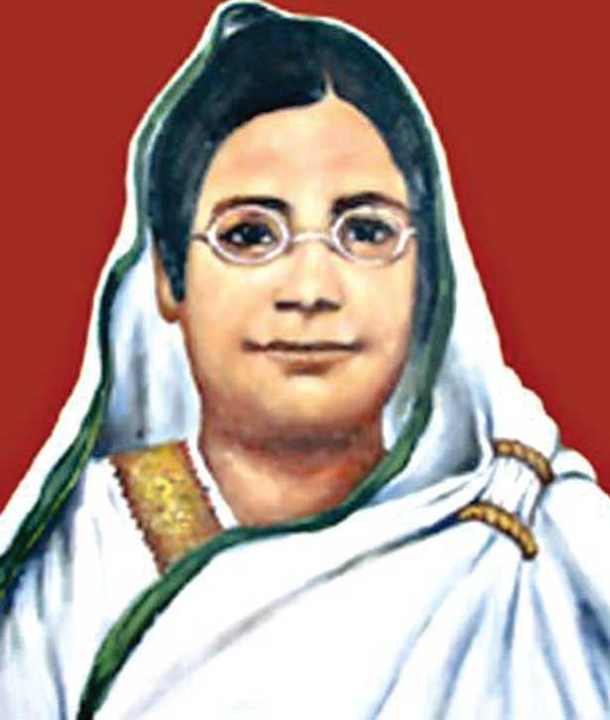
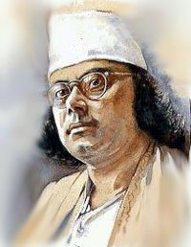
Can you make sentences with these naming words?
1
2
Begum Rokeya
Kazi Nazrul Islam
1. Begum Rokeya is a social worker and a writer.
2. Kazi Nazrul Islam is our national poet.

Slide 7
Can you tell the name of this thing?
Leaf
Can you make sentence with this naming word?

Slide 8
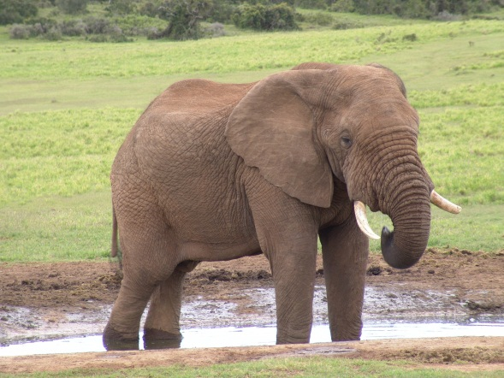
Can you tell the name of this animal?
Elephant
Can you make sentence with these naming word?

Slide 9
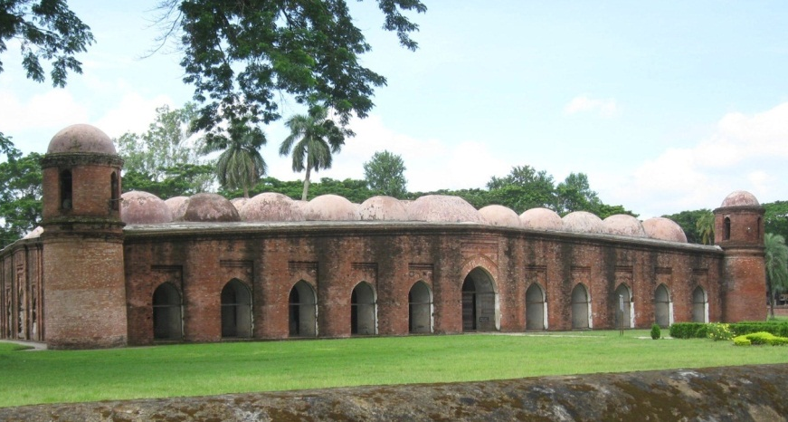
Can you tell the name of the building?
Sat Gombuj Mosque
Can you make sentence with this naming word?

Slide 10
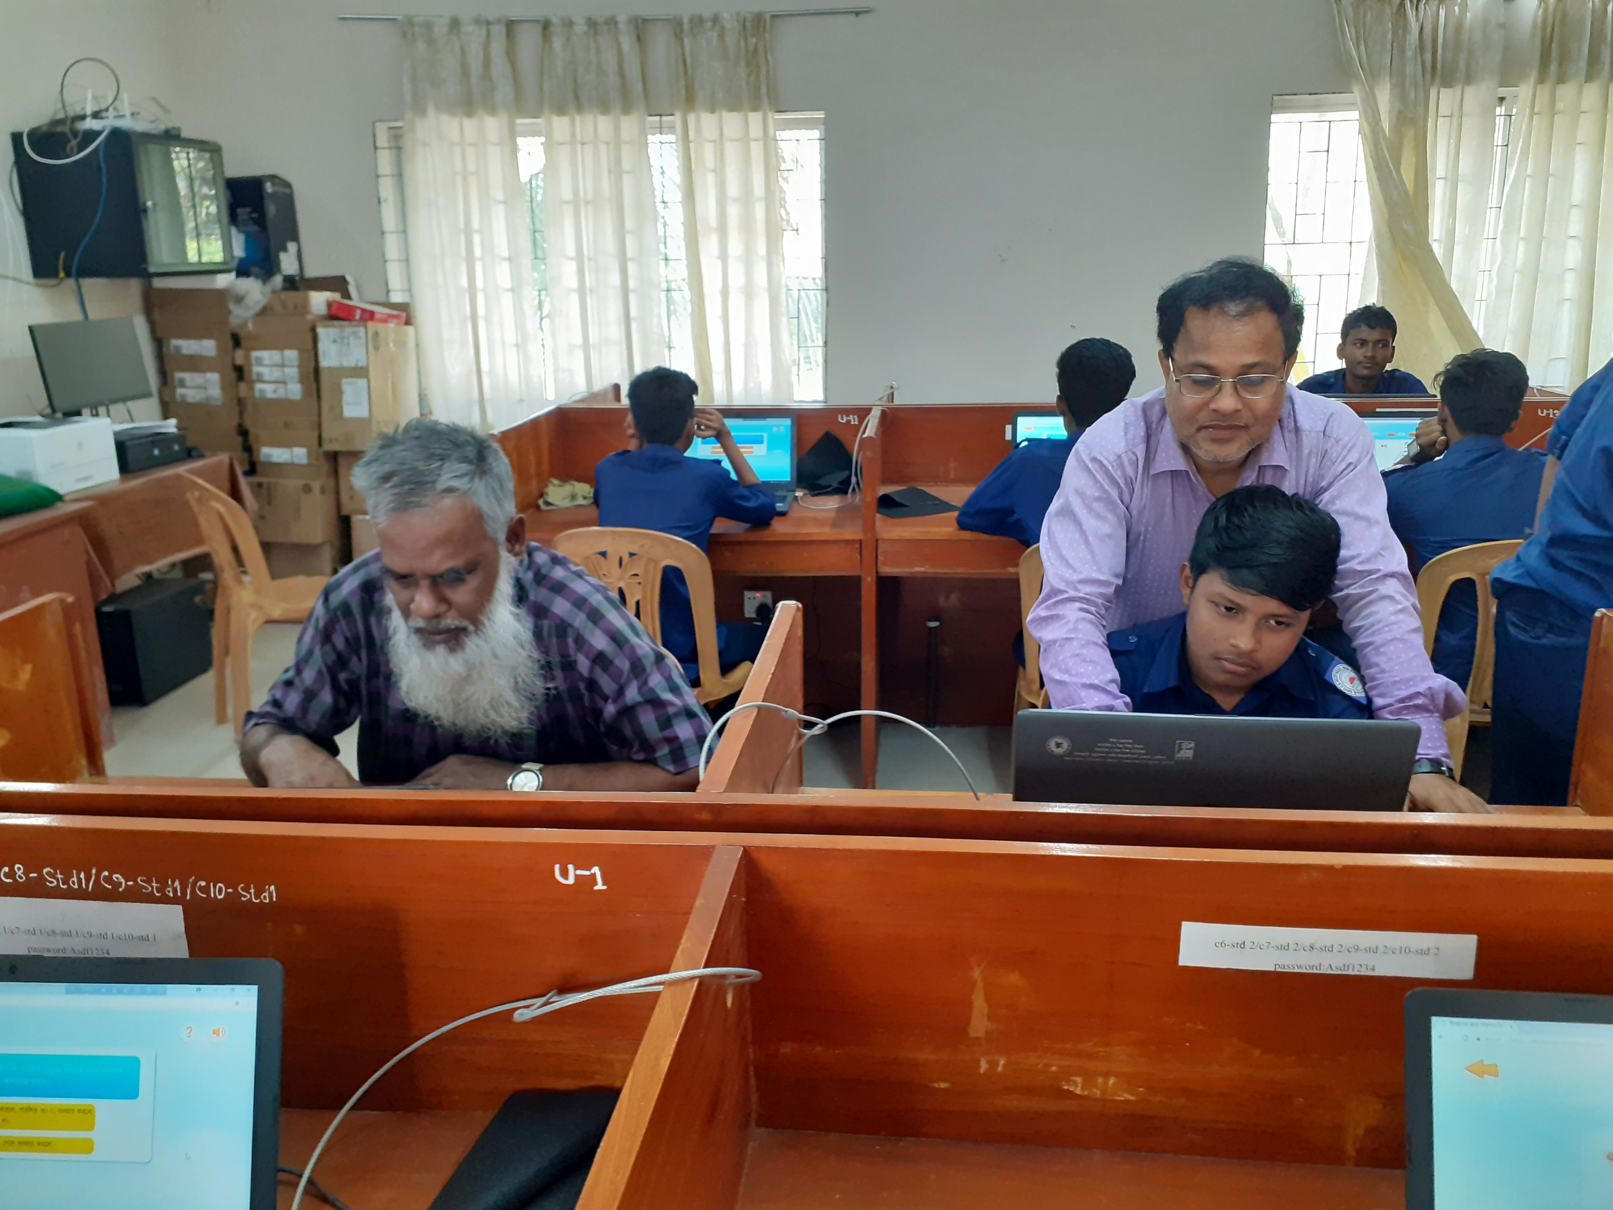
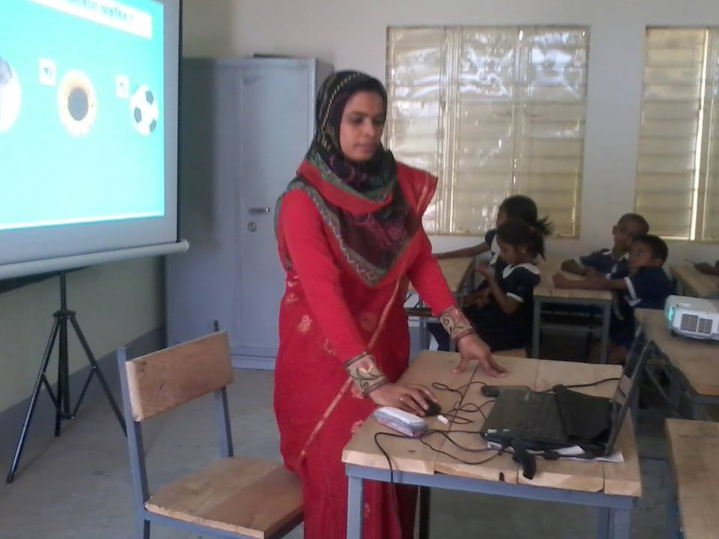
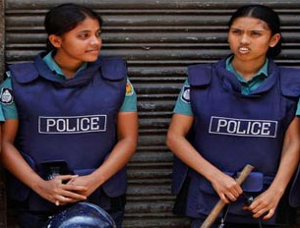
Can you tell the names of their professions?
Teacher
Police
Can you make sentences with these naming words?

Slide 11
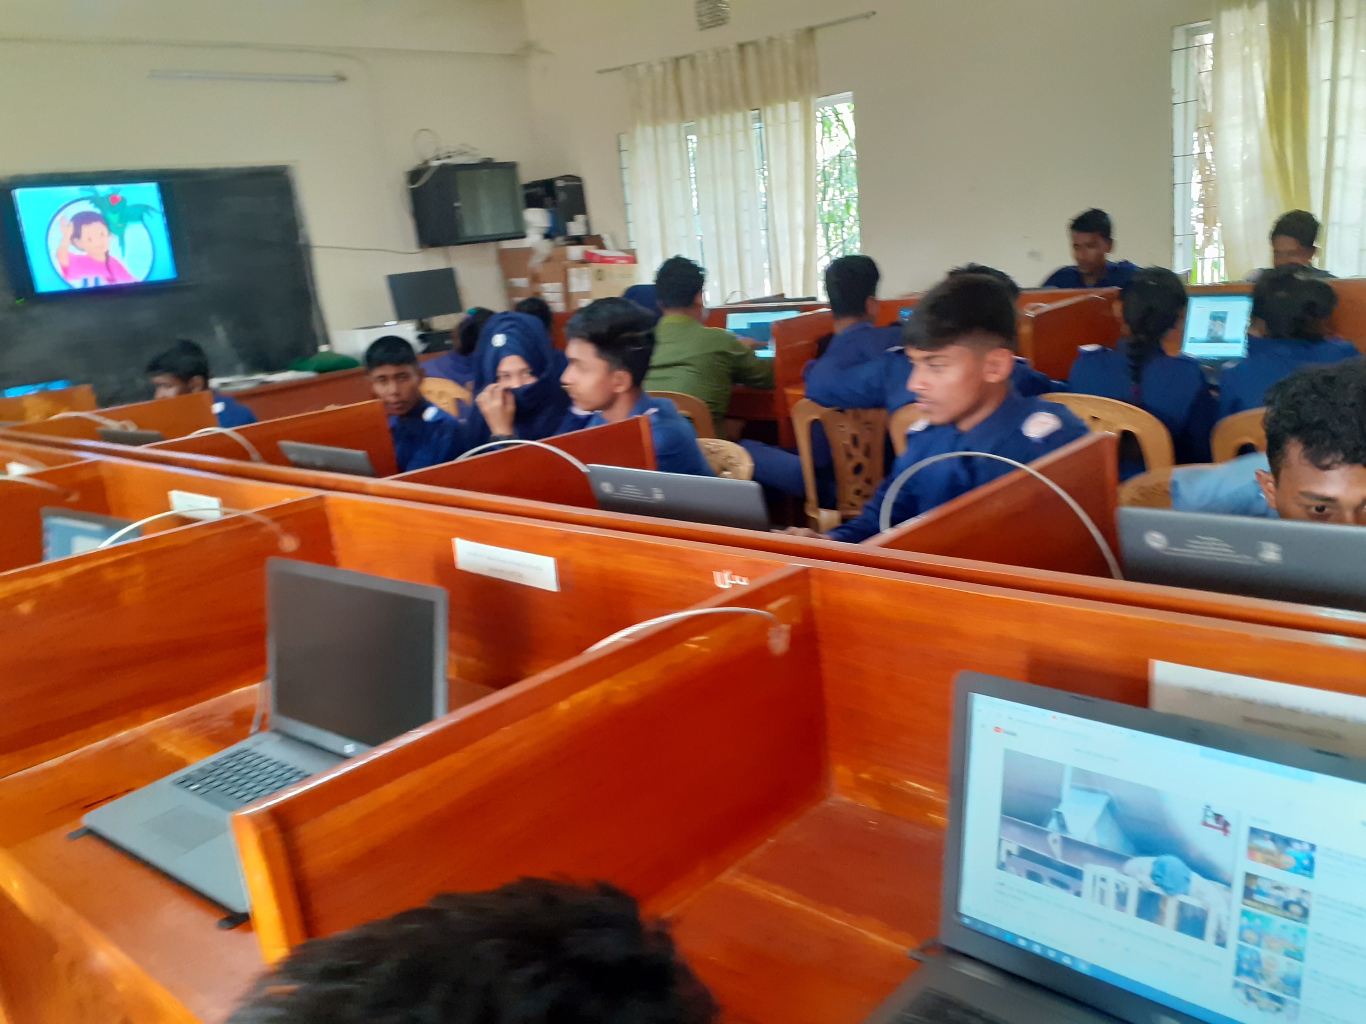
Can you tell what the students are doing here ?
Govt.C.S Pilot Model High School
ILC LAB
Learning Computer

Slide 12
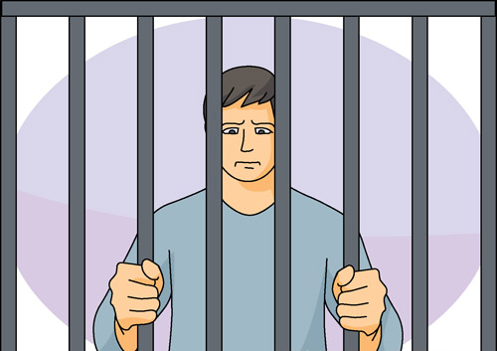
Can you make sentences with these naming words?
Happiness
Punishment
Punishment
Happiness
Knowledge

Slide 13
Look at the sentences and underlined words.
1. Kazi Nazrul Islam is our national poet.
2. The leaf is green.
3. The elephant is a big animal.
4. People like to visit Shat Gombuj Mosque.
5. The teacher is teaching.
6. Happiness keeps us healthy.
The name of any person, place, thing, idea, quality or state in a sentence is called noun.

Slide 14
Pair work
Read the following passage and find out the nouns from it.
Anik Islam lives in Tongi. He is a student. His school is Mozida Govt. High School. He studies attentively. He is a singer too. He likes to sing folk song.
Answer
Anik Islam
Tongi
Student
school
Mozida Govt. High School
singer
song

Slide 15
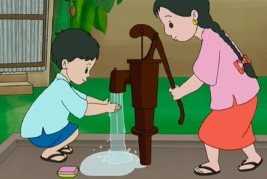
Pair work
Find out at least five naming words from the picture and make sentences with those nouns.

Slide 16
Answer the following questions.
1. What is noun?
2. Find out at least five nouns from your classroom and make sentences with those nouns.

Slide 17
Home work
Look at your surroundings at home and write a list of ten nouns and make sentences with those nouns. (At least 20)

Slide 18
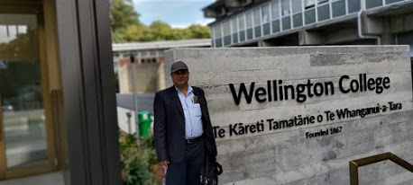
THANK YOU ALL

