Slide 1
WELCOME

Slide 2
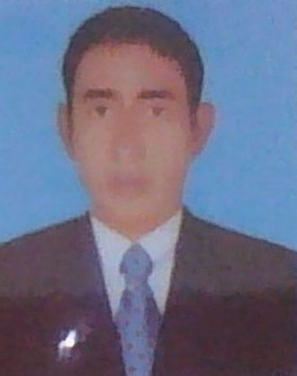
TEACHER IDENTITY
Md: Abdul Matin. Senior Assistant Teacher(English)
Raghunathpur high School
Nawabganj,Dinajpur
E-mail: abmatin1977@gmail.com
Phone:01823385723
UNIT/Chapter:05
Lesson:20
E,F,T :Eight
(Grammar)
Topic : Fill in the Gaps with Clues
Time :45
Date :03/10/2020

Slide 3
often
1. A teacher is --------- compared with ------- architect man.
Based Grammar : Adverb & Arti
2. English is a / an -------------------- language.
Based Grammar : Adjective
3. Once upon a time there --------a man named Aesop.
Based Grammar : Verb
4. I do not compare my ------------- with anybody.
Based Grammar : Noun
5. We feel the necessity ------- learning Bangla.
Based Grammar : Preposition
an
international
was
mother
of

Slide 4
LESSON DICLARATION
So our today’s topic
Fill in the Gaps with Clues

Slide 5
Learning out comes
1.S,S learn some rules of fill in the gaps.
2.S,S use appropriate word in the gap
3.S,Smake successful sentence if there is any gap in a sentence
4. S,S Develop passage by filling gap.
Notes:
OF

Slide 6
Pair works—with your partner (write which grammar part is used.)
at
1. He is very good --------- English.
Based Grammar :
2. That is why, he is ------- by his parents and teachers.
Based Grammar :
3. He is ------------- a letter to his mother.
Based Grammar :
4. They used to fight among --------------.
Based Grammar :
5. -------has been a great challenge------- Bangladesh.
Based Grammar :
Phrase / preposition
loved
Verb
writing
Verb
themselves
Pronoun
It
for
Pronoun
/ Preposition

Slide 7
. Fill in the gaps with clues in group A & B
on
a
by
for
to
the
at
it
into
meat
Once upon a time (a)……………… hungry wolf searched (b )……………… food here and there. But it couldn’t get any. (c )……………… last it found a loaf of bread and a piece of (d )………………. in the hole of a tree. (e )…… hungry wolf squeezed (f )……………… the hole and ate all the food. (g )……………… was a woodcutter’s lunch. He was (h )……………… his way back to the tree to have lunch. As soon as the fox saw the woodcutter, he tried (i )……………… run away. But unfortunately the fox was caught (j )……………… the woodcutter.

Slide 8
HOMEWORK
Write one paragraph and they have 1O gaps in the paragraph

Slide 9
THANK’S

