Slide 1


WELCOME

Slide 2
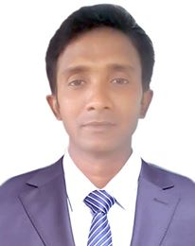

INTRODUCTION
Class : Eight
Subject : English first paper
Lesson : 3
Page : 5-6
Duration : 50 mints.
Date : 07-10-2020
Md. Jamir Uddin
Assistant Teacher (ICT)
Hamkuria Dakhil Madrasah
mobile no: 01718-948922
Email: jamirtarash@gmail.com

Slide 3
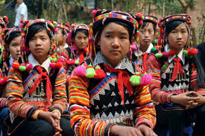
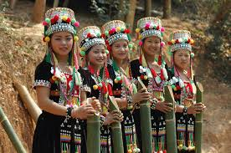
Do you know below the pictures?
ETHNIC PEOPLE
Notes:
The slide is opening question then give correct answers.

Slide 4
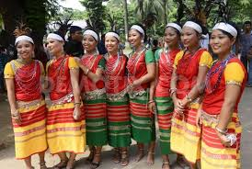
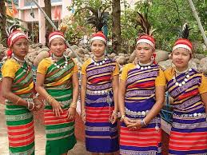
OUR ETHNIC FRIENDS
Notes:
The slide is opening question then give correct answers.

Slide 5
LEARNING OUTCOMES
After reading this lesson students will be able to…..
1. Tell who are the ethnic people;
2. Tell about their living places;
3. Describe their dresses, foods and houses;
4. Describe their occupation & cultures.

Slide 6
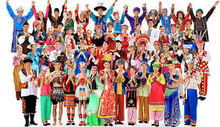
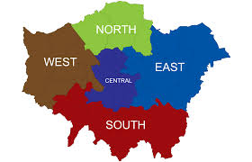
VOCABULARIES
Relating to particular race, nation of tribe and their custom and tradition.
Ethnic
A particular area or part of a country or the world.
Region
Notes:
To shown answer related picture. Give the correct answer after a few questions.

Slide 7
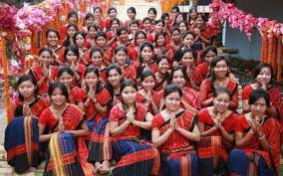
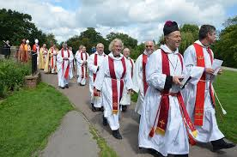
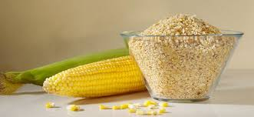
Group of people having same religion or nationality and living in the same general area
Community
An important cereal
Maize
Notes:
To shown answer related picture. Give the correct answer after a few questions.

Slide 8
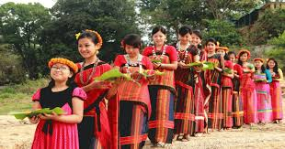
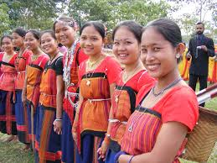
DIFFERENT TYPES OF TRIBAL PEOPLE
MARMAS
CHAKMAS
Notes:
This slide you may show many other pictures tribal people in Bangladesh. The slide is opening question then give correct answer.

Slide 9
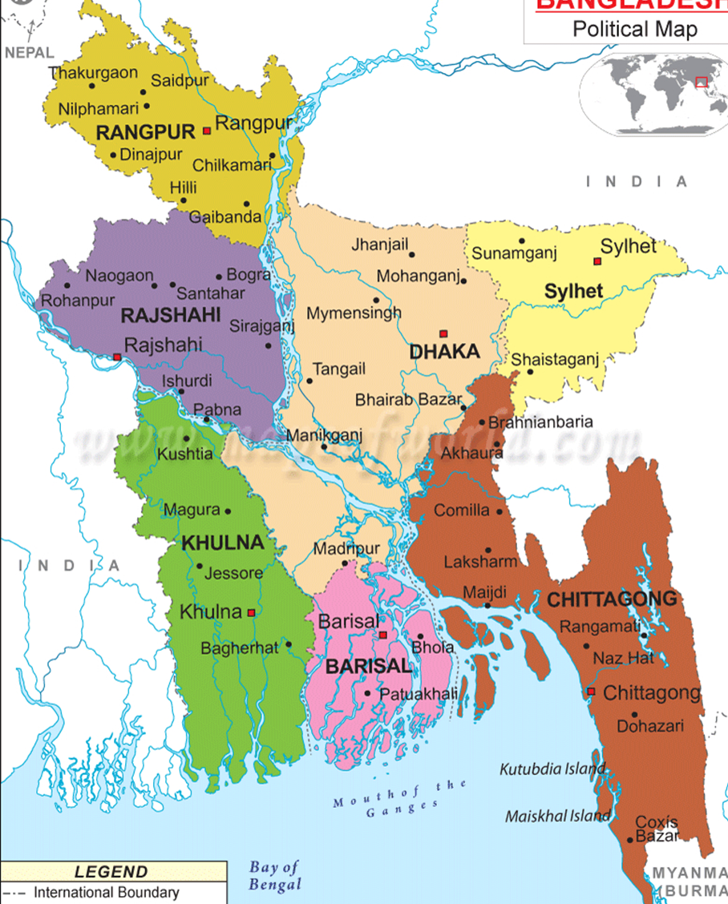
LIVING PLACES OF ETHNIC PEOPLE
THE MAP OF BANGLADESH
Notes:
This slide has shown which area live the ethnic people in our country. You can view another district in Bangladesh.

Slide 10
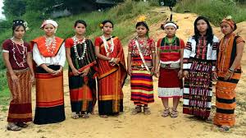
PAIR WORK
Who are the ethnic people ?
Where do they live in Bangladesh ?
Notes:
Ask questions according to Image then before give the correct answer.

Slide 11
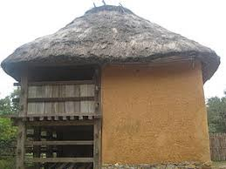
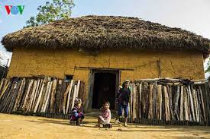
HOUSES OF ETHNIC PEOPLE
The ethnic people build their houses on bamboo or wooden platforms.
What do the ethnic people build their houses on ?
Notes:
The slide is opening questions then the before give the correct answers. This slide you may show many other pictures realated tribal people in Bangladesh.

Slide 12
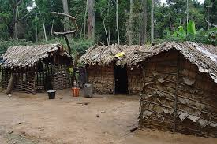
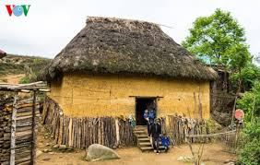
The ethnic people build their houses on bamboo platforms.
What do the ethnic people build their houses on ?
Notes:
The slide is opening question then the before give the correct answers. This slide you may show many other pictures realated tribal people in Bangladesh.

Slide 13
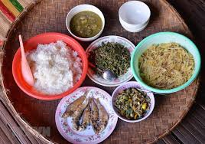
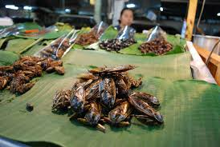
FOODS OF ETHNIC PEOPLE
RICE
FISH
Notes:
The slide is opening question then the before give correct answer. This slide you may show many other pictures realated tribal people in Bangladesh.

Slide 14
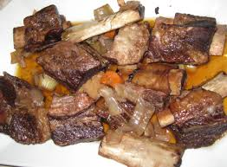
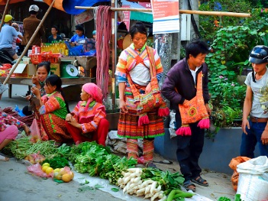
MEAT
VEGETABLES
Notes:
The slide is opening question then the before give correct answer. This slide you may show many other pictures realated tribal people in Bangladesh.

Slide 15
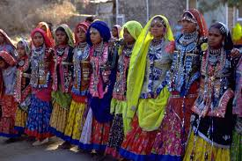
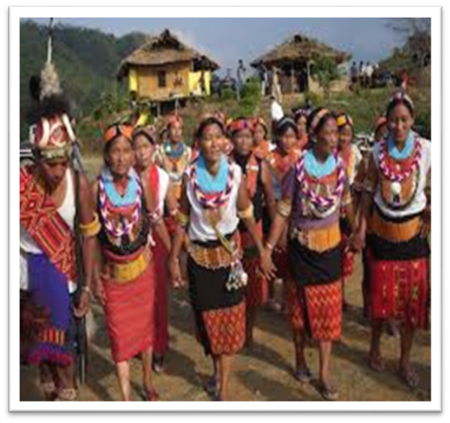
DRESSES OF ETHNIC PEOPLE
WOMEN WEAR THAMIS
WOMEN WEAR ANGIS
Notes:
The slide is image realeted question then the before give correct answer. This slide you may show many other pictures realated tribal people in Bangladesh.

Slide 16

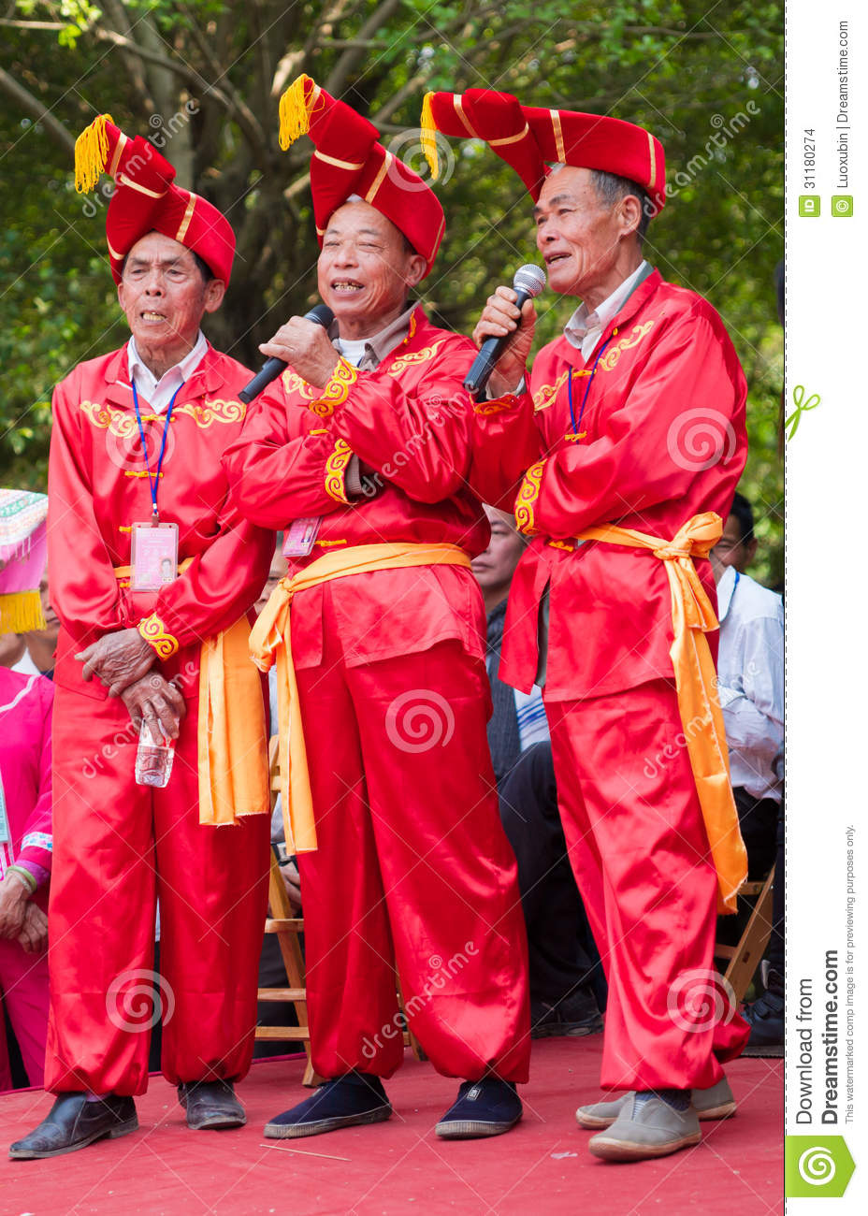
CULTURE OF ETHNIC PEOPLE
MUsICAL INSTRUMENTs
SINGING
Notes:
The slide is image realeted question then the before give correct answer. This slide you may show many other pictures realated tribal people in Bangladesh.

Slide 17
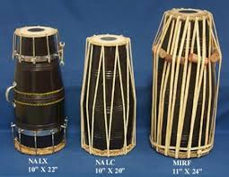
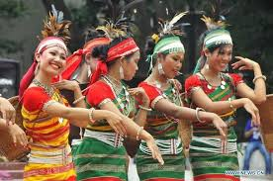
MUCICAL INSTRUMENTs
DANCING
Notes:
You can may question the image realated then the before give the correct answer. This slide you may show many other pictures realated tribal people in Bangladesh.

Slide 18
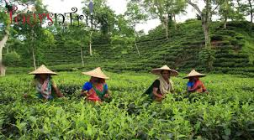
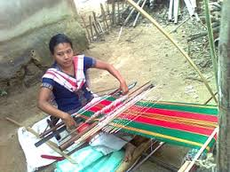
ETHNIC PEOPLE OCCUPATION
FARMING
WEAVING CLOTHES
Notes:
You can may question the image realated then the before give the correct answer. This slide you may show many other pictures realated tribal people in Bangladesh.

Slide 19
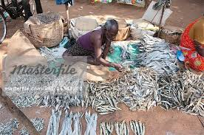
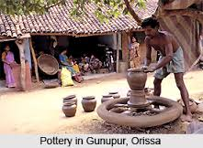
FISHERING
POTTERY
Notes:
You can may question the image realeted then the before give correct answer. This slide you may show many other pictures realated tribal people in Bangladesh.

Slide 20
GROUP WORK
1. What do they cultivate ?
2. What do you mean by maize ?
3. What do the ethnic people build their houses on ?
Notes:
You can another question related learning outcomes and above this slide used of pictures.

Slide 21
EVALUATION
1. Who are the ethnic people?
2. Tell the name of the ethnic people of our country.
3. What are their favourite foods?
4. Tell about their occupation.
5. What are their houses made of?
Notes:
The slide may be declared the lesson related a several questions.

Slide 22
HOME WORK
How the ethnic people are different from the people of plan land, describe in your own language ?

Slide 23
ALL THE BEST
END OF
THE CLASS
TODAY

